Slide 1

Hostel Room Allocation System
Presented by Group 6

Slide 2

TODAY'S TOPICS
Introduction
What We're Working On
Our Services
Sample Pages
Conclusion
Presentation
Outline

Slide 3

Introduction
HOSTEL ROOM ALLOCATION SYSTEM
A software that allows automation of currently existing hostel room allocation process, while not compromising on the choices of the student's choices for their roommates and hostels.

Slide 4

Objective
Computerisation
Data Consistency
User Friendly
Make the currently existing process of the room allocation completely automated.
No loss of data and reducing data redundancy to the possible extent.
A responsive web page with a proper front end and that is easier to interact with.

Slide 5

Multiple Admins
Send and Accepting requests
Easy Record Keeping
Transparency in the system
Our Services
Easy student interaction

Slide 6
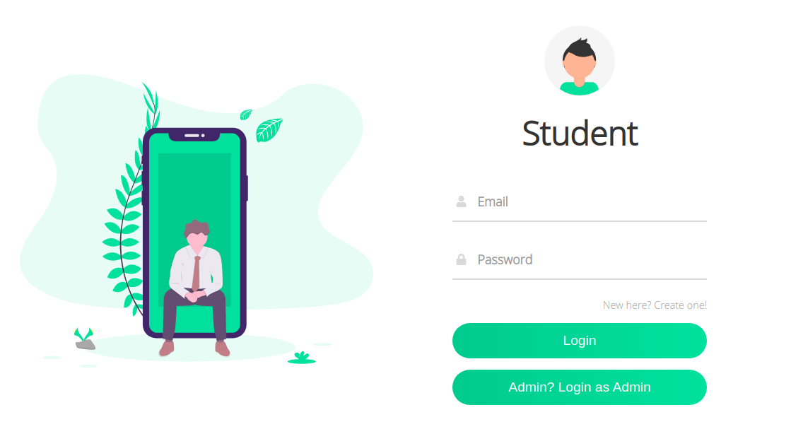
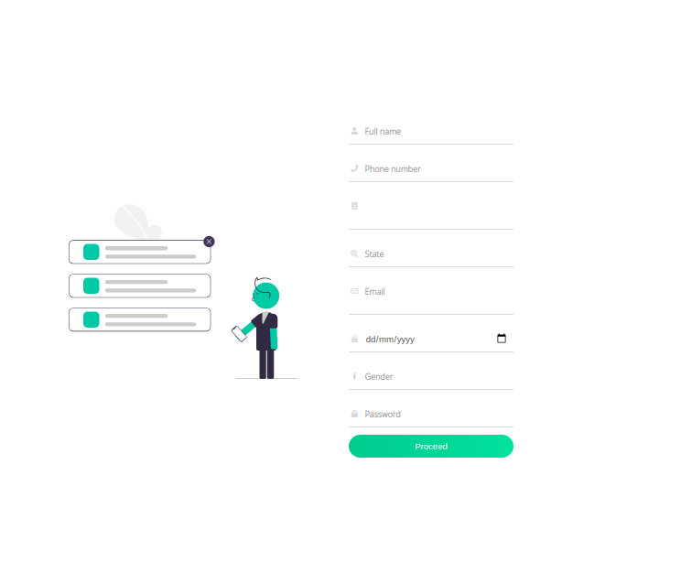

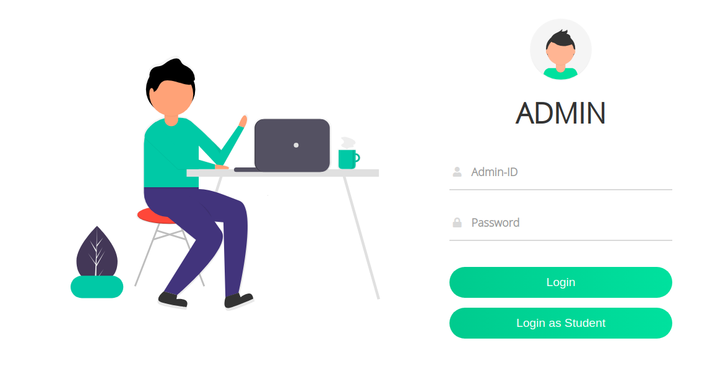
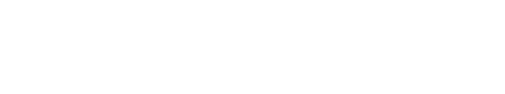
Sample Designs
Web pages for the users logging in.

Slide 7
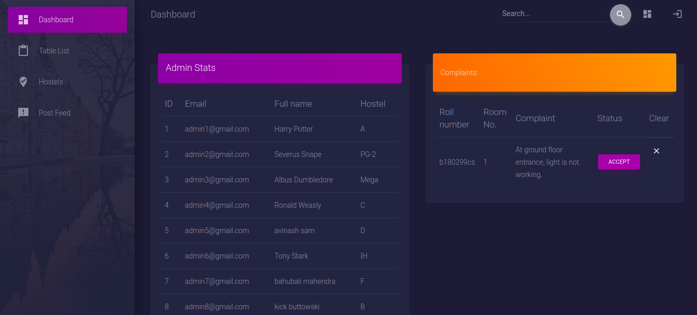
Presentations are communication tools that can be used as demonstrations, lectures, speeches, reports, and more. Most of the time, they’re presented before an audience.
Admin Dashboard

Slide 8
Demo

Slide 9
Reduced the strain of allocating rooms.
Provided the facility of sending room requests to peers.
Instant Complaint box to post student’s issues to hostel administration.
Replaced the use of notice-boards since admins can send updates and feed to all students.
Conclusion

Slide 10
Mohith Kumar Thummaluru
Avinash Samudrala
Rahul Kumawat
Tushar Kumar Patni
Ritik Goutham
Thanks
GROUP 6

