Slide 1
Data Analysis Project Presentation
Mohith Kumar Thummaluru - B180299CS
Rahul Kumawat - B180635CS
Tushar Kumar Patni - B180122CS
Avinash Samudrala - B180409CS
Ritik Gautam - B180630CS

Slide 2
Contents
Introduction
SO2 Monthly data set analysis across cities
Ward wise SO₂ levels
Choropleth maps
Regression for SO₂ levels
Multivariate Analysis
Conclusion

Slide 3
Introduction
Properties of SO₂
SO₂ one of the major pollutant.
SO₂ is a colorless, bad-smelling and toxic gas which is part of a larger group of chemicals.
Sources of SO₂
SO₂, is emitted by the burning of fossil fuels - coal, oil, and diesel etc.

Slide 4
Cont'd...
Effects of SO₂
SO₂ can contribute to respiratory illness by making breathing more difficult.
It combines with water vapour present in the atmosphere to form sulphuric acid that causes acid rain.

Slide 5
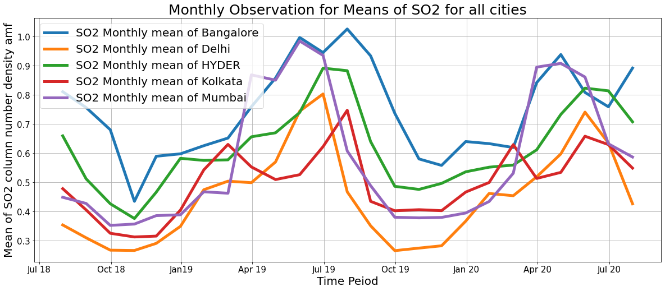
2. SO2 Monthly data set analysis across cities
2.1 Monthly Means

Slide 6
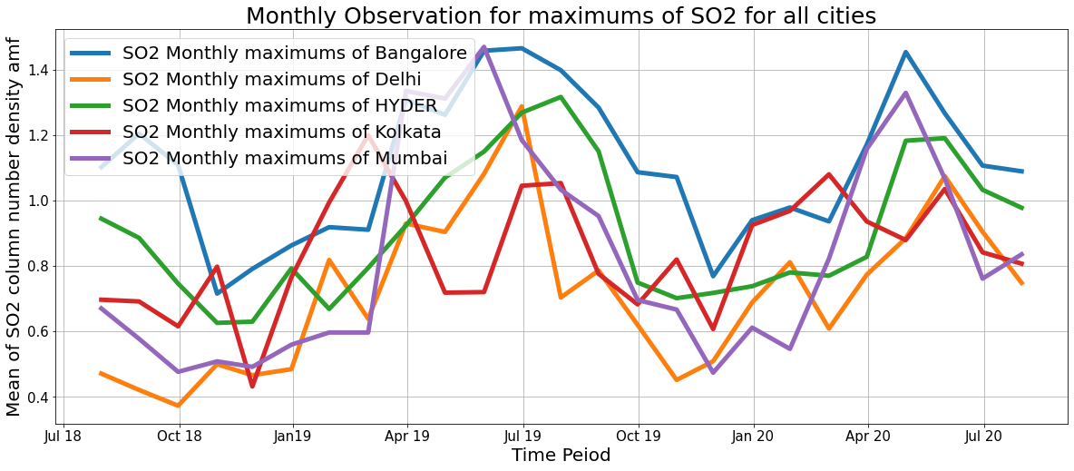
2.2 Monthly Maxs

Slide 7
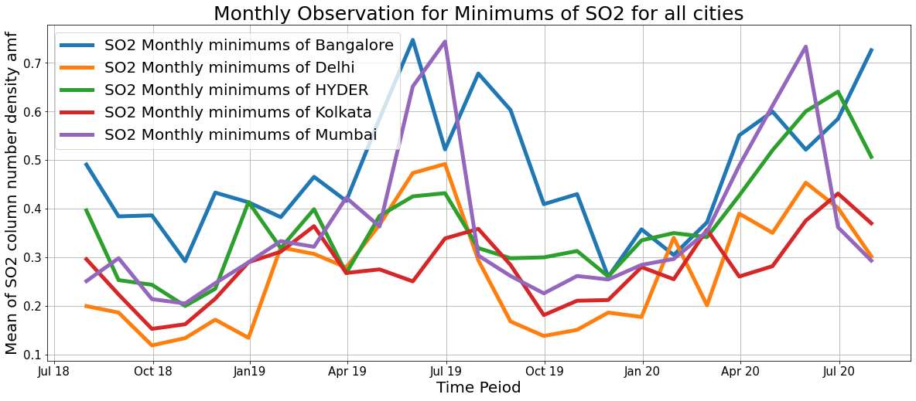
2.3 Monthly Mins

Slide 8
2.4 Observations from the monthly data
Mean values of SO₂ are considerably high in summers than in monsoons and winters.
This is due to the fact that the rise in usage levels of air-conditioners and refrigerators which are the major sources of SO₂ .
A seasonal trend is observed in the levels of SO2.

Slide 9
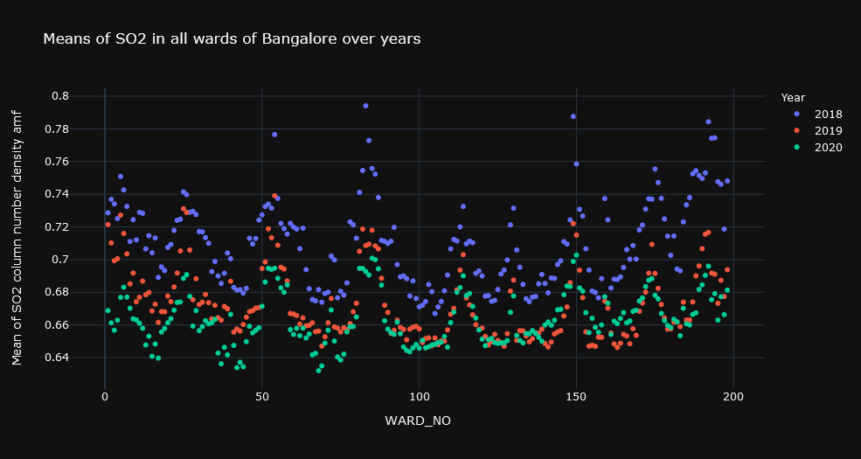
3. Ward Wise SO2 levels
3.1 Bangalore

Slide 10
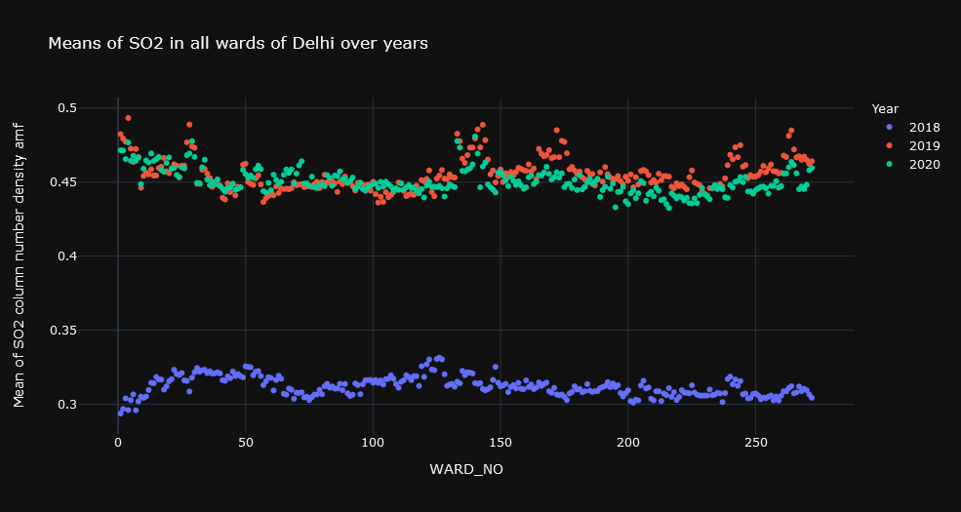
3.2 Delhi

Slide 11
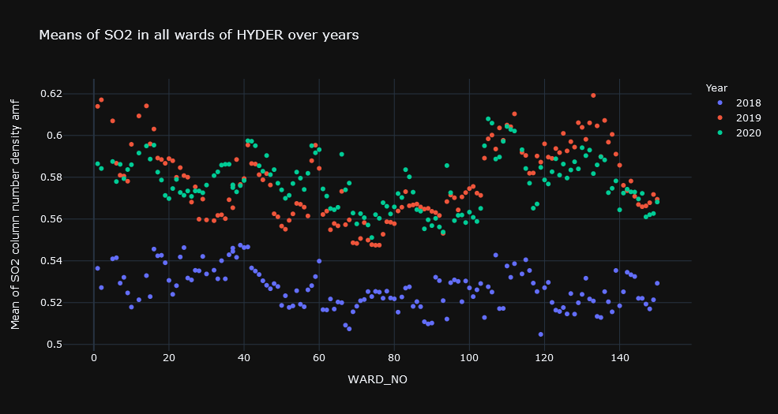
3.3 Hyderabad

Slide 12
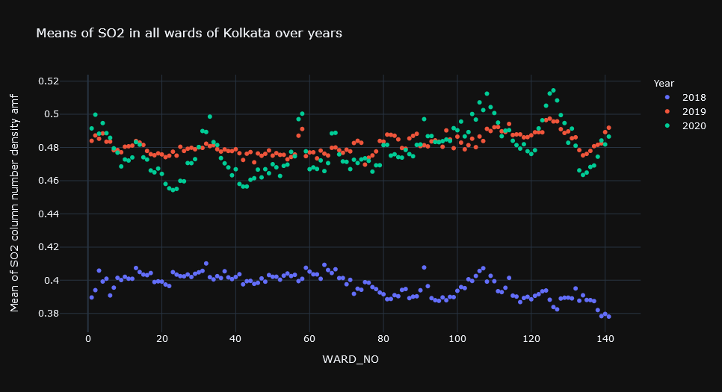
3.4 Kolkata

Slide 13
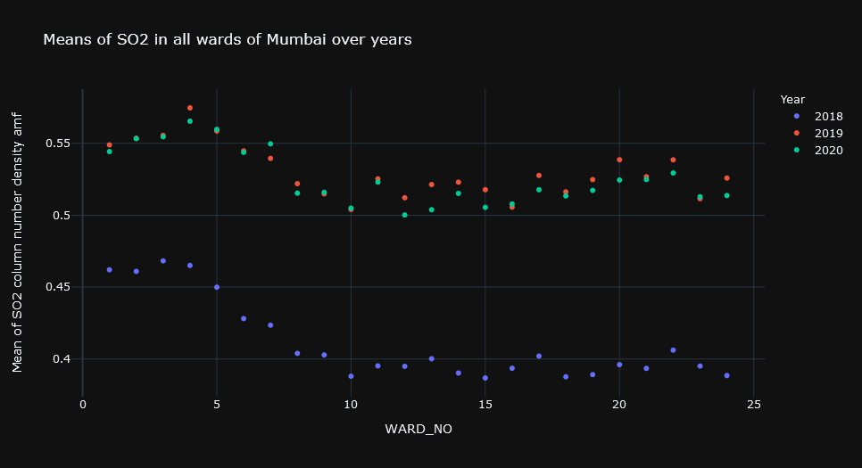
3.5 Mumbai

Slide 14
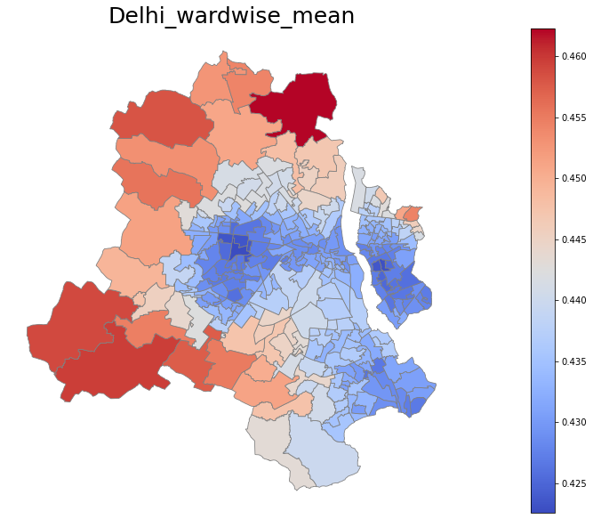
4. Choropleth Map:
Thematic map in which a set of predefined areas is colored in proportion to a statistical variable that represents an aggregate summary of a geographic characteristic within each area.
Here, statistical variable is SO2_column_number_density_amf and the areas are wards of respective cities.

Slide 15
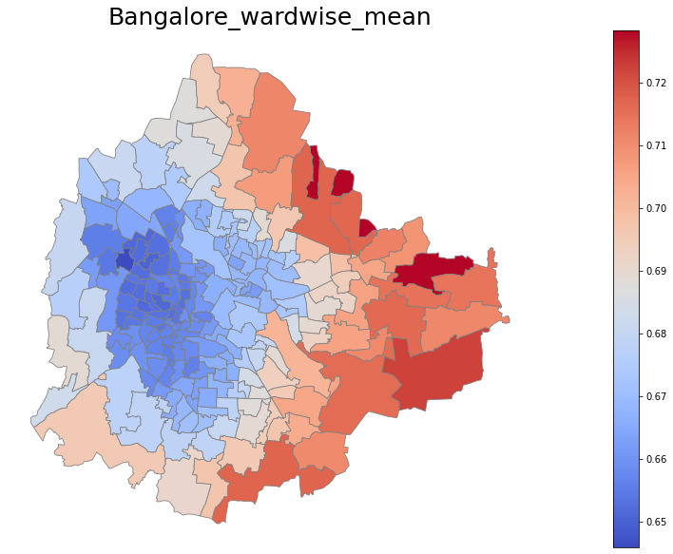
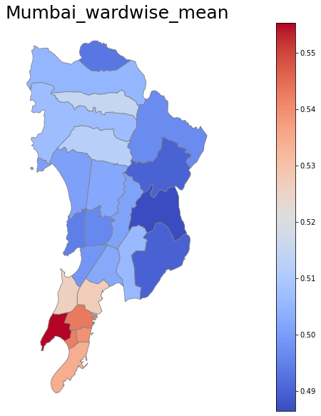

Slide 16
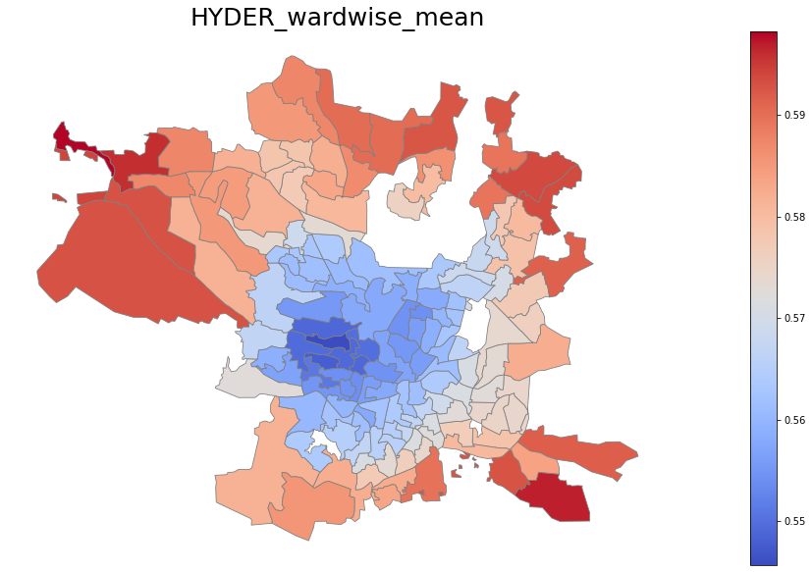
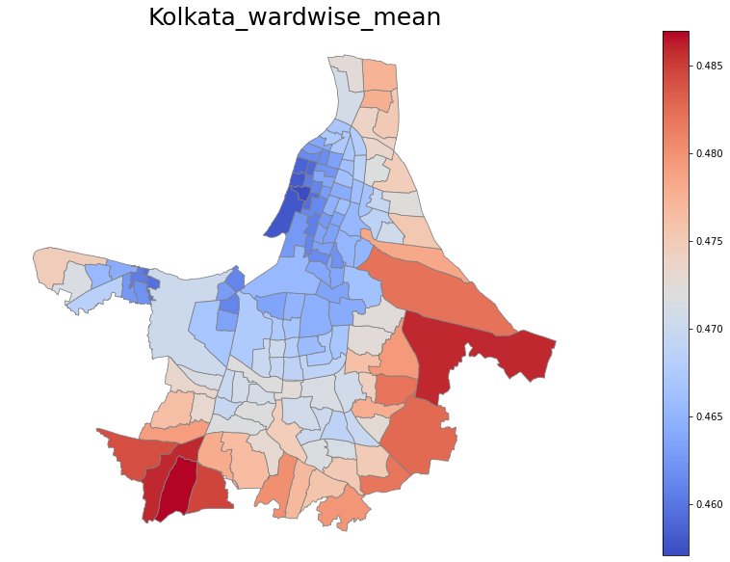

Slide 17
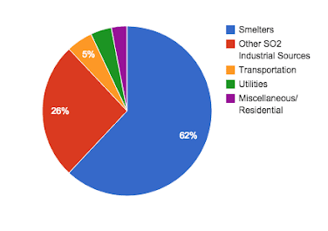
Inference from Choropleth maps:
Major sources of SO2 are smelters.
We can notice a considerable reduction in levels of SO2 in the center hubs of major cities over the past 2-3 years.
This is because people over there are getting aware of the effects of rising levels of SO2 and started inclining towards CNG which reduced the emissions of SO2 from automobiles in the cities.
So the levels of SO2 in the outskirts of cities, where the smelters are high in number, remained high.

Slide 18
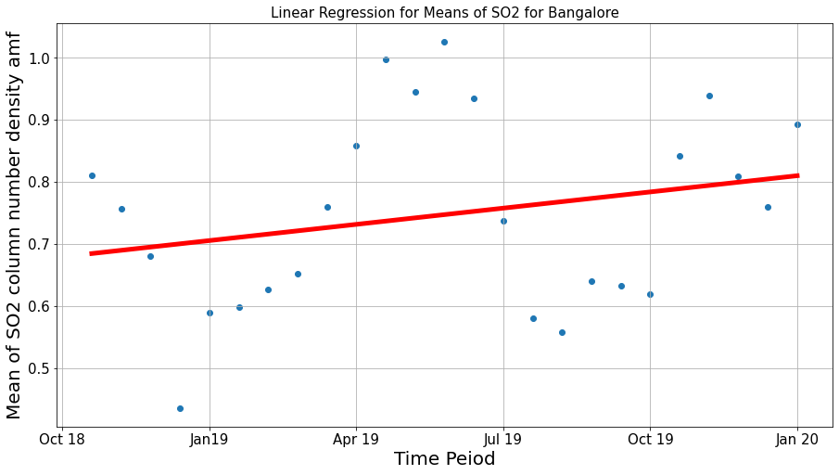
5. Regression of SO2
5.1 Bangalore

Slide 19
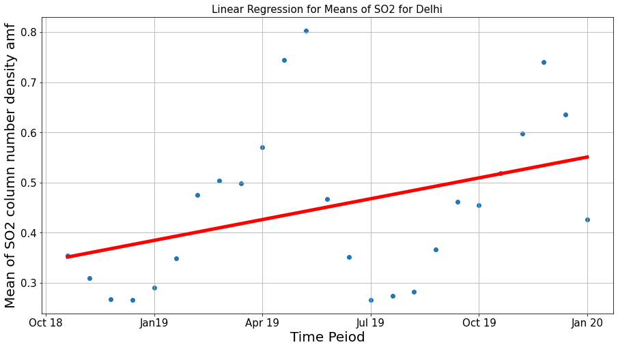
5.2 Delhi

Slide 20
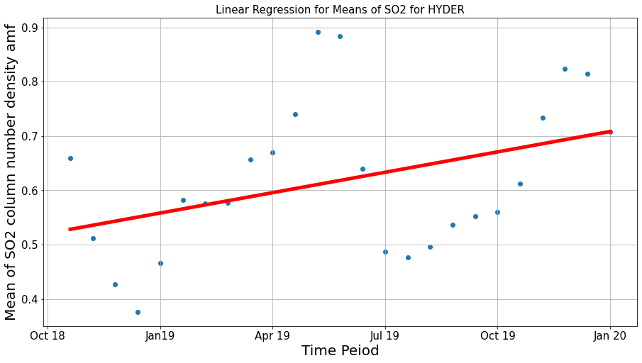
5.3 Hyderabad

Slide 21
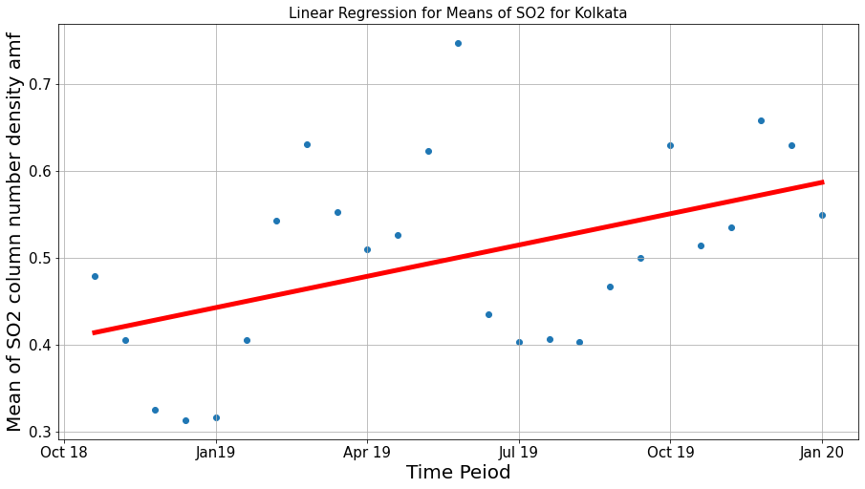
5.4 Kolkata

Slide 22
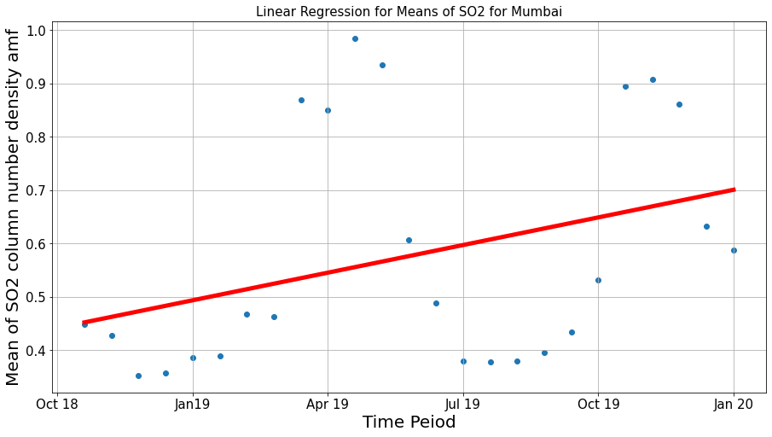
5.5 Mumbai

Slide 23
5.6 Inferences from Regression analysis
Since the trends of SO₂ depends on various parameters, there is no concrete conclusion that can be drawn from the linear regression analysis.
But the noticeable observation that can be seen is that the levels of SO₂ had been rising over the years due to rise in usage of sources that emits SO₂.

Slide 24

6.Multivariate Analysis
Variables used:
Sentinel CO
Sentinel Pollution levels
Sentinel SO₂

Slide 25
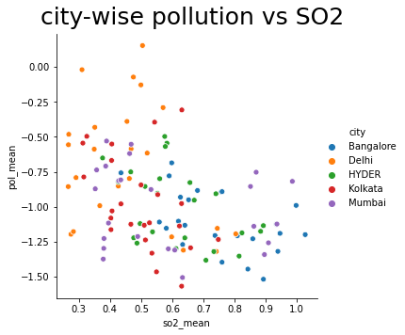
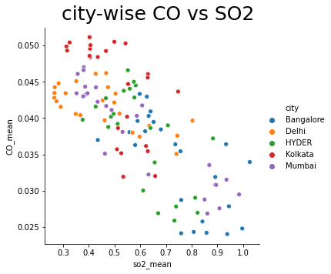
6.1 City-wise analysis of variables

Slide 26
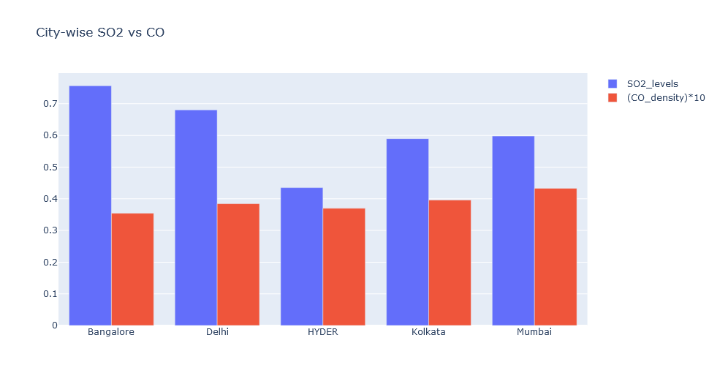
6.2 City-wise CO vs SO₂

Slide 27
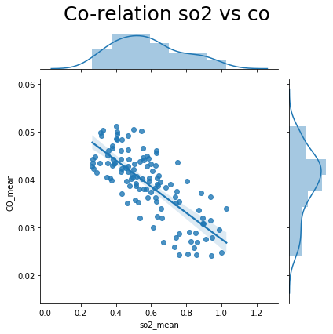
6.3 Correlation b/w SO₂ vs CO
Correlation coefficient
Corr ,_ = pearsonr(SO₂, CO) = -0.76
From this it can be inferred that SO₂ and CO are negatively strongly correlated.

Slide 28
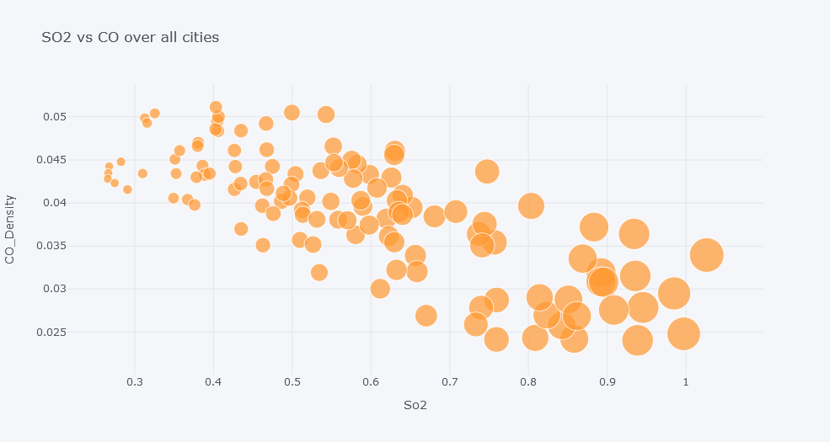
6.4 SO₂ vs CO over all cities

Slide 29
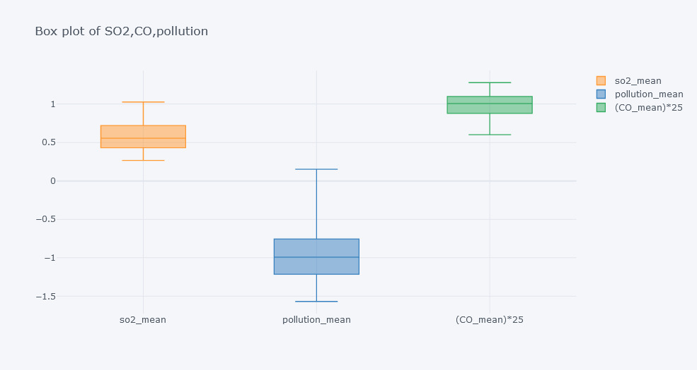
6.5 Box plot of SO₂, CO and Pollution
This is used to used to analyze the shape of the distribution, its central value, and its variability.

Slide 30
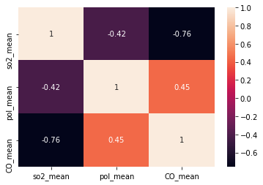
6.6 Heat Map
Here heat map is used to analyze the correlation coefficients across the variables.
It can be noticed that SO₂ mean values are strongly correlates with CO levels than pollution levels.

Slide 31
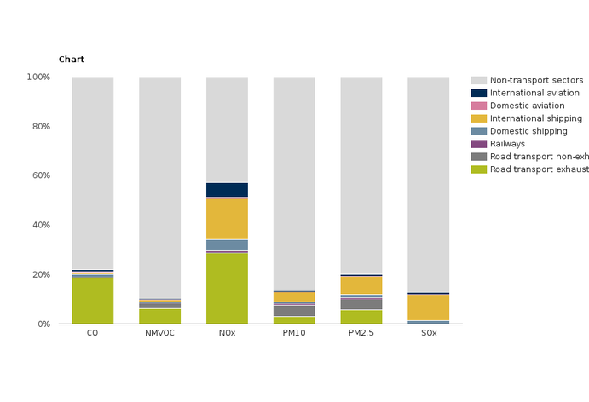
6.7 Inference from Heat Map
CO is strongly positively correlated with pollution than SO₂.
This is due to the fact that CO contributes more than Sulphur oxides for air pollution.

Slide 32
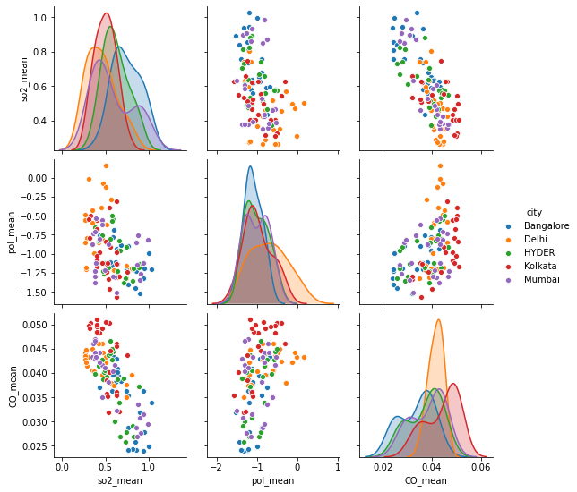
6.8 Pair Plot
We used Pair plot to plot the multiple pairwise bivariate distributions in our dataset.
Here analysis between SO₂ means, CO means and pollution means are done across all the major cities.

Slide 33
7 Conclusion
Climate change is not a myth.
Government should bring strict regulations to reduce the levels of SO₂ like
Monitoring coal-burning power plants sulphur emission activities.
By making powerplants to install scrubbers that remove SO₂ from gases leaving the smokestack.
By conducting awareness campaigns to educate people about the hazards of increase in levels of SO₂.

