Slide 1
Application Delivery Fundamentals 2.0
Spring Core Annotations
Notes:
Faculty Notes:
Introduce yourself, if necessary.
Introduce the module and time frame, which is approximately 1.5 hours
Verify the students have the proper handouts for the module.
Ensure the students have access to the required software for the practice exercises.
Participant Notes:
N/A

Slide 2
Course Goals / Objectives
At the end of this module, participants will be able to:
Spring annotations
Annotation Configuration
@Autowired
@Component
@Qualiifier
Java Based Configuration Annotation
@Configuration
@Bean
Sample Code
Activity

Slide 3

Agenda
This module will cover the following topics:
Some of the Spring Annotations
XML Configuration & Annotations
Java Based Configurations
When use what?
Summary

Slide 4
How Spring works
Your Application Classes (POJOs)
Spring
Application Context
applicationContext.xml
/
Module-servlet.xml
Configuration
Instructions
Creates
Fully configured
application system
Ready for use
Notes:
Just introduce the way people are used to configuring application.

Slide 5
Bean Injection
public class TransferServiceImpl implements
TransferService {
// Constructor Injection
public TransferServiceImpl(AccountRepository ar) {
this.accountRepository = ar;
}
…
// OR – Setter Injection
AccountRepository accountRepository;
public setAccountRepository (AccountRepository ar) {
this.accountRepository = ar;
}
}
Injecting AccountRepository Bean to
TransferServiceImpl
Notes:
Just introduce the way people are used to configuring application.
5

Slide 6
Constructor Injection – XML Configuration
<beans>
<bean id=“transferService” class=“app.impl.TransferServiceImpl”>
<constructor-arg ref=“accountRepository” />
</bean>
<bean id=“accountRepository” class=“app.impl.JdbcAccountRepository”>
<constructor-arg ref=“dataSource” />
</bean>
<bean id=“dataSource” class=“com.mysql.jdbc.Driver”>
<property name=“URL” value=“jdbc:mysql://localhost:3306/codingtondb” />
<property name=“user” value=“root” />
<property name=“password” value=“abcd1234” />
</bean>
</beans>
Constructor Injection
Constructor Injection
Constructor Injection
Notes:
XML Configuration required to Inject a Spring Bean through Constructor.
6

Slide 7
Setter Injection – XML Configuration
<beans>
<bean id=“transferService” class=“app.impl.TransferServiceImpl”>
<property name=“accountRepository” ref=“accountRepository” />
</bean>
<bean id=“accountRepository” class=“app.impl.JdbcAccountRepository”>
<property name=“dataSource” ref=“dataSource” />
</bean>
<bean id=“dataSource” class=“com.mysql.jdbc.Driver”>
<property name=“URL” value=“jdbc:mysql://localhost:3306/codingtondb” />
<property name=“user” value=“root” />
<property name=“password” value=“abcd1234” />
</bean>
</beans>
Place holder (Setter – Getter methods) for injecting bean in parent class.
S
e
t
t
e
r
I
n
j
e
c
t
i
o
n
Notes:
Explain the Setter injection and placeholder (setter / getter methods) for the injecting bean in the parent class.
7

Slide 8
@Autowired
public class TransferServiceImpl implements TransferService {
@Autowired
public TransferServiceImpl(AccountRepository ar) {
this.accountRepository = ar;
}
…
}
public class JdbcAccountRepository implements AccountRepository {
@Autowired
public JdbcAccountRepository(DataSource ds) {
this.dataSource = ds;
}
…
}
Notes:
Explain @Autowired annotation
8

Slide 9
@Autowired – XML Configuration
<beans>
<bean id=“transferService” class=“app.impl.TransferServiceImpl” />
<bean id=“accountRepository” class=“app.impl.JdbcAccountRepository” />
<bean id=“dataSource” class=“com.mysql.jdbc.Driver”>
<property name=“URL” value=“jdbc:mysql://localhost:3306/codingtondb” />
<property name=“user” value=“root” />
<property name=“password” value=“abcd1234” />
</bean>
<context:annotation-config/>
</beans>
No need to specify
constructor-args / Setter reference
looks for annotations on beans
only in the same application context
where it is defined
Notes:
XML Configuration required for @Autowired and . <context:annotation-config/>
9

Slide 10
@Autowired contd…
@Autowired annotation can be applied on setter methods, constructors and fields.
Autowired indicating “required dependencies”.
Autowire will fail if no matching bean is available in the context.
@Autowired(required=false) – indicating not a mandatory dependency. Defaults to true. Autowire will not fail if no matching bean is available in the context.
@Autowired(required=false)
private AccountRepository accountRepository;

Slide 11
@Component
Indicates that the annotated class is a "component"
Both identify POJOs as Spring Beans
Removes the need to specify almost anything in XML
Optionally pass it a String, which will be the bean name
Default bean name is de-capitalized non-qualified name
@Component
public class TransferServiceImpl implements TransferService
public TransferServiceImpl(AccountRepository ar) {
this.accountRepository = ar;
}
…
}

Slide 12
@Component contd…
@Component takes a String parameter that names the bean
Arguably not a best practice to put bean names in your Java code
<context:component-scan base-package="com.accenture.xx.xx.x" /> - required in configuration xml to enable annotation scan in mentioned package
@Component(“myTransferService”)
public class TransferServiceImpl implements TransferService
public TransferServiceImpl(AccountRepository ar) {
this.accountRepository = ar;
} …
}

Slide 13
@Qualifier
To used on a field or parameter as a qualifier for a beans when autowiring
Can be used in other annotations to that can be used as qulaifier
Needed in case multiple instances of the same type exist, one of which needs to be autowired
Using an @Qualifier annotation you can inject named beans
Specify the bean name of the
bean you want to inject
@Autowired
@Qualifier(“primaryDataSource”)
private DataSource dataSource;

Slide 14
When to use What
Start using annotations for small isolated parts of your application (Spring @MVC controllers)
Annotations are spread across your code base
XML is centralized in one (or a few) places
XML for infrastructure and more 'static' beans
Annotations for frequently changing beans

Slide 15



Spring Core Annotations : See-It
Demonstration :
Faculty will demonstrate annotations @Autowired, @Qualifier and @Component
Environment : applicationContext.xml and all files in com.accenture.adfx.module2.sample
Duration: 20 min
Steps:
Open ADFExtensionCodebaseM2SpringCoreAnnotation_participant
Open folder com.accenture.adfx.module2.sample
Run the following files one by one and check the logs
AutowiredSampleClient.java (log 2a)
QualifierSampleClient.java (log 2b)
ComponentSampleClient.java (log 2c)
Refer to their respective main and impl classes too along with applicationContext.xml
2a
2b
2c
2a

Slide 16
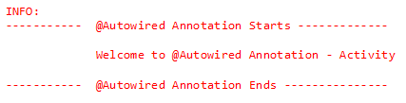


Spring Core Annotations : Try It
Time Allocated: 30 minutes
Environment - Eclipse
Steps:
Open ADFExtensionCodebaseM2SpringCoreAnnotation_participant
Open folder com.accenture.adfx.module2.activity
Complete
TODO 1 – TODO4 in applicationContext.xml
TODO 1 in AutowiredActivityMain.java
TODO 1 – TODO3 in AutowiredActivityClient.java
TODO 1 in ComponentActivityMain.java
TODO 1 – TODO3 in ComponentActivityClient.java
TODO 1 in QualifierActivityMain.java
TODO 1 – TODO3 in QualifierActivityClient.java

Slide 17
Java Based Annotations
Enables us to write most of the configurations without using XML.
Uses Annotations instead of XML
Commonly used annotations are:
@Configuration
@Bean
@Import
@Primary
@Lazy

Slide 18
@Configuration and @Bean
Class level annotation that defines a class as a source of bean definitions.
Uses @Bean annotation to identify a POJO as a Spring Bean
@Configuration
public class MyConfiguration{
@Bean
public TestBean testBean(){
return new TestBean();
}
}
Code is equal to the following XML Declaration
<beans>
<bean id =“testBean” class=“com.beans.TestBean/>
</beans>

Slide 19
@Import
@Import annotation is used for importing beans defined in some other Configuration class.
@Configuration
public class MyConfiguration1{
@Bean
public TestBean testBean(){
…. }}
@Configuration
@Import(MyConfiguration1.class)
public class MyConfiguration2{
@Bean
public HelloBean helloBean(){ return new TestBean();
…. }}

Slide 20
@Primary
In the same application context, if multiple beans are qualified to autowire a single dependency, we might require to give one bean a preference over other beans.
@Primary is used for the same!!!
@Primary has no effect until component-scan is used.

Slide 21
@Primary – Example (Contd..)
@Component
public class InvoiceService{
private InvoiceRepository invRepository;
@Autowired
public InvoiceService(InvoiceRepository invRepository)
{
this.invRepository = invRepository.
}
}
@Component
Public class JDBCRepository
{
…
}

Slide 22
@Primary - Example
@Component
@Primary
Public class HibernateRepository { … }
In the above example, since HibernateRepository is annotated with @Primary, Spring will automatically inject this repository over other similar beans equally qualified.

Slide 23
@Lazy
Indicates whether a bean is to be lazily initalized.
Used on class directly or indirectly annotated with @Component or on methods annotated with @Bean
By default bean initialization is eager unless specified explicitly as lazy.

Slide 24
Overview
@Component, so the functionality is the same as we have discussed for @Component, but we annotate classes that are services in the application
@Repository it is a @Component, but we annotate classes that are repositories, so we have the database-related operations in these classes
@Bean it is used to explicitly declare a single bean, rather than letting the framework do it automatically with scanning

Slide 25
Overview
@Autowire this is how we inject a dependency, we do not have to instantiate the class with the ’new’ keyword, it is handler by the framework itself
@Qualitfier there may be a situation when you create more than one bean of the same type and want to wire only one of them with a property, in such case you can use @Qualifier annotation along with @Autowired to remove the confusion by specifying which exact bean will be wired

Slide 26
Overview
@Configuration it is a @Component as well. Indicates that the given class declares one or more @Bean methods. It indicates also that the class may be processed by the Spring container to generate bean definitions and service requests for those beans at runtime
@ComponentScan Spring container can detect and register the beans and the classes with the @Component annotation ( as well as the @Services and @Repositorys ). We can define the package name in which Spring is going to scan for the components.

Slide 27
Overview
@EnableAutoConfiguration auto-configures the beans that are present in the classpath. For example, if we have tomcat-embedded.jar in the classpath, we need the Tomcat Embedded ServletContainer Factory bean to configure the tomcat server. This will be done because of this annotation

Slide 28
Overview
@SpringBootApplication because most of the applications needs the @Configuration, @ComponentScan and the @EnableAutoConfiguration annotations, they have been merged into this single @EnableAutoConfiguration annotation

Slide 29
Additional Resources
Additional Links :
http://static.springsource.org/spring/docs/2.5.x/api/org/springframework/beans/factory/annotation/

Slide 30
Course / Module Summary
Fill in the blanks to complete Module Summary
@Autowired annotation can be applied on _____________, ___________ and _______.
Using an ___________annotation you can inject named beans.
____________ annotation takes a String parameter that names the bean
Notes:
@Autowired annotation can be applied on setter methods , constructors and fields.
Using an @Qualifier annotation you can inject named beans
@Component annotation takes a String parameter that names the bean

Slide 31
Course / Module Summary
Fill in the blanks to complete Module Summary
@Autowired annotation can be applied on setter methods, constructors and fields.
Using an @Qualifier annotation you can inject named beans.
@Component annotation takes a String parameter that names the bean
Notes:
@Autowired annotation can be applied on setter methods , constructors and fields.
Using an @Qualifier annotation you can inject named beans
@Component annotation takes a String parameter that names the bean

Slide 32
Spring Life Cycle
When a bean is initialized it might require to perform some action before it can come into a usable state(State in which application can use it).
When a bean is getting destroyed, there might be some cleanup activity required for the given bean. These activities are known as bean Lifecycle.

Slide 33
Spring Life Cycle Activities
Standard bean lifecycle interfaces & the standard order of execution are given below. 1- IoC container will look for the configuration metadata of given Bean. 2- Once found, the container will create the instance of Bean(Using reflection API). 3- After instance creation dependency will be injected(DI).

Slide 34
Spring Life Cycle Activities
If Bean Class implements any of the below-highlighted interfaces then the corresponding method will be invoked in below order(Point 4 – 13).
4- setBeanName method of BeanNameAware Interface. It sets the name of the bean in the bean factory that created this bean.
5- setBeanClassLoader method of BeanClassLoaderAware Interface. Callback that supplies the bean to a bean instance.

Slide 35
Spring Life Cycle Activities
6- setBeanFactory method of BeanFactoryAware Interface. Callback that supplies the owning factory to a bean instance.
Below method execution will be applicable when running in an application context. (Points 7 – 11)
7- setResourceLoader method of ResourceLoaderAware Interface. It set the ResourceLoader that this object runs in.
8- setApplicationEventPublisher method of ApplicationEventPublisherAware Interface. Set the ApplicationEventPublisher that this object runs in.

Slide 36
Spring Life Cycle Activities
9- setMessageSource method of MessageSourceAware Interface. Set the MessageSource that this object runs in.
10- setApplicationContext method of ApplicationContextAware Interface. Set the ApplicationContext that this object runs in.
11- setServletContext method of ServletContextAware Interface. Set the ServletContext that this object runs in.

Slide 37
Spring Life Cycle Activities
12- postProcessBeforeInitialization method of BeanPostProcessor Interface. Apply this BeanPostProcessor to the given new bean instance before any bean initialization callbacks.
13- afterPropertiesSet method of InitializingBean Interface. Invoked by a BeanFactory after it has set all bean properties supplied.

Slide 38
Spring Life Cycle Activities
In case Bean class has custom init method defined(via init-method attribute)
14- Custom init method will be invoked.
15- postProcessAfterInitialization methods of BeanPostProcessors. Apply this BeanPostProcessor to the given new bean instance after any bean initialization callbacks

Slide 39
Spring Life Cycle Activities
When Bean Factory is getting shut down following lifecycle methods will be executed.
1- DisposableBean’s destroy method. Invoked by a BeanFactory on the destruction of a singleton. 2- Custome destroy method will be executed if there is any defined via destroy-method attributes

Slide 40
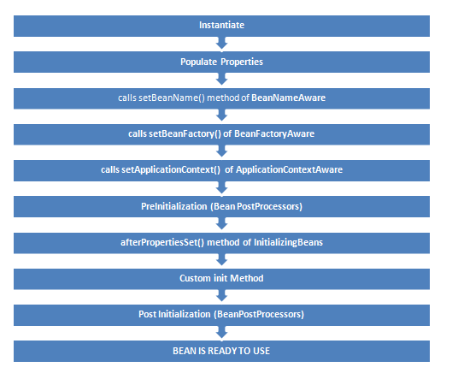
Spring Life Cycle Activities

Slide 41
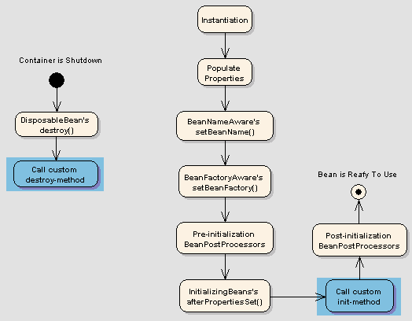
Spring Life Cycle Activities

Slide 42
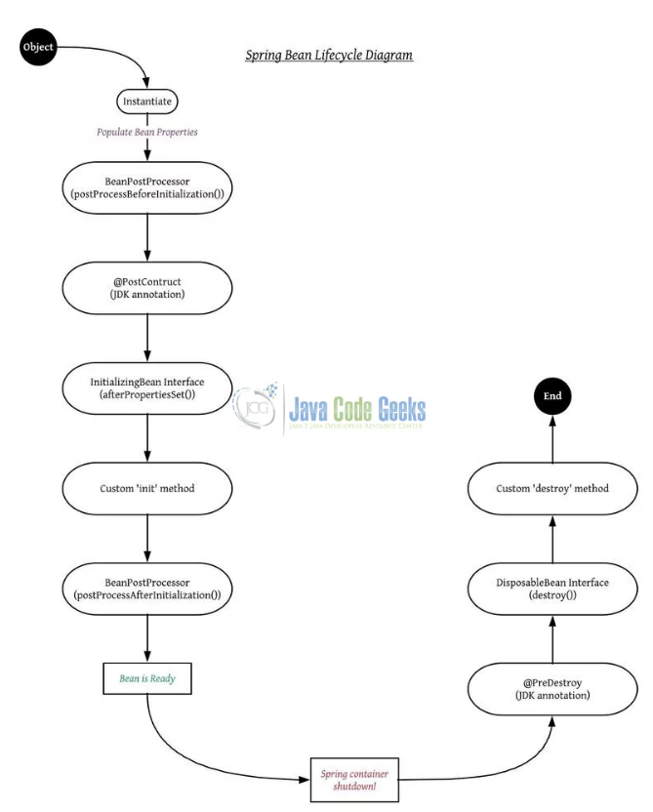
Spring Life Cycle Activities

Slide 43
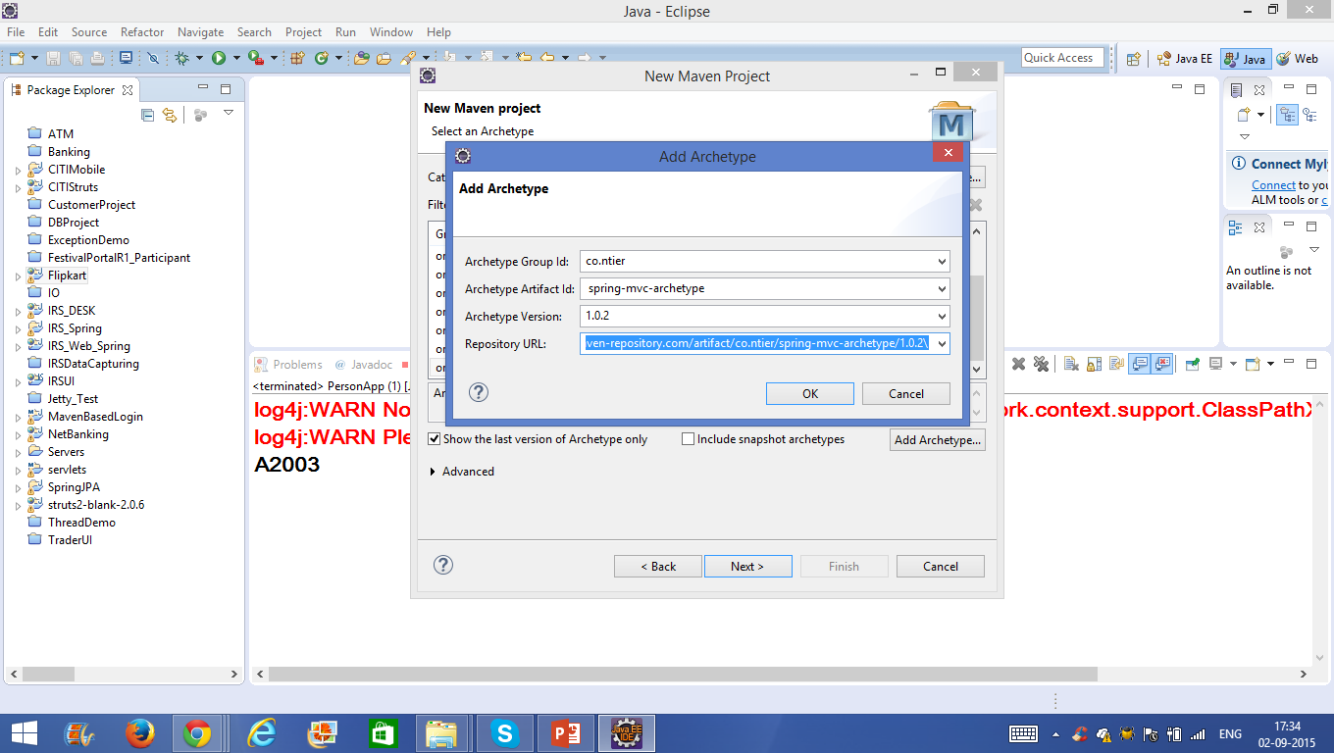

Slide 44
Course / Module Summary
Now that you have completed this module, you should be familiar with the following concepts:
Spring’s configuration directives can be written in XML or using annotations
You can mix and match XML and annotations as you please
@Autowired and @Component allow for almost empty configuration files

Slide 45
Questions

