Slide 1
Application Delivery Fundamentals 2.0 B: Java
Spring MVC

Slide 2
Module Objectives
At the end of this section, you should be able to:
Describe Model View Controller (MVC) Design Pattern
Explain Spring MVC implementation
Create a Spring MVC-based application

Slide 3
What You Need
JDK 1.8 or later
Gradle 4+ or Maven 3.2+
You can also import the code straight into your IDE:
Spring Tool Suite (STS)
IntelliJ IDEA
Eclipse 2019

Slide 4
Model View Controller Design Pattern
Model View Controller (MVC): A fundamental design pattern for separating user interface logic from business logic
Separates the domain (Model), the user interface (View), and the actions based on user input (Controller) into three separate categories:
Model
Handles the behavior and data of the application
View
Handles the display of information
Controller
Interprets the user inputs, informing the model and/or the view to change as appropriate
3
Notes:
Faculty Notes:
Review information on the slide and in participant notes.
Animation on slide:
Introductory info appears on launch
On first click: Model + Description
On second click: View + Description
On third click: Controller + Description
Participants Notes:
The Model View Controller (MVC) design pattern is a high-level architectural pattern that emphasizes the separation of data and business services (model), user interface (view), and the interactions between them (controller).
The MVC design pattern deals primarily with user interface and data interactions at a high level.
Lower-level design patterns can be applied in combination with the MVC design pattern.
For example, the front controller pattern can be used with the MVC design pattern to forward all requests matching a pattern to a specific class (Front controller class).

Slide 5
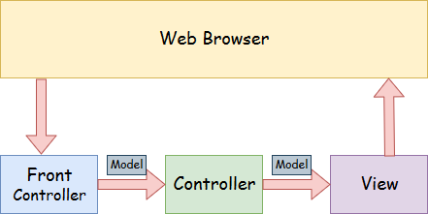
Model View Controller Design Pattern
3
Notes:
Faculty Notes:
Review information on the slide and in participant notes.
Animation on slide:
Introductory info appears on launch
On first click: Model + Description
On second click: View + Description
On third click: Controller + Description
Participants Notes:
The Model View Controller (MVC) design pattern is a high-level architectural pattern that emphasizes the separation of data and business services (model), user interface (view), and the interactions between them (controller).
The MVC design pattern deals primarily with user interface and data interactions at a high level.
Lower-level design patterns can be applied in combination with the MVC design pattern.
For example, the front controller pattern can be used with the MVC design pattern to forward all requests matching a pattern to a specific class (Front controller class).

Slide 6
Spring MVC Flow
WebApplicationContext Configuration file
SimpleUrlHandlerMapping
The flow:
Client Browser
Client request
DispatcherServlet
Controller
Model and view
View Resolver
9
Notes:
Faculty Notes:
Review information on the slide and in the participant notes.
Animation on Slide:
On Display: “The Flow”.
On Clicks 1-9: Each click reveals the next step in the flow.
Participant Notes:
The diagram depicts the following:
The DispatcherServlet is the first place a request meets the application. This implementation of the Front Controller pattern uses a HandlerMapping implementation to determine which Controller class should process the request. There are many types of HandlerMapping implementations which provide flexibility in determining how requests are mapped to individual Controller implementations. A typical HandlerMapping looks at the URL to determine to which Controller to map. For example, a URL like login.htm can be mapped to LoginController, whereas validate.htm can map to ValidateController.
The WebApplicationContext file stores configuration related to beans, View Resolvers, Controller mapping, etc.
Controllers are responsible for interactions between the web requests and the application’s model. A controller typically retrieves data from the request.
When processing web forms, such as a user registration page, the Controller invokes validation logic and passes the form’s data to the model for storage in a database. When the controller has processed the request, it typically returns a ModelAndView class. The ModelAndView class defines a logical view name, which is resolved to an actual view implementation with the help of a ViewResolver.
The ModelAndView class, as its name implies, also holds the data to be displayed to the user. The view accesses the data stored in ModelAndView for rendering to the end user.

Slide 7
Spring MVC Spring @MVC vs. Spring <MVC/>
Earlier versions on Spring (Before 2.5) relied more on xml configurations
Spring 2.5 introduced a simplified, annotation-based model for developing
Spring MVC applications
informally referred to as “Spring @MVC”
Spring Framework uses annotations like @Controller, @RequestMapping, and so on, to mark a class as a Controller or to map a request to its handler respectively
4
Notes:
Faculty Notes:
Review information on the slide and in the participant notes.
Note: In this module, annotations and workflows are covered at a depth that is targeted for this audience.
When teaching these concepts, to avoid confusion and to avoid adding unnecessary complexity, thoroughly review all notes, and deliver only the content in this deck.
Participants Notes:
Earlier versions of Spring used xml files for all configurations. This was informally known as Spring<MVC/>.
Annotations were introduced in Spring 2.5.
Annotations simplify process of defining dependencies, request mapping, etc.
Annotations will be covered in more detail later in this module.

Slide 8
Dispatcher Servlet
Spring MVC, as many other web frameworks, is designed around the front controller pattern.
A central Servlet, the DispatcherServlet, provides a shared algorithm for request processing.
Actual work is performed by configurable delegate components.
This model is flexible and supports diverse workflows.
The DispatcherServlet, as any Servlet, needs to be declared and mapped according to the Servlet specification by using Java configuration or in web.xml.
In turn, the DispatcherServlet uses Spring configuration to discover the delegate components it needs for request mapping, view resolution, exception handling, and more.

Slide 9
Dispatcher Servlet
public class MyWebApplicationInitializer implements WebApplicationInitializer {
@Override
public void onStartup(ServletContext servletCxt) {
// Load Spring web application configuration
AnnotationConfigWebApplicationContext ac = new AnnotationConfigWebApplicationContext();
ac.register(AppConfig.class);
ac.refresh();
// Create and register the DispatcherServlet
DispatcherServlet servlet = new DispatcherServlet(ac);
ServletRegistration.Dynamic registration = servletCxt.addServlet("app", servlet);
registration.setLoadOnStartup(1);
registration.addMapping("/app/*");
}
}

Slide 10
Dispatcher Servlet
<web-app>
<listener>
<listener-class>org.springframework.web.context.ContextLoaderListener</listener-class>
</listener>
<context-param>
<param-name>contextConfigLocation</param-name>
<param-value>/WEB-INF/app-context.xml</param-value>
</context-param>

Slide 11
Dispatcher Servlet
<servlet>
<servlet-name>app</servlet-name>
<servlet-class>org.springframework.web.servlet.DispatcherServlet</servlet-class>
<init-param>
<param-name>contextConfigLocation</param-name>
<param-value></param-value>
</init-param>
<load-on-startup>1</load-on-startup>
</servlet>
<servlet-mapping>
<servlet-name>app</servlet-name>
<url-pattern>/app/*</url-pattern>
</servlet-mapping>
</web-app>

Slide 12
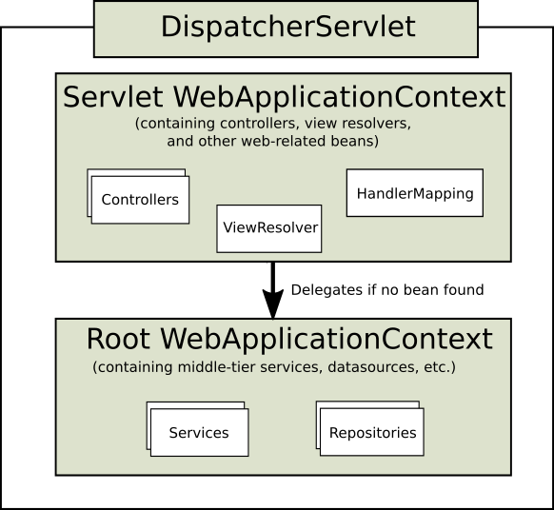
Context Hierarchy

Slide 13
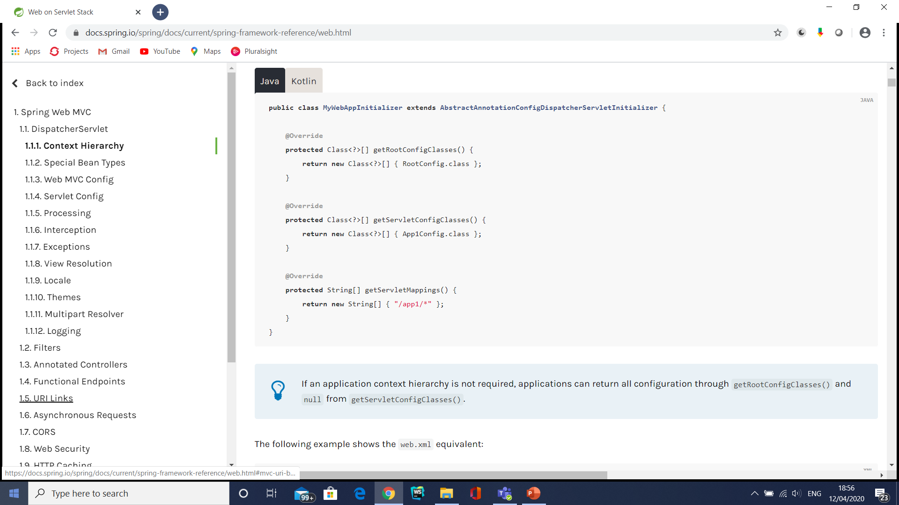
Web Application Context Hierarchy

Slide 14
Dispatcher Servlet Process
The Dispatcher Servlet processes requests as follows:
The WebApplication Context is searched for and bound in the request as an attribute that the controller and other elements in the process can use. It is bound by default under the DispatcherServlet.WEB_APPLICATION_CONTEXT_ATTRIBUTE key.
The locale resolver is bound to the request to let elements in the process resolve the locale to use when processing the request (rendering the view, preparing data, and so on).
Locale resolver is optional.
The theme resolver is bound to the request to let elements such as views determine which theme to use.
Themes also optional.
In a multipart file resolver, the request is inspected for multiparts.
If multiparts are found, the request is wrapped in a MultipartHttpServletRequest for further processing by other elements in the process.

Slide 15
Dispatcher Servlet Process
An appropriate handler is searched for.
If a handler is found, the execution chain associated with the handler (preprocessors, postprocessors, and controllers) is executed in order to prepare a model or rendering.
Alternatively, for annotated controllers, the response can be rendered (within the HandlerAdapter) instead of returning a view.
If a model is returned, the view is rendered.
If no model is returned (maybe due to a preprocessor or postprocessor intercepting the request, perhaps for security reasons), no view is rendered, because the request could already have been fulfilled.

Slide 16
DispatcherServlet initialization parameters
Parameter | Explanation
contextClass | Class that implements ConfigurableWebApplicationContext, to be instantiated and locally configured by this Servlet. By default, XmlWebApplicationContext is used.
contextConfigLocation | String that is passed to the context instance (specified by contextClass) to indicate where contexts can be found. The string consists potentially of multiple strings (using a comma as a delimiter) to support multiple contexts. In the case of multiple context locations with beans that are defined twice, the latest location takes precedence.

Slide 17
DispatcherServlet initialization parameters
Parameter | Explanation
namespace | Namespace of the WebApplicationContext. Defaults to [servlet-name]-servlet.
throwExceptionIfNo HandlerFound | Whether to throw a NoHandlerFoundException when no handler was found for a request. The exception can then be caught with a HandlerExceptionResolver (for example, by using an @ExceptionHandler controller method) and handled as any others. By default, this is set to false, in which case the DispatcherServlet sets the response status to 404 (NOT_FOUND) without raising an exception.

Slide 18
Spring MVC Config
The MVC Java configuration and the MVC XML namespace provide default configuration suitable for most applications and a configuration API to customize it.
@Configuration
@EnableWebMvc
public class WebConfig {
}

Slide 19
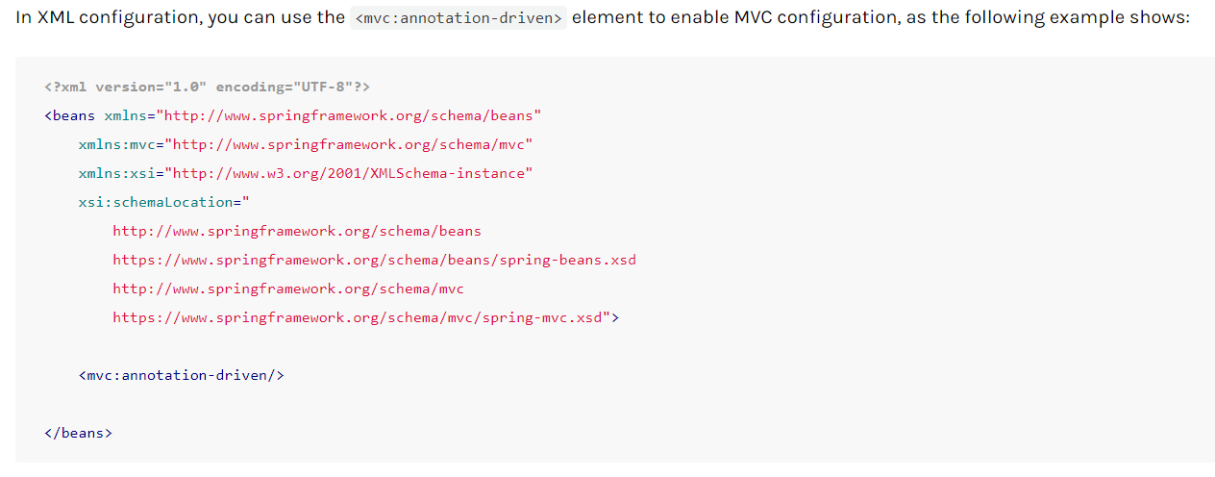
Spring MVC Config

Slide 20
Validation
By default, if Bean Validation is present on the classpath (for example, Hibernate Validator), the LocalValidatorFactoryBean is registered as a global Validator for use with @Valid and Validated on controller method arguments.
In Java configuration, you can customize the global Validator instance, as the following example shows:
@Configuration @EnableWebMvc public class WebConfig implements WebMvcConfigurer {
@Override public Validator getValidator()
{ // ... }
}

Slide 21
Validation
<?xml version="1.0" encoding="UTF-8"?> <beans xmlns="http://www.springframework.org/schema/beans" xmlns:mvc="http://www.springframework.org/schema/mvc" xmlns:xsi="http://www.w3.org/2001/XMLSchema-instance" xsi:schemaLocation=" http://www.springframework.org/schema/beans https://www.springframework.org/schema/beans/spring-beans.xsd http://www.springframework.org/schema/mvc https://www.springframework.org/schema/mvc/spring-mvc.xsd">
<mvc:annotation-driven validator="globalValidator"/> </beans>

Slide 22
Validation
@Bean
public MessageSource messageSource() {
ResourceBundleMessageSource source = new ResourceBundleMessageSource();
source.setBasename("messages");
return source;
}
@Override
public Validator getValidator() {
LocalValidatorFactoryBean validator = new LocalValidatorFactoryBean();
validator.setValidationMessageSource(messageSource());
return validator;
}

Slide 23
Special Bean Types
Bean type | Explanation
HandlerMapping | Map a request to a handler along with a list of interceptors for pre- and post-processing. The two main HandlerMapping implementations are RequestMappingHandlerMapping (which supports @RequestMapping annotated methods) and SimpleUrlHandlerMapping (which maintains explicit registrations of URI path patterns to handlers).
HandlerAdapter | The interface HandlerAdapter is responsible to invoke a handler method and to return the response as ModelAndView to the DispatcherServlet. The DispatcherServlet then uses a HandlerAdapter to invoke this method. The servlet doesn't invoke the method directly – it basically serves as a bridge between itself and the handler objects, leading to a loosely coupling design.

Slide 24
Special Bean Types
Bean type | Explanation
HandlerExceptionResolver | Strategy to resolve exceptions, possibly mapping them to handlers, to HTML error views, or other targets.
ViewResolver | Resolve logical String-based view names returned from a handler to an actual View with which to render to the response.
LocaleResolver, LocaleContextResolver | Resolve the Locale a client is using and possibly their time zone, in order to be able to offer internationalized views.
ThemeResolver | Resolve themes your web application can use — for example, to offer personalized layouts.

Slide 25
Special Bean Types
Bean type | Explanation
MultipartResolver | Abstraction for parsing a multi-part request (for example, browser form file upload) with the help of some multipart parsing library.
FlashMapManager | Store and retrieve the “input” and the “output” FlashMap that can be used to pass attributes from one request to another, usually across a redirect.

Slide 26
Locale and Theme Resolver
spring-mvc-locale-resolver-example (refer project)
Fileupload(Multipart resolver)

Slide 27
Interceptors
All HandlerMapping implementations support handler interceptors.
Interceptors must implement HandlerInterceptor from the org.springframework.web.servlet package.
It has three methods that should provide enough flexibility to do all kinds of pre-processing and post-processing:
HandlerInterceptor interface defined 3 methods.
preHandle(request, response, handler) – Used to intercept the request before handed over to the handler method. Here handler is the chosen handler object to handle the request.
postHandle(request, response, handler, modelAndView) – Used to intercept the request after handler has completed request processing but DispatcherServlet is yet to render the view.
afterCompletion(request, response, handler, exception)

Slide 28
Interception
The preHandle(..) method returns a boolean value.
It can be used to break or continue the processing of the execution chain.
When this method returns true, the handler execution chain continues.
When it returns false, the DispatcherServlet assumes the interceptor itself has taken care of requests.
It does not continue executing the other interceptors and the actual handler in the execution chain.

Slide 29
Interceptors
@Configuration
@EnableWebMvc
public class WebConfig implements WebMvcConfigurer {
@Override
public void addInterceptors(InterceptorRegistry registry) {
registry.addInterceptor(new LocaleChangeInterceptor());
registry.addInterceptor(new ThemeChangeInterceptor()).addPathPatterns("/**").excludePathPatterns("/admin/**");
registry.addInterceptor(new SecurityInterceptor()).addPathPatterns("/secure/*");
}
}

Slide 30
Interceptors
<mvc:interceptors>
<bean class="org.springframework.web.servlet.i18n.LocaleChangeInterceptor"/>
<mvc:interceptor>
<mvc:mapping path="/**"/>
<mvc:exclude-mapping path="/admin/**"/>
<bean class="org.springframework.web.servlet.theme.ThemeChangeInterceptor"/>
</mvc:interceptor>
<mvc:interceptor>
<mvc:mapping path="/secure/*"/> <bean class="org.example.SecurityInterceptor"/>
</mvc:interceptor>
</mvc:interceptors>

Slide 31
Interceptors
firstSpringApplication(refer project)

Slide 32
Content Types
@Configuration
@EnableWebMvc
public class WebConfig implements WebMvcConfigurer { @Override
public void configureContentNegotiation(ContentNegotiationConfigurer configurer)
{
configurer.mediaType("json", MediaType.APPLICATION_JSON);
configurer.mediaType("xml", MediaType.APPLICATION_XML);
}
}

Slide 33
Content Types
<mvc:annotation-driven content-negotiation-manager="contentNegotiationManager"/>
<bean id="contentNegotiationManager" class="org.springframework.web.accept.ContentNegotiationManagerFactoryBean">
<property name="mediaTypes">
<value> json=application/json xml=application/xml </value> </property>
</bean>

Slide 34
Message Converters
Message converters are to marshal and unmarshal object in a different format (like JSON, XML etc.).
Spring MVC uses the HttpMessageConverter interface to convert HTTP requests and responses.

Slide 35
How do the Message Converters work?
When receiving a new request, Spring will make use of the “Accept” header to determine the media type that it needs to respond with.
Spring then tries to find a registered converter that is capable of handling that specific media type – and it will use it to convert the entity and send back the response.
For receiving a request which contains JSON information – the framework will use the “Content-Type” header to determine the media-type in the request body.
Spring searches for the appropriate HttpMessageConverter that can convert the body sent by the client to a Java Object.

Slide 36
How do the Message Converters work?

Slide 37
Further digging into the process
@ResponseBody means that the returned value of the method will constitute the body of the HTTP response.
Of course, an HTTP response can’t contain Java objects.
The processed data on the server is transformed to a format suitable for REST applications, typically JSON or XML.
As discussed above, the “Accept” header specified by the Client will be used to choose the appropriate HTTP Converter to marshal/transform the processed entity to the required format in response.
Now, let’s assume that there is no the “Accept” header, the default attempt that Spring makes is to convert the response to JSON.
But what if there is no corresponding MappingJackson2HttpMessageConverter JAR included in the classpath.
Then the application throws an exception –

Slide 38
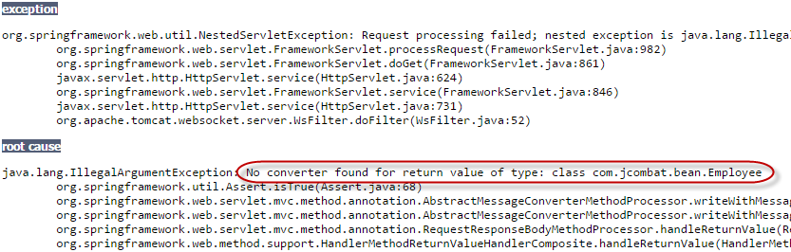
Further digging into the process

Slide 39
Further digging into the process
But if the JAR is present in the classpath, the HTTP Response body contains –
1 2 3 4 | { "empId":"1234", "name":"Abhimanyu" }

Slide 40
Further digging into the process
@RequestBody is often used as argument in a Controller method.
It indicates to Spring that the body of the HTTP Request needs to be deserialized into its corresponding Java entity.
As discussed previously, the “Content-Type” header specified by the Client will be used to determine the appropriate converter for this.
1 2 3 4 5 | @RequestMapping(value = "/{name}", method = RequestMethod.GET) public @ResponseBody void updateEmployee(@PathVariable("id") String id, @RequestBody Employee employee) { employeeService.update(employee); }

Slide 41
Further digging into the process
When we consume the service with “Content-Type” as application/json and HTTP request body as JSON data (as mentioned below), the @RequestBody determines the appropriate converter and deserializes the incoming JSON request data into its corresponding Java entity as specified in the controller argument.
1 2 3 4 | { "empId":"1234", "name":"Abhimanyu" }

Slide 42
The Default Message Converters
By default, the following HttpMessageConverters instances are pre-enabled:
ByteArrayHttpMessageConverter – converts byte arrays
StringHttpMessageConverter – converts Strings
ResourceHttpMessageConverter – converts org.springframework.core.io.Resource for any type of octet stream
SourceHttpMessageConverter – converts javax.xml.transform.Source
FormHttpMessageConverter – converts form data to/from a MultiValueMap<String, String>.
Jaxb2RootElementHttpMessageConverter – converts Java objects to/from XML (added only if JAXB2 is present on the classpath)

Slide 43
The Default Message Converters
MappingJackson2HttpMessageConverter – converts JSON (added only if Jackson 2 is present on the classpath)
MappingJacksonHttpMessageConverter – converts JSON (added only if Jackson is present on the classpath)
AtomFeedHttpMessageConverter – converts Atom feeds (added only if Rome is present on the classpath)
RssChannelHttpMessageConverter – converts RSS feeds (added only if Rome is present on the classpath)
Message Converters

Slide 44
Message Converters
@Configuration
@EnableWebMvc
public class WebConfiguration implements WebMvcConfigurer {
@Override
public void configureMessageConverters(List<HttpMessageConverter<?>> converters) {
Jackson2ObjectMapperBuilder builder = new Jackson2ObjectMapperBuilder()
.indentOutput(true)
.dateFormat(new SimpleDateFormat("yyyy-MM-dd"))
.modulesToInstall(new ParameterNamesModule());
converters.add(new MappingJackson2HttpMessageConverter(builder.build()));
converters.add(new MappingJackson2XmlHttpMessageConverter(builder.createXmlMapper(true).build()));
}
}

Slide 45
Message Converters
<mvc:annotation-driven>
<mvc:message-converters>
<bean class="org.springframework.http.converter.json.MappingJackson2HttpMessageConverter">
<property name="objectMapper" ref="objectMapper"/>
</bean>
<bean class="org.springframework.http.converter.xml.MappingJackson2XmlHttpMessageConverter">
<property name="objectMapper" ref="xmlMapper"/> </bean> </mvc:message-converters>

Slide 46
Message Converters
</mvc:annotation-driven>
<bean id="objectMapper" class="org.springframework.http.converter.json.Jackson2ObjectMapperFactoryBean" p:indentOutput="true" p:simpleDateFormat="yyyy-MM-dd" p:modulesToInstall="com.fasterxml.jackson.module.paramnames.ParameterNamesModule"/>
<bean id="xmlMapper" parent="objectMapper" p:createXmlMapper="true"/>

Slide 47
Message Converters
http-message-converter-master(Refer Project)

Slide 48
CORS
@RestController
@RequestMapping("/account")
public class AccountController {
@CrossOrigin
@GetMapping("/{id}")
public Account retrieve(@PathVariable Long id) {
// ...
}
@DeleteMapping("/{id}")
public void remove(@PathVariable Long id) {
// ...
}

Slide 49
CORS
@CrossOrigin(origins = "https://domain2.com", maxAge = 3600)
@RestController @RequestMapping("/account")
public class AccountController {
@GetMapping("/{id}")
public Account retrieve(@PathVariable Long id)
{ // ... }
@DeleteMapping("/{id}")
public void remove(@PathVariable Long id)
{ // ... }
}

Slide 50
Global Configuration
@Configuration
@EnableWebMvc
public class WebConfig implements WebMvcConfigurer {
@Override
public void addCorsMappings(CorsRegistry registry) {
registry.addMapping("/api/**")
.allowedOrigins("https://domain2.com")
.allowedMethods("PUT", "DELETE")
.allowedHeaders("header1", "header2", "header3")
.exposedHeaders("header1", "header2")
.allowCredentials(true).maxAge(3600);
// Add more mappings...
}
}

Slide 51
Global Configuration
<mvc:cors>
<mvc:mapping path="/api/**"
allowed-origins="https://domain1.com, https://domain2.com"
allowed-methods="GET, PUT"
allowed-headers="header1, header2, header3"
exposed-headers="header1, header2" allow-credentials="true"
max-age="123" />
<mvc:mapping path="/resources/**"
allowed-origins="https://domain1.com" />
</mvc:cors>

Slide 52
Exceptions
If an exception occurs during request mapping or is thrown from a request handler (such as a @Controller), the DispatcherServlet delegates to a chain of HandlerExceptionResolver beans to resolve the exception.
It provides alternative handling, which is typically an error response.

Slide 53
Exceptions
HandlerExceptionResolver | Description
SimpleMapping ExceptionResolver | A mapping between exception class names and error view names. Useful for rendering error pages in a browser application.
DefaultHandler ExceptionResolver | Resolves exceptions raised by Spring MVC and maps them to HTTP status codes. See also alternative ResponseEntityExceptionHandler and REST API exceptions.
ResponseStatus ExceptionResolver | Resolves exceptions with the @ResponseStatus annotation and maps them to HTTP status codes based on the value in the annotation.
ExceptionHandler ExceptionResolver | Resolves exceptions by invoking an @ExceptionHandler method in a @Controller or a @ControllerAdvice class.

Slide 54
View Resolution
Spring MVC defines the View Resolver
View interfaces that render models in a browser without tying to a specific view technology.
View Resolver provides a mapping between view names and actual views.
View addresses the preparation of data before handing over to a specific view technology.

Slide 55
ViewResolver implementations
ViewResolver | Description
AbstractCachingView Resolver | Sub-classes of AbstractCachingViewResolver cache view instances that they resolve. Caching improves performance of certain view technologies. To turn off the cache set the cache property to false. Furthermore, if view is refreshed at runtime (for example, when a FreeMarker template is modified), use the removeFromCache(String viewName, Locale loc) method.
XmlViewResolver | Implementation of ViewResolver that accepts a configuration file written in XML with the same DTD as Spring’s XML bean factories. The default configuration file is /WEB-INF/views.xml.

Slide 56
ViewResolver implementations
ViewResolver | Description
ResourceBundleView Resolver | Implementation of ViewResolver that uses bean definitions in a ResourceBundle, specified by the bundle base name. For each view it is supposed to resolve, it uses the value of the property [viewname].(class) as the view class and the value of the property [viewname].url as the view URL.
UrlBasedViewResolver | Simple implementation of the ViewResolver interface that affects the direct resolution of logical view names to URLs without an explicit mapping definition. This is appropriate if your logical names match the names of your view resources in a straightforward manner, without the need for arbitrary mappings.

Slide 57
ViewResolver implementations
ViewResolver | Description
InternalResourceViewResolver | Convenient subclass of UrlBasedViewResolver that supports InternalResourceView (in effect, Servlets and JSPs) and subclasses such as JstlView and TilesView. You can specify the view class for all views generated by this resolver by using setViewClass(..).
FreeMarkerViewResolver | Convenient subclass of UrlBasedViewResolver that supports FreeMarkerView and custom subclasses of them.
ContentNegotiatingView Resolver | Implementation of the ViewResolver interface that resolves a view based on the request file name or Accept header.

Slide 58
View Resolver
@Configuration
@EnableWebMvc
public class WebConfig implements WebMvcConfigurer {
@Override
public void configureViewResolvers(ViewResolverRegistry registry) {
registry.enableContentNegotiation(new MappingJackson2JsonView());
registry.jsp();
}
}

Slide 59
View Resolver
<mvc:view-resolvers>
<mvc:content-negotiation>
<mvc:default-views>
<bean class="org.springframework.web.servlet.view.json.MappingJackson2JsonView"/>
</mvc:default-views>
</mvc:content-negotiation>
<mvc:jsp/>
</mvc:view-resolvers>

Slide 60
ViewResolver
MultipleViewResolversExample(Refer Project)
Differs based on view name in controller

Slide 61
Static Resources
@Configuration
@EnableWebMvc
public class WebConfig implements WebMvcConfigurer {
@Override
public void addResourceHandlers(ResourceHandlerRegistry registry) {
registry.addResourceHandler("/resources/**")
.addResourceLocations("/public", "classpath:/static/")
.setCachePeriod(31556926);
}
}

Slide 62
Static Resources
<mvc:resources mapping="/resources/**" location="/public, classpath:/static/" cache-period="31556926" />

Slide 63
Annotated Controllers
@Controller
public class HelloController {
@GetMapping("/hello")
public String handle(Model model) {
model.addAttribute("message", "Hello World!");
return "index";
}
}

Slide 64
Declaration
<?xml version="1.0" encoding="UTF-8"?>
<beans xmlns="http://www.springframework.org/schema/beans" xmlns:xsi="http://www.w3.org/2001/XMLSchema-instance" xmlns:p="http://www.springframework.org/schema/p" xmlns:context="http://www.springframework.org/schema/context" xsi:schemaLocation=" http://www.springframework.org/schema/beans https://www.springframework.org/schema/beans/spring-beans.xsd http://www.springframework.org/schema/context https://www.springframework.org/schema/context/spring-context.xsd">
<context:component-scan base-package="org.example.web"/>
<!-- ... -->
</beans>

Slide 65
Declaration
@Configuration
@ComponentScan("org.example.web")
public class WebConfig {
// ...
}

Slide 66
Spring MVC DispatcherServlet (1 of 3)
DispatcherServlet:
Is the core of Spring MVC
Acts as a Front Controller
Coordinates all request handling activities
Dispatches to registered handlers for processing a web request.
10
Notes:
Faculty Notes:
Review information on the slide and in the participant notes.
Participant Notes:
The Front Controller design pattern requires definition of a single component that is responsible for processing application requests.

Slide 67


Spring MVC DispatcherServlet (2 of 3)
Spring MVC’s front controller (DispatcherServlet) coordinates the entire request lifecycle:
Configured in web.xml:
Is mapped using a URL Pattern. In this case, .htm
11
Notes:
Faculty Notes:
Review information on the slide and in the participant notes.
Participant Notes:
Configuring DispatcherServlet is the first step in Spring configuration.
<load-on-startup> indicates it should be the first Servlet to load at web server startup.

Slide 68
Spring MVC DispatcherServlet (3 of 3)
Spring MVC’s front controller (DispatcherServlet) coordinates the entire request lifecycle:
All requests matching .htm pattern automatically will be mapped to DispatcherServlet
DispatcherServlet loads Spring application context from an XML file* that usually contains <bean> definitions for the Spring MVC components
Note: *default is <servlet-name>-servlet.xml
12
Notes:
Faculty Notes:
Review information on the slide and in the participant notes.
Participant Notes:
All JavaEE web applications have web.xml as their deployment descriptor. This descriptor keeps information on which Servlet is where, as well as the welcome file list and many more deployments and configuration-related information.
The web.xml file is a must have file. No application can be deployed without this file.

Slide 69
Spring MVC Application Flow (1 of 4)
The application flow is:
DispatcherServlet receives request and coordinates business functionality
Looks for xml configuration file and calls appropriate controller
3. Controller maps the request to handler, handler processes request/returns instance of ModelAndView to DispatcherServlet
13
Notes:
Faculty Notes:
Review participant notes.
Participant Notes:
In a web application when a client request is received the application looks for web.xml, which initiates the Spring Framework, by passing the request to DispatcherServlet.
DispatcherServlet receives the client request and coordinates the business functionality.
DispatcherServlet then looks for the xml configuration file and calls the appropriate controller.
The Controller maps the client request to the appropriate handler. The handler processes the client request and returns the instance of ModelAndView to DispatcherServlet.

Slide 70
Spring MVC Application Flow (2 of 4)
DispatcherServlet receives request and coordinates business functionality.
14
Notes:
Faculty Notes:
Review the slide information and the participant notes.
Participant Notes:
The configuration information presented on the slide is in web.xml.
web.xml redirects all requests matching .htm pattern to the dispatcher. The dispatcher automatically looks for dispatcher-servlet.xml for further instructions.
dispatcher-servlet.xml identifies the controller for this request.

Slide 71
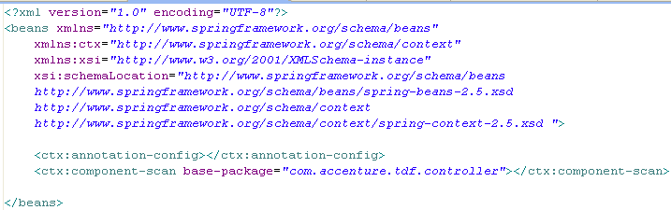
Spring MVC Application Flow (3 of 4)
DispatcherServlet looks for the xml configuration file and calls appropriate controller
Use the following in the .xml configuration file to send the DispatcherServlet looking for Controller(s).
15
Notes:
Faculty Notes:
Review the slide information and the participant notes.
Participant Notes:
The configuration on the slide should be in dispatcher-servlet.xml (as shown on the previous slide).
The xml file name differs depending on the servlet-name in the web.xml.
In the example shown, the base-package in the component-scan tag defines the name of the package which holds its controllers.

Slide 72

Spring MVC Application Flow (4 of 4)
Controller maps the request to appropriate handler which in turn processes the request and returns instance of ModelAndView to DispatcherServlet.
16
Notes:
Faculty Notes:
Review the slide information and the participant notes.
Participant Notes:
The class shown belongs to the same package as seen on the previous slide.
@Controller marks this class as a controller.
@RequestMapping(“/userlogin.htm”) signifies that all requests coming from this .htm should be handled by the method that follows – validateUser.

Slide 73

Spring MVC @Controller
@Controller
Indicates that a particular class serves the role of a controller.
Eliminates the need to extend any Controller base class
Request and Response are automatically filled in by Spring MVC
5
Notes:
Faculty Notes:
Review information on the slide.
Animation on slide:
On Display: Information and code appears
On click: Blue callout bubble appears
Participant Notes:
N/A

Slide 74
@RequestMapping with Wildcards
@RequestMapping(value = "*.request", method = { RequestMethod.GET,
RequestMethod.POST })
public String myHandlingMethod() {
return "next";
}
Refer day15springjparestdemo project
@RequestMapping("*.rest")
public ModelAndView myOtherHandlingMethod() {
return new ModelAndView("previous", "x", "abc");
}

Slide 75
Spring MVC @Controller
Controllers interpret user input and convert it into a model object that can be used by view.
@Controller is a stereotype annotation and hence, dispatcher servlet can automatically scan for these classes.
To enable auto-detection use the following in dispatcher-servlet.xml file.
<context:component-scan base-package=“com.accenture.controllers.*"/>
The component-scan tag also allows us to exclude / include packages during auto-detection
<context:include-filter type="annotation" expression="org.aspectj.lang.annotation.Aspect"/>
5
Notes:
Faculty Notes:
Review information on the slide.
Animation on slide:
On Display: Information and code appears
On click: Blue callout bubble appears
Participant Notes:
N/A

Slide 76
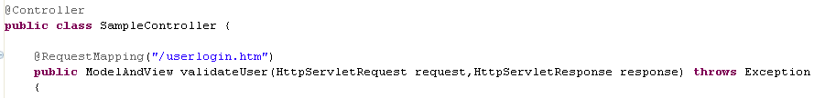
Spring MVC @RequestMapping
@RequestMapping
Is used to map URLs like '/userlogin.htm’ to an entire class or a particular handler method.
Typically, class-level annotation maps a specific request pattern
Execute this method to process requests for /userlogin.htm.
6
Notes:
Faculty Notes:
Review information on the slide and in the participant notes.
Animation on slide:
On Display: Information and code appears on launch
On click: Blue callout bubble appears
Participant Notes:
Typically the class-level annotation maps a specific request pattern to a controller; with additional method-level annotations 'narrowing‘ the primary mapping to specific request parameters.

Slide 77
Spring MVC @RequestMapping
Handler methods annotated with @RequestMapping have very flexible method signatures.
The methods can accept the following types of parameters
HttpServletRequest
HttpServletResponse
ModelAttribute
ModelMap
BindingResult
Errors
The following return types are supported
ModelAndView
ModelMap
ModelAttribute
String
5
Notes:
Faculty Notes:
Review information on the slide.
Animation on slide:
On Display: Information and code appears
On click: Blue callout bubble appears
Participant Notes:
N/A

Slide 78
Handler Methods – Method Arguments

Slide 79
Spring MVC @RequestMapping
Controller method argument | Description
WebRequest, NativeWeb Request | Generic access to request parameters and request and session attributes, without direct use of the Servlet API.
javax.servlet.ServletRequest, javax.servlet.ServletResponse | Choose any specific request or response type — for example, ServletRequest, HttpServletRequest, or Spring’s MultipartRequest, MultipartHttpServletRequest.
javax.servlet.http.HttpSession | Enforces the presence of a session. As a consequence, such an argument is never null. Note that session access is not thread-safe. Consider setting the RequestMappingHandlerAdapter instance’s synchronizeOnSession flag to true if multiple requests are allowed to concurrently access a session.
javax.servlet.http.PushBuilder | Servlet 4.0 push builder API for programmatic HTTP/2 resource pushes. Note that, per the Servlet specification, the injected PushBuilder instance can be null if the client does not support that HTTP/2 feature.

Slide 80
Http Session
@RequestMapping(value = { "/login" }, method = RequestMethod.POST)
@ResponseBody
public String login(HttpSession session,String username,String password) throws Exception {
Member member=userService.authenticateUser(username, password);
if(member!=null) {
session.setAttribute("MEMBER", member);
} else {
throw new Exception("Invalid username or password");
}
return Utils.toJson("SUCCESS");
}

Slide 81
Push Builder
The most important feature of Servlet 4.0, due to HTTP/2, is the implementation of the server push capability.
The concept behind this technique is that if the client/browser requests a certain resource, the server assumes, in advance, that some other related resources may also be requested soon.
Because of this assumption, it pushes them into the cache (called 'cache push') before they are actually needed.
For example, it is very much likely that when a webpage is loaded, it may eventually request a CSS file or another image.
The server proactively starts pushing the bytes of these assets simultaneously, without the need for the client to make an explicit request.

Slide 82
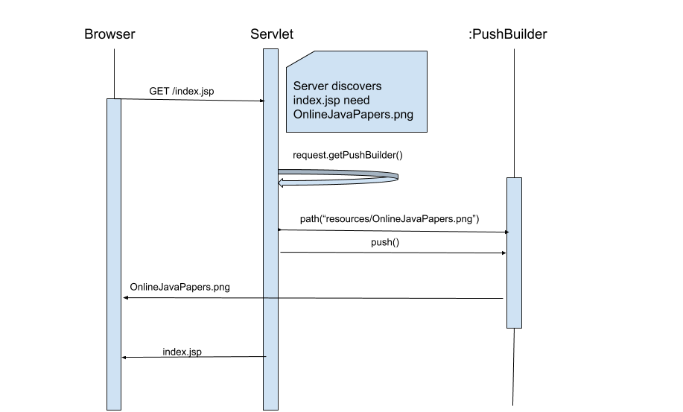
Push Builder

Slide 83
Spring MVC @RequestMapping
Controller method argument | Description
java.security.Principal | Currently authenticated user — possibly a specific Principal implementation class if known.
HttpMethod | The HTTP method of the request.
java.util.Locale | The current request locale, determined by the most specific LocaleResolver available (in effect, the configured LocaleResolver or LocaleContextResolver).
java.util.TimeZone + java.time.ZoneId | The time zone associated with the current request, as determined by a LocaleContextResolver.

Slide 84
Spring MVC @RequestMapping
Controller method argument | Description
java.io.InputStream, java.io. Reader | For access to the raw request body as exposed by the Servlet API.
java.io.OutputStream, java.io.Writer | For access to the raw response body as exposed by the Servlet API.
@PathVariable | For access to URI template variables.
@MatrixVariable | For access to name-value pairs in URI path segments.

Slide 85
Matrix Variable
http://localhost:8080/user/firstName=Sunil/lastName=Singh
http://localhost:8080/user/name=sunil
http://localhost:8080/employee/Mike;salary=45000;dept=HR
http://localhost:8080/employee/Mike;id=12;dept=HR;/India;id=25
http://localhost:8080/car/Audi;color=RED,BLACK,WHITE
http://localhost:8080/person/Mike;dob=2017-02-12
Refer Spring matrix variable project

Slide 86
Spring MVC @RequestMapping
Controller method argument | Description
@RequestParam | For access to the Servlet request parameters, including multipart files. Parameter values are converted to the declared method argument type. Note that use of @RequestParam is optional for simple parameter values. See “Any other argument”, at the end of this table.
@RequestHeader | For access to request headers. Header values are converted to the declared method argument type.
@CookieValue | For access to cookies. Cookies values are converted to the declared method argument type. See @CookieValue.
@RequestBody | For access to the HTTP request body. Body content is converted to the declared method argument type by using HttpMessageConverter implementations.

Slide 87
Spring MVC @RequestMapping
Controller method argument | Description
HttpEntity<B> | For access to request headers and body. The body is converted with an HttpMessageConverter.
@RequestPart | For access to a part in a multipart/form-data request, converting the part’s body with an HttpMessageConverter.
java.util.Map, org.springframework.ui.Model, org.springframework.ui.ModelMap | For access to the model that is used in HTML controllers and exposed to templates as part of view rendering.
RedirectAttributes | Specify attributes to use in case of a redirect (that is, to be appended to the query string) and flash attributes to be stored temporarily until the request after redirect.

Slide 88
Spring MVC @RequestMapping
Controller method argument | Description
@ModelAttribute | For access to an existing attribute in the model (instantiated if not present) with data binding and validation applied. Note that use of @ModelAttribute is optional (for example, to set its attributes).
Errors, BindingResult | For access to errors from validation and data binding for a command object (that is, a @ModelAttribute argument) or errors from the validation of a @RequestBody or @RequestPart arguments. You must declare an Errors, or BindingResult argument immediately after the validated method argument.
SessionStatus + class-level @SessionAttributes | For marking form processing complete, which triggers cleanup of session attributes declared through a class-level @SessionAttributes annotation.
UriComponentsBuilder | For preparing a URL relative to the current request’s host, port, scheme, context path, and the literal part of the servlet mapping.

Slide 89
Spring MVC @RequestMapping
Controller method argument | Description
@SessionAttribute | For access to any session attribute, in contrast to model attributes stored in the session as a result of a class-level @SessionAttributes declaration.
@RequestAttribute | For access to request attributes.
Any other argument | If a method argument is not matched to any of the earlier values in this table and it is a simple type (as determined by BeanUtils#isSimpleProperty, it is a resolved as a @RequestParam. Otherwise, it is resolved as a @ModelAttribute.

Slide 90
Spring MVC @RequestMapping
Controller method argument | Description
@SessionAttribute | For access to any session attribute, in contrast to model attributes stored in the session as a result of a class-level @SessionAttributes declaration.
@RequestAttribute | For access to request attributes.
Any other argument | If a method argument is not matched to any of the earlier values in this table and it is a simple type (as determined by BeanUtils#isSimpleProperty, it is a resolved as a @RequestParam. Otherwise, it is resolved as a @ModelAttribute.

Slide 91
Session Attribute
Refer Session Scope Project

Slide 92
Handler Methods – Return Values

Slide 93
Spring MVC @RequestMapping
Controller method return value | Description
@ResponseBody | The return value is converted through HttpMessageConverter implementations and written to the response.
HttpEntity<B>, ResponseEntity<B> | The return value that specifies the full response (including HTTP headers and body) is to be converted through HttpMessageConverter implementations and written to the response.
HttpHeaders | For returning a response with headers and no body.

Slide 94
Spring MVC @RequestMapping
Controller method return value | Description
String | A view name to be resolved with ViewResolver implementations and used together with the implicit model — determined through command objects and @ModelAttribute methods. The handler method can also programmatically enrich the model by declaring a Model argument.
View | A View instance to use for rendering together with the implicit model — determined through command objects and @ModelAttribute methods. The handler method can also programmatically enrich the model by declaring a Model argument.
java.util.Map, org.springframe work.ui.Model | Attributes to be added to the implicit model, with the view name implicitly determined through a RequestToViewNameTranslator.

Slide 95
Spring MVC @RequestMapping
Controller method return value | Description
@ModelAttribute | An attribute to be added to the model, with the view name implicitly determined through a RequestToViewNameTranslator. Note that @ModelAttribute is optional. See "Any other return value" at the end of this table.
ModelAndView object | The view and model attributes to use and, optionally, a response status.
void | A method with a void return type (or null return value) is considered to have fully handled the response if it also has a ServletResponse, an OutputStream argument, or an @ResponseStatus annotation. The same is also true if the controller has made a positive ETag or lastModified timestamp check (see Controllers for details). If none of the above is true, a void return type can also indicate “no response body” for REST controllers or a default view name selection for HTML controllers.

Slide 96
Spring MVC @RequestMapping
Controller method return value | Description
DeferredResult<V> | Produce any of the preceding return values asynchronously from any thread — for example, as a result of some event or callback.
Callable<V> | Produce any of the above return values asynchronously in a Spring MVC-managed thread.
ListenableFuture<V>, java.util.concurrent.CompletionStage<V>, java.util.concurrent.CompletableFuture<V> | Alternative to DeferredResult, as a convenience (for example, when an underlying service returns one of those).

Slide 97
Spring MVC @RequestMapping
Controller method return value | Description
ResponseBodyEmitter, SseEmitter | Emit a stream of objects asynchronously to be written to the response with HttpMessageConverter implementations. Also supported as the body of a ResponseEntity. See Asynchronous Requests and HTTP Streaming.
StreamingResponseBody | Write to the response OutputStream asynchronously. Also supported as the body of a ResponseEntity. See Asynchronous Requests and HTTP Streaming.
Reactive types — Reactor, RxJava, or others through ReactiveAdapterRegistry | Alternative to DeferredResult with multi-value streams (for example, Flux, Observable) collected to a List. For streaming scenarios (for example, text/event-stream, application/json+stream), SseEmitter and ResponseBodyEmitter are used instead, where ServletOutputStream blocking I/O is performed on a Spring MVC-managed thread and back pressure is applied against the completion of each write. See Asynchronous Requests and Reactive Types.

Slide 98
Spring MVC @RequestMapping
Controller method return value | Description
ResponseBodyEmitter, SseEmitter | Emit a stream of objects asynchronously to be written to the response with HttpMessageConverter implementations. Also supported as the body of a ResponseEntity. See Asynchronous Requests and HTTP Streaming.
StreamingResponseBody | Write to the response OutputStream asynchronously. Also supported as the body of a ResponseEntity. See Asynchronous Requests and HTTP Streaming.
Reactive types — Reactor, RxJava, or others through ReactiveAdapterRegistry | Alternative to DeferredResult with multi-value streams (for example, Flux, Observable) collected to a List. For streaming scenarios (for example, text/event-stream, application/json+stream), SseEmitter and ResponseBodyEmitter are used instead, where ServletOutputStream blocking I/O is performed on a Spring MVC-managed thread and back pressure is applied against the completion of each write. See Asynchronous Requests and Reactive Types.

Slide 99
Spring MVC @RequestMapping
Controller method return value | Description
Any other return value | Any return value that does not match any of the earlier values in this table and that is a String or void is treated as a view name (default view name selection through RequestToViewNameTranslator applies), provided it is not a simple type, as determined by BeanUtils#isSimpleProperty. Values that are simple types remain unresolved.

Slide 100
Spring MVC Components
DispatcherServlet
Acts as a Controller
Controller Class
This class will return the Model And View
CommandClass
The class of the object that will be used to represent the user data. This is also called Form Backing Bean
ViewResolver
Customizable view resolution class Application Context Configuration file
JSP*
Acts as View
Note: *JSP is not part of Spring but it is commonly used to create a user interface in Spring applications
7
Notes:
Faculty Notes:
Review information on the slide and in the participant notes.
Animation on slide:
On Display: Boxes on left are shown
On clicks (1-5): Additional information on right appears
On click (6): Note at bottom appears
Participant Notes:
The information on this slide is for your reference.
Command classes is not within the scope of this course.

Slide 101
Spring MVC : See-It
Demonstration :
Create a Spring MVC application.
Environment: Eclipse
Duration: 20 min
Steps:
Open Project ADFExtensionCodebaseM3_Spring MVC_participant
Navigate to Java Resources/src
Open package com.accenture.adfx.newcodington.module3.sample
Open SpringappController.java and complete the TODOs.
Open and review the index.html, web.xml, Module3-servlet.xml and hello.jsp files.

Slide 102
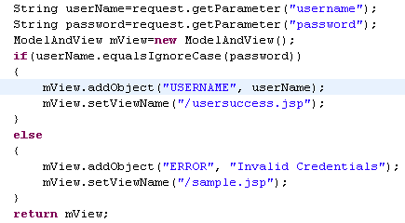
Spring MVC ModelAndView
ModelAndView contains the model (some data) and either a logical view name, or an implementation of the View interface.
17
Notes:
Faculty Notes:
Review the slide information and the participant notes.
Participant Notes:
An actual view (object of a class that implements View interface) or a logical name, as shown on the slide, may be returned.
The logical view name is resolved using configuration information in the spring configuration file.

Slide 103

Spring MVC View Resolvers
Logical view names become view objects.
InternalResourceViewResolver resolves a logical view name…
18
Notes:
Faculty Notes:
Review the slide information and the participant notes.
Participant Notes:
The configuration shown is in dispatcher-servlet.xml (as per the previous slide). The xml file name differs depending on the servlet-name mentioned in the web.xml.
Resolve logical view names returned from controllers into View objects
InternalResourceViewResolver resolves a logical view name by taking the logical view name returned in a Model And-View object and surrounding it with a prefix and a suffix to arrive at the path of a template within the web application.
InternalResourceViewResolver is an implementation of View interface which helps add a prefix and a suffix to the logical names. The addition of both the prefix and suffix translates the logical name into a complete path.

Slide 104
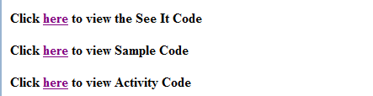

Spring MVC Sample Code
Follow the steps below to see examples on Spring Core:
Open Project ADFExtensionCodebaseM3_Spring MVC_participant
Run it on Tomcat server. This is dependent on completion of the previous See It. You should be able to see a click button. Click on it. Click on Home.
You should see a screen like the one below (see 2a. below).
Click the link to view sample code.
Enter user name and password (see 2b below)
Password should match the name. Try various combinations and see how it behaves.
2a
2b
19
Notes:
Faculty Notes:
Walk through the steps to view the Spring Core examples.
Give participants a few minutes to view and understand the role of each file:
index.jsp, sample.jsp, usersuccess.jsp inside the WebContent folder – (View or User Interface)
com.accenture.adf.controller.SampleController.java under src – (Controller)
web.xml and Module27-servlet.xml under WebContent ->WEB-INF – (Configuration Files)
Animation on slide:
On Display: “Follow the steps” text is shown.,
On first click: Step 1.
On second click: Step 2 and associated screen shot.
On third click: Step 3.
On fourth click: Step 4 and associated screen shot.
On fifth click: Step 5.
Participant Notes:
N/A

Slide 105
Activity 1: Spring MVC
Objective:
Write/modify a web-based application using Spring MVC Framework components to insert a record in the Museum table.
Instructions:
Navigate to the Module 3_Activity 1.docx document embedded in the project ADFExtensionCodebaseM3Spring MVC_participant
Follow the instructions provided to complete the activity.
20
Notes:
Faculty Notes:
Introduce the objectives of the activity.
The suggested duration is 20 minutes. Conclude the activity early if learners finish early.
Note: This activity was designed for students/classes with a high level understanding of Java and Spring.
It is up to faculty to determine whether or not it is appropriate for the class participants for each offering.
Participant Notes:
Navigate to the Module 27, Activity 1 page on the course web site.
Follow the instructions provided on the web page to locate the codebase, launch Eclipse and complete the activity.

Slide 106
Questions

Slide 107
Module Summary
MVC is a fundamental design pattern for separating user interface logic from business logic
Spring Web MVC module is based on MVC design Pattern
Spring MVC’s key components are:
DispatcherServlet
Controller Classes
View Resolvers
22
Notes:
Faculty Notes:
Review the information on the slide.
Participant Notes:
N/A

