Slide 1
Hospital Management System
Adira Mohitha
46002541

Slide 2
Project Details
Objective: To build a hospital management system
Description: This system is built to help hospital management enter and store details of their patients, their treatment and billing data conveniently.
Proposed Solution: We are building this system in three phases.
Phase 1: Console Application
Phase 2: Windows Presentation Form with SQL database
Phase 3: Web Application (ASP.Net MVC Application)

Slide 3
Diagram Depicting Entire Project
Database
For WPF & Web App
Presentation Layer
Business Logic
Data Access Layer
Web App(ASP.Net MVC)
WPF application
Console App
Using ADO.Net
Non-Generic
List
For Console App

Slide 4
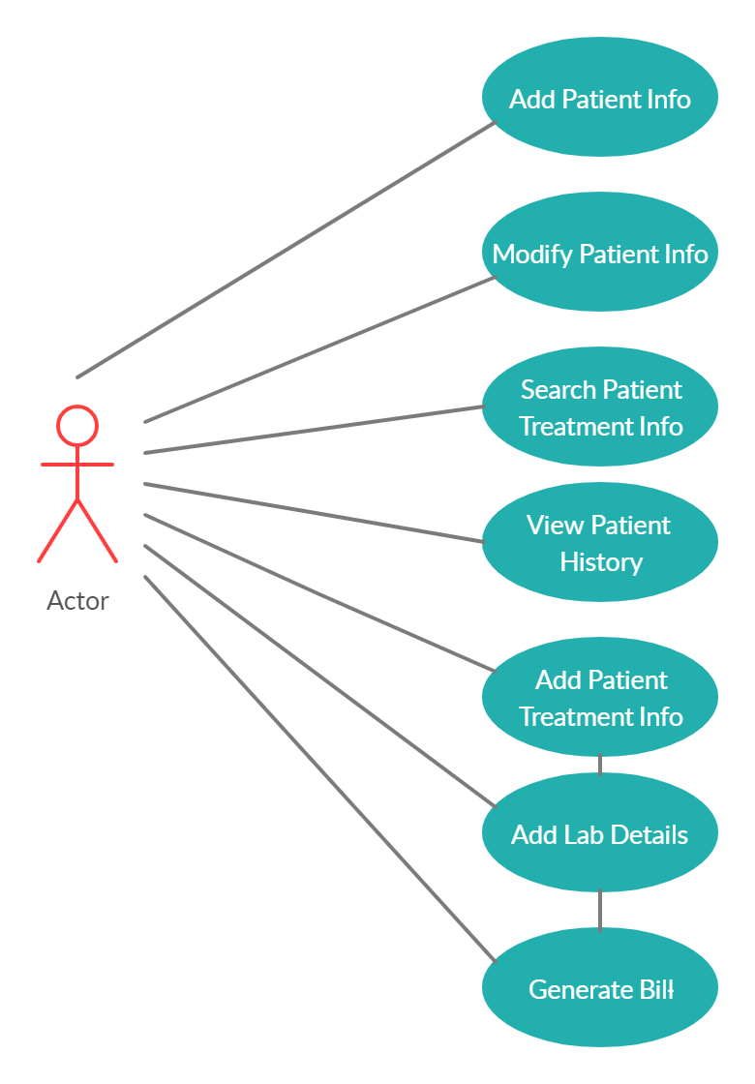
Use Case Diagram

Slide 5
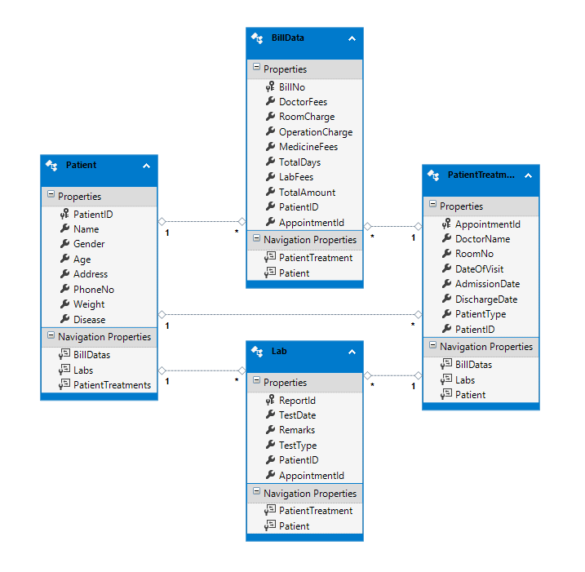
Class Diagram

Slide 6
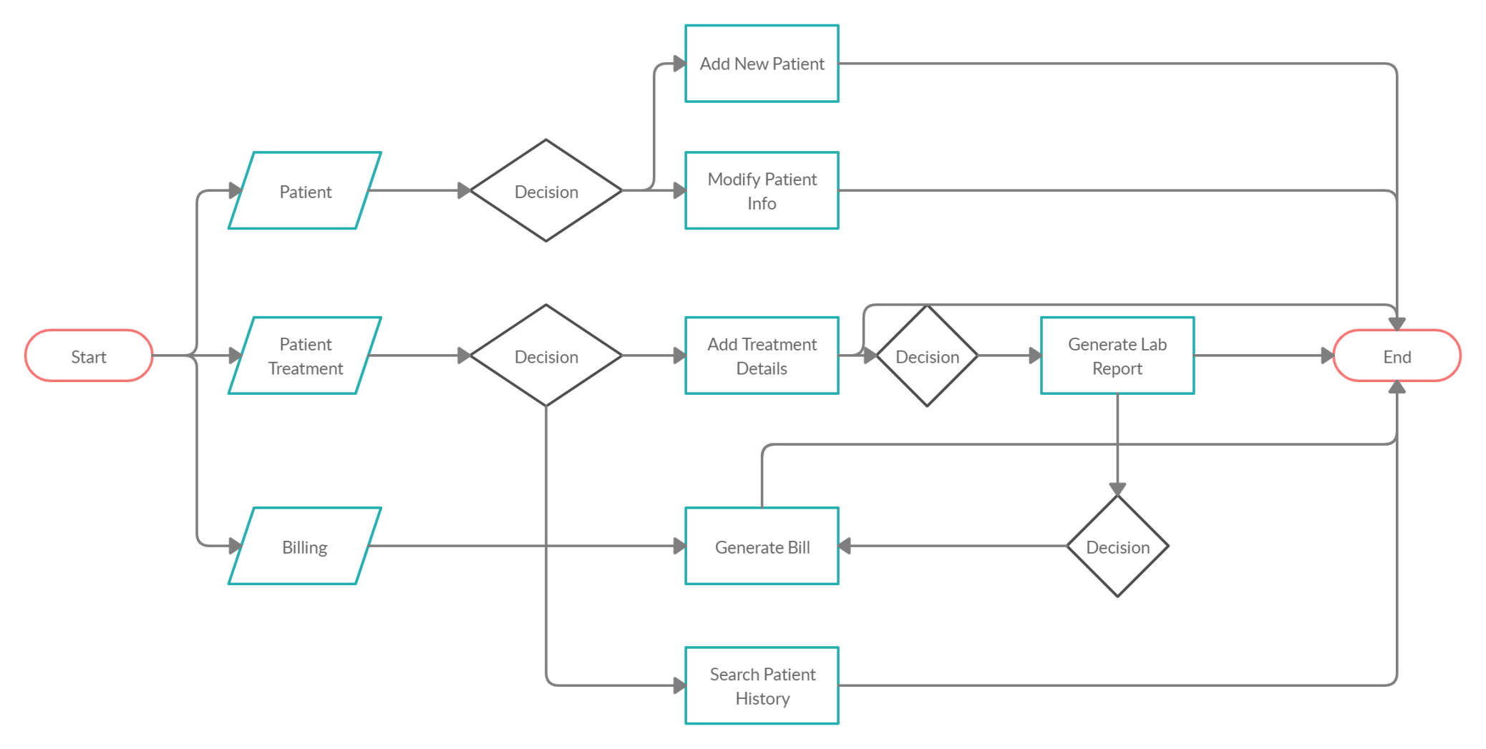
Sequence/Activity Diagram

Slide 7
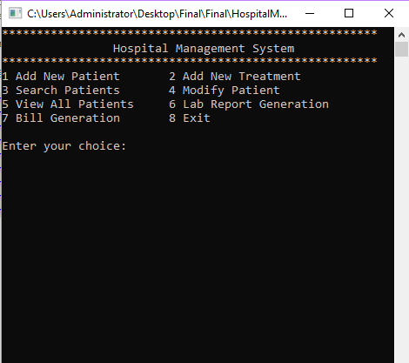
Screen shots-Console Application

Slide 8
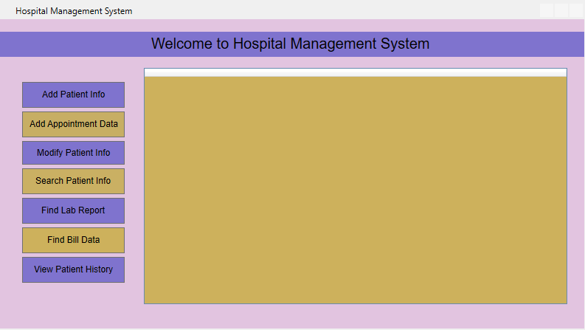
Screen shots – WPF Application

Slide 9
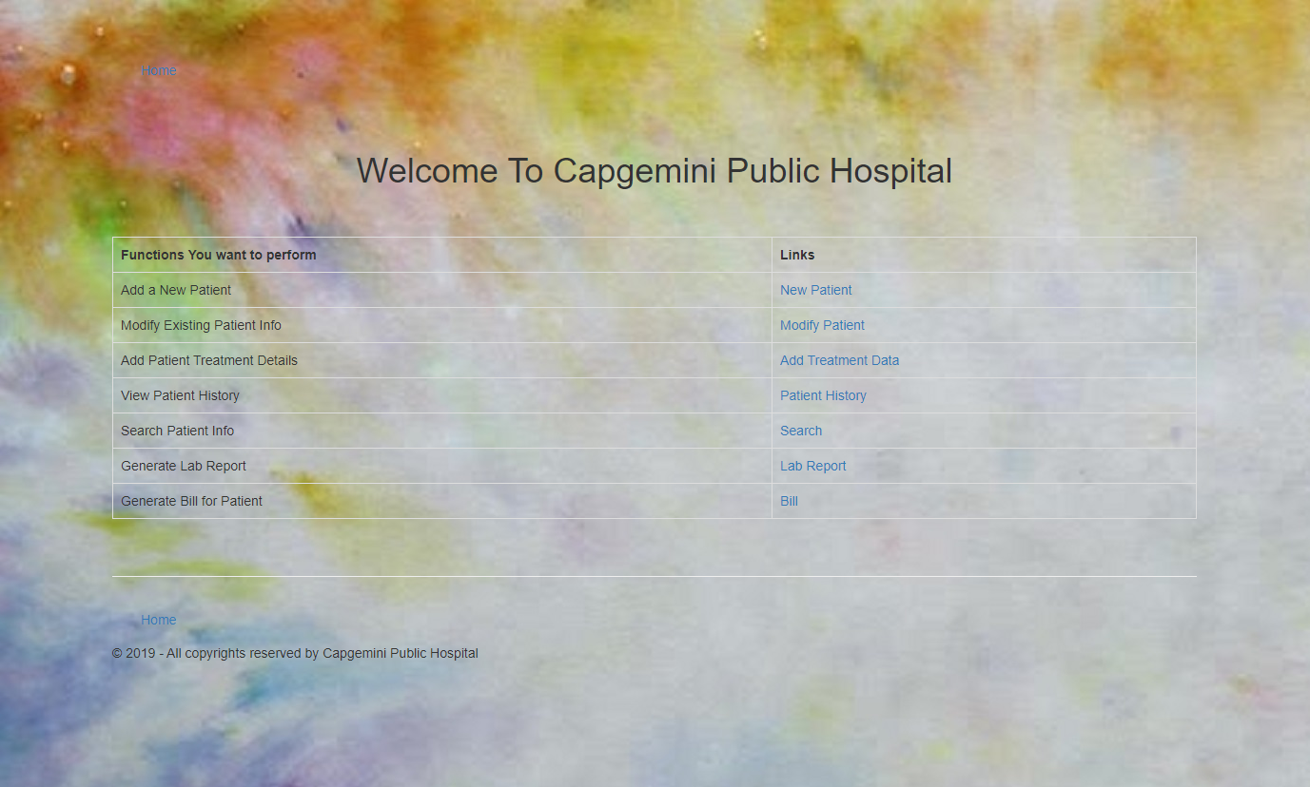
Screen shots – Web Application

Slide 10
Future Enhancements
Better validations
More efforts to UI
Adding more tightly coupled entities : Doctors, Wards, Departments etc.
Adding File I/O operations for storing data in files

Slide 11
Thank You

