Slide 1
Hereditary Disease Prediction in Eukaryote DNA
PROJECT BY:
SAI MOHITH CHINNARI (1604-18-735-086)
DARAPANENI ANUTHAM SIVA KRISHNA(1604-18-735-083)
MOHAMMAD RIAZ (1604-18-735-079)
UNDER THE GUIDANCE OF:
MRS.G.PRASHANTHI
Assistant Professor, ECED
MJCET, Hyderabad

Slide 2
Overview
Introduction and application areas.
Literature survey
Design objective
Methodology
Block diagram and its explanation
Project Time Line Diagram
References

Slide 3
Introduction:
DNA Structure
Signal Processing

Slide 4
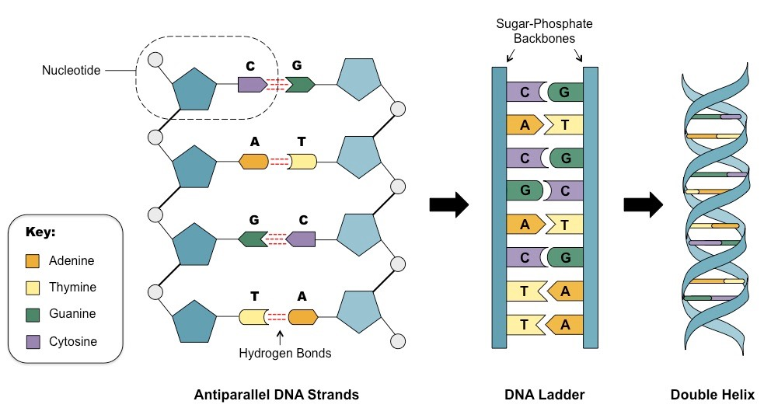
DNA STRUCTURE:
1

Slide 5
Signal Processing:
Signal processing condenses measurements to extract information about some distant state of nature. Signal processing can be described from different perspectives. To an acoustician, it is a tool to turn measured signals into useful information.
2

Slide 6
Application Areas:
Disease prediction
Cluster analysis
Pattern Recognition
Data compression
Database

Slide 7
Problems in proposed area:
The existing clinical detection techniques of disease genes are rather insufficient in terms of accuracy concern, cost, time consumption.
Algorithms such as Multilayer perceptron(MLP) have greater accuracy but have a slow rate of convergence and high computational price.
Performance issues.

Slide 8
Literature Survey:
S.NO | PROTECT TITLE | AUTHOR | OVERVIEW
1 | Hereditary disease prediction in eukaryotic DNA: an adaptive signal processing approach | Lopamudra Das, Sarita Nanda & J.K. Das | Comparison of the diseased gene is made against the healthy ones .Disease genes are discriminated from healthy ones based on the magnitude of mean square error (MSE),which is calculated through the adaptive filter.
2 | A non-invasive cancer gene detection technique using FLANN based adaptive filter | Saikat Singha Roy, Soma Barman | Cancer genes are distinguished from healthy genes based on amount of normalized mean square error, which is estimated through adaptive filter. 131 Genes are used to train the identifier and the proposed technique successfully identifies 369 test dataset.
3 | DNA Coding Sequence Prediction | Das L , Das J K , Nanda S , Mohapatra S | The Geometric mapping technique along with Modified Gabor wavelet transform (MGWT) has been incorporated to segregate cancerous and non-cancerous gene sequences.

Slide 9
Design Objective:
Data mining techniques.
Machine learning techniques.
Adaptive signal processing approach.
Functional link artificial neural networks(FLANN) based on Adaptive filter.
Hereditary disease prediction is being tackled by:

Slide 10

Design methodology
MATLAB:
MATLAB is a programming and numeric computing platform used by millions of engineers and scientists to analyze data, develop algorithms, and create models.

Slide 11

JUPYTER NOTEBOOK
The Jupyter Notebook App is a server-client application that allows editing and running notebook documents via a web browser. The Jupyter Notebook App can be executed on a local desktop requiring no internet access (as described in this document) or can be installed on a remote server and accessed through the internet.

Slide 12
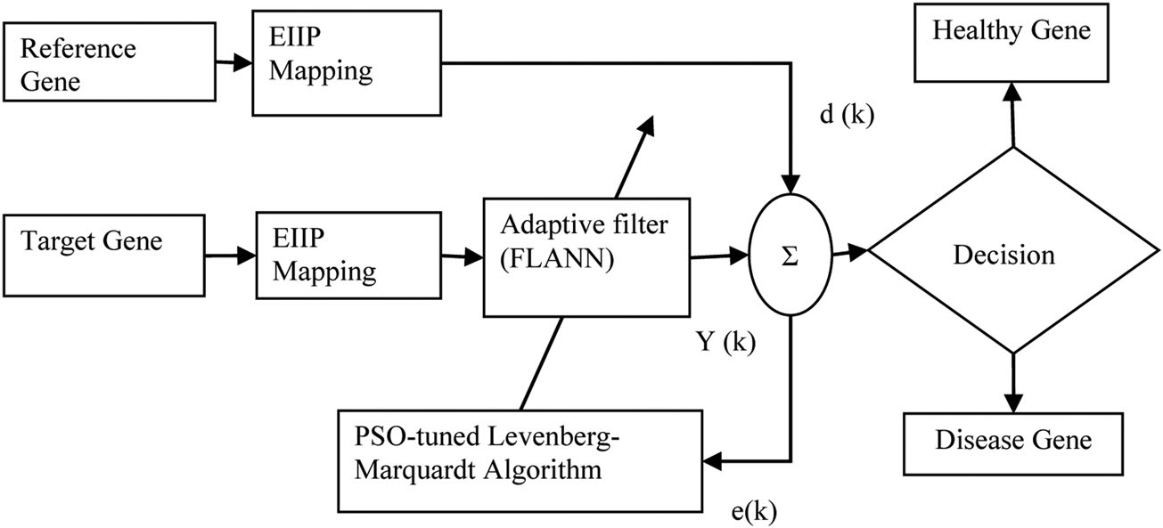
Block Diagram:

Slide 13
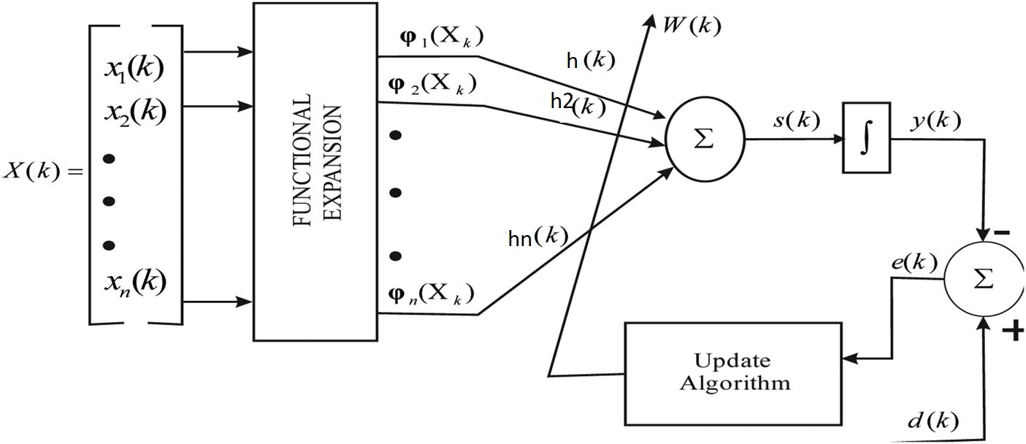

1.EIIP Mapping
Nucleotide | EIIP Value
Adenine [A] | 0.1260
Guanine [G] | 0.0806
Cytosine [C] | 0.1340
Thymine [T] | 0.1335
X[k]= [ 0.1340 0.1340 0.1260 0.1340 0.1335…….0.1340 ]

Slide 14
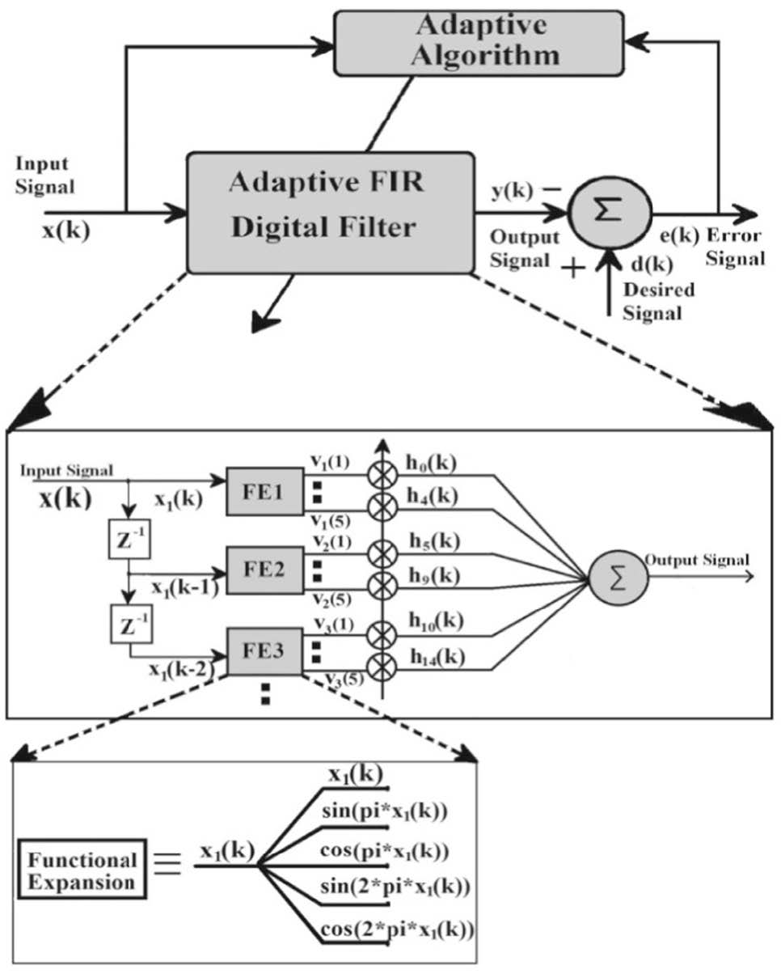
2. Adaptive Filter
x(k)= [1, sin{ax (k)}, cos {nx (k)}, sin {2nx (k)}, cos{2nx (k)}]
X(0.0806) = [1,0.25,0.9,0.48,0.87]
h(k) = [ho(k), h₁(k), h₂(k),... h2n+1(k)]^{T}
Hence the estimated output of the identification model is computed as:
y(k)= v(k) h(k)

Slide 15
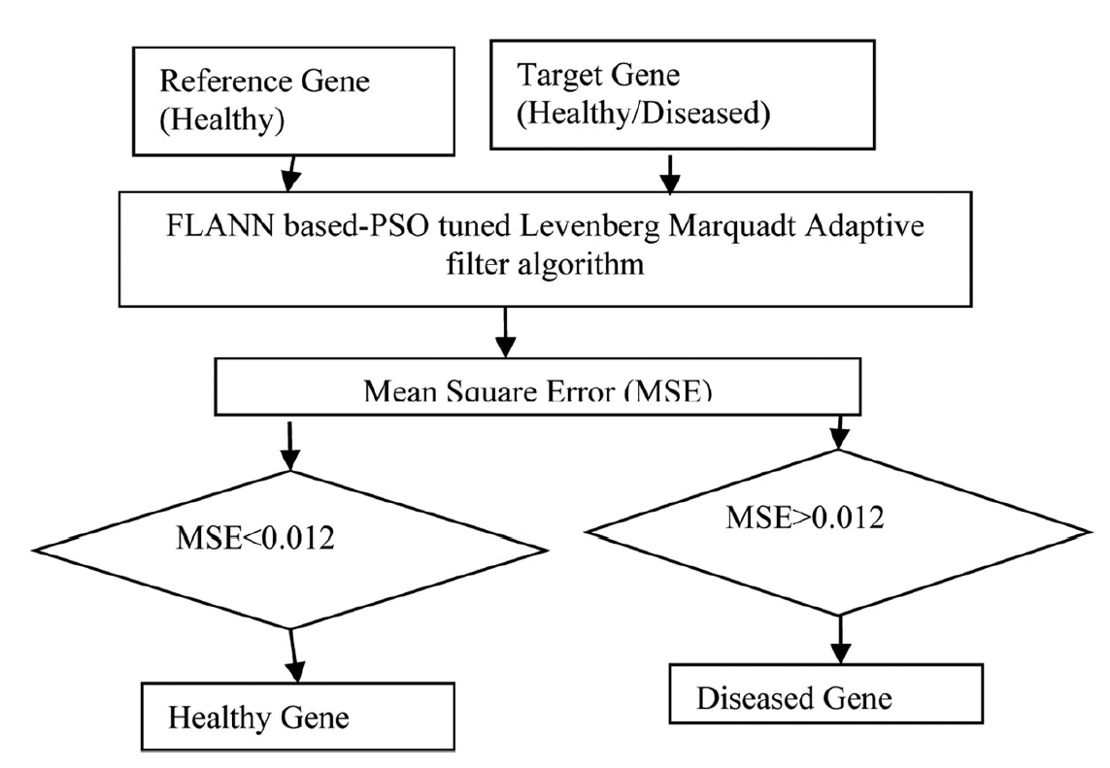

3.Mean Square Error:
e(k) = d(k) – y(k)
d(k) = h(k) * x(k)

Slide 16
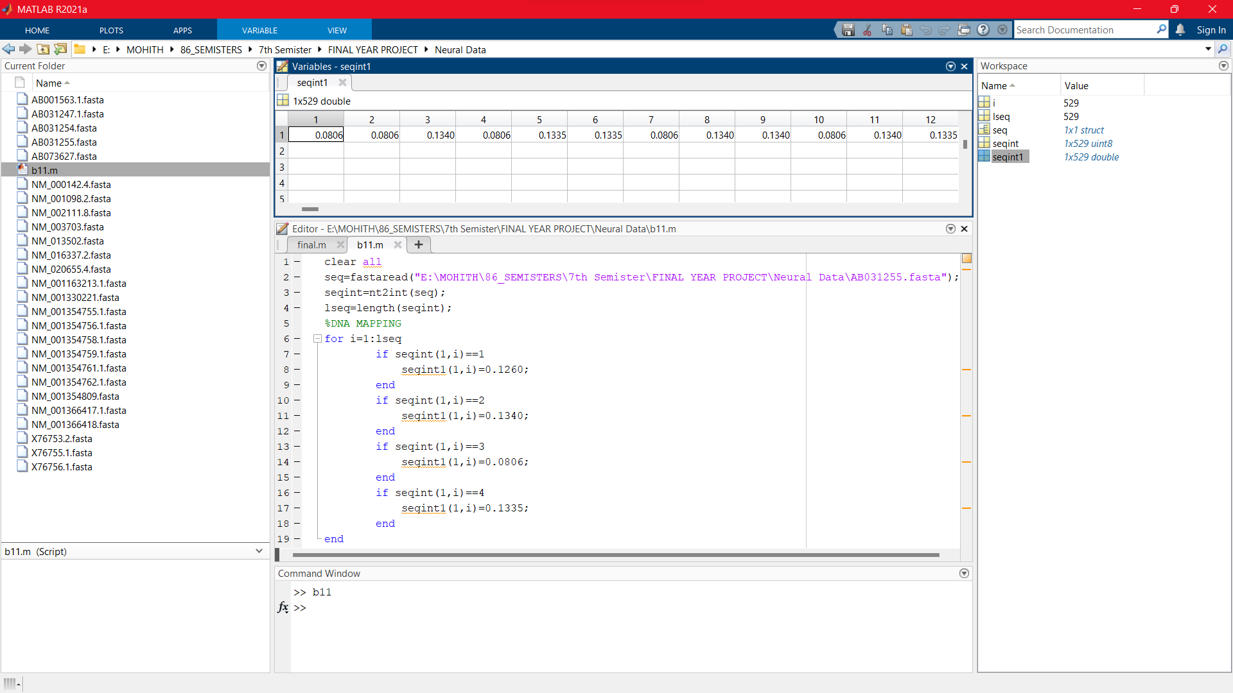
SIMULATION: 1.EIIP MAPPING

Slide 17
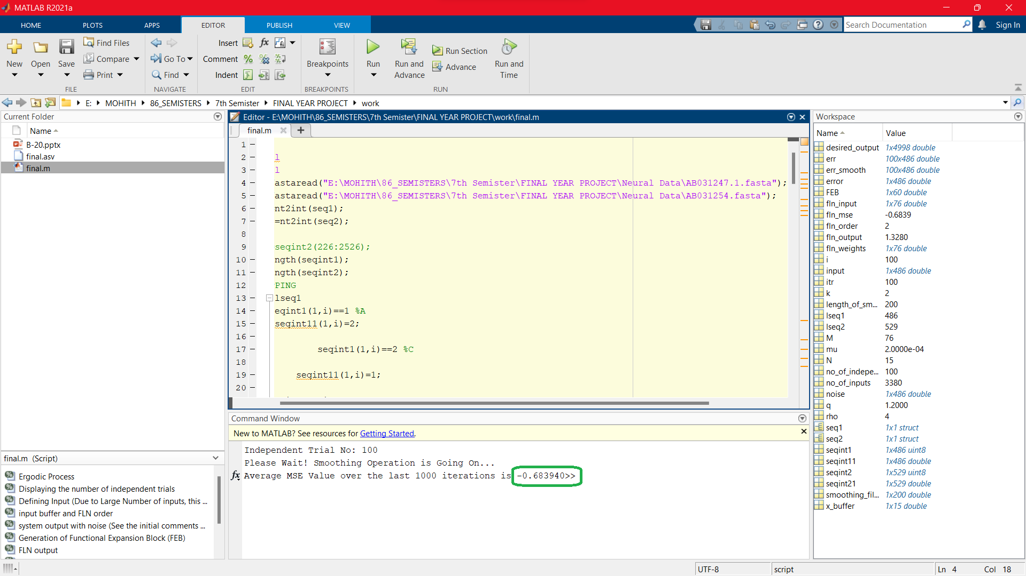
2.Healthy Gene:

Slide 18
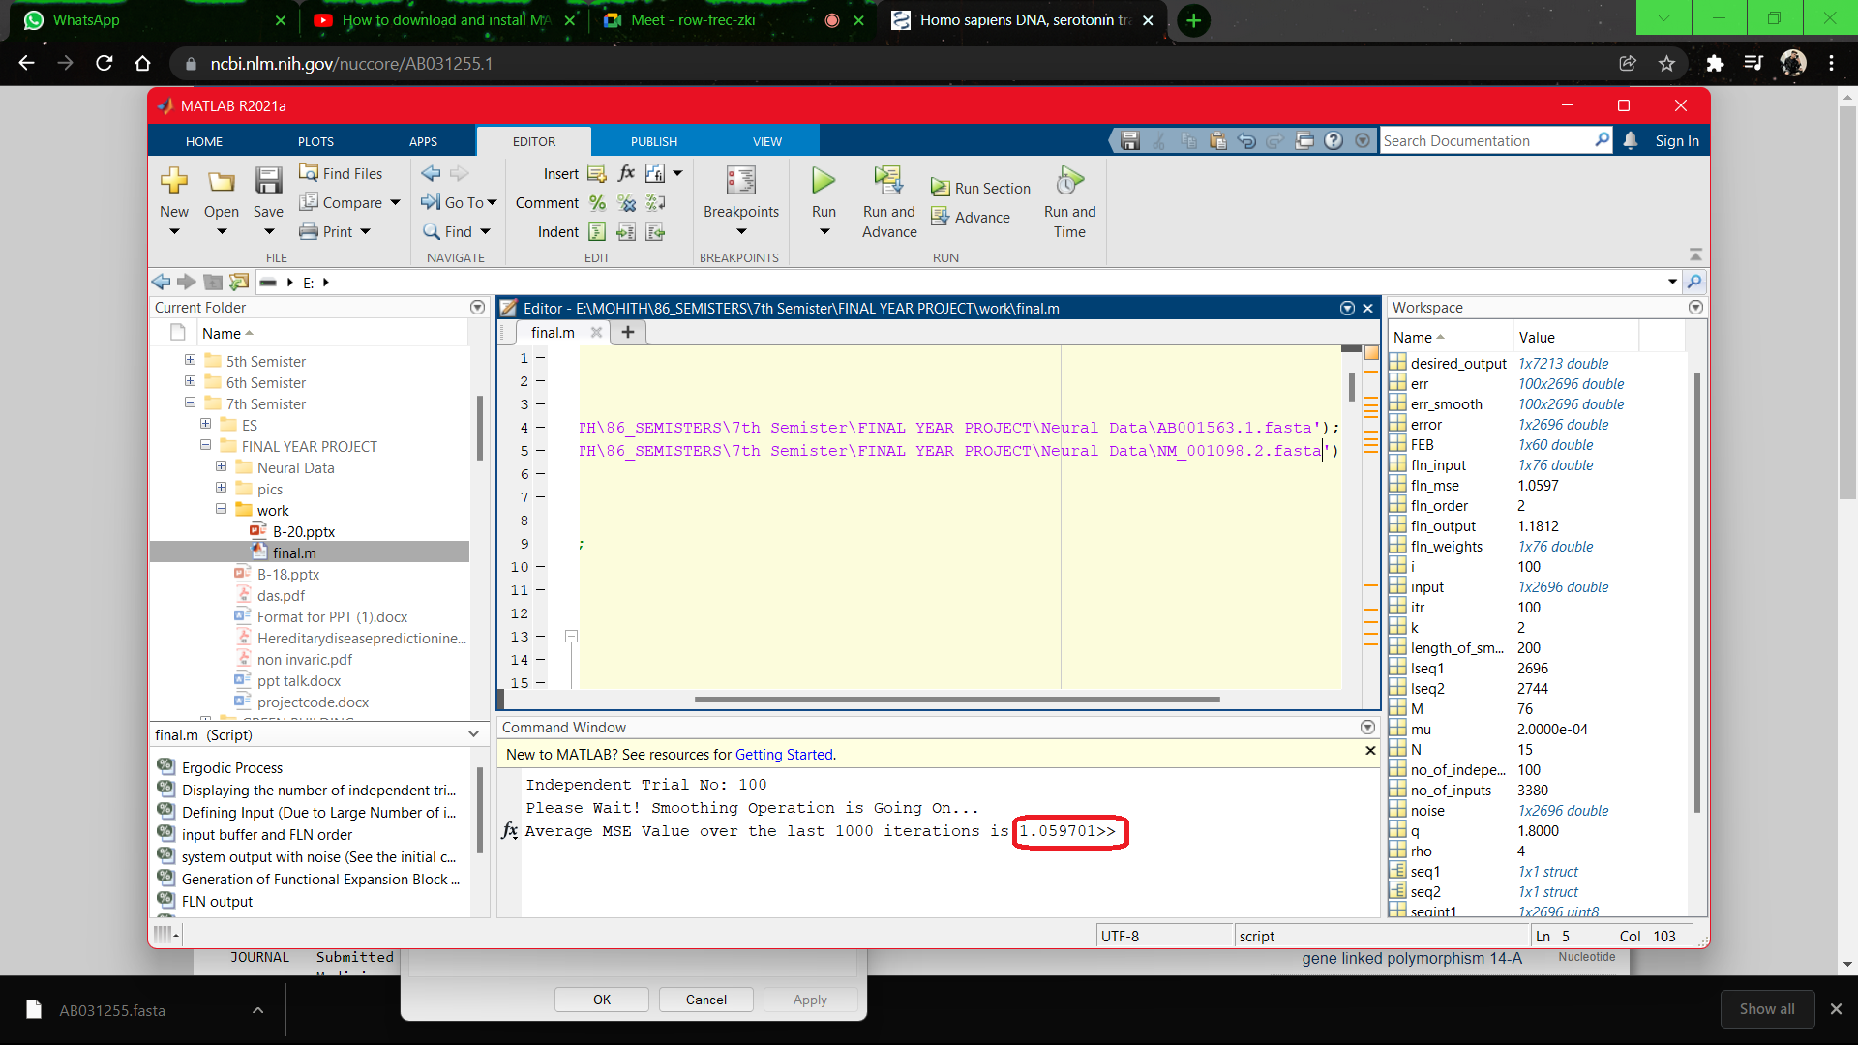
3.Diseased Gene

Slide 19
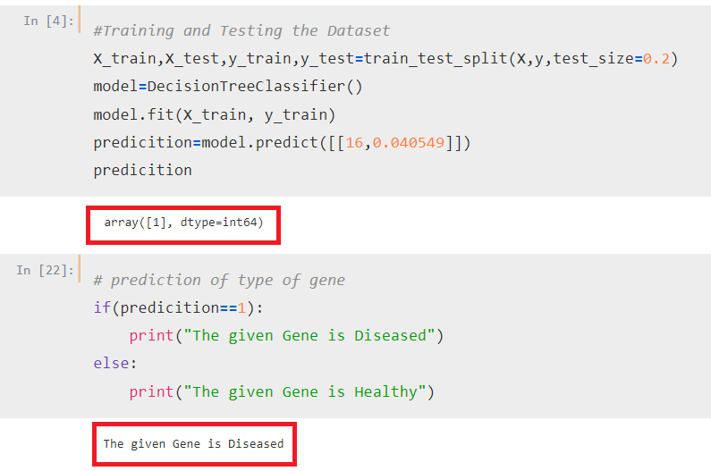
4.Machine Learning Outputs:
Diseased Gene

Slide 20
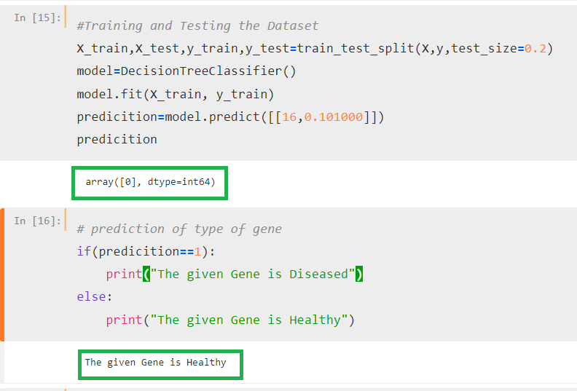
Healthy Gene

Slide 21
Project Timing Diagram:
S.NO | DATE | PLANNED WORK
1 | 10 – 11 – 2021 | Study of DNA structure
2 | 17 – 11 – 2021 | Study of Research Papers
3 | 24 – 11 – 2021 | EIIP Mapping Calculations
4 | 8 – 12 – 2021 | Working with Adaptive Filter
5 | 15 – 01 – 2022 | EIIP Mapping Simulation
6 | 4 – 02 – 2022 | Simulation of MSE
7 | 10 – 02 – 2022 | Creating MSE Dataset
8 | 26 – 03 – 2022 | Understanding Machine Learning
9 | 2 – 04 – 2022 | Implementation of Machine learning Code
10 | 15 – 04 – 2022 | Identification of Type of Gene

Slide 22
References:
Ross, C. A.; Tabrizi, S. J. Huntington’s Disease: From Molecular Pathogenesis to Clinical Treatment. Lancet Neurol.
Ambrose, C. M.; Duyao, M. P.; Barnes, G.; Bates, G. P.; Lin, C. S.; Srinidhi, J;Baxendale, S; Hummerich, H; Lehrach, H.; Altherr, M; et al. Structure and Expression of the Huntington’s Disease Gene: Evidence Against Simple Inactivation due to an Expanded CAG Repeat. Somat. Cell Mol. Genet.
Akhtar, M.; Epps, J.; Ambikairajah, E. Signal Processing in Sequence Analysis Advances in Eukaryotic Gene Prediction. IEEE J. Sel. Top. Signal Process.
https://www.ncbi.nlm.nih.gov/nucleotide/

Slide 23

THANK YOU

