Slide 1
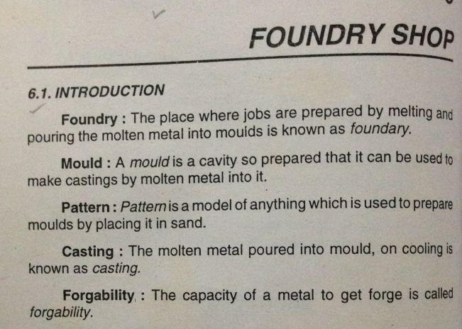
FOUNDRY SHOP

Slide 2
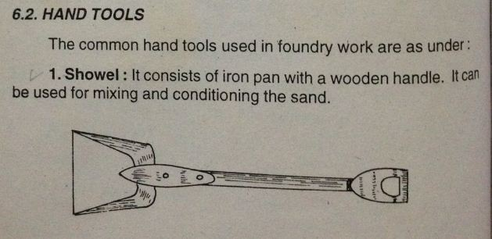
FOUNDRY SHOP

Slide 3
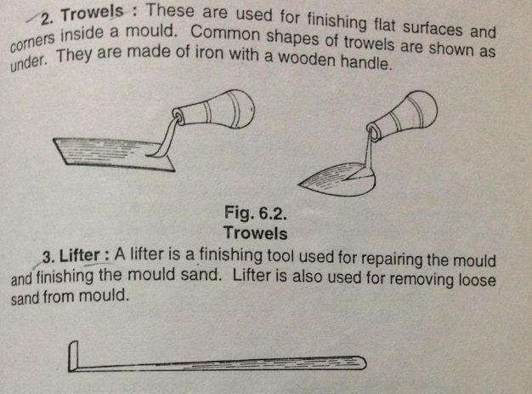
FOUNDRY SHOP

Slide 4
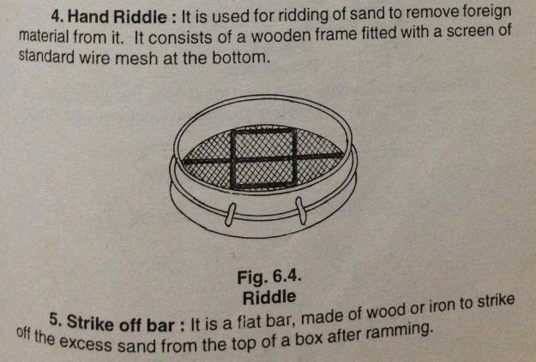
FOUNDRY SHOP

Slide 5
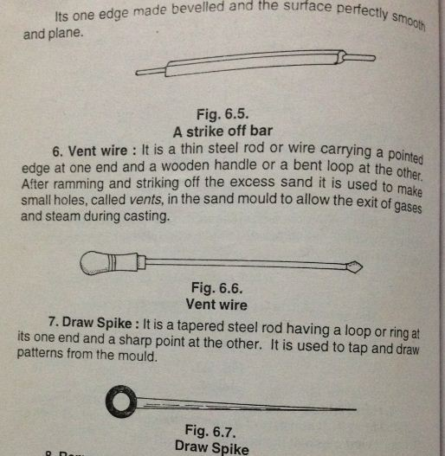
FOUNDRY SHOP

Slide 6
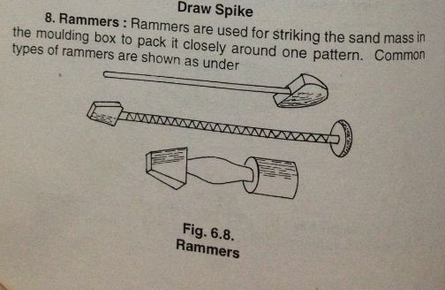
FOUNDRY SHOP

Slide 7
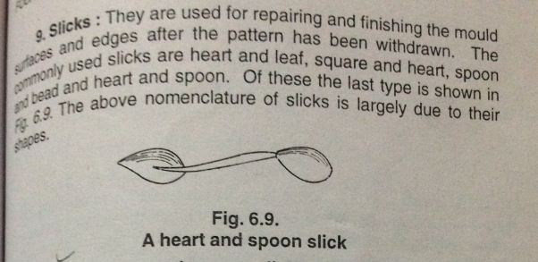
FOUNDRY SHOP

Slide 8
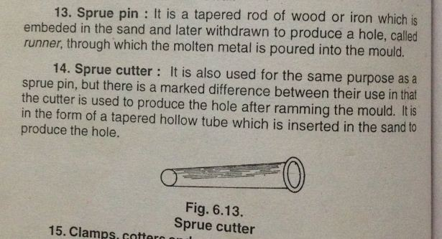
FOUNDRY SHOP

Slide 9
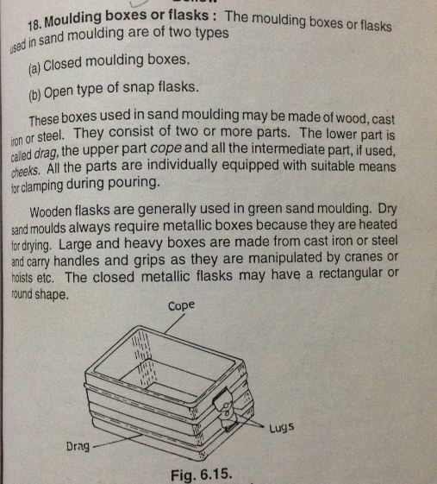
FOUNDRY SHOP

Slide 10
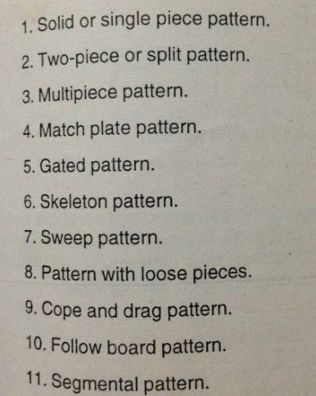
TYPES OF PATTERN

Slide 11
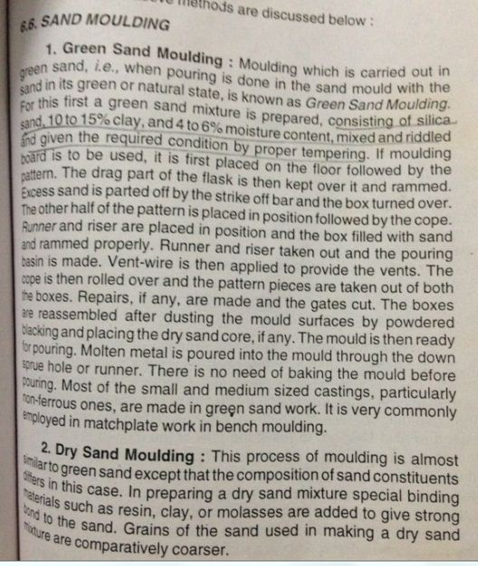
FOUNDRY SHOP

Slide 12
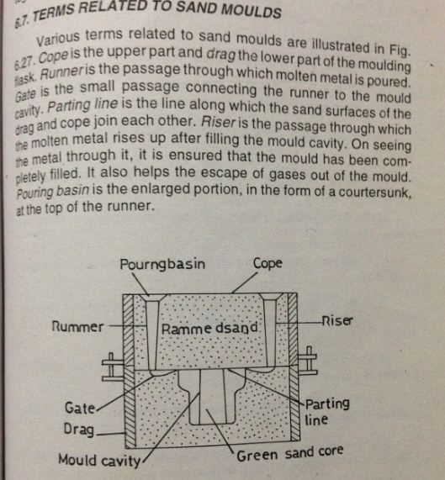
FOUNDRY SHOP

Slide 13
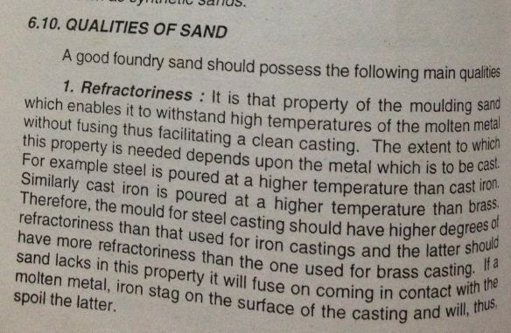
FOUNDRY SHOP

Slide 14
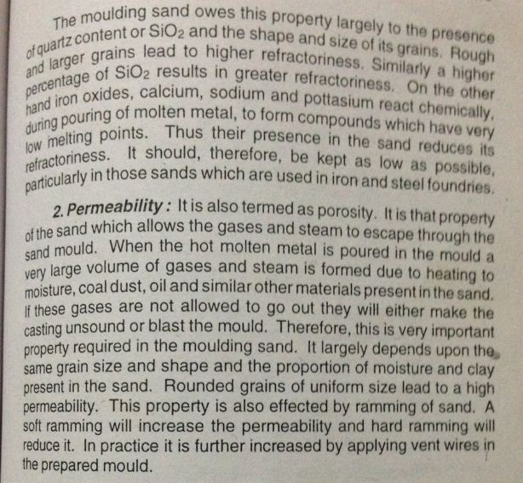
FOUNDRY SHOP

Slide 15
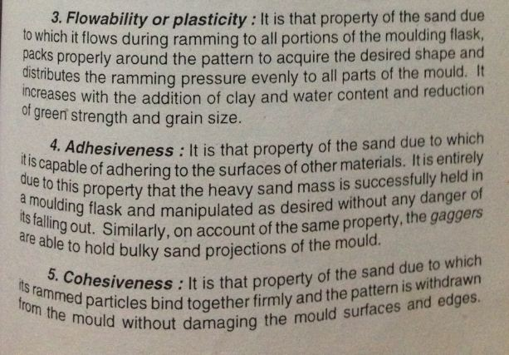
FOUNDRY SHOP

Slide 16
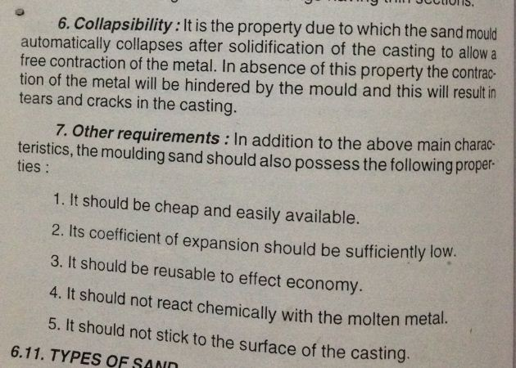
FOUNDRY SHOP

Slide 17
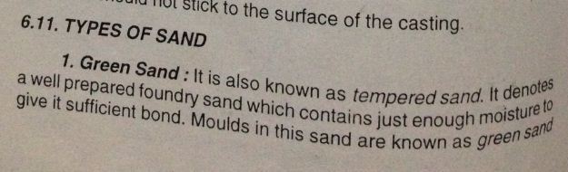
FOUNDRY SHOP

Slide 18
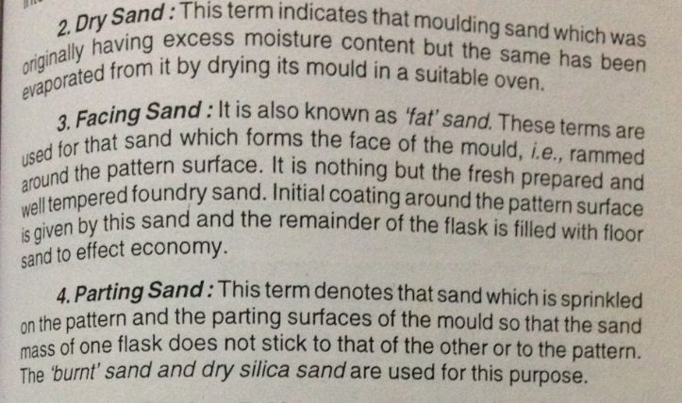
FOUNDRY SHOP

Slide 19
CONSTITUENTS OF SAND
SILICA SAND – 70 – 80 %
CLAY SAND – 10-15 %
BENTONITE – 4-6 &
WATER – 2-4 %

