Slide 1
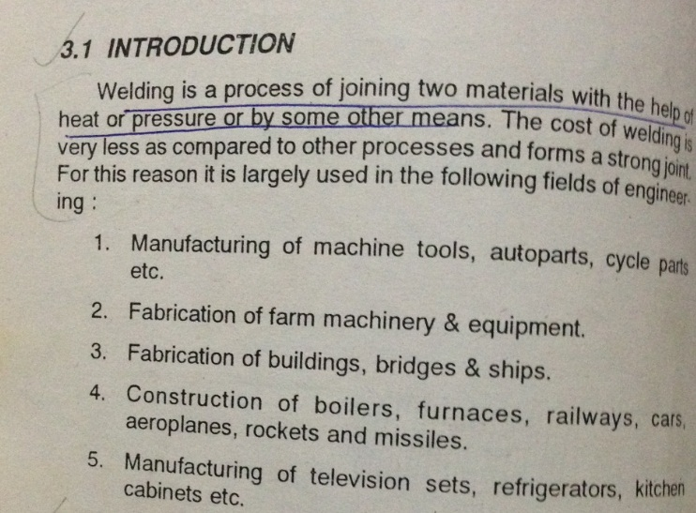
WELDING SHOP

Slide 2
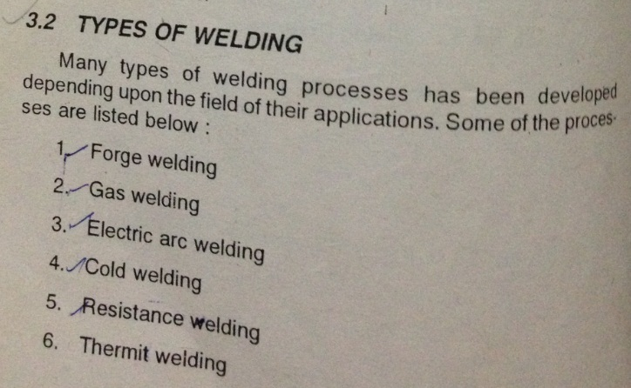
WELDING SHOP

Slide 3
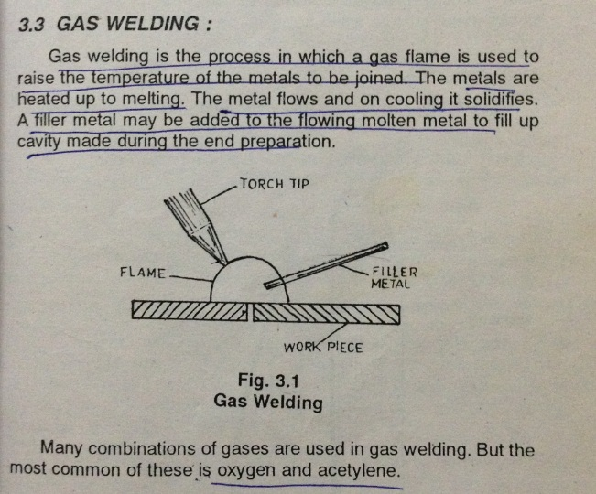
WELDING SHOP

Slide 4
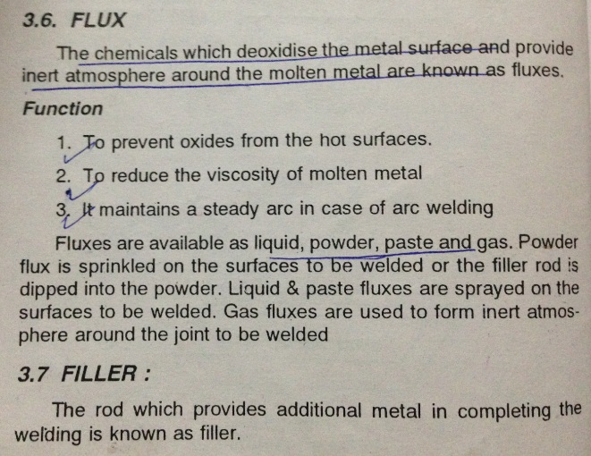
WELDING SHOP

Slide 5
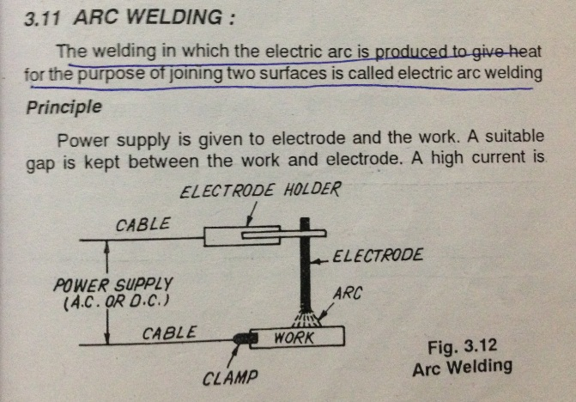
WELDING SHOP

Slide 6
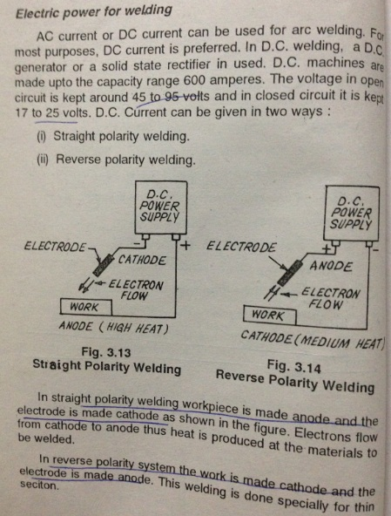
WELDING SHOP

Slide 7
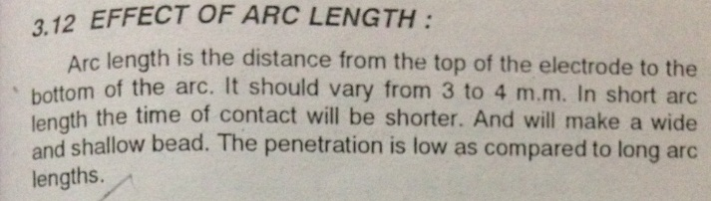
WELDING SHOP

Slide 8
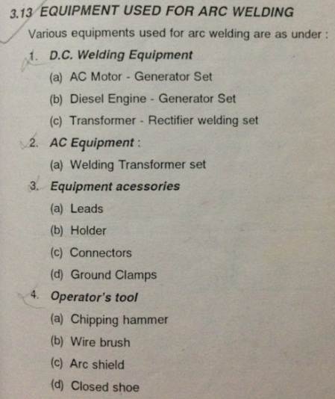
WELDING SHOP

Slide 9
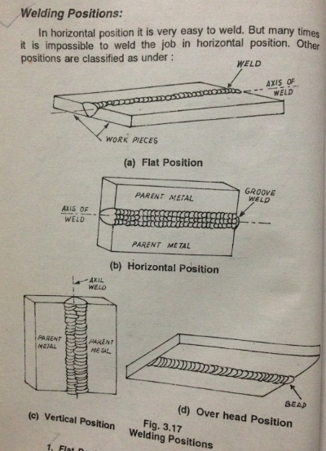
WELDING SHOP

Slide 10
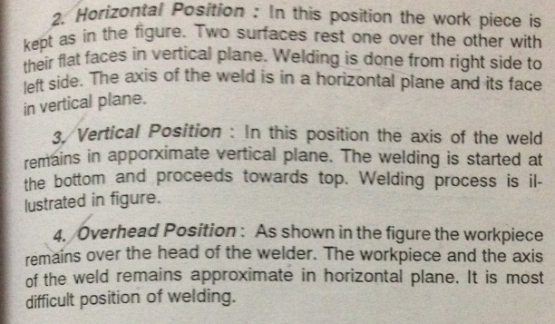
WELDING SHOP

Slide 11
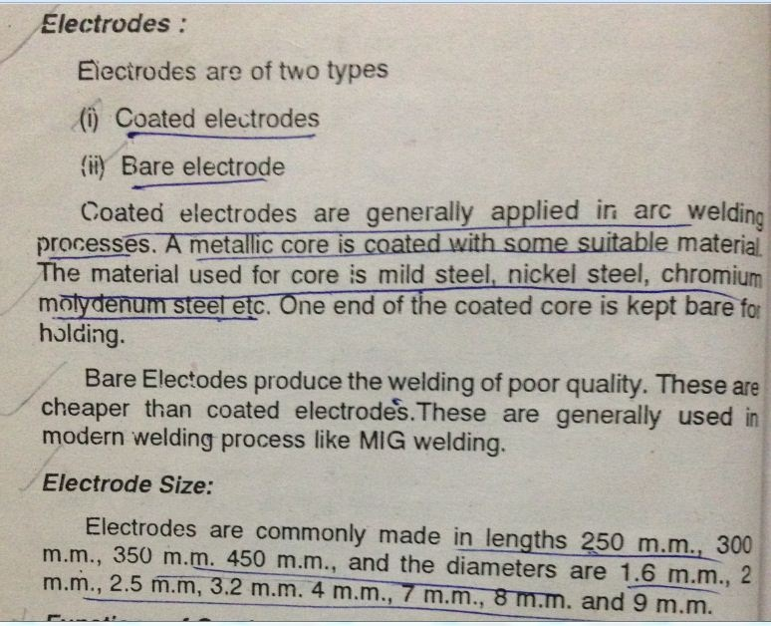
WELDING SHOP

Slide 12
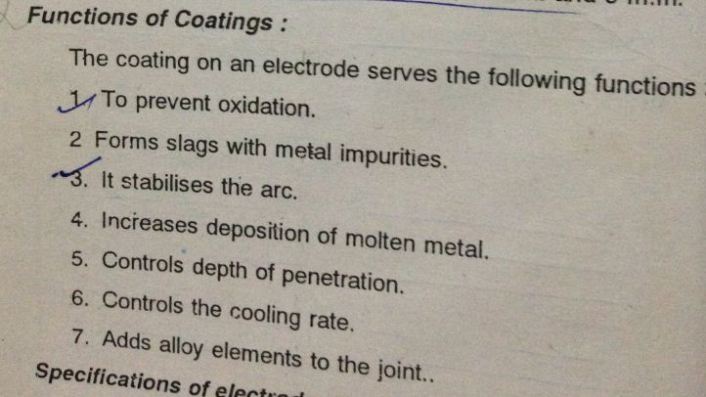
WELDING SHOP

Slide 13
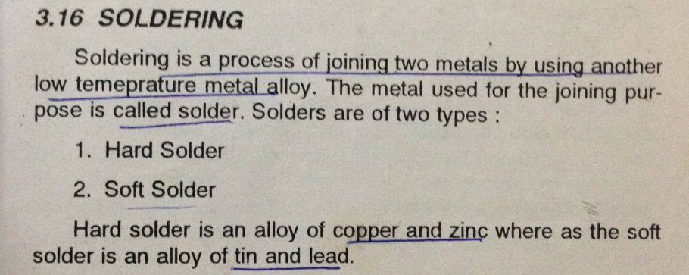
WELDING SHOP

Slide 14
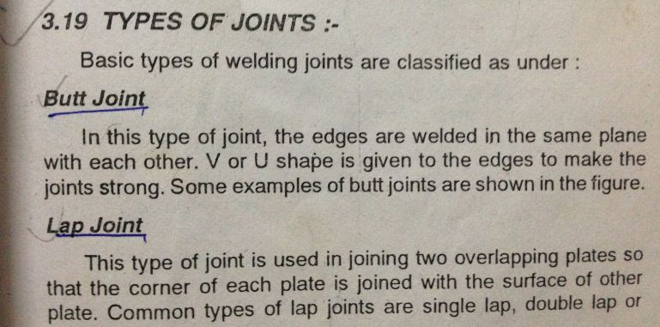
WELDING SHOP

Slide 15
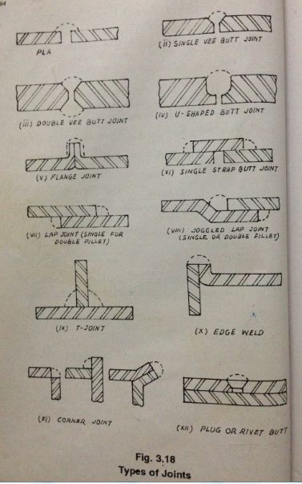
WELDING SHOP

Slide 16
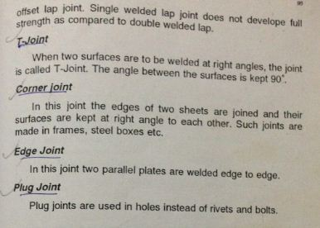
WELDING SHOP

Slide 17
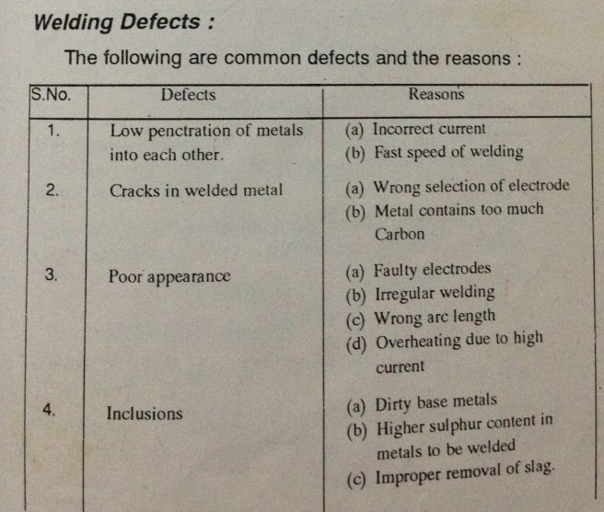
WELDING SHOP

