Slide 1
Project Title:
AMS Solar Energy Prediction Contest
Evaluation - I
Himank Jain(MT2021054)
Lakshmi Hegde(MT2021072)

Slide 2
Problem Statement:
Renewable energy sources, such as solar and wind, offer many environmental advantages over fossil fuels for electricity generation, but the energy produced by them fluctuates with changing weather conditions. Electric utility companies need accurate forecasts of energy production in order to have the right balance of renewable and fossil fuels available. Goal of this project is to discover which statistical and machine learning techniques provide the best short term predictions of solar energy production.

Slide 3
Data format:
Training data:
The total data for each of the model variables , are stored in a multidimensional array , in netCDF4 files. Each netCDF file contains the latitude-longitude grid and timestamp values as well as metadata listing the full names of each variable and the associated units.
train.csv contains the total daily incoming solar energy in at 98 Oklahoma Mesonet sites that have been in continuous operation since January 1, 1994.

Slide 4
station_info.csv contains the latitude, longitudes, and elevation (meters) of each Mesonet station.
Target:predict the total daily incoming solar energy at 6 Oklahoma Mesonet sites namely HINT, IDAB, SLAP, WEST, BESS and ACME

Slide 5
Preprocessing
Training data:
Model variables data is stored in netCDF4 file. There are 15 model variables. Each netCDF4 file, holds the grids , for each ensemble member, at every time step.
For each of the 6 target stations, we have chosen precipitation variable, from each variable data, as it involves all the dimensions.
Data comes from 11 ensemble members, at 3 hour increments . We have averaged out the data, at different forecast hour, over all ensemble members.

Slide 6
Contd...
Target data:
We need to predict total incoming solar energy at 6 sites, as mentioned.
We have converted the target data, in the form of , “Site-Date” i,e for each site , on each date, the corresponding solar energy is recorded.
Dealing with null values:
There are no null values in the training data.

Slide 7
Exploratory analysis
The train.csv contains 4018 rows and labels for 98 stations. We only use the 6 stations required for the this contest. The train data converted is to the format ‘station-date’ format.
df_stations contains lat,long values for each station which are used to map stations to the grid positions
Each nc file corresponds to a predictor in which the precipitation array has shape : [5113,11,5,9,16].
The 5113 rows are from 1994 to 2007. for training we only use from 1994 to 2004.

Slide 8
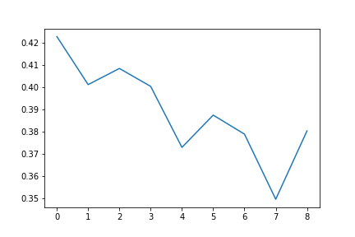
Contd….
Precipitatoin Vs Latititude
The average precipitation decreases with increase in latitude

Slide 9
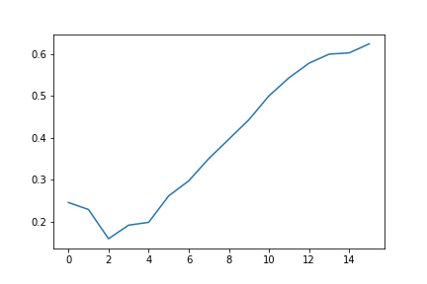
Contd…
Longitude vs Precipitation
Precipitation on average seems to increase on average with increase in longitude.

Slide 10
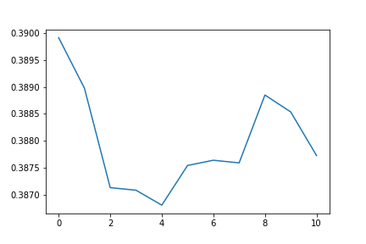
Contd..
Ensembler vs Precipitation
The 1st ensembler on average reports large values of precipitation while ensemble 5th reports less.

Slide 11
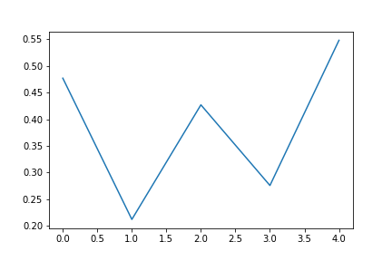
Contd….
Hour vs Precipitation
Precipitation seems to be higher on first and last recorded hours while lower on 2nd and 4th hours.

Slide 12
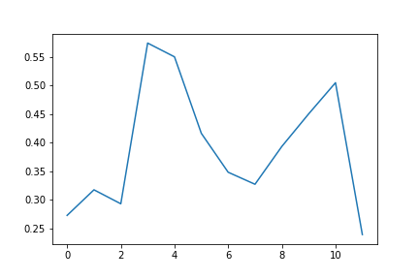
Contd…
Month vs Precipitation
The precipitation varies drastically with month

Slide 13
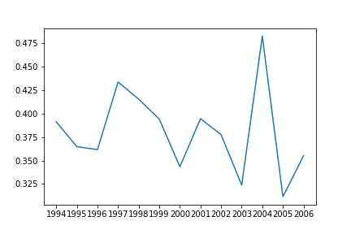
Contd…
Year vs Precipitation
There seems to be a peek in precipitation in 2004 and a sudden drop the following year in 2005.

Slide 14
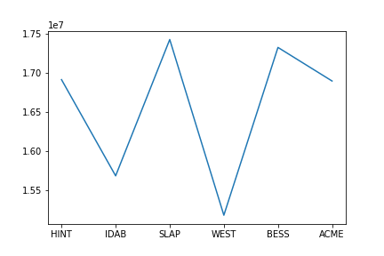
Contd…
Station vs Expected Energy
The average expected energy in each station seems to vary largely. This is probably due to their relative position with respect to each other.

Slide 15
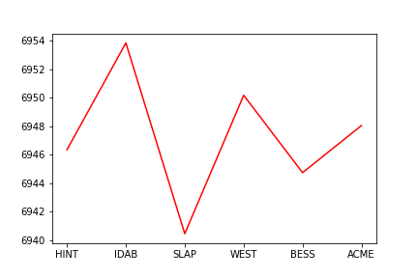
Contd…
Station vs Precipitation
Interesting….. There seems to be some trend which is contradicting the previous plot.

Slide 16
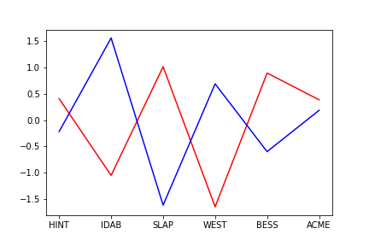
Contd…
Precipitation vs Energy
The expected energy for a station seems to be inversely proportional to its precipitation!

Slide 17
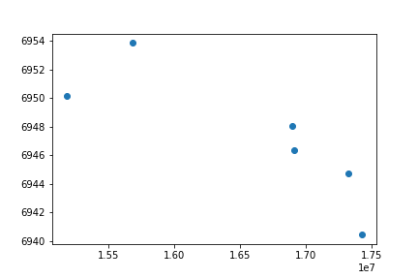
Contd…
Precipitaton vs Energy
Inverse Trend.
Infact, the correlation between average precipitation and expected energy for each station is -0.83. They are highly correlated.

Slide 18
Modelling Error(MAE):
Simple Prec mean VS Energy (Univariate) LR: 7929137
Multivariate Linear Regression: 3255361.03257
Ridge Regression: 3255344
RF: 3249814
Kernel LR: 3378505
SVR: 3338213,def(3551392)
GBR: 3236471
XGB: 3174168, def(3286766)

Slide 19
Final Results:
The best results (Least MAE) in public data set were obtained by using XGB
3174168

