Slide 1
Sentiment Analysis of Demonetisation
Details: Find out the views of different people on the demonetisation by analysing the tweets from twitter. Use the Twitter API to extract all tweets related to demonetisation in India by using appropriate filters. Divide each tweet text into words to calculate the sentiment of the whole tweet. Rate the word as per its meaning from +5 to -5 using the dictionary AFINN. The AFINN is a dictionary which consists of 2500 words which are rated from +5 to -5 depending on their meaning.

Slide 2
Now, you have to generate a sentiment rating for each tweet. After that, perform the sentiment analysis by filtering out positive sentiment tweets from negative sentiment tweets. Finally, provide a conclusion whether based on twitter data, the general sentiment is in favour of demonetisation or against, and by how much. You can provide insights on following parameters: Is the overall sentiment positive or negative? Is the latest sentiment positive or negative? When were the peak positive sentiment levels? When were the lowest negative sentiment levels? Who were the 5 biggest positive sentiment influencers? Who were the 5 biggest negative sentiment influencers? Ask more questions like these which can be answered by this dataset and then find answers to them. Finally present them using graphs and visualisations.

Slide 3
Total number of tweets collected : 2541.
The data is collected between 26-06-2018 00:04:32 and 29-06-2018 12:26:05.
No. of positive sentiment tweets : 446.
No. of negative sentiment tweets : 746.
Sentiment value is the normalized value of all the words in the tweet.
Overall sentiment : -275.577.
The general sentiment is against the demonetisation.
The latest tweet is given by sushantkumar91 and the sentiment value of his tweet is -0.9045.
Top 5 negative influencers :
  Niranja11092526 : -2.0
  DiazDeepan : -1.632
  Coolredwine : -1.565
  MelonAppleYT : -1.459
  Prabhakarup1 : -1.341
Top 5 positive influencers :
  Cmusholt : 2.121
  OBEROI_R_US : 2.012
  Arulpharm : 1.372
  Slmehra : 1.25
  Oshanology : 1.178

Slide 4
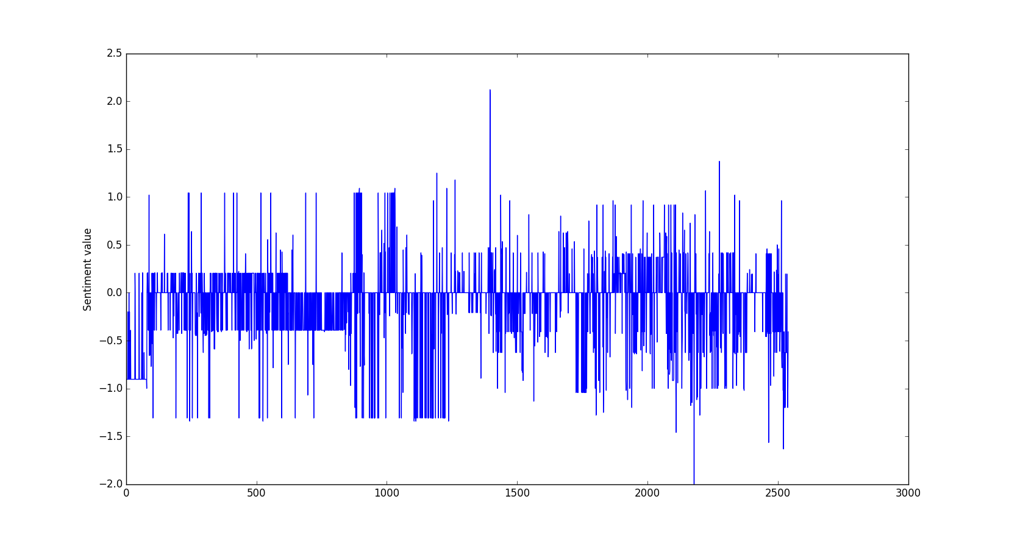

Slide 5
The highest peak is at the time : 28-06-2018 13:19:32.
The lowest peak is at the time : 26-06-2018 15:49:37.

