Slide 1


Astrosage Analysis
Mohit kumar
15-10-25

Slide 2
Introduction to Astrosage
AstroSage is a leading astrology platform offering horoscope matching, birth chart generation, and AI astrologers. It is widely used by Hindus and astrologers for making important life decisions like marriage, business, and moving to a new home.
It is known as one of the most authentic astrology sources, helping people with both daily and specialized queries through the divine science of astrology.
Founded in 2000 by Pt. Punit Pandey, AstroSage is guided by expert astrologers from different schools like KP, Lal Kitab, and Nadi to provide accurate and practical astrological insights.

Slide 3
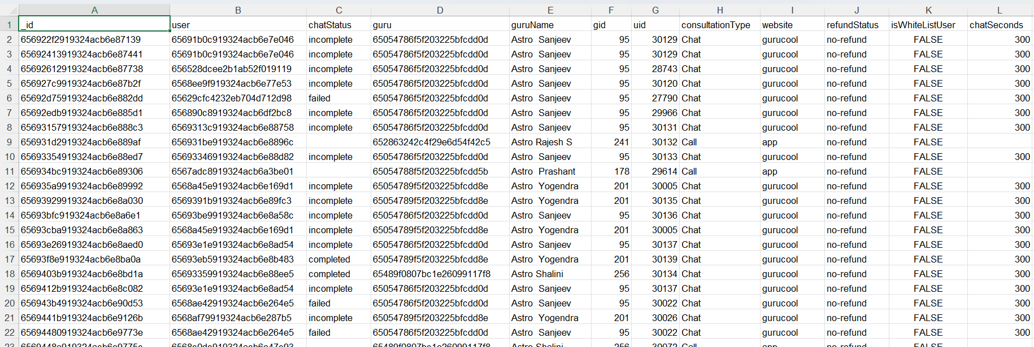
Problem Statement
AstroSage has received a 1 crore investment and aims to optimize its call center operations. The goal is to determine how to allocate this investment to maximize operational efficiency, customer satisfaction, and profitability. The analysis will consider historical call data, performance metrics, and market trends to make informed decisions.

Slide 4
ATTRIBUTES USED
_id: Unique identifier for each record.
user: User ID associated with the record.
chatStatus: Status of the chat.
guru: Unique identifier for the guru.
guruName: Name of the guru.
gid: Guru ID.
uid: User ID.
consultation Type: Type of consultation.
website: Source of the consultation.
Refund Status: Indicates if the session is refundable or not.
is WhiteList User: Boolean indicating if the user is whitelisted.
chat Seconds: Duration of the chat in seconds.
queue: Boolean indicating if the session was queued.
FreeCall: Boolean indicating if the call was free.

Slide 5
ATTRIBUTES USED
Free Chat: Boolean indicating if the chat was free.
Year: The year the account is created.
Created_Date: The date when the account is created.
Created_Time: The time when the account is created.
CreatedAT: Original creation date and time.
updatedAt: Original update date and time.
__v: Version key.
statementEntryId: Identifier for the statement entry.
chatStartTime: Start time of the chat.
chatEndTime: End time of the chat.
timeDuration: Undefined, some technical data as per app.
callChannel: Channel used for the call.

Slide 6
ATTRIBUTES USED
calIvrType: IVR type used during the call.
callStatus: Status of the call.
CallSid: Unique identifier for the call session.
amount: Amount charged for the session.
astrologerCallStatus: Status of the astrologer during the call.
astrologerOnCallDuration: Duration of the astrologer's call.
astrologersEarnings: Earnings of the astrologer from the session.
netAmount: Net amount after deductions.
region: Region of the user.
userCallStatus: Status of the user's call.
userOnCallDuration: Duration of the user's call.
rating: Rating assigned based on the session's status.

Slide 7

Data Overview
There are 4 different consultation service that AstroSage offers.
In total 149 Gurus are available.
This dataset enable us to predict and suggest future investments to grow the revenue and increase the customer satisfaction.
There 28027 consultations in which most of them are Chats and then it’s Calls.

Slide 8

Analytical approach and Tool
Data Cleaning: Used spreadsheets functions like trim and Removing duplicates for data cleaning.
Data Enrichment: Added new variables using Date functions for better analysis.
Customer Segmentation: Applied SORT and FILTER functions to classify customers based on consultant type and time duration.
Used Pivot tables to analyze the performance of consultants over different category type and ratings recieved on basis of consultations from users.
Visualization: Created dynamic charts and dashboards for data representation, enabling interactive data exploration.

Slide 9
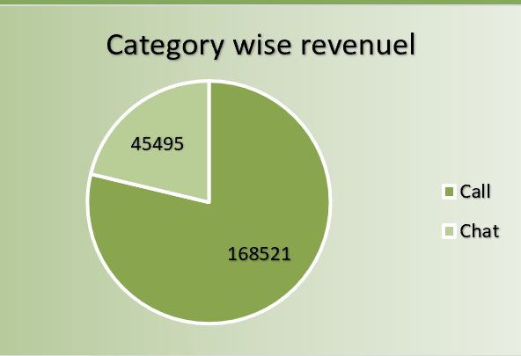
Category wise revenue
The Pie chart represents category wise revenue, which gives insights like how much each category is adding the value to the total revenue.
As we can see Call is generating more revenue then other, this also helps us to find that chat is no performing upto the required level so should focus more on it in order to increase the total revenue

Slide 10
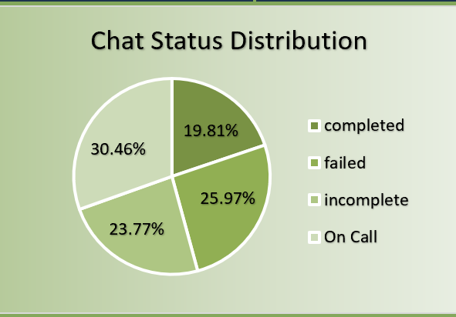
Chat Status Distribution
The Pie chart shown gives us insights about the Chat status distribution, this insight will help us to understand what is the percentage of chats are complete or not.
As we can see that only 19.81% of the chats are completed, which means around 50% are incomplete so the Astrosage must focus more on the incomplete and failed chats to increase both revenue and customer satisfaction and 30% is on the Call.

Slide 11
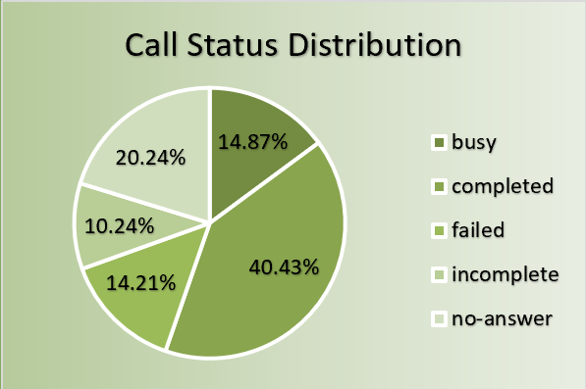
Call Status Distribution
The pie chart shows that only 40.43% of calls are completed, while nearly 60% remain incomplete.
AstroSage should focus on reducing failed and incomplete calls by improving customer handling and minimizing waiting time to boost satisfaction and revenue.

Slide 12
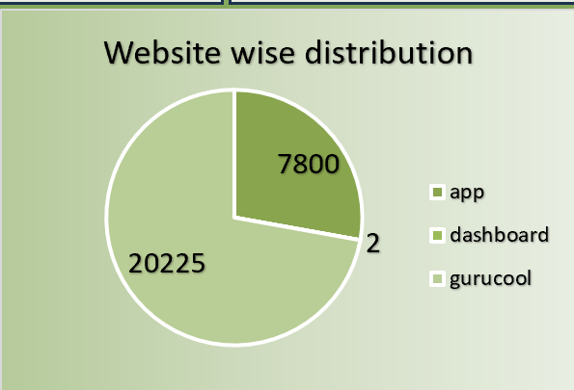
Website wise Distribution
The Website wise distribution chart shows the count of consultations through different website channels.
Most of the consultations are from the gurucool website with 20225 where as dashboard is only with 2, but we can see that app has count of 7800 so the call center can invest more on app to attract more consultations.

Slide 13
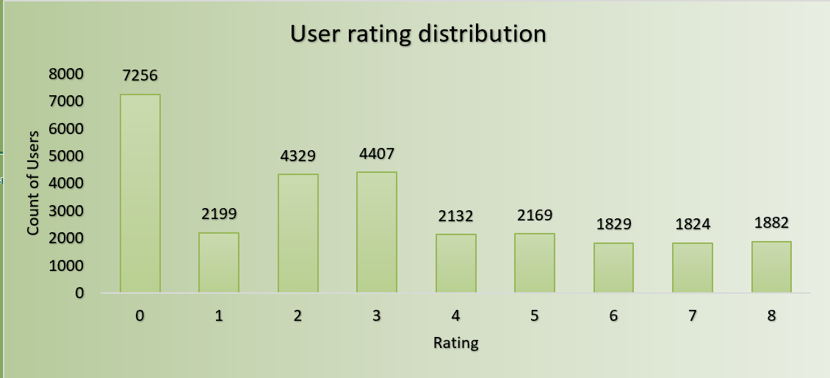
User Rating Distribution
The column chart, User rating distribution this let us know exactly what is the count of ratings for different customer satisfaction levels.
The most of the count of ratings is below 3 so the Astroguru must try to prove the best service in order to get better ratings.

Slide 14
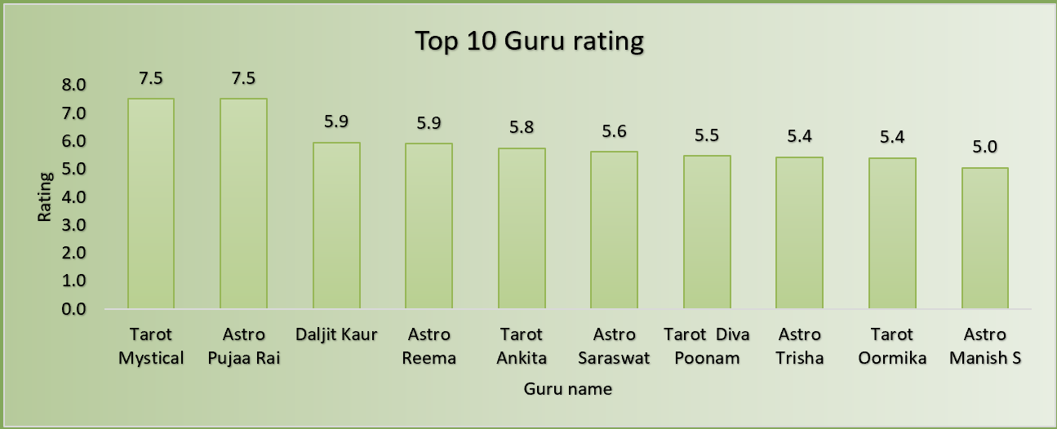
Top 10 Gurus Rating
The Top 10 Guru rating chart represents the top 10 best gurus with the highest rating then the other gurus.
This graph can be used to encourage the top gurus with bonus and increments, and can let them guild other gurus so all of them perform the best possible.

Slide 15
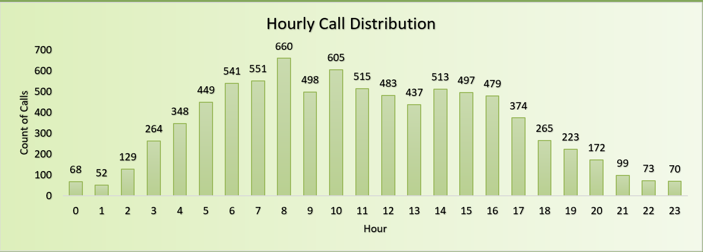
Hourly Call Distribution
The graph represents hourly call distribution. We can clearly see the peek call time is between 5 to 16.
For the better handling in the peak time it is necessary to allocate more agents and distribute the calls evenly.
Enhancing the call technology and feasible work shifts among the agents will lead to the betterment of customer satisfaction.

Slide 16
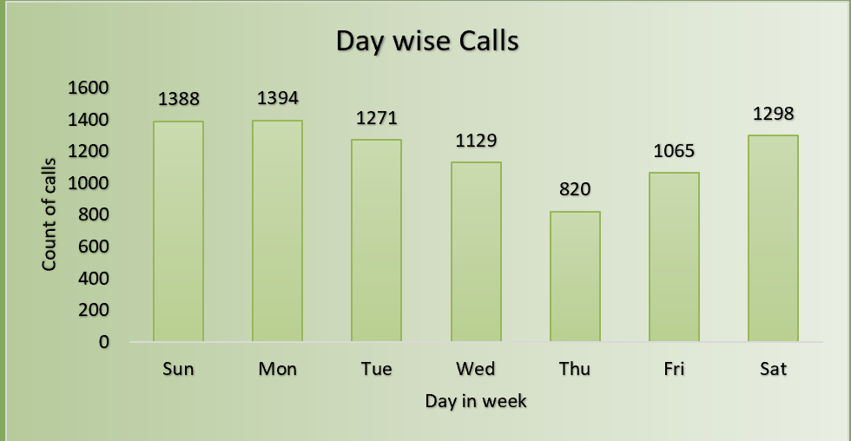
Day wise Calls
The Day wise calls graph gives insights about how many calls where received per day in a week.
The most of the calls received on Sunday and Monday, where as Thursday received the minimum calls with count of 820.

Slide 17
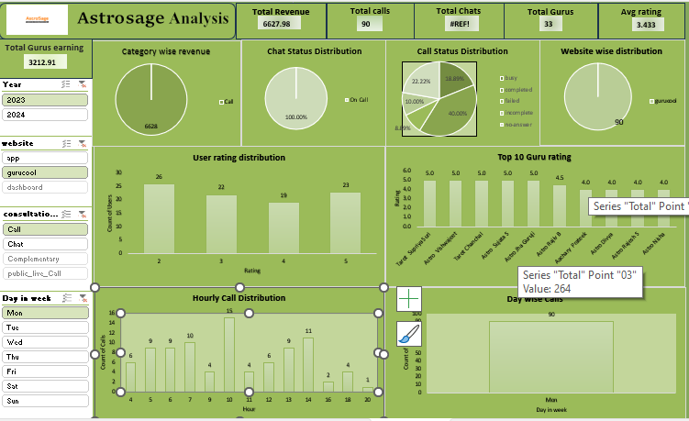
Astrosage Analysis Dashboard

Slide 18
The Dashboard consists of the following metrics
There are 6 Dynamic text fields they are Total revenue, Total calls, Total chats, Total Gurus, Average rating and Total Gurus Earnings.
There 4 visual filters they are YEAR, Website, Consultation Type, Day in week.
Pie chart of Category wise revenue.
Pie chart of Chat status distribution.
Pie chart of Call status distribution.
Pie chart of Website wise distribution.
Column chart of User rating distribution.
Column chart of Top 10 Guru rating.
Column chart of Hourly Call Distribution.
Column chart of Day wise calls.

Slide 19
Recommendations
Implement AI-powered chatbot systems to automate basic queries and reduce agent workload.
Introduce analytics dashboards (Power BI/Tableau) for real-time performance monitoring.
Hire additional part-time or full-time agents during peak call periods.
Launch automated feedback surveys post-call to measure satisfaction in real time.
Automatically directs customer calls to the most suitable agent based on issue type, sentiment, or past interactions.
Uses AI to analyse tone, sentiment, and keywords in reviews and recorded calls, Detecting frustrated or unsatisfied customers early.
Focusing on call consultations can increase revenue and customers satisfaction.
Recognizing top consultants and organizing regular training will ensure consistent service quality.

Slide 20
Conclusion
Today, we've explored the performance of AstroSage's call center, revealing valuable insights and identifying opportunities for improvement and betterment of customer satisfaction.
Our analysis has shown that AstroSage is handling large volume of users with less efficiency.
However some of the users are still not satisfied with the AstroSage services due to which average rating was very low, but we have discussed the solutions for enchancment of the AstroSage.
Implementing these recommendations will improve AstroSage's efficiency, customer satisfaction, and market competitiveness.

Slide 21


