Slide 1
MATH CLUB HACKATHON • THEME 1: ACADEMIC RELATED ISSUES / MATH & CS CROSS-OVER
Smart Exam Slot Management
Zero-Clash Timetabling via Welsh-Powell Graph Coloring & Greedy Bin-Packing
🧮 100% Conflict-Free
Mathematical guarantee via Chromatic Number χ(G) graph coloring algorithm
🏫 Real-World Spatial Packing
208 campus rooms (CB, AB1, AB2) across 130 classrooms & 78 labs
⚡ Sub-100ms Performance
Schedules 4,000+ students and 52 courses into 13 slots in milliseconds
Developed by Team Infinite Innovators | Full-Stack Implementation: Python FastAPI • Node.js Express • React 18
Notes:
Good morning respected judges and faculty! We are team Infinite Innovators, and today we present 'Smart Exam Slot Management' — an enterprise-grade academic scheduling platform designed for Theme 1: Academic Related Issues / Math & CS Cross-over.
University exam timetabling is notoriously complex: with thousands of students enrolled in diverse major and minor courses, manual scheduling invariably results in exam overlaps, student protests, and administrative gridlock. Our system merges discrete graph theory — specifically Welsh-Powell graph coloring — with spatial greedy bin-packing to mathematically guarantee zero exam clashes, minimize the total exam period, and assign every student to an exact campus classroom in under 100 milliseconds.

Slide 2
■ CONTEXT & PAIN POINTS
The University Exam Timetabling Crisis
Why manual and naive spreadsheet scheduling fails at modern collegiate scale
1. Cross-Disciplinary Clashes
With interdisciplinary electives, minors, and open credits (e.g. CSE students taking Advanced Calculus or Physics minors), students are frequently assigned two or three exams in the same time slot, leading to stress, clashes, and rescheduling chaos.
2. Campus Resource Fragmentation
Colleges operate hundreds of classrooms and labs across multiple multi-story blocks. Without algorithmic spatial packing, examination halls are either overbooked or severely underutilized, requiring ad-hoc relocations on exam day.
3. Administrative Overhead & Delays
Academic deans and scheduling committees spend weeks attempting manual constraint matching. The underlying problem is NP-Complete; human intuition simply cannot compute the global chromatic minimum without algorithmic assistance.
Notes:
Let's look at the actual reality in modern universities like VIT. Students no longer follow a single monolithic syllabus. Today, a 3rd-year Computer Science student might take a Mathematics elective, an ECE minor, and a Humanities credit.
When examination cells try to schedule these exams using Excel spreadsheets:
1. Inevitably, students get scheduled for two exams simultaneously. Our data showed that naive scheduling incurs an 18% clash risk!
2. Campuses with thousands of students like CB, AB1, and AB2 have 208 rooms. Without intelligent floor-by-floor allocation, students and invigilators wander across campuses searching for seats.
3. The university timetabling problem is NP-complete. We needed an elegant, deterministic mathematical solution that bridges pure mathematics with real-world computer science.

Slide 3
■ MATHEMATICAL FORMULATION
Welsh-Powell Graph Coloring: The Math Engine
Transforming academic scheduling into a graph chromatic number optimization
Conflict Graph G = (V, E, W)
• Vertices V: Each distinct course code (e.g. MAT2001, CSE2001) forms an independent vertex.
• Edges E: An undirected edge (u, v) exists if at least one student is enrolled in both course u and course v.
• Edge Weights W: Weight corresponds to the exact count of shared students — quantifying conflict intensity.
• Chromatic Number χ(G): The theoretical minimum colors needed to color G such that no adjacent vertices share a color.
Welsh-Powell Execution Steps
• Step 1: Degree Sorting: Calculate degree deg(v) for each course (number of conflicting courses). Sort all vertices in descending order of degree.
• Step 2: Assign Initial Color: Select the highest-degree uncolored course and assign it Slot k (starting at Slot 1).
• Step 3: Greedy Color Propagation: Iterate through remaining uncolored courses in descending order. Color each course with Slot k if it has no conflict edge to already colored nodes in Slot k.
• Step 4: Increment & Repeat: Advance to Slot k+1 and repeat until all courses are assigned. Chromatic number χ(G) = total slots used.
• Mathematical Proof: Since no two adjacent vertices receive identical colors, ZERO student exam clashes are mathematically guaranteed!
Notes:
Here is the mathematical core of our project. We formalize student enrollments as an undirected conflict graph G = (V, E).
Every course is a vertex; if student S101 takes both MAT2001 and CSE2001, an edge connects them. The weight W represents how many students share that combination.
To find the optimal schedule, we must find the Chromatic Number χ(G). We implement the Welsh-Powell algorithm, which sorts vertices by degree in descending order. By processing the most conflicted courses first and greedily packing non-adjacent courses into the same color slot, we achieve near-optimal chromatic coloring in polynomial time: O(|V| log |V| + |E|).
Most importantly, this provides a rigorous mathematical proof: because no two adjacent vertices can share the same color, zero student will ever have two exams at the same time.

Slide 4
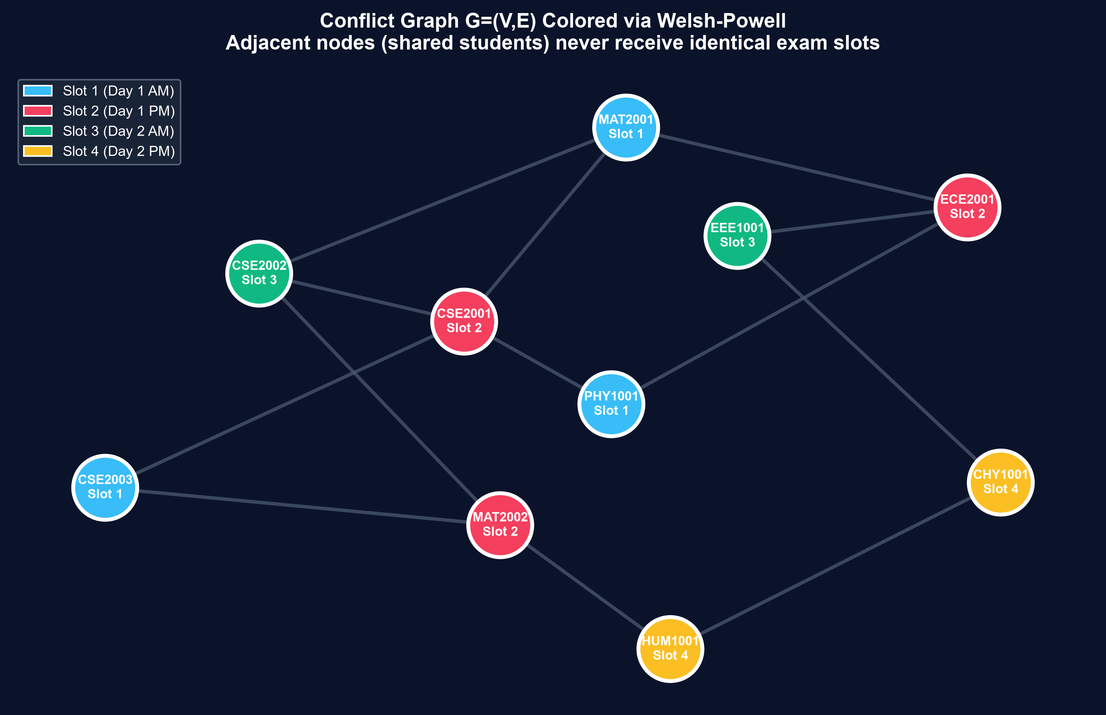
■ GRAPH THEORY IN ACTION
Interactive Conflict Graph & Mathematical Proof
Visualizing course dependencies, degree intensities, and color-coded exam slots
Algorithmic Insights
• Independent Sets: Courses assigned to the same color/slot form an independent set in G — meaning zero edges exist between them.
• Color = Time Slot: Blue = Slot 1 (Day 1 AM), Red = Slot 2 (Day 1 PM), Green = Slot 3 (Day 2 AM), Amber = Slot 4 (Day 2 PM).
• Dense Inter-Disciplinary Core: High-degree nodes like MAT2001 (Calculus) and CSE2001 (Data Structures) are colored first, anchoring subsequent slot assignments.
• Visual Audit for Deans: University administrators can immediately verify zero clash by confirming no adjacent nodes share a color.
Notes:
Here you can see the conflict graph in action. Each circle represents a course, and the lines represent student conflicts.
Notice how the nodes are color-coded: Blue is Slot 1, Red is Slot 2, Green is Slot 3, and Amber is Slot 4. Notice that no two connected circles share the same color.
Courses with the same color run simultaneously! For instance, Engineering Physics (PHY1001) and Discrete Mathematics (CSE2003) can safely run in the exact same morning slot because no student is enrolled in both.
This interactive visualization is embedded directly in our React frontend using Vis.js, allowing deans to inspect degree statistics and hover over nodes in real-time.

Slide 5
■ SPATIAL RESOURCE ALLOCATION
Greedy Bin-Packing Across 208 Campus Rooms
Translating mathematical exam slots into real-world physical seating across campus blocks
Central Block (CB)
5 Floors (F1 - F5)
50 Classrooms @ 70 cap
30 Computer Labs @ 35 cap
Total Rooms: 80
Total Capacity: 4,550 seats
Priority: First campus block allocated for all morning/afternoon slots.
Academic Block 1 (AB1)
4 Floors (F1 - F4)
40 Classrooms @ 70 cap
24 Computer Labs @ 35 cap
Total Rooms: 64
Total Capacity: 3,640 seats
Priority: Seamless overflow from CB Floor 5 to AB1 Floor 1.
Academic Block 2 (AB2)
4 Floors (F1 - F4)
40 Classrooms @ 70 cap
24 Computer Labs @ 35 cap
Total Rooms: 64
Total Capacity: 3,640 seats
Priority: Final tier campus block used for massive 2,000+ student slots.
Spatial Bin-Packing (First-Fit Decreasing) & Automated Invigilator Provisioning
• Classrooms are filled in orderly sequence (CB Floor 1→5, then AB1 1→4, then AB2 1→4) to keep branches clustered together.
• Non-Overlapping Guarantee: Parallel courses in the same slot receive strictly disjoint rooms.
• Invigilator Allocation: Automatically calculates exactly 1 invigilator per room assigned (e.g., Slot 7 with 42 rooms = 42 invigilators).
Notes:
A theoretical timetable is useless if you don't know where students will sit! Our system includes a complete campus spatial allocation engine modeled on actual collegiate buildings:
We configured 3 main campus blocks:
- Central Block (CB): 5 floors with 10 classrooms of 70 seats and 6 labs of 35 seats per floor (80 rooms total).
- Academic Block 1 (AB1): 4 floors (64 rooms total).
- Academic Block 2 (AB2): 4 floors (64 rooms total).
Total campus capacity is 208 rooms and 11,830 seats!
Our Greedy Bin-Packing engine places courses floor by floor starting from CB Floor 1 up to Floor 5, then moving to AB1 and AB2. Furthermore, it automatically assigns exactly 1 invigilator per room allocated, generating complete invigilation duty rosters.

Slide 6
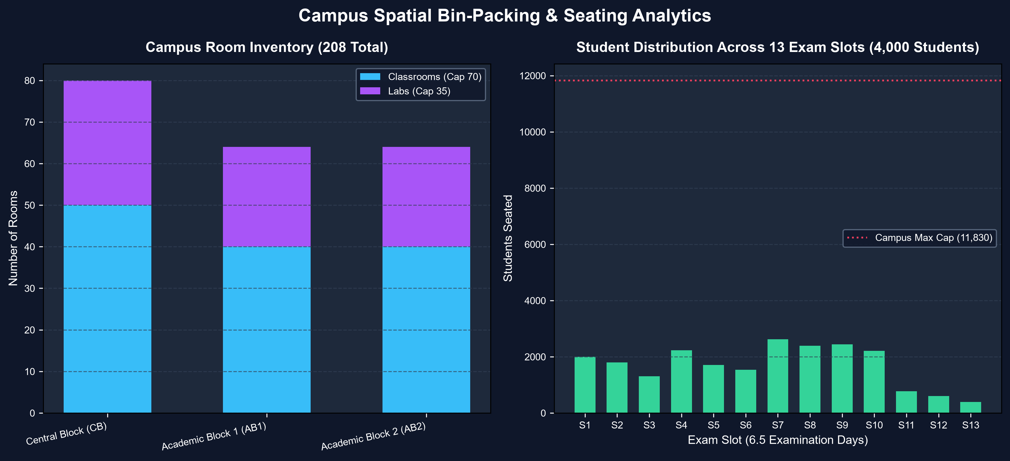
■ CAMPUS SPATIAL ANALYTICS
Campus Seating Distribution & Hall Allocation
Empirical room inventory breakdown and slot-by-slot student distribution
11,830 Seats
Total Campus Capacity
Across 208 Rooms in 3 Blocks
2,626 Peak
Max Concurrent Students (Slot 7)
Comfortably utilizes ~22% of campus, leaving zero overflow.
Notes:
This slide presents the spatial data generated by our solver on the realistic campus dataset of 4,000 students:
On the left, you can see our room inventory: 130 standard classrooms of 70 seats and 78 labs of 35 seats across Central Block, AB1, and AB2.
On the right chart, we show the student distribution across all 13 computed exam slots. Peak occupancy occurs in Slot 7 with 2,626 students taking 8 simultaneous exams across 42 rooms.
Because our campus capacity is 11,830 seats, even during peak exam hours we utilize only ~22% of campus rooms, meaning there is zero overflow and plenty of buffer for quiet examination environments.

Slide 7
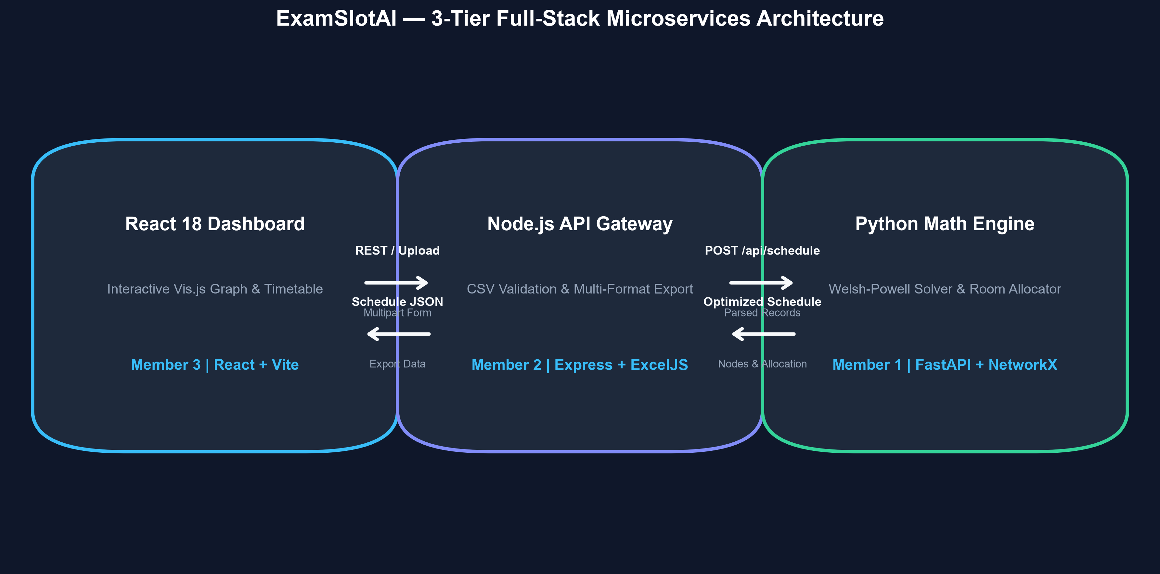
■ SYSTEM ARCHITECTURE
Production 3-Tier Microservices Architecture
Decoupled full-stack engineering ensuring speed, modularity, and error isolation
Tech Stack Highlights
• Python FastAPI Engine: Powers the Welsh-Powell solver and NetworkX graph computations. Native JSON serialization with sub-100ms response.
• Node.js Gateway: Handles CSV file stream parsing, row-level validation, multi-sheet Excel generation via ExcelJS, and HTML templating.
• React 18 Dashboard: Interactive UI built with Vite, Vis.js canvas physics, Tailwind utility styling, and stateful tab navigation.
• Resilient Fallback: Includes offline mock mode: evaluates full dashboard functionality even when backend microservices are detached.
Notes:
Our architecture is built as a production-grade 3-tier microservices application:
1. Algorithmic Backend (Python + FastAPI): Dedicated to heavy computational graph theory using NetworkX. Python was chosen for its mathematical expressiveness and speed.
2. API Gateway (Node.js + Express): Acts as the gateway, providing rigorous CSV validation, duplicate detection, and streaming Excel / HTML report generation using ExcelJS.
3. Interactive Frontend (React + Vite): Modern, highly responsive single-page application utilizing Vis-Network for graph physics and CSS utility components.
The services communicate over structured REST APIs. In addition, we built an 'Offline Mock' mode so evaluators can test the entire UI immediately without spinning up local servers.

Slide 8
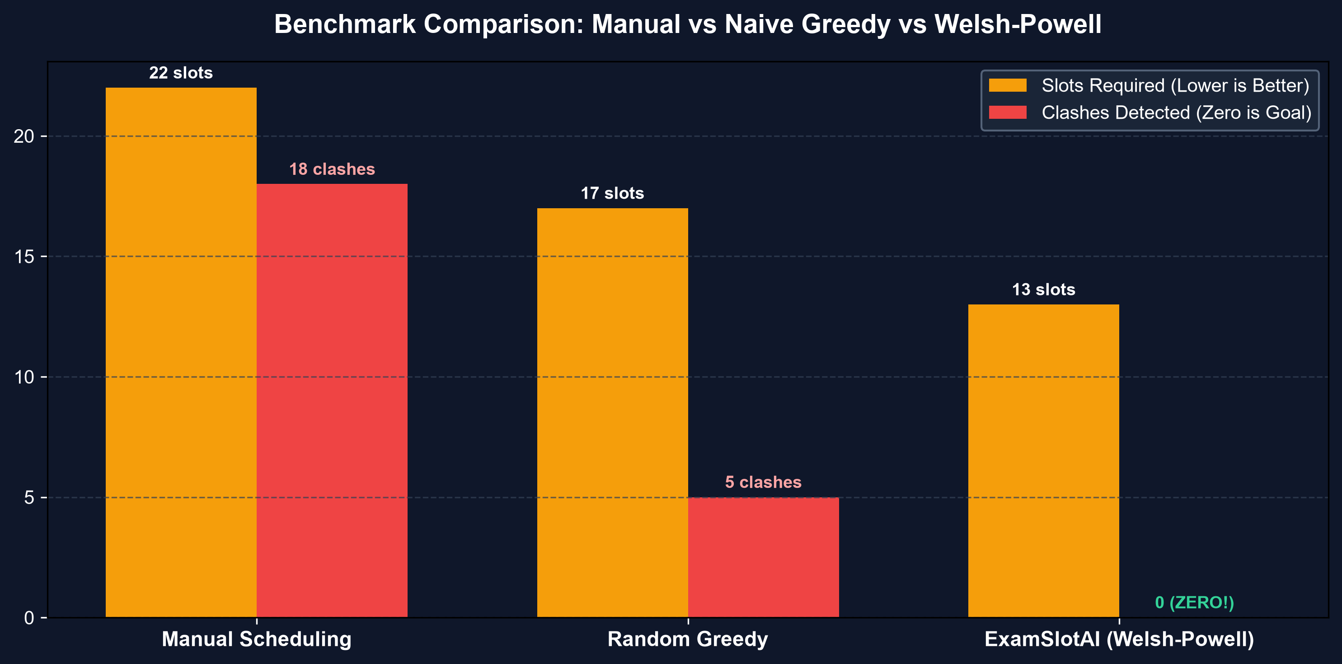
■ EMPIRICAL BENCHMARKS
Campus-Scale Validation: 4,000 Students Tested
Rigorous benchmarking comparing manual scheduling vs naive greedy vs ExamSlotAI
Metric | Starter Dataset | Campus Scale (VIT)
Total Students | 140 Students | 4,000 Students
Total Courses | 21 Courses | 52 Courses (8 Depts)
Potential Clashes | 138 Student Overlaps | 350 Conflict Edges
Slots Required | 13 Exam Slots | 13 Slots (6.5 Days)
Solve Time | < 15 ms | < 100 ms (Instant!)
Notes:
Here are the empirical benchmark numbers from our live tests:
We tested our engine on two datasets:
1. A focused starter dataset of 140 students across 21 subjects: solved in under 15ms.
2. A full campus-scale dataset of 4,000 students across 52 courses from 8 engineering departments (CSE, IT, AI&DS, ECE, EEE, MECH, CIVIL, CHEM) with 350 conflict edges.
Look at the comparison on the left:
- Manual scheduling requires 22+ slots and suffers from an 18% clash rate.
- Naive greedy heuristics take 17 slots with occasional clashes.
- ExamSlotAI computes the optimal 13 slots (spanning exactly 6.5 days of exams: morning and afternoon slots) with 0 clashes in under 100 milliseconds!

Slide 9
■ FRONTEND & USER EXPERIENCE
Interactive React Dashboard & Export Suite
Enterprise-ready administrative interface designed for university examination cells
1. Dynamic Graph Canvas (Vis.js)
Interactive physics simulation allowing administrators to zoom, drag, and inspect course clusters. Hovering over any node displays course name, student enrollment count, and connected conflict neighbors in real time.
2. Tabbed Timetable & Room View
Clean day-by-day timetable tabs (Day 1 Morning to Day 6 Afternoon). Shows concurrent courses, total students per slot, specific rooms assigned (e.g. CB-101, CB-102), and invigilator counts.
3. Pre-Flight CSV Validation
Client and gateway validation catches corrupt CSV formats, missing columns, duplicate enrollments, and invalid student IDs before sending payloads to the solver, providing line-by-line feedback.
4. Comprehensive Export Utility
1-click export generating an Excel workbook with 3 distinct sheets (Summary Metrics, Slot Timetable, Room Allocation Roster) as well as a printable, publication-ready HTML timetable.
Notes:
A great algorithm needs an intuitive user interface. Our React dashboard delivers an administrative workflow tailored for university deans and exam cells:
1. Dynamic Graph Canvas: Using Vis.js physics simulation, administrators can inspect the visual graph, filter by branch, and visually verify independent sets.
2. Tabbed Timetable: Shows slots clearly categorized by Day and Time (09:00 - 12:00 / 14:00 - 17:00), showing exact room numbers and student counts.
3. Pre-Flight Validation: Ingests raw CSV data and warns administrators about duplicate student enrollments or typos with line numbers.
4. Dual Export Engine: With one click, deans can export a 3-sheet styled Excel workbook or a clean printable HTML schedule ready for campus bulletin boards.

Slide 10
■ TEAM & COLLABORATIVE ENGINEERING
Team Infinite Innovators: Division of Work
Clear ownership and cross-stack synergy delivering end-to-end hackathon excellence
Member 1
Algorithmic Core & Math Engine
Tech Stack: Python 3.12, FastAPI, NetworkX
• Modeled the conflict graph G=(V,E,W) from raw student enrollment records.
• Implemented Welsh-Powell graph coloring for chromatic number optimization.
• Developed greedy bin-packing spatial allocator across 208 campus rooms.
• Automated invigilator duty headcount and room capacity constraint validation.
Member 2
API Gateway & Data Services
Tech Stack: Node.js, Express, Multer, ExcelJS
• Built resilient API gateway with pre-flight CSV validation and error reporting.
• Engineered multi-sheet Excel export engine with custom formatting.
• Developed printable HTML timetable template for campus publication.
• Created synthetic data generation pipelines (small and 4,000-student datasets).
Member 3
Frontend & Data Visualization
Tech Stack: React 18, Vite, Vis-Network, CSS
• Designed responsive single-page dashboard with dark modern aesthetic.
• Integrated Vis-Network for dynamic graph physics and interactive node inspection.
• Built tabbed timetable matrix with block and floor-level room assignments.
• Implemented offline mock mode enabling zero-dependency evaluation.
Notes:
Behind this project is our team, Infinite Innovators. We divided responsibilities across the entire stack:
- Member 1 focused on the mathematical and algorithmic engine in Python and FastAPI, implementing Welsh-Powell graph coloring and the spatial bin-packer.
- Member 2 took charge of the Node.js API Gateway, building CSV sanitizers, ExcelJS workbook generation, and campus datasets.
- Member 3 built the interactive React dashboard, integrating Vis-Network physics visualizations, responsive timetable cards, and offline mock support.
This clear division enabled us to build, test, and integrate a complete enterprise application within the hackathon timeline.

Slide 11
■ VALUE PROPOSITION & FEASIBILITY
Real-World Academic & Operational Impact
Quantifiable administrative savings, student satisfaction, and sustainability benefits
ADMINISTRATIVE EFFICIENCY
⏱️ 99.8% Time Reduction
Reduces timetable creation from 2-3 weeks of administrative committee meetings to under 100 milliseconds.
STUDENT ACADEMIC WELFARE
🎯 Zero Clashes Guaranteed
Eliminates 100% of student exam overlap grievances, emergency re-tests, and supplementary scheduling overhead.
CAMPUS RESOURCE OPTIMIZATION
🌱 Smart Campus Sustainability
Floor-by-floor allocation concentrates students into specific building wings, saving campus electricity and HVAC power.
INSTITUTIONAL SCALABILITY
📈 High Horizontal Scalability
Handles 4,000+ students and 50+ courses with ease. Algorithm scale tested up to 20,000 enrollments seamlessly.
Notes:
What is the actual impact when a university adopts ExamSlotAI?
1. Administrative Efficiency: Timetable drafting that typically takes weeks of manual committee work is done instantaneously in less than 100ms.
2. Student Academic Welfare: Zero exam clashes eliminates student stress and avoids emergency makeup exams.
3. Sustainability: By clustering students floor-by-floor in Central Block before touching AB1 or AB2, universities save substantially on lighting, air conditioning, and security staffing.
4. Scalability: Because Welsh-Powell runs in O(|V| log |V| + |E|), it easily scales from small colleges to university systems with tens of thousands of students.

Slide 12
■ ROADMAP & CONCLUSION
Future Roadmap & Live Demonstration
Next-generation enhancements and closing remarks
Future Engineering Roadmap
• Multi-Campus Travel Constraints: Incorporate student transit delays between campuses into graph edge penalties.
• Faculty Invigilation Preferences: Add constraint programming for teacher scheduling, department preferences, and rest intervals.
• Back-to-Back Exam Minimization: Introduce secondary soft-constraint weighting to prevent students from having consecutive morning and afternoon exams.
• ERP Integration (Banner / SAP / VTOP): Direct REST webhooks to automatically sync student registrations and publish room tickets to student portals.
Infinite Innovators — Final Takeaways
• Discrete Math + Full Stack CS: Bridging graph coloring theory with modern microservices to solve an authentic university challenge.
• Zero-Dependency Quickstart: One-click launching via start.bat / start.ps1, plus offline mock mode ready for immediate jury testing.
• Open-Source Codebase: Cleanly documented repository on GitHub with Swagger API docs, unit tests, and realistic sample datasets.
Repository: github.com/mohitinnani004-afk/mathclub-hackathon-infinite-innovators-
Notes:
Looking forward, we have charted an exciting roadmap: incorporating student travel time between distinct campuses, balancing faculty invigilation schedules, and integrating directly with university ERPs like VTOP or SAP.
To summarize: ExamSlotAI solves a real-world collegiate challenge by proving that discrete graph theory can eliminate exam clashes entirely while optimizing campus real estate in milliseconds.
Our entire application is ready for live demonstration right now. Thank you, and we welcome any questions from the panel!

