Slide 1

Determining Similarity Between Cities and Recommending locations for Tourist/Business Owners
IBM Coursera
Mohit Jain

Slide 2
Introduction
To compare the similarity between two biggest financial cities of the world Toronto and New York.
Similarity well be compare based on the neighborhoods and venues nearby like hospital, entertainment, school, cafes, outdoor activities etc.
Business owners/entrepreneurs who wants to start a business in either cities. Model will help in determining which location is more appropriate for their business.
This model can also be used to recommend top places to tourists like Yelp. Target audience is Tourists, business owners, industrialist or entrepreneurs, small business.
IBM Coursera
Mohit Jain

Slide 3
Objective
Similarity between cities
This project aims to predict similarity between two financial cities include schools, entertainment, universities, hospitals, restaurants etc. which helps people to make strategic decision whether to migrate or not.
Determining Location
Second aim of this project to provide appropriate location to start their business which helps business owners, industrialist etc. to take strategic decision.
Data Sources
Four square data location data
Extracting Toronto data from Wikipedia.
Geospatial Data
IBM Coursera
Mohit Jain

Slide 4
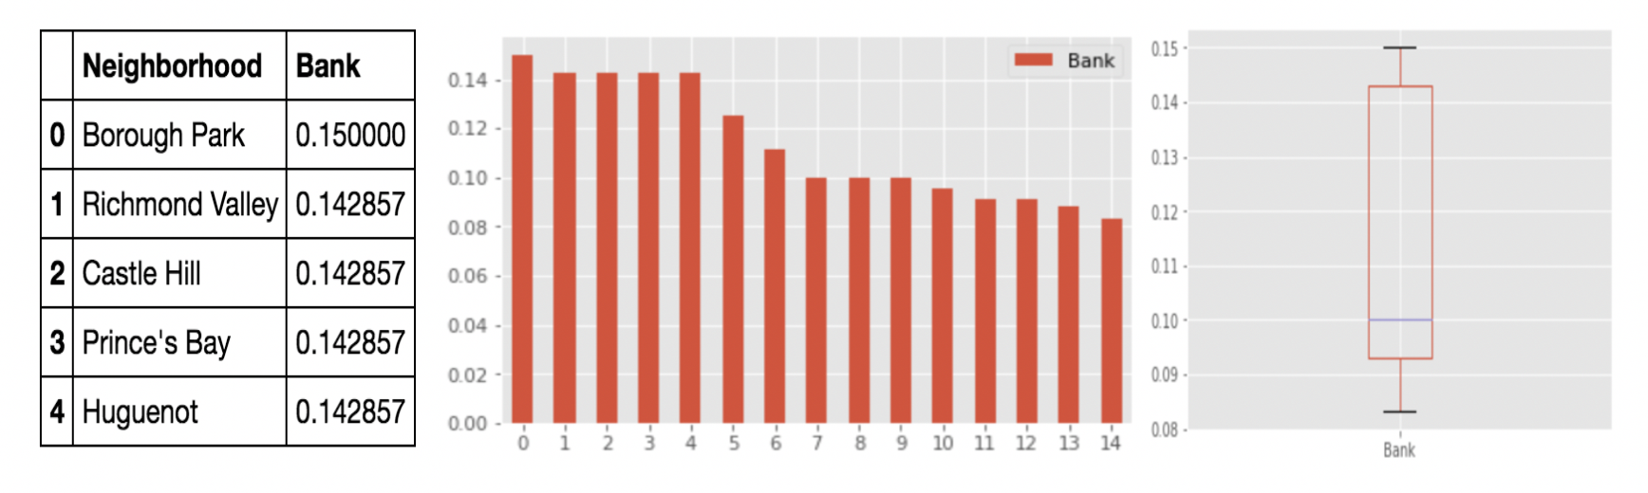
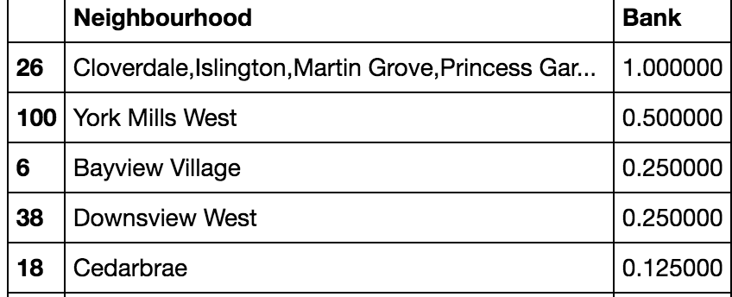
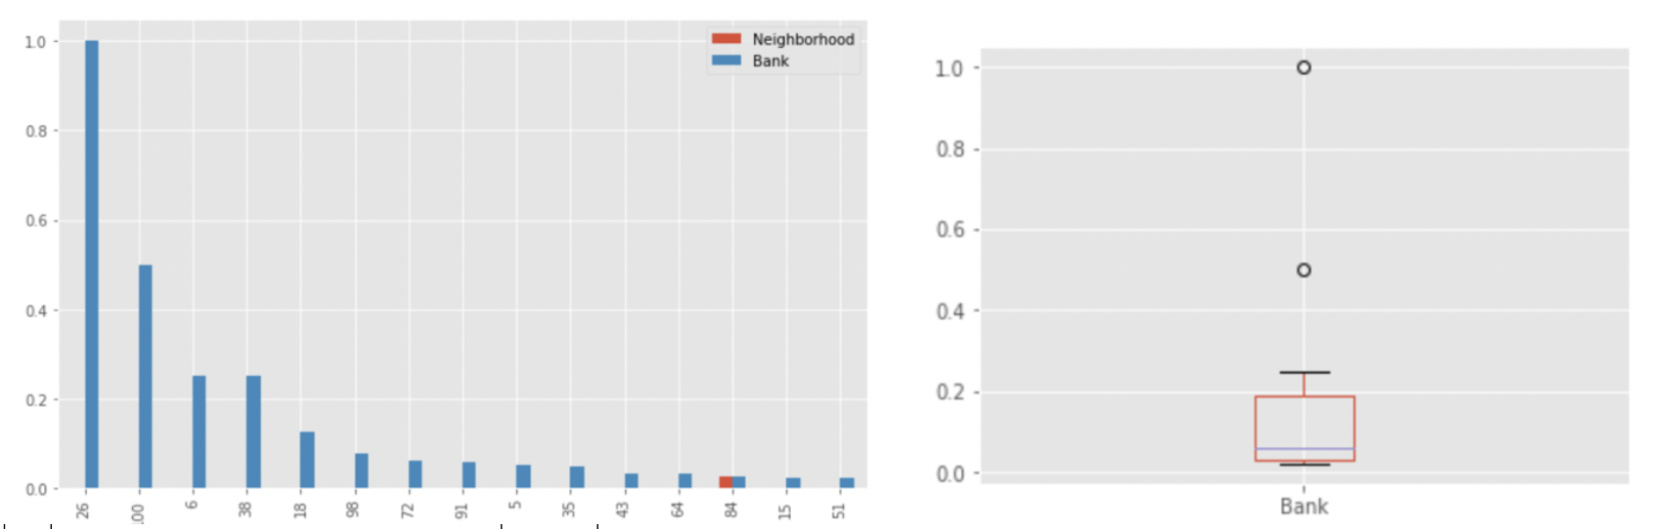
Exploratory Data Analysis (1/2)
Relationship between Neighborhoods and Banks (New York)
Relationship between Neighborhoods and Banks (Toronto)

Slide 5
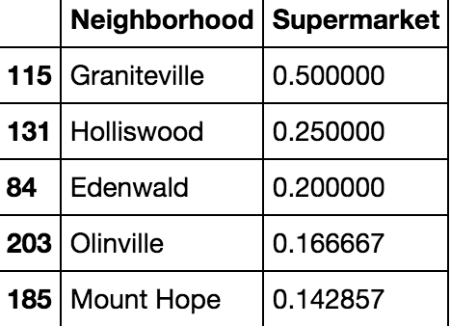
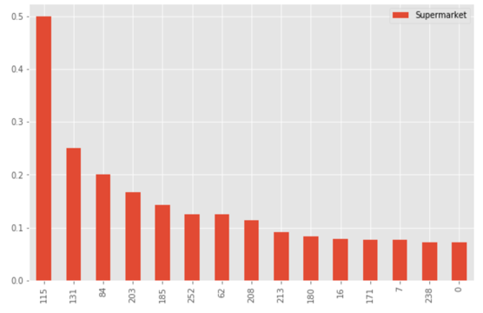
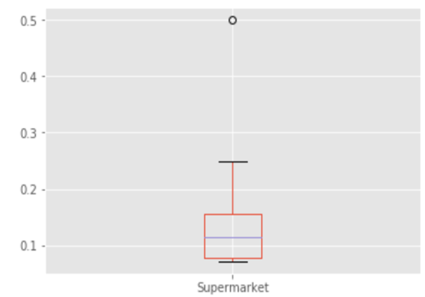
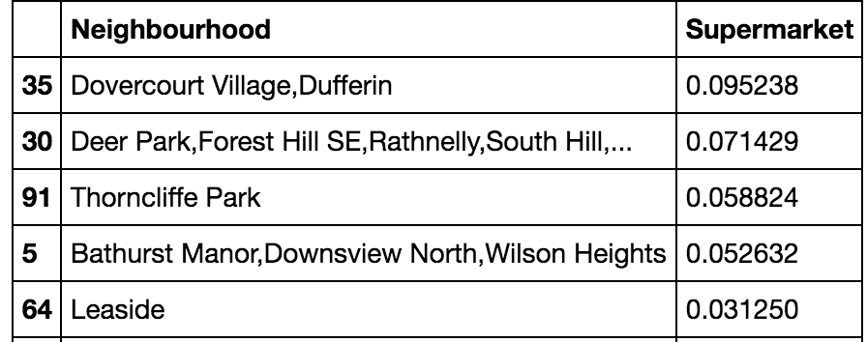
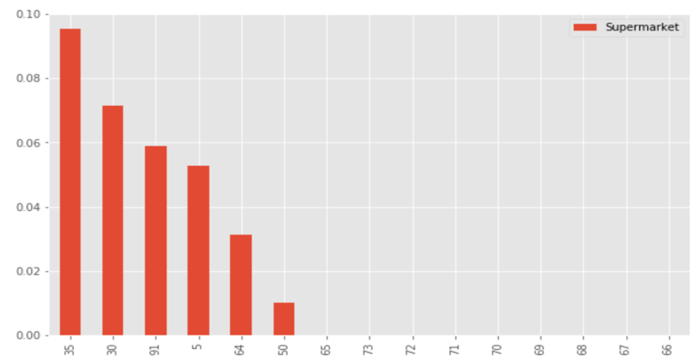
Exploratory Data Analysis (2/2)
Relationship between Neighborhoods and Supermarket (New York)
Relationship between Neighborhoods and Supermarket (Toronto)

Slide 6
Data Pre-processing
New York Data
Data https://cocl.us/new_york_dataset extracted from this source will be in JSON Format and
transformed into Pandas data frame.
Next step is defining the columns for transformed data frame.
The column names are Borough, Neighborhood, Latitude, Longitude.
Using Four square link API we will request and explore venues for New York within the radius of 500m and pulling the 100 closest venues around each neighbor.
Toronto Data
Toronto data is pulled from Wikipedia 'https://en.wikipedia.org/wiki/List_of_postal_codes_of_Canada:_M').text and transformed into pandas data frame.
Filtered the values where value of Borough is "Not assigned".
Combined the neighborhood which has same Postcode and Borough and dropped the duplicates.
If value of Neighbourhood is “Not assigned” then value of borough and neighborhood are same.
Using Four square link API we will request and explore venues for Toronto within the radius of 500m and pulling the 100 closest venues around each neighbor.
IBM Coursera
Mohit Jain

Slide 7
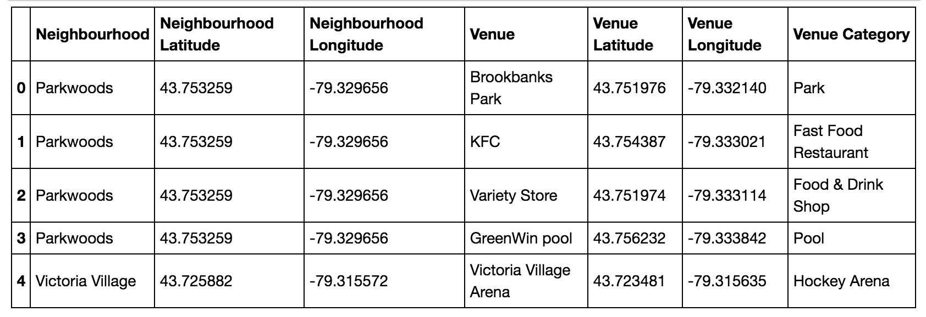
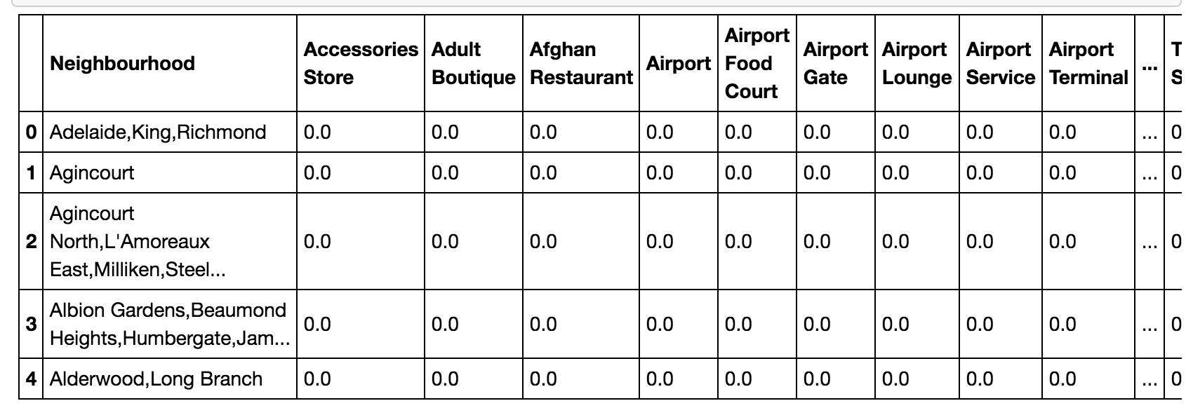
Feature Engineering
Venues attribute has categorical values such as airlines, coffee, gym, school etc.
We have used one hot encoding technique to convert into dummy variables which has values 0 or 1.
Total attributes of the data frame before One-hot Encoding is 7. After one-hot encoding it increases to 280 columns.
IBM Coursera
Mohit Jain

Slide 8
Methodology
K-Nearest Neighbor Algorithm
KNN model was used to compare the cities between current residing and other cities and recommend K number of cities which are similar to each other.
We calculate Euclidean distance between cities and lower value will give more similarity between the cities.
K-means algorithm
K-means algorithm is used to find the clusters between two cities.
K-means will find the clusters or the group of cities which are close to each other.
Choose K, then select K random centroids
Assign records to the cluster to the closest centroid.
When records are moved to a new cluster, the centroid for the affected clusters needs to be recalculated.
This movement and recalculation are repeated until movement no longer results in an improvement.
Recommend Top Places
Using Four square API we explore all the venues of each neighborhood.
Values of the Venues are in categorical form such as Airport, Bar, Indian restaurant, School, Hospital.
We convert values of venues into 0 or 1 using one-hot encoding technique.
Take the mean of the rows.
Then transpose the data frame obtained in point 4 and sort it in descending order.
Then display Top 10 values or venues of each neighborhood.
IBM Coursera
Mohit Jain

Slide 9
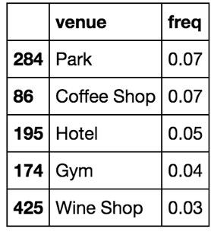
Results
Model help person to migrate to different city which is similar to his/her residing city.
Example:- Person residing in Toronto and neighborhood is. This person personal preferences are Bank', 'Bar','Church','Department Store', 'Kids Store', 'Pool','Supermarket','Train Station' and wants to migrate to New York.
The model explained in 4.1.1 will recommend below neighborhoods of new york.
Neighborhood Chinatown
Neighborhood Financial District
Neighborhood Bensonhurst
Neighborhood Manhattan Valley
Neighborhood Vinegar Hill
Recommend top places or venues in the city to the tourist.
Example:- User is coming to New York and neighborhood is Battery Park City . Top Places or venues given by the algorithm
Compare the neighborhoods of New York and Toronto and cluster them based on their similarity.
Using K-means clustering algorithm. We have found both cities are quite similar to each other if we consider feature vector: {'Bank', 'Bar','Church','Department Store', 'Kids Store', 'Pool','Supermarket','Train Station','Office','Museum','Pool'}
IBM Coursera
Mohit Jain

Slide 10
Conclusions
In this study, I have created two different models.
First one will help user to determine which cities they need to migrate based on their preferences using KNN model.
Second one will recommend top places or venues of their travelling city.
Third one is comparison between 2 different cities New York/Toronto and found to be quite similar to each other using K-means alogirthm see in section 5.2.
we also found Train stations are very less in Toronto.
In New York, there are good amount of train stations in Richmond valley, Huguernot and Laurelton
Top banks in Toronto are in Cloverdale,Islington,Martin Grove,Princess Gar, York Mills West and every nieighborhood has a bank.
Neighborhoods like Graniteville are like an outlier which has almost double stores as compared to any other neighborhood around it.
There are very less supermarkets in the neighborhoods of Toronto and places like Little Portugal, Trinity, Parkswoods, parksdale has zero super markets.
IBM Coursera
Mohit Jain

