Slide 1
Monolith Advance Printer Software
VirSoftech
Internship Report
(3rd May 2019 to 15th July 2019)
Mohit Kumar
16113052

Slide 2
About Monolith
Monolith Software is the product of Mutoh Company which basically makes the hardware of the printers .
Monolith Dashboard –At all times, Display current status of printers that are connected to Monolith. It will also show key health parameters of printer so that printers are operational at all times.
Monolith Printer Software will perform the basic operations which every printer software performs.
It will also perform the advanced operations like Multi-layer-Printing ,Crop-Marks, Tiling and Step & Repeat.
It allows the user to add up to four printers and four Cutters at a time.User can performs the operations on all printers and Cutters by using the Monolith.
It will save the setting that user have applied on previous job as Preset and can be applied on other jobs to save the time of user.
It will also calculate the media wastage and show the way to how to print the job to reduce the media wastage of big size job.

Slide 3
About VirSoftech
VirSoftech is a Software Development Company which is founded by IIT Kharagpur alumnus. VirSoftech currently working in two countries India and Japan. The company works in domain of Software development.
It works on Own Software product like eVal OMR Software, Indian Government Project like Abhilekh-Patal (Portal for Access to Archives and Learning) and other MNC like Muthoh company projects ONYX software which is installed in printer ValueJet Series.
The product Like Mutoh Company Printer Software Monolith which is an advanced printer software which is installed in ValueJet (VJ) Series.

Slide 4
Tools Used
Perforce P4V- For Version Control
ASP.NET and WPF-For UI development
C# and XAML (eXtensible Application Markup Language)-Programming Languages for Back-End development.
Visual Studio 2017- Editor for programming behavioural scripts

Slide 5
About My Role
Monolith Software
Project Manager
Software Developer
UI Designer
Software Tester
I have worked as a Software developer in this project for 75 days. I have worked on the Application Backend as well as the User Interface (UI) of software. On completion of a task it is first tested by tester for finding out the bugs and after correcting the bugs, it is approved by the Project Manager. After approval, the developed feature would be merged with the master build in the project repository, tagged with appropriate version

Slide 6
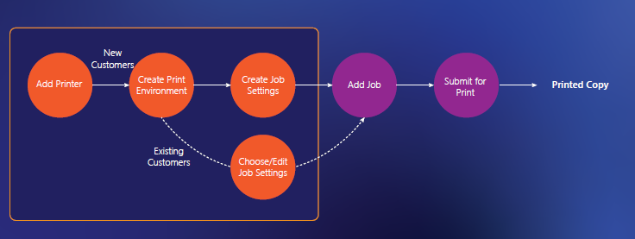
About My Work
I had worked on the following things-:

Slide 7
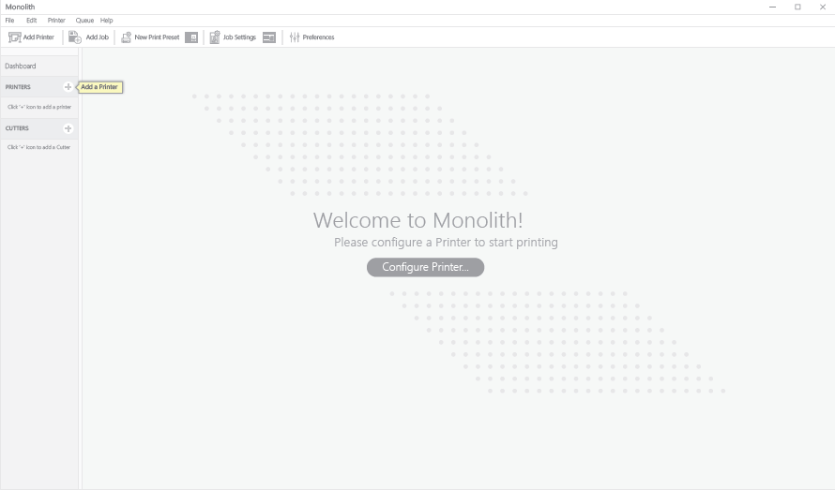
Home Page for the new Customers which are using it first, it looks like something that I have built-

Slide 8
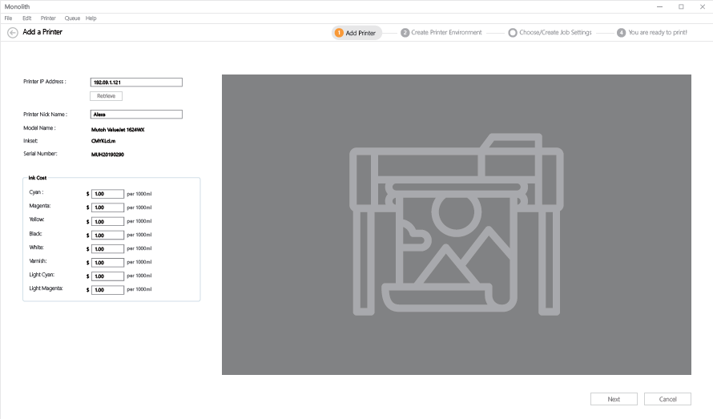

Slide 9
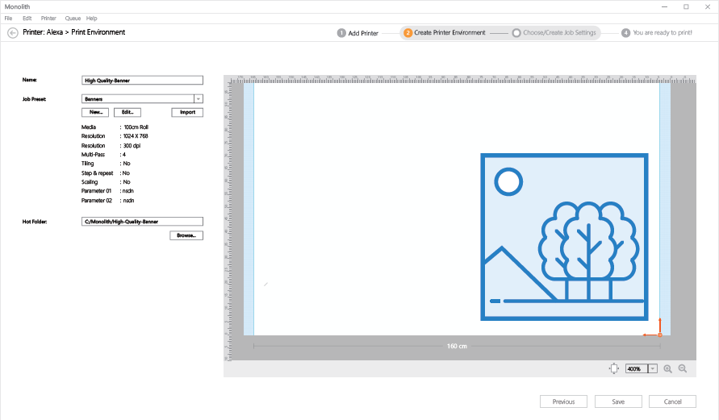

Slide 10
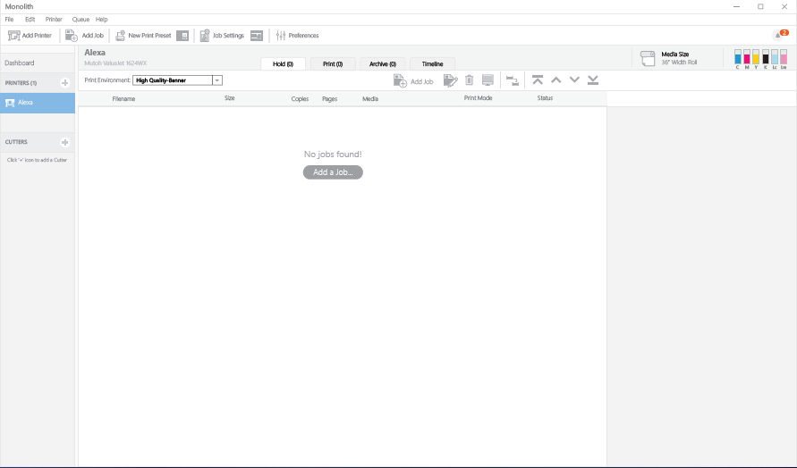

Slide 11
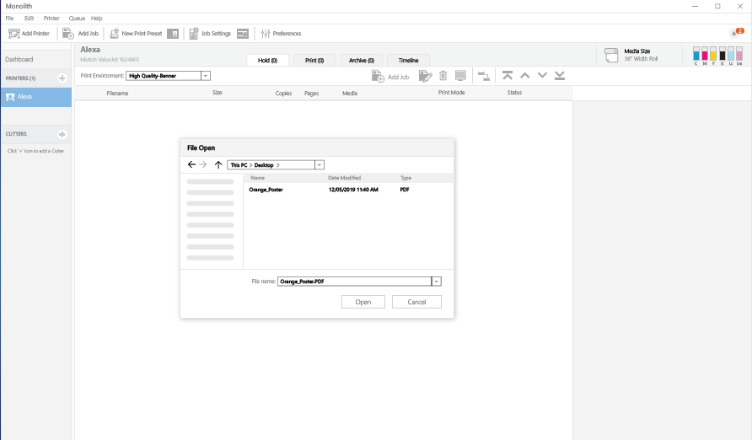

Slide 12
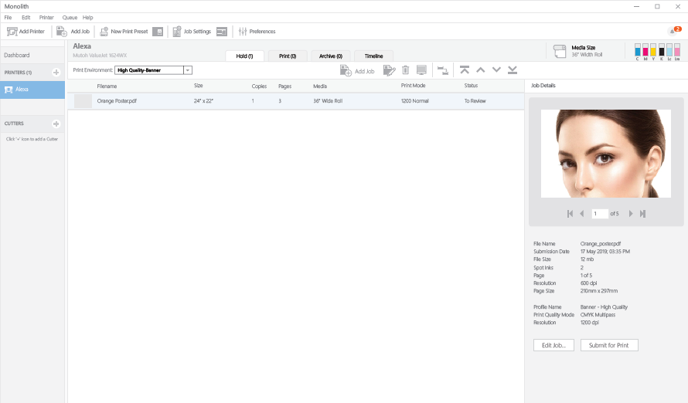

Slide 13
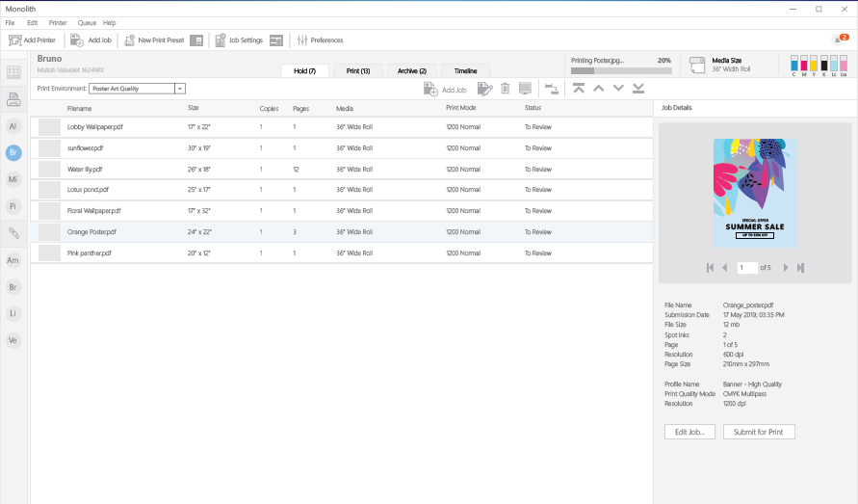

Slide 14
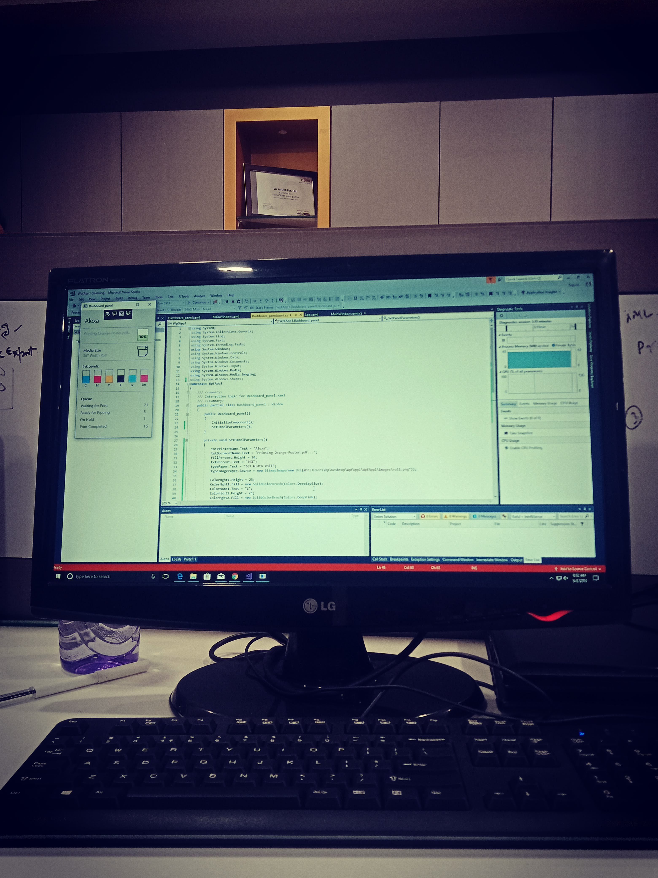

Slide 15
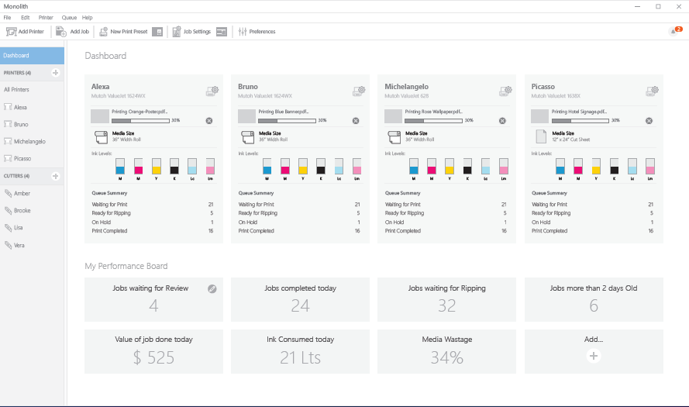

Slide 16
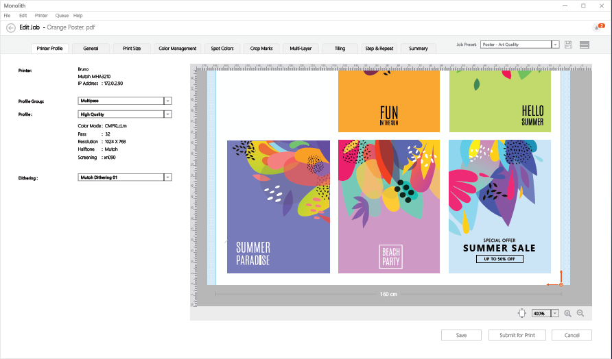

Slide 17
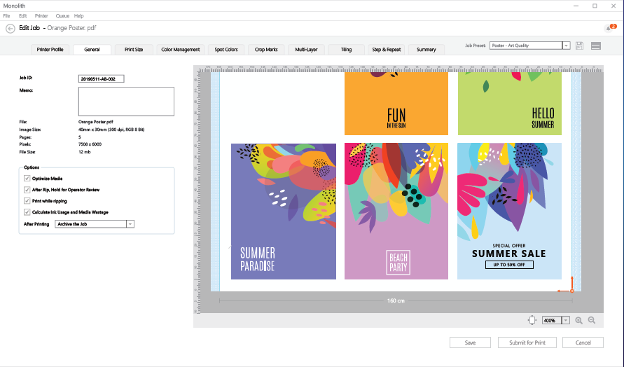

Slide 18
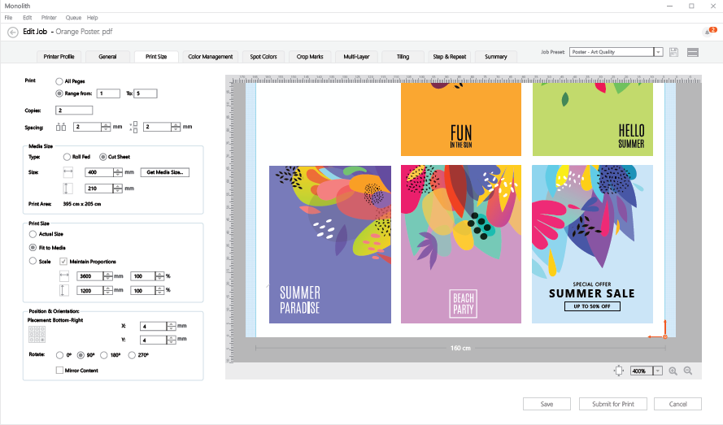

Slide 19
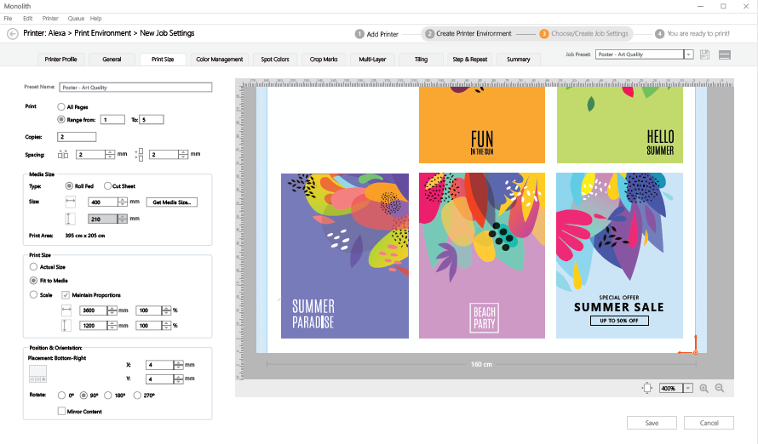

Slide 20
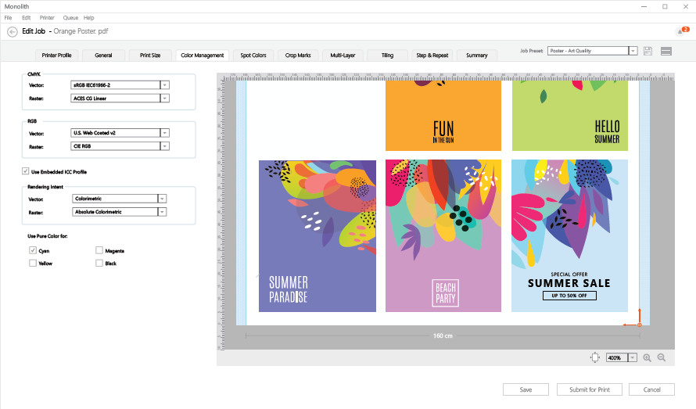

Slide 21
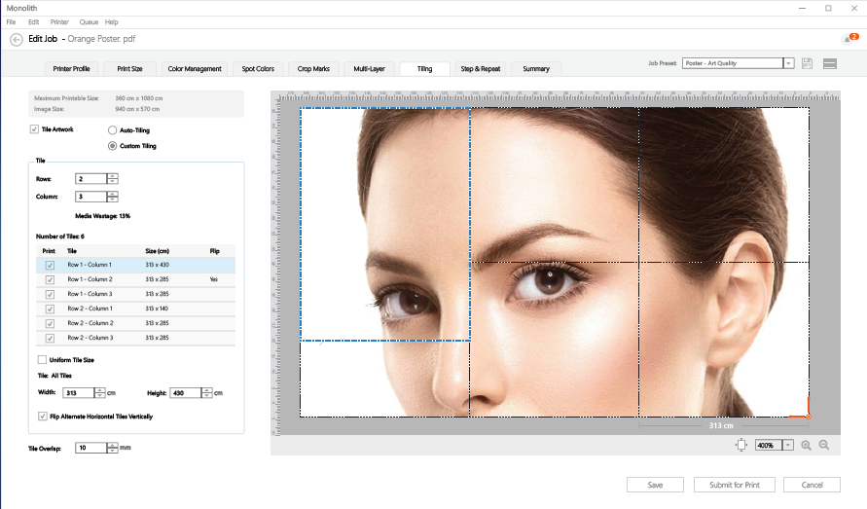

Slide 22
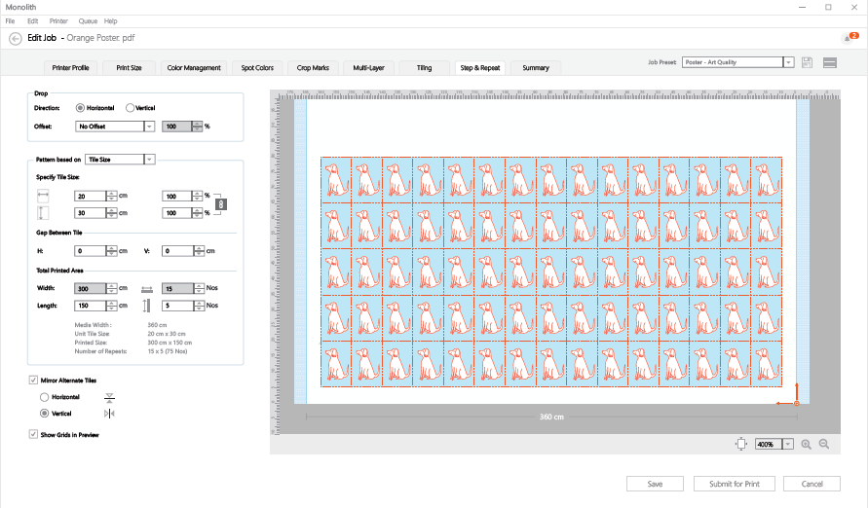

Slide 23
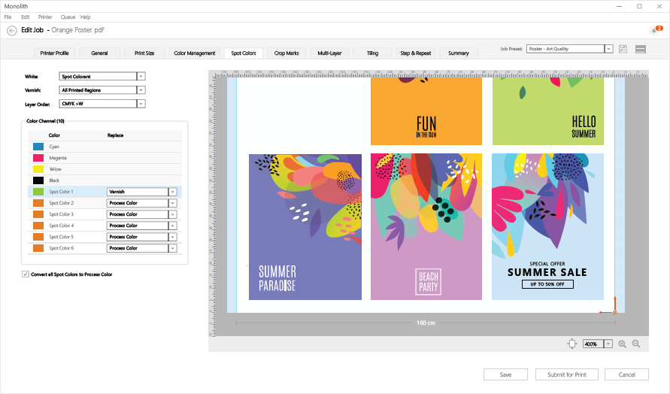
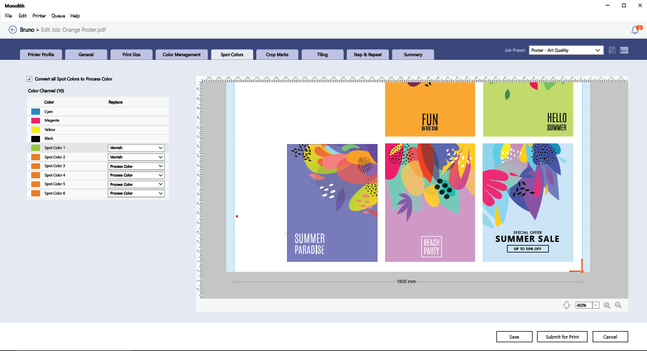

Slide 24
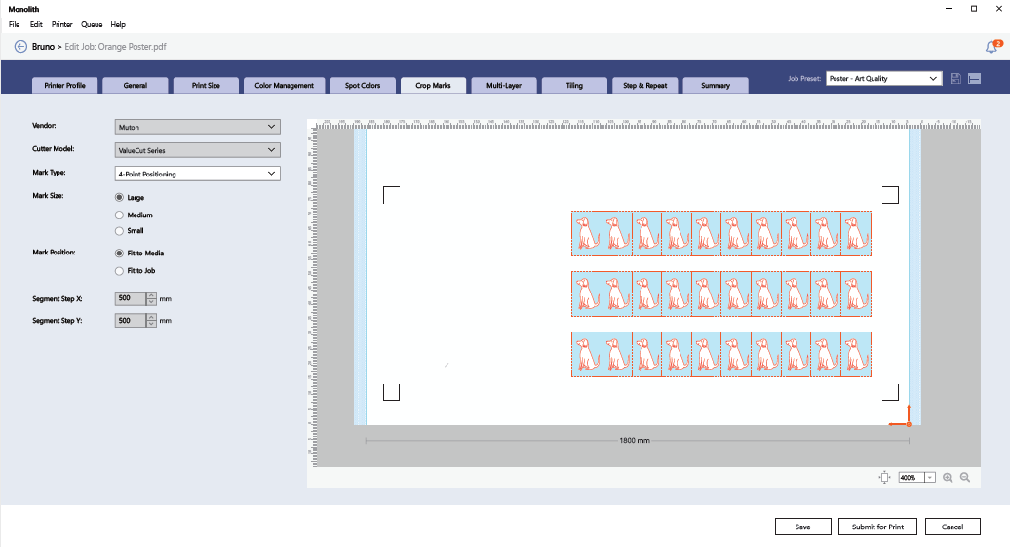

Slide 25
