Slide 1

A N I M A T I O N

Slide 2
What is ANIMATION?
Definition:
  A collection of static images joined together and shown consecutively so that they appear to move.
Animation is about storytelling by bringing things to life (making them move).

Slide 3
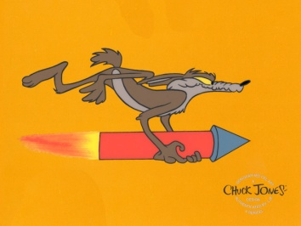
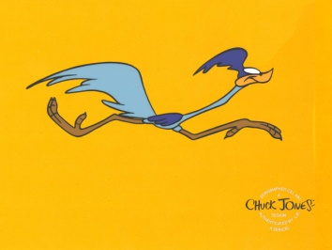
What is ANIMATION?
What kind of stories to tell?
  Scientific, Visualization, Entertainment, Fiction, Non-fiction.
What is unique about animation?
  Unprecedented control!
  Anything can happen
  Total control over how things look
  Total control over how things move

Slide 4
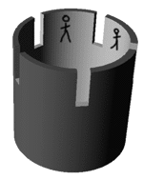
5.1 What is ANIMATION?
Animation
  process of creating images one at a time to be displayed rapidly in sequence giving the illusion of movement .
Persistence of vision
  blending together by the eye and brain of rapidly displayed sequential images, giving the illusion of movement.

Slide 5

Usage of Animation
Artistic purposes
Storytelling
Displaying data (scientific visualization)
Instructional purposes

Slide 6
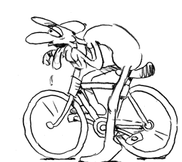
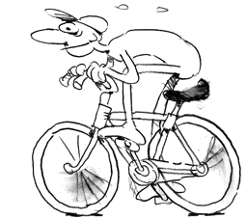
12 Basic Principles of Animation
Timing
  The basics are: more drawings between poses slow and smooth the action. Fewer drawings make the action faster and crisper. A variety of slow and fast timing within a scene adds texture and interest to the movement.

Slide 7
12 Basic Principles of Animation
Secondary Action
  This action adds to and enriches the main action and adds more dimension to the character animation, supplementing and/or re-enforcing the main action.

Slide 8
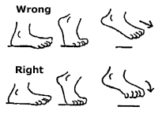

12 Basic Principles of Animation
Follow Through and Overlapping Action
  When the main body of the character stops all other parts continue to catch up to the main mass of the character, such as arms, long hair, clothing, coat tails or a dress, floppy ears or a long tail (these follow the path of action). Nothing stops all at once

Slide 9
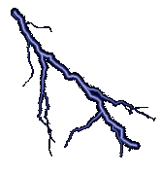

12 Basic Principles of Animation
Straight Ahead Action and Pose-To-Pose Action
  Straight ahead animation starts at the first drawing and works drawing to drawing to the end of a scene. You can lose size, volume, and proportions with this method, but it does have spontaneity and freshness. Fast, wild action scenes are done this way.

Slide 10
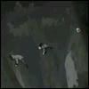
12 Basic Principles of Animation
Straight Ahead Action and Pose-To-Pose Action
  Pose to Pose is more planned out and charted with key drawings done at intervals throughout the scene. Size, volumes, and proportions are controlled better this way, as is the action.

Slide 11



12 Basic Principles of Animation
Staging
  A pose or action should clearly communicate to the audience the attitude, mood, reaction or idea of the character as it relates to the story and continuity of the story line. The effective use of long, medium, or close up shots, as well as camera angles also helps in telling the story.

Slide 12
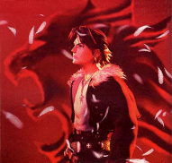
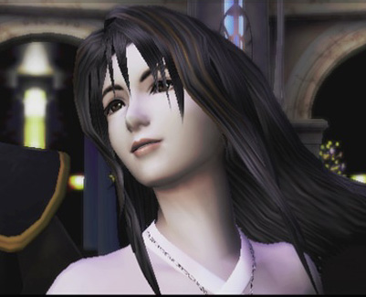
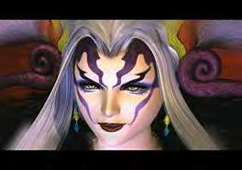
12 Basic Principles of Animation
Appeal
  A live performer has charisma. An animated character has appeal. Appealing animation does not mean just being cute and cuddly. All characters have to have appeal whether they are heroic, villainous, comic or cute.
  Appeal, as you will use it, includes an easy to read design, clear drawing, and personality development that will capture and involve the audience¹s interest.

Slide 13
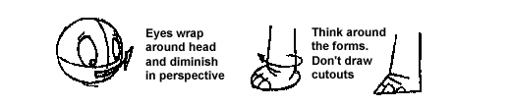
12 Basic Principles of Animation
Solid Drawing
  The basic principles of drawing form, weight, volume solidity and the illusion of three dimension apply to animation as it does to academic drawing.
  Transform these into color and movement giving the characters the illusion of three-and four-dimensional life. Three dimensional is movement in space.

Slide 14
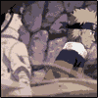

12 Basic Principles of Animation
Ease In and Out
  As action starts, we have more drawings near the starting pose, one or two in the middle, and more drawings near the next pose.
  Fewer drawings make the action faster and more drawings make the action slower. Slow-ins and slow-outs soften the action, making it more life-like

Slide 15
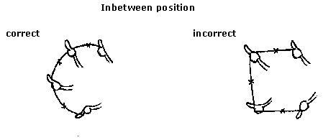
12 Basic Principles of Animation
Arcs
  All actions, with few exceptions (such as the animation of a mechanical device), follow an arc or slightly circular path.
  This is especially true of the human figure and the action of animals. Arcs give animation a more natural action and better flow.

Slide 16
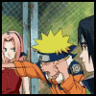
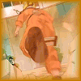
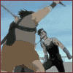

12 Basic Principles of Animation
Anticipation
  This movement prepares the audience for a major action the character is about to perform, such as, starting to run, jump or change expression.
  A dancer does not just leap off the floor. A backwards motion occurs before the forward action is executed. The backward motion is the anticipation.

Slide 17




12 Basic Principles of Animation
Squash and Stretch
  This action gives the illusion of weight and volume to a character as it moves. Also squash and stretch is useful in animating dialogue and doing facial expressions.

Slide 18

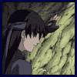
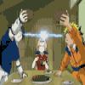
12 Basic Principles of Animation
Exaggeration
  Exaggeration is not extreme distortion of a drawing or extremely broad, violent action all the time. It’s like a caricature of facial features, expressions, poses, attitudes and actions.
  Exaggeration in a walk or an eye movement or even a head turn will give your animation more appeal.

Slide 19
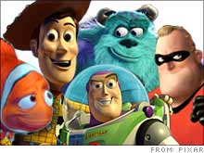
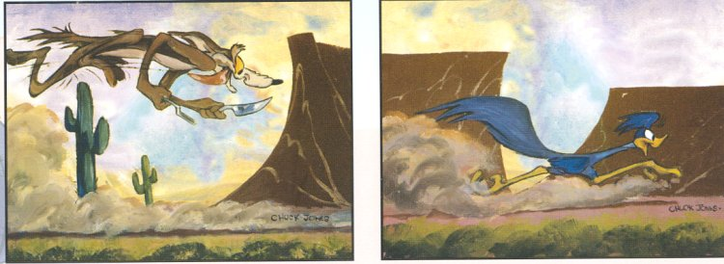
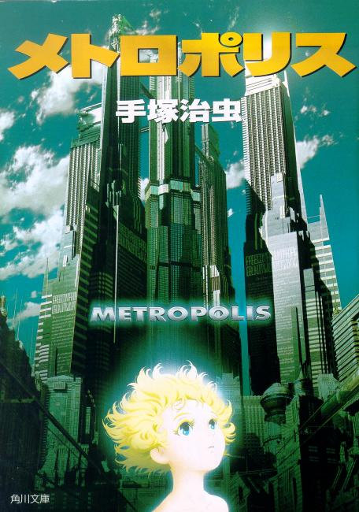
CELL VS DIGITAL

Slide 20
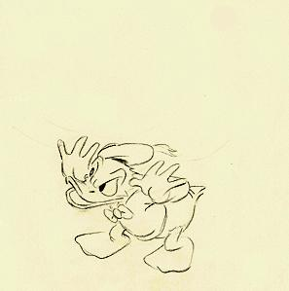
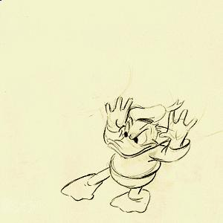
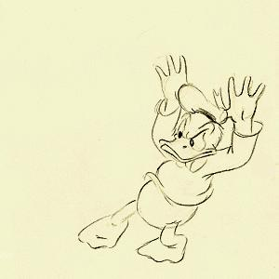
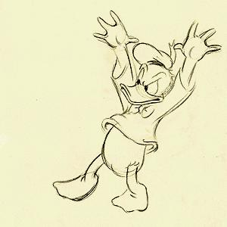
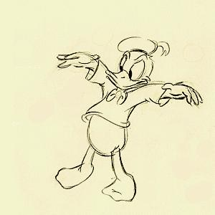
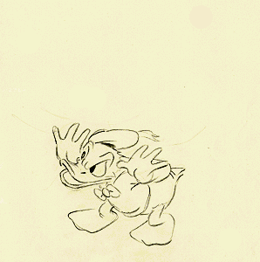
What is Cell Animation?
Method used for creating hand-drawn animation.
Individual frames are drawn in a sequence that, when played back quickly (usually 10 to 30 frames per second), creates the illusion of continuous movement.

Slide 21
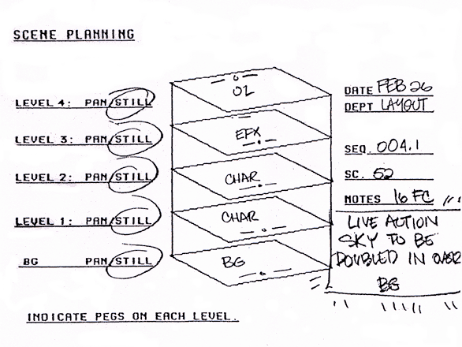
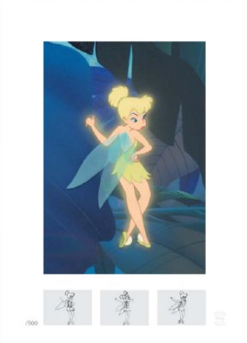
What is Cell Animation?
Animators drew on semi-transparent sheets of vellum, or acetate cells (cellulose acetate) - they could see through the frame they were drawing to the previous frames.

Slide 22
What is Digital Animation
Electronically generated movement of anything on your computer screen.
Three different levels of digital animation:
  Basic
  Intermediate
  Advanced

Slide 23
What is Digital Animation
Basic
  At the most fundamental level, animation consists of simple transitions (wipes and dissolves between PowerPoint slides, for example) and path animations (moving text and logos).

Slide 24


What is Digital Animation
Intermediate
  The next level up is cel animation (the method used in cartoons) and special effects, which include all manner of distortions and color effects applied to a graphic, photo or movie.

Slide 25
What is Digital Animation
Advanced
  The most sophisticated level of digital animation is 3D animation. Movies such as "Toy Story" and "A Bug's Life" are the most prominent examples of what can be achieved through the latest computer technology.
  Ambitious designers can take advantage of these same tools to manufacture some dazzling 3D creations of their own.

Slide 26
Creating Animation
2 step process for creating animations
  Step 1: Planning
  Step 2: Implementation
Step 1: Planning
  Decide on the problem to be solved
  Design a solution – storyboard
  Determine the characters and objects to appear on

Slide 27
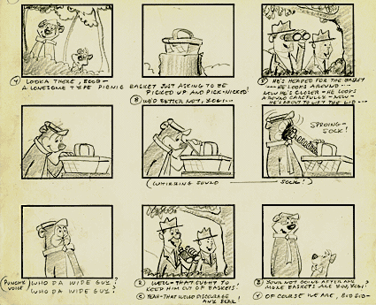
Story Board Example

Slide 28
Creating Animation
Step 2: Implementation
  Start production
  Post-production
  Test playback and review
  Amendments
  Delivery or packaging

Slide 29
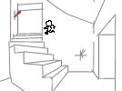
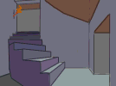
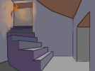
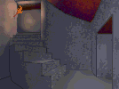
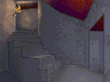
Animation Steps

Slide 30
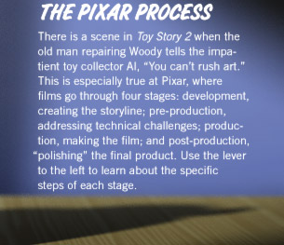
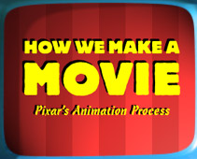
Pixar’s Animation Step for Monster’s Inc.

Slide 31
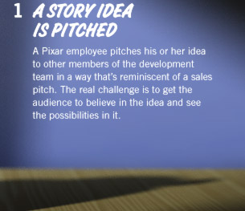
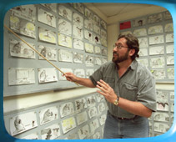
Pixar’s Animation Step for Monster’s Inc.
Step 1: Planning

Slide 32
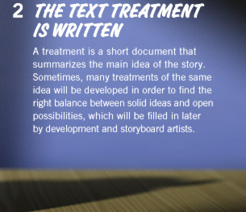
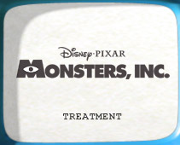
Pixar’s Animation Step for Monster’s Inc.

Slide 33
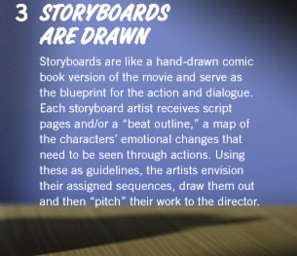
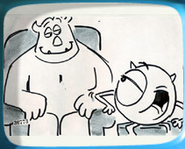
Pixar’s Animation Step for Monster’s Inc.

Slide 34
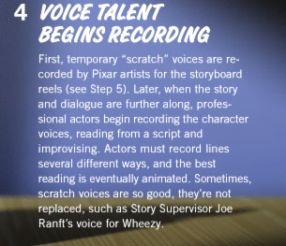
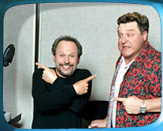
Pixar’s Animation Step for Monster’s Inc.

Slide 35
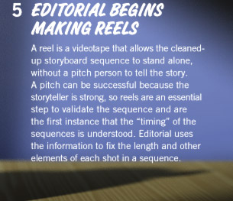
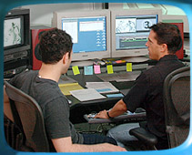
Pixar’s Animation Step for Monster’s Inc.

Slide 36
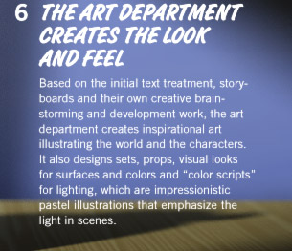
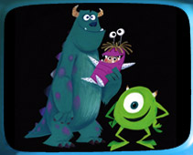
Pixar’s Animation Step for Monster’s Inc.

Slide 37


Pixar’s Animation Step for Monster’s Inc.
Step 2: Implementation

Slide 38


Pixar’s Animation Step for Monster’s Inc.

Slide 39


Pixar’s Animation Step for Monster’s Inc.

Slide 40


Pixar’s Animation Step for Monster’s Inc.

Slide 41


Pixar’s Animation Step for Monster’s Inc.

Slide 42


Pixar’s Animation Step for Monster’s Inc.

Slide 43


Pixar’s Animation Step for Monster’s Inc.

Slide 44


Pixar’s Animation Step for Monster’s Inc.

Slide 45
More about Animation
http://en.wikipedia.org/wiki/Animation

