Slide 1

(Spline, Bezier, B-Spline)

Slide 2
Spline
Drafting terminology
  Spline is a flexible strip that is easily flexed to pass through a series of design points (control points) to produce a smooth curve.
Spline curve – a piecewise polynomial (cubic) curve whose first and second derivatives are continuous across the various curve sections.

Slide 3
Bezier curve
Developed by Paul de Casteljau (1959) and independently by Pierre Bezier (1962).
French automobil company – Citroen & Renault.
P₁
P₂
P₃
P₀

Slide 4
Parametric function
n
P(u) = ∑ B_{n,i}(u)p_{i}
Where
B_{n,i}(u) = . n!. u^{i}(1-u)^{n-i}
i!(n-i)! 0<= u<= 1
i=0
For 3 control points, n = 2
P(u) = (1-u)²p₀ + 2u(1-u) p₁+ u²p₂
For four control points, n = 3
P(u) = (1-u)³p₀ + 3u(1-u) ² p₁ + 3u ² (1-u)p₂ + u³p₃

Slide 5
algorithm
De Casteljau
  Basic concept
    To choose a point C in line segment AB such that C divides the line segment AB in a ratio of u: 1-u
A
C
B
P₁
Let u = 0.5
20
11
u=0.25
00
01
u=0.75
10
21
P₂
P₀

Slide 6
properties
The curve passes through the first, P₀ and last vertex points, P_{n} .
The tangent vector at the starting point P₀ must be given by P₁ – P₀ and the tangent P_{n} given by P_{n} – P_{n-1}
This requirement is generalized for higher derivatives at the curve’s end points. E.g 2nd derivative at P₀ can be determined by P₀ ,P₁ ,P₂ (to satisfy continuity)
The same curve is generated when the order of the control points is reversed

Slide 7
Properties (continued)
Convex hull
  Convex polygon formed by connecting the control points of the curve.
  Curve resides completely inside its convex hull

Slide 8
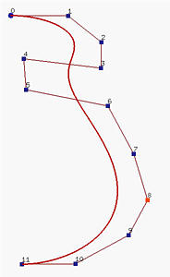
B-Spline
Motivation (recall bezier curve)
  The degree of a Bezier Curve is determined by the number of control points
  E. g. (bezier curve degree 11) – difficult to bend the "neck" toward the line segment P₄P₅.
  Of course, we can add more control points.
  BUT this will increase the degree of the curve → increase computational burden

Slide 9
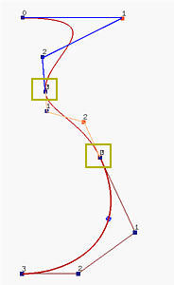
B-Spline
Motivation (recall bezier curve)
  Joint many bezier curves of lower degree together (right figure)
  BUT maintaining continuity in the derivatives of the desired order at the connection point is not easy or may be tedious and undesirable.

Slide 10
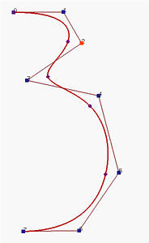
B-Spline
Motivation (recall bezier curve)
  – moving a control point affects the shape of the entire curve- (global modification property) – undesirable.
  Thus, the solution is B-Spline – the degree of the curve is independent of the number of control points
  E.g - right figure – a B-spline curve of degree 3 defined by 8 control points

Slide 11
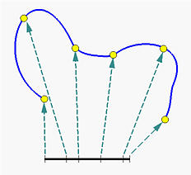
B-Spline
In fact, there are five Bézier curve segments of degree 3 joining together to form the B-spline curve defined by the control points
little dots subdivide the B-spline curve into Bézier curve segments.
Subdividing the curve directly is difficult to do → so, subdivide the domain of the curve by points called knots
0 u 1

Slide 12
B-Spline
In summary, to design a B-spline curve, we need a set of control points, a set of knots and a degree of curve.

Slide 13
B-Spline curve
n
P(u) = ∑ N_{i,k}(u)p_{i} (u₀ < u < u_{m}).. (1.0)
Where basis function = N_{i,k}(u)
Degree of curve → k-1
Control points, p_{i} → 0 < i < n
Knot, u → u₀ < u < u_{m}
m = n + k
i=0

Slide 14
B-Spline : definition
P(u) = ∑ N_{i,k}(u)p_{i} (u₀ < u < u_{m})
u_{i} → knot
[u_{i}, u_{i+1}) → knot span
(u₀, u₁, u₂, …. u_{m} )→ knot vector
The point on the curve that corresponds to a knot u_{i}, → knot point ,P(u_{i})
If knots are equally space → uniform (e.g, 0, 0.2, 0.4, 0.6…)
Otherwise → non uniform (e.g: 0, 0.1, 0.3, 0.4, 0.8 …)

Slide 15
B-Spline : definition
Uniform knot vector
  Individual knot value is evenly spaced
  (0, 1, 2, 3, 4)
  Then, normalized to the range [0, 1]
  (0, 0.25, 0.5, 0.75, 1.0)

Slide 16
Type of B-Spline uniform knot vector
Non-periodic knots (open knots)
Periodic knots (non-open knots)
First and last knots are duplicated k times.
E.g (0,0,0,1,2,2,2)
Curve pass through the first and last control points
First and last knots are not duplicated – same contribution.
E.g (0, 1, 2, 3)
Curve doesn’t pass through end points.
used to generate closed curves (when first = last control points)

Slide 17
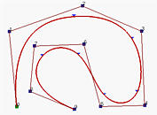
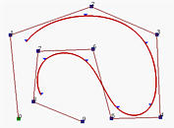
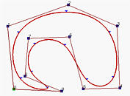
Type of B-Spline knot vector
Non-periodic knots (open knots)
Periodic knots (non-open knots)
(Closed knots)

Slide 18
Non-periodic (open) uniform B-Spline
The knot spacing is evenly spaced except at the ends where knot values are repeated k times.
E.g P(u) = ∑ N_{i,k}(u)p_{i} (u₀ < u < u_{m})
Degree = k-1, number of control points = n + 1
Number of knots = m + 1 @ n+ k + 1
→for degree = 1 and number of control points = 4 →(k = 2, n = 3)
→ Number of knots = n + k + 1 = 6
non periodic uniform knot vector (0,0,1,2,3, 3)
* Knot value between 0 and 3 are equally spaced → uniform
n
i=0

Slide 19
Non-periodic (open) uniform B-Spline
Example
For curve degree = 3, number of control points = 5
→ k = 4, n = 4
→ number of knots = n+k+1 = 9
→ non periodic knots vector = (0,0,0,0,1,2,2,2,2)
For curve degree = 1, number of control points = 5
→ k = 2, n = 4
→ number of knots = n + k + 1 = 7
→ non periodic uniform knots vector = (0, 0, 1, 2, 3, 4, 4)

Slide 20
Non-periodic (open) uniform B-Spline
For any value of parameters k and n, non periodic knots are determined from
0 0≤ i < k
i – k + 1 k ≤ i ≤ n
n – k + 2 n < i ≤n+k
u_{i} =
(1.3)
e.g k=2, n = 3
0 0≤ i < 2
i – 2 + 1 2 ≤ i ≤ 3
3 – 2 + 2 3 < i ≤5
u_{i} =
u = (0, 0, 1, 2, 3, 3)

Slide 21
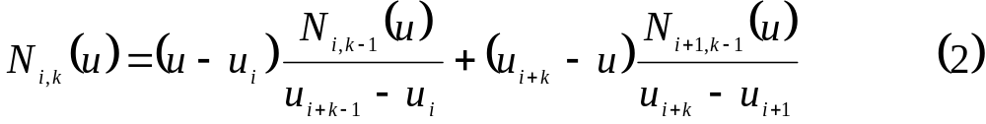
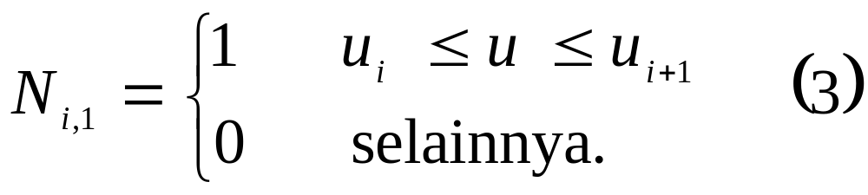
B-Spline basis function
(1.1)
(1.2)
Otherwise
In equation (1.1), the denominators can have a value of zero, 0/0 is presumed to be zero.
If the degree is zero basis function N_{i,1}(u) is 1 if u is in the i-th knot span [u_{i}, u_{i+1}).

Slide 22

B-Spline basis function
For example, if we have four knots u₀ = 0, u₁ = 1, u₂ = 2 and u₃ = 3, knot spans 0, 1 and 2 are [0,1), [1,2), [2,3)
the basis functions of degree 0 are N_{0,1}(u) = 1 on [0,1) and 0 elsewhere, N_{1,1}(u) = 1 on (1,2) and 0 elsewhere, and N_{2,1}(u) = 1 on (2,3) and 0 elsewhere.
This is shown below

Slide 23

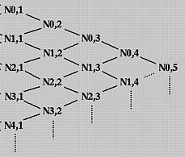
B-Spline basis function
To understand the way of computing N_{i,p}(u) for p greater than 0, we use the triangular computation scheme

Slide 24
Non-periodic (open) uniform B-Spline
Example
Find the knot values of a non periodic uniform B-Spline which has degree = 2 and 3 control points. Then, find the equation of B-Spline curve in polynomial form.

Slide 25
Non-periodic (open) uniform B-Spline
Answer
Degree = k-1 = 2 → k=3
Control points = n + 1 = 3 → n=2
Number of knot = n + k + 1 = 6
Knot values → u₀=0, u₁=0, u₂=0, u₃=1,u₄=1,u₅= 1

Slide 26
Non-periodic (open) uniform B-Spline
Answer(cont)
To obtain the polynomial equation, P(u) = ∑ N_{i,k}(u)p_{i}
= ∑ N_{i,3}(u)p_{i}
= N_{0,3}(u)p₀ + N_{1,3}(u)p₁ + N_{2,3}(u)p₂
firstly, find the N_{i,k}(u) using the knot value that shown above, start from k =1 to k=3
n
i=0
2
i=0

Slide 27
Non-periodic (open) uniform B-Spline
Answer (cont)
For k = 1, find N_{i,1}(u) – use equation (1.2):
  N_{0,1}(u) = 1 u₀≤ u ≤u₁ ; (u=0)
  0 otherwise
  N_{1,1}(u) = 1 u₁≤ u ≤u₂ ; (u=0)
  0 otherwise
  N_{2,1}(u) = 1 u₂≤ u ≤u₃ ; (0≤ u ≤ 1)
  0 otherwise
  N_{3,1}(u) = 1 u₃≤ u ≤u₄ ; (u=1)
  0 otherwise
  N_{4,1}(u) = 1 u₄≤ u ≤u₅ ; (u=1)
  0 otherwise

Slide 28
Non-periodic (open) uniform B-Spline
Answer (cont)
For k = 2, find N_{i,2}(u) – use equation (1.1):
  N_{0,2}(u) = u - u₀ N_{0,1} + u₂ – u N_{1,1} (u₀ =u₁ =u₂ = 0)
  u₁ - u₀ u₂ – u₁
  = u – 0 N_{0,1} + 0 – u N_{1,1} = 0
  0 – 0 0 – 0
  N_{1,2}(u) = u - u₁ N_{1,1} + u₃ – u N_{2,1} (u₁ =u₂ = 0, u₃ = 1)
  u₂ - u₁ u₃ – u₂
  = u – 0 N_{1,1} + 1 – u N_{2,1} = 1 - u
  0 – 0 1 – 0

Slide 29
Non-periodic (open) uniform B-Spline
Answer (cont)
  N_{2,2}(u) = u – u₂ N_{2,1} + u₄ – u N_{3,1} (u₂ =0, u₃ =u₄ = 1)
  u₃ – u₂ u₄ – u₃
  = u – 0 N_{2,1} + 1 – u N_{3,1} = u
  1 – 0 1 – 1
  N_{3,2}(u) = u – u₃ N_{3,1} + u₅ – u N_{4,1} (u₃ =u₄ = u₅ = 1)
  u₄ – u₃ u₅– u₄
  = u – 1 N_{3,1} + 1 – u N_{4,1} = 0
  1 – 1 1 – 1

Slide 30
Non-periodic (open) uniform B-Spline
Answer (cont)
For k = 2
N_{0,2}(u) = 0
N_{1,2}(u) = 1 - u
N_{2,2}(u) = u
N_{3,2}(u) = 0

Slide 31
Non-periodic (open) uniform B-Spline
Answer (cont)
For k = 3, find N_{i,3}(u) – use equation (1.1):
  N_{0,3}(u) = u - u₀ N_{0,2} + u₃ – u N_{1,2} (u₀ =u₁ =u₂ = 0, u₃ =1 )
  u₂ - u₀ u₃ – u₁
  = u – 0 N_{0,2} + 1 – u N_{1,2} = (1-u)(1-u) = (1- u)²
  0 – 0 1 – 0
  N_{1,3}(u) = u - u₁ N_{1,2} + u₄ – u N_{2,2} (u₁ =u₂ = 0, u₃ = u₄ = 1)
  u₃ - u₁ u₄ – u₂
  = u – 0 N_{1,2} + 1 – u N_{2,2} = u(1 – u) +(1-u)u = 2u(1-u)
  1 – 0 1 – 0

Slide 32
Non-periodic (open) uniform B-Spline
Answer (cont)
  N_{2,3}(u) = u – u₂ N_{2,2} + u₅ – u N_{3,2} (u₂ =0, u₃ =u₄ = u₅ =1)
  u₄ – u₂ u₅ – u₃
  = u – 0 N_{2,2} + 1 – u N_{3,2} = u²
  1 – 0 1 – 1
  N_{0,3}(u) =(1- u)^{2,} N_{1,3}(u) = 2u(1-u), N_{2,3}(u) = u²
  The polynomial equation, P(u) = ∑ N_{i,k}(u)p_{i}
  P(u) = N_{0,3}(u)p₀ + N_{1,3}(u)p₁ + N_{2,3}(u)p₂
  = (1- u)² p₀ + 2u(1-u) p₁ + u²p₂ (0 <= u <= 1)
n
i=0

Slide 33
Non-periodic (open) uniform B-Spline
Exercise:
Find the polynomial equation for curve with degree = 1 and number of control points = 4

Slide 34
Non-periodic (open) uniform B-Spline
Answer
k = 2 , n = 3 → number of knots = 6
Knot vector = (0, 0, 1, 2, 3, 3)
For k = 1, find N_{i,1}(u) – use equation (1.2):
  N_{0,1}(u) = 1 u₀≤ u ≤u₁ ; (u=0)
  N_{1,1}(u) = 1 u₁≤ u ≤u₂ ; (0≤ u ≤ 1) N_{2,1}(u) = 1 u₂≤ u ≤u₃ ; (1≤ u ≤ 2)
  N_{3,1}(u) = 1 u₃≤ u ≤u₄ ; (2≤ u ≤ 3) N_{4,1}(u) = 1 u₄≤ u ≤u₅ ; (u=3)

Slide 35
Non-periodic (open) uniform B-Spline
Answer (cont)
For k = 2, find N_{i,2}(u) – use equation (1.1):
  N_{0,2}(u) = u - u₀ N_{0,1} + u₂ – u N_{1,1} (u₀ =u₁ =0, u₂ = 1)
  u₁ - u₀ u₂ – u₁
  = u – 0 N_{0,1} + 1 – u N_{1,1}
  0 – 0 1 – 0
  = 1 – u (0≤ u ≤ 1)

Slide 36
Non-periodic (open) uniform B-Spline
Answer (cont)
For k = 2, find N_{i,2}(u) – use equation (1.1):
  N_{1,2}(u) = u - u₁ N_{1,1} + u₃ – u N_{2,1} (u₁ =0, u₂ =1, u₃ = 2)
  u₂ - u₁ u₃ – u₂
  = u – 0 N_{1,1} + 2 – u N_{2,1}
  1 – 0 2 – 1
  N_{1,2}(u) = u (0≤ u ≤ 1)
  N_{1,2}(u) = 2 – u (1≤ u ≤ 2)

Slide 37
Non-periodic (open) uniform B-Spline
Answer (cont)
  N_{2,2}(u) = u – u₂ N_{2,1} + u₄ – u N_{3,1} (u₂ =1, u₃ =2,u₄ = 3)
  u₃ – u₂ u₄ – u₃
  = u – 1 N_{2,1} + 3 – u N_{3,1} =
  2 – 1 3 – 2
  N_{2,2}(u) = u – 1 (1≤ u ≤ 2)
  N_{2,2}(u) = 3 – u (2≤ u ≤ 3)

Slide 38
Non-periodic (open) uniform B-Spline
Answer (cont)
  N_{3,2}(u) = u – u₃ N_{3,1} + u₅ – u N_{4,1} (u₃ = 2, u₄ = 3, u₅ = 3)
  u₄ – u₃ u₅– u₄
  = u – 2 N_{3,1} + 3 – u N_{4,1} =
  3 – 2 3 – 3
  = u – 2 (2≤ u ≤ 3)

Slide 39
Non-periodic (open) uniform B-Spline
Answer (cont)
  The polynomial equation P(u) = ∑ N_{i,k}(u)p_{i}
  P(u) = N_{0,2}(u)p₀ + N_{1,2}(u)p₁ + N_{2,2}(u)p₂ + N_{3,2}(u)p₃
  P(u) = (1 – u) p₀ + u p₁ (0≤ u ≤ 1)
  P(u) = (2 – u) p₁ + (u – 1) p₂ (1≤ u ≤ 2)
  P(u) = (3 – u) p₂ + (u - 2) p₃ (2≤ u ≤ 3)

Slide 40
Periodic uniform knot
Periodic knots are determined from
  U_{i} = i - k (0 ≤ i ≤ n+k)
Example
  For curve with degree = 3 and number of control points = 4 (cubic B-spline)
  (k = 4, n = 3) → number of knots = 8
  (0, 1, 2, 3, 4, 5, 6, 8)

Slide 41
Periodic uniform knot
Normalize u (0<= u <= 1)
N_{0,4}(u) = 1/6 (1-u)³
N_{1,4}(u) = 1/6 (3u ³ – 6u ² +4)
N_{2,4}(u) = 1/6 (-3u ³ + 3u ² + 3u +1)
N_{3,4}(u) = 1/6 u³
P(u) = N_{0,4}(u)p₀ + N_{1,4}(u)p₁ + N_{2,4}(u)p₂ + N_{3,4}(u)p₃

Slide 42
Periodic uniform knot
In matrix form
P(u) = [u³,u², u, 1].M_{n}.
M_{n} = 1/6
P₀
P₁
P₂
P₃
-1 3 -3 1
-6 3 0
-3 0 3 0
1 4 1 0

Slide 43
Periodic uniform knot
P₀

Slide 44
Closed periodic
Example
k = 4, n = 5
P₂
P₁
P₃
P₀
P₄
P₅

Slide 45
Closed periodic
Equation 1.0 change to
N_{i,k}(u) = N_{0,k}((u-i)mod(n+1))
→ P(u) = ∑ N_{0,k}((u-i)mod(n+1))p_{i}
n
i=0
0<= u <= n+1

Slide 46
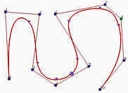
Properties of B-Spline
The m degree B-Spline function are piecewise polynomials of degree m → have C^{m-1} continuity. →e.g B-Spline degree 3 have C² continuity.
u=2
u=1

Slide 47
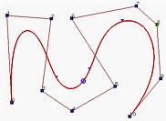
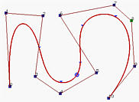
Properties of B-Spline
In general, the lower the degree, the closer a B-spline curve follows its control polyline.
Degree = 7
Degree = 5
Degree = 3

Slide 48
Properties of B-Spline
Equality m = n + k must be satisfied
Number of knots = m + 1
k cannot exceed the number of control points, n+ 1

Slide 49
Properties of B-Spline
2. Each curve segment is affected by k control points as shown by past examples.→ e.g k = 3, P(u) = N_{i-1,k} p_{i-1} + N_{i,k} p_{i}+ N_{i+1,k} p_{i+1}

Slide 50
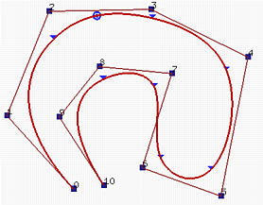
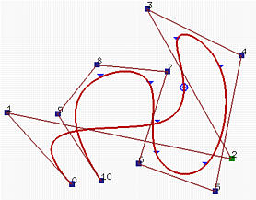
Properties of B-Spline
Local Modification Scheme: changing the position of control point P_{i} only affects the curve C(u) on interval [u_{i}, u_{i+k}).
Modify control point P₂

Slide 51
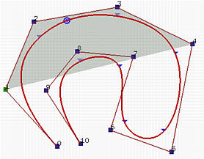
Properties of B-Spline
3. Strong Convex Hull Property: A B-spline curve is contained in the convex hull of its control polyline. More specifically, if u is in knot span [u_{i},u_{i+1}), then C(u) is in the convex hull of control points P_{i-p}, P_{i-p+1}, ..., P_{i}.
Degree = 3, k = 4
Convex hull based on 4 control points

Slide 52
Properties of B-Spline
4. Non-periodic B-spline curve C(u) passes through the two end control points P₀ and P_{n}.
5. Each B-spline function Nk,m(t) is nonnegative for every t, and the family of such functions sums to unity, that is ∑ N_{i,k} (u) = 1
6. Affine Invariance
to transform a B-Spline curve, we simply transform each control points.
7. Bézier Curves Are Special Cases of B-spline Curves
n
i=0

Slide 53
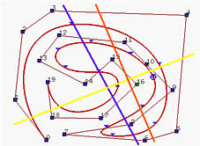
Properties of B-Spline
8. Variation Diminishing : A B-Spline curve does not pass through any line more times than does its control polyline

Slide 54
Knot Insertion : B-Spline
knot insertion is adding a new knot into the existing knot vector without changing the shape of the curve.
new knot may be equal to an existing knot → the multiplicity of that knot is increased by one
Since, number of knots = k + n + 1
If the number of knots is increased by 1→ either degree or number of control points must also be increased by 1.
Maintain the curve shape →maintain degree →change the number of control points.

Slide 55
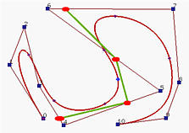
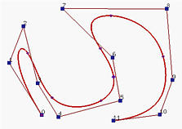
Knot Insertion : B-Spline
So, inserting a new knot causes a new control point to be added. In fact, some existing control points are removed and replaced with new ones by corner cutting
Insert knot u = 0.5

Slide 56
Single knot insertion : B-Spline
Given n+1 control points – P₀, P₁, .. P_{n}
Knot vector, U= (u₀, u₁,…u_{m})
Degree = p, order, k = p+1
Insert a new knot t into knot vector without changing the shape.
→ find the knot span that contains the new knot. Let say [u_{k}, u_{k+1})

Slide 57
Single knot insertion : B-Spline
This insertion will affected to k (degree + 1) control points (refer to B-Spline properties) → P_{k}, P_{k-1}, P_{k-1},…P_{k-p}
Find p new control points Q_{k} on leg P_{k-1}P_{k}, Q_{k-1} on leg P_{k-2}P_{k-1}, ..., and Q_{k-p+1} on leg P_{k-p}P_{k-p+1} such that the old polyline between P_{k-p} and P_{k} (in black below) is replaced by P_{k-p}Q_{k-p+1}...Q_{k}P_{k} (in orange below)
P_{k-2}
P_{k-1}
Q_{k-1}
Q_{k}
P_{k}
P_{k-p+1}
Q_{k-p+1}
P_{k-p}

Slide 58
Single knot insertion : B-Spline
All other control points are not change
The formula for computing the new control point Q_{i} on leg P_{i-1}P_{i} is the following
  Q_{i} = (1-a_{i})P_{i-1}+ a_{i}P_{i}
  a_{i} = t- u_{i} k-p+1<= i <= k
  u_{i+p}-u_{i}

Slide 59
Single knot insertion : B-Spline
Example
Suppose we have a B-spline curve of degree 3 with a knot vector as follows:
u₀ to u₃ | u₄ | u₅ | u₆ | u₇ | u₈ to u₁₁
0 | 0.2 | 0.4 | 0.6 | 0.8 | 1
Insert a new knot t = 0.5 , find new control points and new knot vector?

Slide 60
Single knot insertion : B-Spline
Solution:
- t = 0.5 lies in knot span [u₅, u₆)
- the affected control points are P₅, P₄, P₃ and P₂
find the 3 new control points Q₅, Q₄, Q₃
we need to compute a₅, a₄ and a₃ as follows
  a₅ = t - u₅ = 0.5 – 0.4 = 1/6
u₈ -u₅ 1 – 0.4
- a₄ = t - u₄ = 0.5 – 0.2 = 1/2
u₇ –u₄ 0.8 – 0.2
- a₃ = t - u₃ = 0.5 – 0 = 5/6
u₆ -u₃ 0.6 – 0

Slide 61
Single knot insertion : B-Spline
Solution (cont)
The three new control points are
Q₅ = (1-a₅)P₄+ a₅P₅ = (1-1/6)P₄+ 1/6P₅
Q₄ = (1-a₄)P₃+ a₄P₄ = (1-1/6)P₃+ 1/6P₄
Q₃ = (1-a₃)P₂+ a₃P₃ = (1-5/6)P₂+ 5/6P₃

Slide 62
Single knot insertion : B-Spline
Solution (cont)
The new control points are P₀, P₁, P₂, Q₃, Q₄, Q₅, P₅, P₆, P₇
the new knot vector is
u₀ to u₃ | u₄ | u₅ | u₆ | u₇ | u₈ | u₉ to u₁₂
0 | 0.2 | 0.4 | 0.5 | 0.6 | 0.8 | 1

