Slide 1
Hidden Lines and Surfaces
(Visible Surface determination)

Slide 2
Hidden Surface Removal
Goal: Determine which surfaces are visible and which are not.
  Z-Buffer is just one of many hidden surface removal algorithms.
Other names:
  Visible-surface detection
  Hidden-surface elimination
Display all visible surfaces, do not display any occluded surfaces.
We can categorize into
  Object-space methods
  Image-space methods

Slide 3
Hidden Surface Elimination
Object space algorithms: determine which objects are in front of others
  Resize doesn’t require recalculation
  Works for static scenes
  May be difficult to determine
Image space algorithms: determine
which object is visible at each pixel
  Resize requires recalculation
  Works for dynamic scenes

Slide 4
Hidden Surface Elimination Complexity
If a scene has n surfaces, then since every surfaces may have to be tested against every other surface for visibility, we might expect an object precision algorithm to take O(n²) time.
On the other hand, if there are N pixels, we might expect an image precision algorithm to take O(nN) time, since every pixel may have to be tested for the visibility of n surfaces.
Since the number of the number of surfaces is much less than the number of pixels, then the number of decisions to be made is much fewer in the object precision case, n < < N.

Slide 5
Hidden Surface Elimination Complexity
Different algorithms try to reduce these basic counts.
Thus, one can consider bounding volumes (or “extents”) to determine roughly whether objects cannot overlap - this reduces the sorting time. With a good sorting algorithm, O(n²) may be reducible to a more manageable O(n log n).
Concepts such as depth coherence (the depth of a point on a surface may be predicable from the depth known at a nearby point) can cut down the number of arithmetic steps to be performed.
Image precision algorithms may benefit from hardware acceleration.

Slide 6
Back-Face Culling
Don’t draw surfaces facing away from viewpoint:
  Assumes objects are solid polyhedra
    Usually combined with additional methods
  Compute polygon normal n:
    Assume counter-clockwise vertex
    order
    For a triangle (a, b, c): n = (b – a) × (c – a)
  Compute vector from viewpoint to any
  point p on polygon v:
  Facing away (don’t draw) if n and v are
  pointed in opposite directions →
  dot product n · v > 0
c
n
a
b
y
x
z

Slide 7
Back-Face Culling Example
n₁·v = (2, 1, 2) · (-1, 0, -1)
= -2 – 2 = -4,
so n₁·v < 0
so n₁ front facing polygon
n₂ = (-3, 1, -2)
n₁ = (2, 1, 2)
n₂ ·v = (-3, 1, -2) · (-1, 0, -1)
= 3 + 2 = 5
so n₂ · v > 0
so n₂ back facing polygon
v = (-1, 0, -1)

Slide 8
Back-Face Culling
If the viewpoint is on the +z axis looking at the origin, we only need check the sign of the z component of the object’s normal vector
  if n_{z} < 0, it is back facing
  if n_{z} > 0 it is front facing
  What if n_{z} = 0?
    the polygon is parallel to the view direction, so we don’t see it

Slide 9
Painter’s Algorithm
Object-space algorithm
Draw surfaces from back (farthest away) to front (closest):
  Sort surfaces/polygons by their depth (z value)
  Draw objects in order (farthest to closest)
  Closer objects paint over the top of farther away objects

Slide 10
List Priority Algorithms
A visibility ordering is placed on the objects
  Objects are rendered back to front based on that ordering
Problems:
  overlapping polygons
x
z

Slide 11
Depth Sort Algorithm
An extension to the painter’s algorithm
  Performs a similar algorithm but attempts to resolve overlapping polygons
Algorithm:
  Sort objects by their minimum z value (farthest from the viewer)
  Resolve any ambiguities caused by overlapping polygons, splitting polygons if necessary
  Scan convert polygons in ascending order of their z values (back to front)

Slide 12
Depth-Sort Algorithm
Depth-Sort test for overlapping polygons:
  Let P be the most distant polygon in the sorted list.
  Before scan converting P, we must make sure it does not overlap another polygon and obscure it
  For each polygon Q that P might obscure, we make the following tests. As soon as one succeeds, there is no overlap, so we quit:
    Are their x extents non-overlapping?
    Are their y extents non-overlapping?
    Is P entirely on the other side of Q’s plane from the viewpoint?
    Is Q entirely on the same side of P’s plane as the viewpoint?
    Are their projections onto the (x, y) plane non-overlapping?

Slide 13
Depth-Sort Algorithm
x
Test 3 succeeds:
Test 3 fails, test 4 succeeds:
P
z
Q
x
P
z
Q

Slide 14
Depth-Sort Algorithm
If all 5 tests fail, assume that P obscures Q, reverse their roles, and repeat steps 3 and 4
If these tests also fail, one of the polygons must be split into multiple polygons and the tests run again.

Slide 15
Z-Buffering

Slide 16
Z-Buffering
Visible Surface Determination Algorithm:
  Determine which object is visible at each pixel.
  Order of polygons is not critical.
  Works for dynamic scenes.
Basic idea:
  Rasterize (scan-convert) each polygon, one at a time
  Keep track of a z value at each pixel
    Interpolate z value of vertices during rasterization.
  Replace pixel with new color if z value is greater. (i.e., if object is closer to eye)

Slide 17
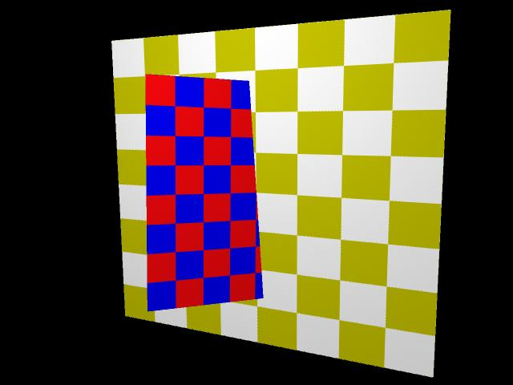
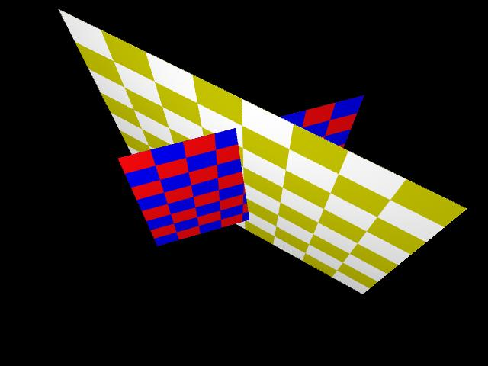
Example
Goal is to figure out which polygon to draw based on which is in front of what. The algorithm relies on the fact that if a nearer object occupying (x,y) is found, then the depth buffer is overwritten with the rendering information from this nearer surface.

Slide 18
Z-buffering
Need to maintain:
  Frame buffer
    contains colour values for each pixel
  Z-buffer
    contains the current value of z for each pixel
The two buffers have the same width and height.
No object/object intersections.
No sorting of objects required.
Additional memory is required for the z-buffer.
  In the early days, this was a problem.

Slide 19
Z-Buffering: Algorithm
allocate z-buffer;
The z-buffer algorithm:
compare pixel depth(x,y) against buffer record d[x][y]
for (every pixel){ initialize the colour to the background};
for (each facet F){
for (each pixel (x,y) on the facet)
if (depth(x,y) < buffer[x][y]){ / / F is closest so far
set pixel(x,y) to colour of F;
d[x][y] = depth(x,y)
}
}
}

Slide 20
Z-Buffering: Example
Scan convert the following two polygons.
The number inside the pixel represents its z-value.
-1
(3,3)
(0,3)
-1
-2
-3
-3
-2
-3
-4
-5
-5
-4
-3
-4
-5
-6
-7
-7
-6
-5
-4
(0,0)
(3,0)
(0,0)
(3,0)
Does order matter?

Slide 21
Z-Buffering: Example
−∞
−∞
−∞
−∞
−∞
−∞
−∞
−∞
-1
-1
-1
-1
−∞
−∞
−∞
−∞
-1
−∞
−∞
−∞
−∞
−∞
−∞
−∞
−∞
-2
-3
-2
-3
-2
-2
-3
-3
-2
−∞
-3
+
=
−∞
−∞
−∞
+
=
−∞
−∞
−∞
−∞
-3
-4
−∞
−∞
−∞
−∞
-3
-4
-5
−∞
−∞
−∞
−∞
-5
-4
-3
-5
-4
-3
-3
-4
-5
−∞
−∞
−∞
−∞
-4
-5
−∞
−∞
−∞
−∞
-4
-5
-6
-7
-4
-7
-6
-5
-4
−∞
-5
−∞
-6
−∞
-7
−∞
-7
-6
-5
-4
−∞
−∞
−∞
-1
−∞
−∞
−∞
−∞
-1
−∞
-1
−∞
−∞
−∞
−∞
-1
-1
−∞
−∞
-3
-2
−∞
−∞
−∞
−∞
-3
-2
−∞
−∞
-2
-3
−∞
−∞
−∞
−∞
+
=
+
=
-2
-3
-3
-2
−∞
-5
−∞
-4
−∞
-3
−∞
−∞
−∞
−∞
-5
-4
-3
−∞
-3
-4
-5
−∞
−∞
−∞
−∞
-3
-4
-5
-4
-3
-7
−∞
-6
−∞
-5
−∞
-4
−∞
−∞
−∞
−∞
-7
-6
-5
-4
−∞
-4
-5
-6
-7
−∞
−∞
−∞
−∞
-4
-5
-7
-6
-5
-4

Slide 22
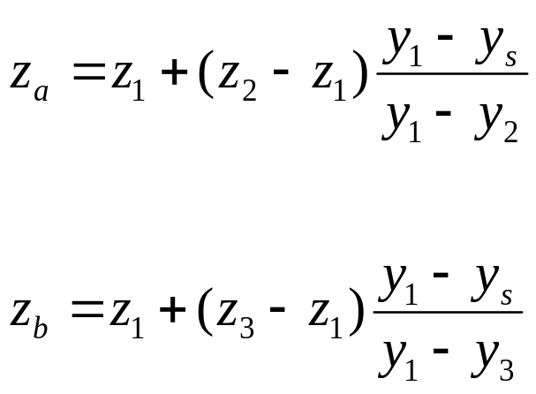
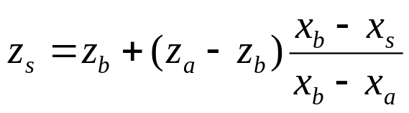
Z-Buffering: Computing Z
How do you compute the z value at a given pixel?
  Interpolate between vertices
z₁
y₁
z_{a}
z_{b}
y_{s}
z_{s}
y₂
z₂
y₃
z₃
How do we compute x_{a} and x_{b}?

Slide 23
Z-buffer Implementation
Modify the 2D polygon algorithm slightly.
  When projected onto the screen 3D polygons look like 2D polygons (don’t sweat the projection, yet).
Compute Z values to figure out what’s in front.
Modifications to polygon scan converter
  Need to keep track of z value in GET and AET.
  Before drawing a pixel, compare the current z value to the z-buffer.
  If you color the pixel, update the z-buffer.
  For optimization:
    Maintain a horizontal z-increment for each new pixel.
    Maintain a vertical z-increment for each new scanline.

Slide 24
GET Entries Updated for Z-buffering
GET Entries before Z-buffering
With Z-buffering:
y_{max}
x @ y_{min}
1/m
vertZ
y_{max}
x @ y_{min}
1/m
z @y_{min}
Vertical Z
Increment

Slide 25
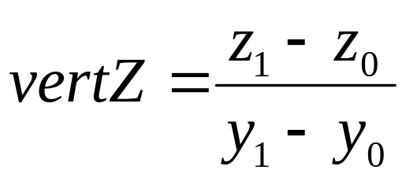
Computing the Vertical Z Increment
This value is the increment in z each time we move to a new scan line

Slide 26
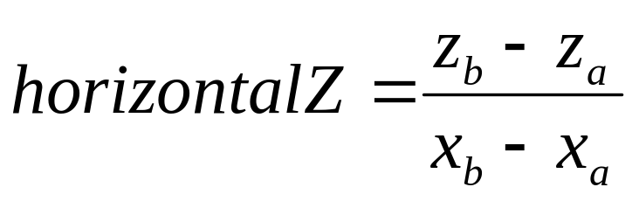
Horizontal Z Increment
We can also compute a horizontalZ increment for the x direction.
As we move horizontally between pixels, we increment z by horizontalZ.
Given the current z values of the two edges of a span, horizontalZ is given by

Slide 27
Horizontal Increment of a Span
p_{a} = (x_{a}, y_{a}, z_{a})
8
7
6
p_{b} = (x_{b}, y_{b}, z_{b)}
5
4
3
edge a
2
edge b
1
0
0
1
2
3
4
5
6
7
8

Slide 28
AET Entries Updated for Z-buffering
AET Entries before Z-buffering:
With Z-buffering:
Note: horizontalZ doesn’t need to be stored in the AET – just computed each iteration.
x @
current y
y_{max}
1/m
x @
current y
z @
current x,y
y_{max}
1/m
vertZ

Slide 29
Z-Buffering : Recap
Create a z-buffer which is the same size as the frame-buffer.
Initialize frame-buffer to background.
Initialize z-buffer to far plane.
Scan convert polygons one at a time, just as before.
Maintain z-increment values in the edge tables.
At each pixel, compare the current z-value to the value stored in the z-buffer at the pixel location.
  If the current z-value is greater
    Color the pixel the color for this point in the polygon.
    Update the z-buffer.

Slide 30
Z-Buffering : Summary
Advantages:
  Easy to implement
  Fast with hardware support → Fast depth buffer memory
  On most hardware
  No sorting of objects
  Shadows are easy
Disadvantages:
  Extra memory required for z-buffer:
    Integer depth values
    Scan-line algorithm
  Prone to aliasing
    Super-sampling

Slide 31
VSD The z-buffer approach
The algorithm can be adapted in a number of ways. For example, a rough depth sort into nearest surface first ensures that dominant computational effort is not expended in rendering pixels that are subsequently overwritten.
The buffer could represent one complete horizontal scan line. If the scan line does not intersect overlapping facets, there may be no need to consider the full loop for (each facet F). An algorithm similar to the polygon filling algorithm (exploiting an edge table, active edge table, edge coherence and depth coherence) can be used

Slide 32
Cutting Triangles
If triangle intersects plane → Split
Plane
a
Plane
a
A
A
c
t₁
t₃
c
B
t₂
b
B
t₁ =(a, b, A)
t₂ = (b, B, A)
t₃ = (A, B, c)
b
Must maintain same vertex ordering to keep the same normal!

Slide 33
Cutting Triangles (cont.)
Assume we’ve c isolated on one side of plane and that f_{plane}(c) > 0, then:
  Add t₁ and t₂ to negative subtree:
  minus.add(t₁)
  minus.add(t₂)
  Add t₃ to positive subtree:
  plus.add(t₃)
–
Plane
+
a
A
t₁
t₃
c
t₂
B
t₁ =(a, b, A)
t₂ = (b, B, A)
t₃ = (A, B, c)
b

Slide 34
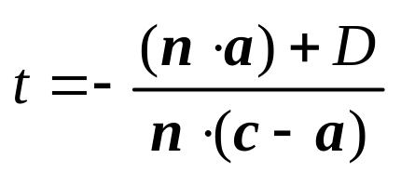
Cutting Triangles (cont.)
How do we find A and B?
  A: intersection of line between
  a and c with the plane f_{plane}
  Use parametric form of line:
p(t) = a + t(c – a)
  Plug p into the plane equation for
  the triangle:
f_{plane}(p) = (n · p) + D = n · (a + t(c – a)) + D
  Solve for t and plug back into p(t) to get A
  Repeat for B
a
A
c
B
b
We use same formula in ray tracing!!

Slide 35
Cutting Triangles (cont.)
What if c is not isolated by the plane?
if (f_{a} * f_{c} ≥ 0) // If a and c on same side:
a->c; c->b; b->a; // Shift vertices clockwise.
else if (f_{b} * f_{c} ≥ 0) // If a and c on same side:
a->c; c->b; b->a; // Shift vertices counter-clockwise.
c
plane
b
plane
a
plane
b
a
c
a
c
b
Assumes a consistent, counter-clockwise ordering of vertices

Slide 36
Cutting Triangles: Complete Algorithm
if (f_{a} * f_{c} ≥ 0) // If a and c on same side:
a->c; c->b; b->a; // Shift vertices clockwise.
else if (f_{b} * f_{c} ≥ 0) // If a and c on same side:
a->c; c->b; b->a; // Shift vertices counter-clockwise.
// Now c is isolated on one side of the plane.
compute A,B; // Compute intersections points.
t₁ = (a,b,A); // Create sub-triangles.
t₂ = (b,B,A);
t₃ = (A,B,c);
// Add sub-triangles to tree.
if (f_{plane}(c) ≥ 0)
minus.add(t₁);
minus.add(t₂);
plus .add(t₃);
else
plus .add(t₁);
plus .add(t₂);
minus.add(t₃);

Slide 37
Z-Buffering
Image precision algorithm:
  Determine which object is visible at each pixel
  Order of polygons not critical
  Works for dynamic scenes
  Takes more memory
Basic idea:
  Rasterize (scan-convert) each polygon
  Keep track of a z value at each pixel
    Interpolate z value of polygon vertices during rasterization
  Replace pixel with new color if z value is smaller (i.e., if object is closer to eye)

Slide 38
Scan Line Algorithms
Image precision
Similar to the ideas behind polygon scan conversion, except now we are dealing with multiple polygons
Need to determine, for each pixel, which object is visible at that pixel
The approach we will present is the “Watkins Algorithm”

Slide 39
Warnock’s Algorithm
An area-subdivision technique
Idea:
  Divide an area into four equal sub-areas
  At each stage, the projection of each polygon will do one of four things:
    Completely surround a particular area
    Intersect the area
    Be completely contained in the area
    Be disjoint to the area

Slide 40
Warnock’s Algorithm
Disjoint polygons do not influence an area.
Parts of an intersecting polygon that lie outside the area do not influence that area
At each step, we determine the areas we can color and color them, then subdivide the areas that are ambiguous.

Slide 41
Warnock’s Algorithm
At each stage of the algorithm, examine the areas:
  If no polygons lie within an area, the area is filled with the background color
  If only one polygon is in part of the area, the area is first filled with the background color and then the polygon is scan converted within the area.
  If one polygon surrounds the area and it is in front of any other polygons, the entire area is filled with the color of the surrounding polygon.
  Otherwise, subdivide the area and repeat the above 4 tests.

Slide 42
Warnock’s Algorithm
Initial scene

Slide 43
Warnock’s Algorithm
First subdivision

Slide 44
Warnock’s Algorithm
Second subdivision

Slide 45
Warnock’s Algorithm
Third subdivision

Slide 46
Warnock’s Algorithm
Fourth subdivision

Slide 47
Warnock’s Algorithm
Subdivision continues until:
  All areas meet one of the four criteria
  An area is pixel size
    in this case, the polygon with the closest point at that pixel determines the pixel color

