Slide 1



PB(Project)
View in Power BI
Last data refresh:
3/10/2024 8:54:05 AM UTC
Downloaded at:
3/10/2024 8:56:48 AM UTC

Slide 2
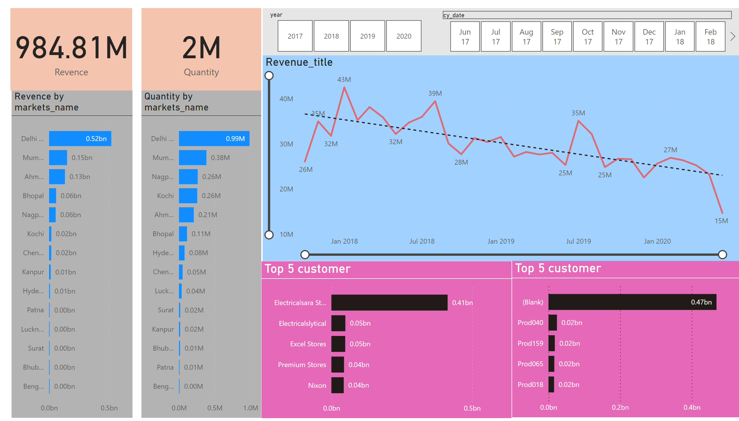
Page 1
Notes:
card
No alt text provided
card
No alt text provided
barChart
No alt text provided
barChart
No alt text provided
slicer
No alt text provided
slicer
No alt text provided
Top 5 customer
No alt text provided
Top 5 customer
No alt text provided
Revenue_title
No alt text provided

