Slide 1
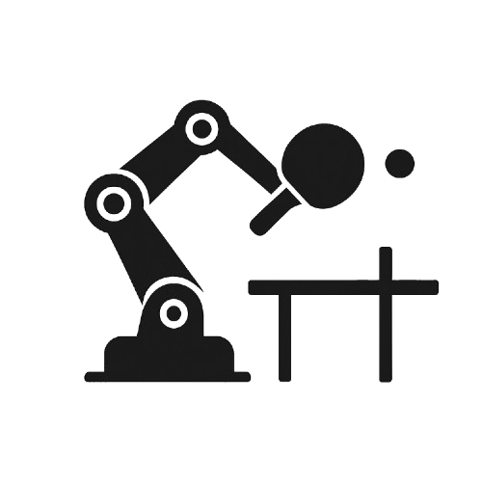

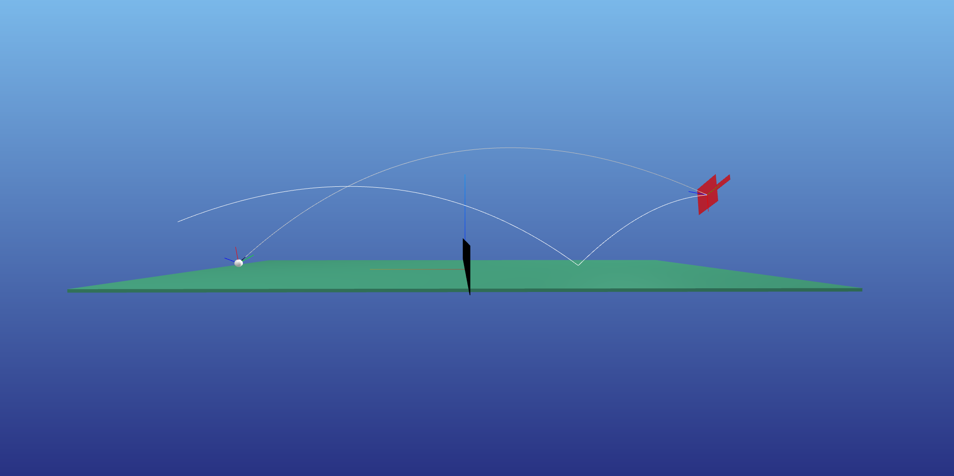
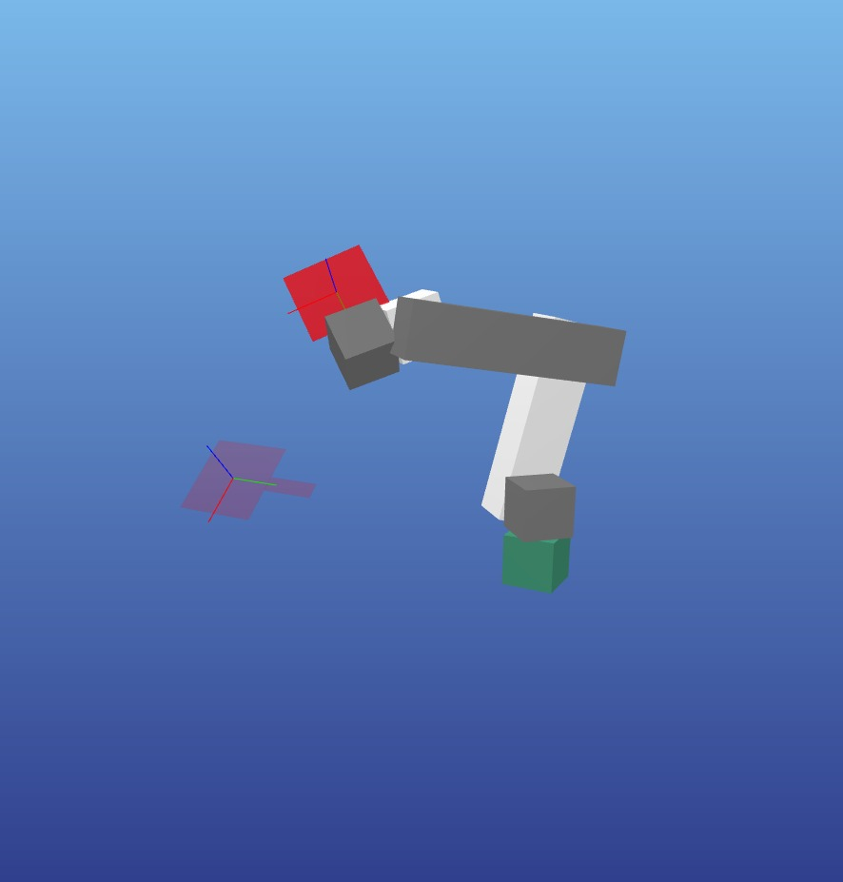
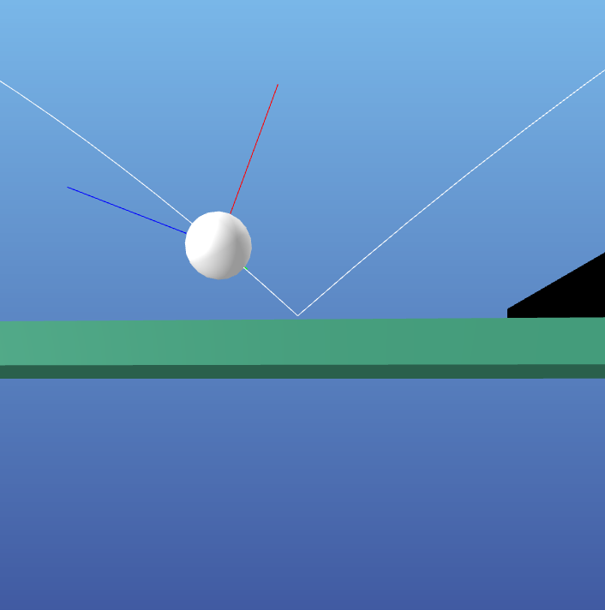


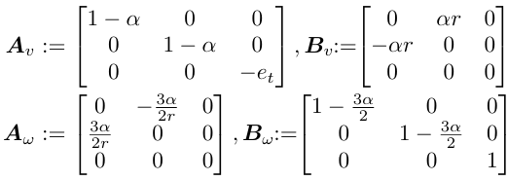

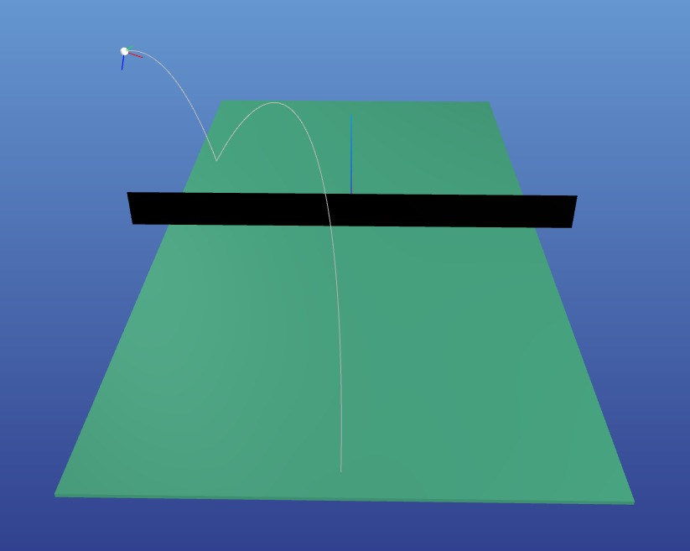
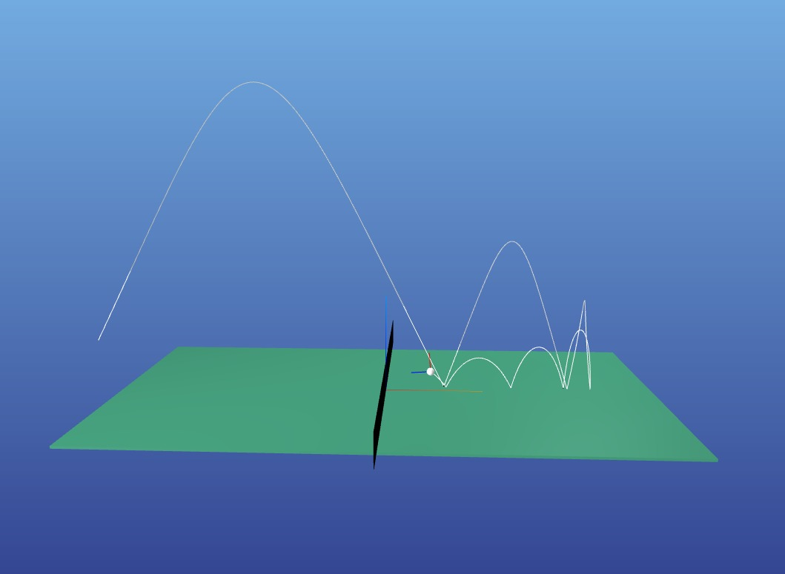
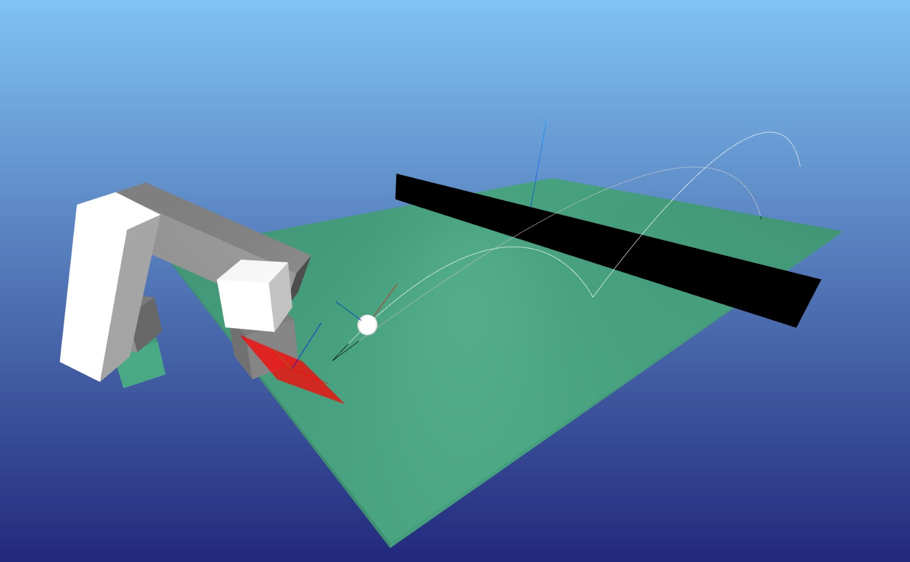
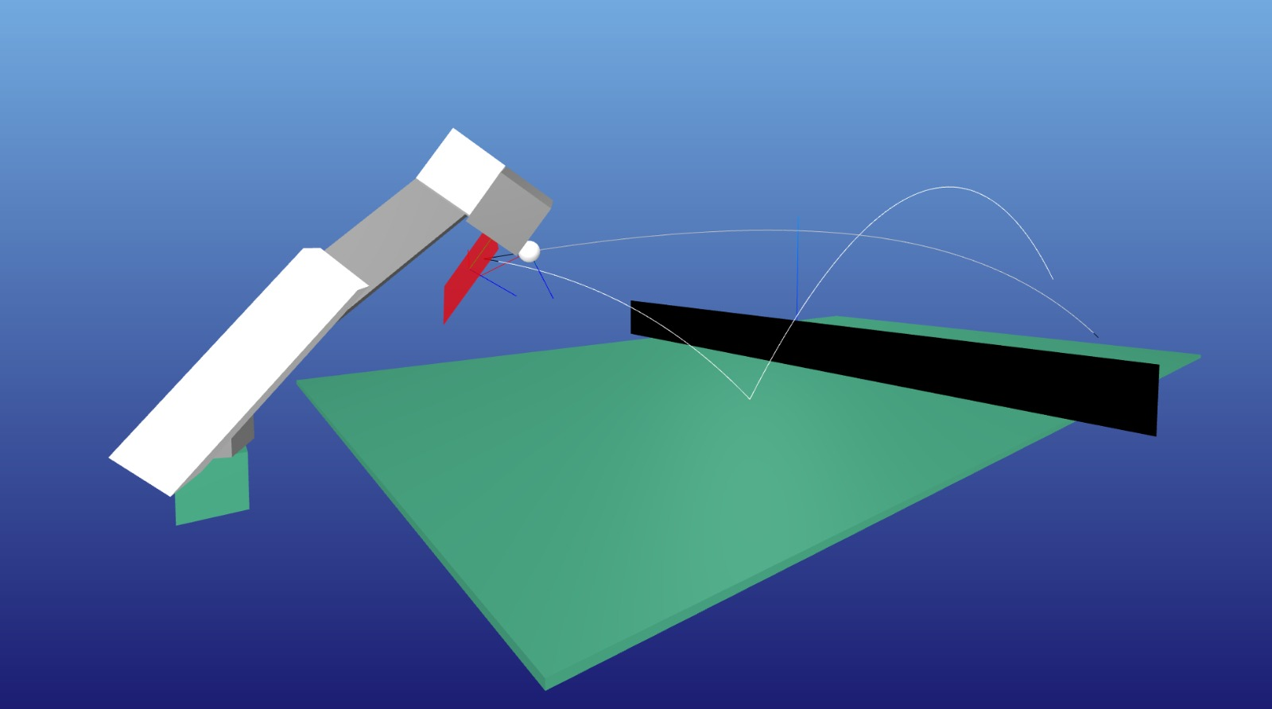



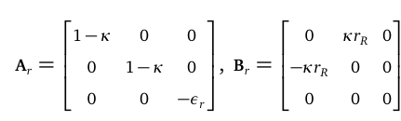


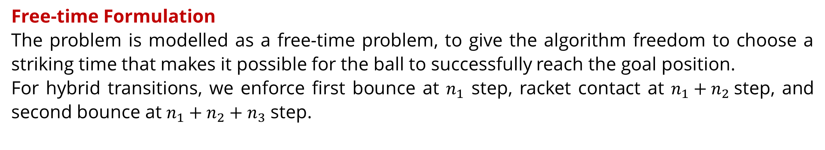
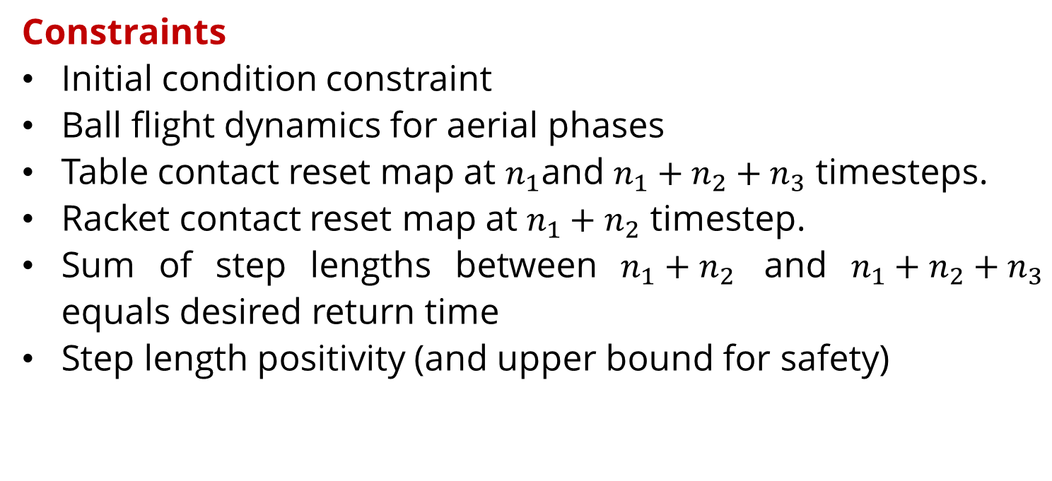
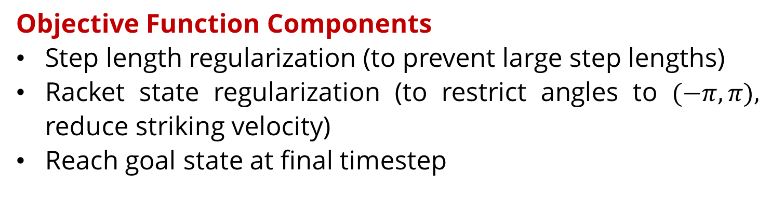
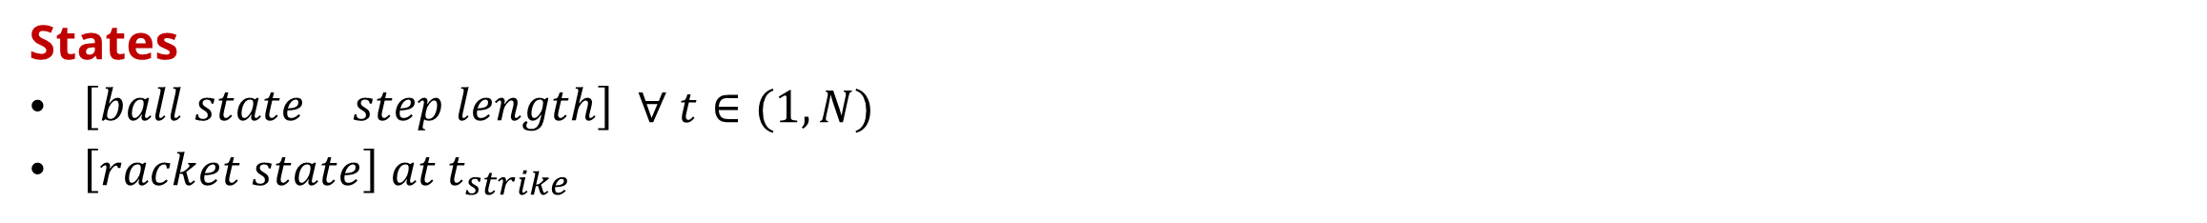
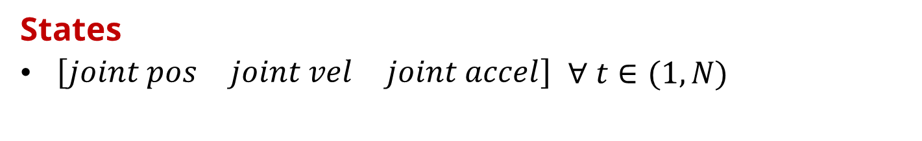
Table Tennis Playing Robots?!
Mohit Vikas Javale, Atharva Sunder Ramdas
Problem Statement
Implementation Details
Motivation
Table tennis is a fast-paced, high-dexterity task that is easy to learn but difficult to master—even for humans. A major challenge arises from the ball's lightweight and smooth design, which makes it highly susceptible to aerodynamic forces. These effects, primarily accentuated by heavy spin, significantly influence the ball’s motion and make accurate placement of the ball difficult.
Also, both of us are table tennis player and enjoy it very much: we think it would be cool to figure out what the optimal stroke looks like in many cases to improve our own gameplay : )
Goals
To figure out dynamics of interactions taking place in a table-tennis scenario and implement then to create a custom simulator.
Devise an optimal control strategy for a robotic 6DOF manipulator to successfully return a ball.
Get 2 such manipulator robots to successfully hold long rallies with one another.
Hopefully, also get this setup to where it could be deployed in real-time over actual hardware
Approach:
Focused Player: In this approach, given some initial condition of the ball, the control algorithm tries to find a solution that return the ball to a specified desired location at a specified desired time while satisfying table tennis rules.
Defensive Player: In this approach, given some initial condition, the control algorithm itself figures out an optimal location and time to return the ball, such that table tennis rules are followed over the trajectory.
End Effector Initial Conditions
Ball Flight Dynamics
Racket Contact Reset Map
Initial conditions
Racket position, rotation, velocity
UR5 Replica
Goal Position
Table Contact Reset Map
End Effector Ball Contact Condition
Ball Trajectory Optimization
Manipulator Trajectory Optimization
Free-time Formulation
The problem is modelled as a free-time problem, to give the algorithm freedom to choose a striking time that makes it possible for the ball to successfully reach the goal position.
For hybrid transitions, we enforce first bounce at $n_{1}$ step, racket contact at ${n_{1}+n}_{2}$step, and second bounce at $n_{1}+n_{2}+n_{3}$ step.
Kinematic Formulation
Trajectory optimization is done over kinematics and not dynamics due to compute limitations. (6DOF manipulator dynamics are highly non-linear)
States
$\left[\begin{matrix}ball state & step length\end{matrix}\right]$ $∀ t∈(1, N)$
$\left[racket state\right]$ $at t_{strike}$
States
$\left[\begin{matrix}joint pos & joint vel & joint accel\end{matrix}\right]$ $∀ t∈(1, N)$
Objective Function Components
Acceleration regularization (to enforce smooth trajectories)
Reach racket state at strike time
Reach zero config state at final timestep
Objective Function Components
Step length regularization (to prevent large step lengths)
Racket state regularization (to restrict angles to $(−π,π),$ reduce striking velocity)
Reach goal state at final timestep
Constraints
Initial condition constraints
Kinematic derivative constraints
Constraints
Initial condition constraint
Ball flight dynamics for aerial phases
Table contact reset map at $n_{1}$and $n_{1}+n_{2}+n_{3}$ timesteps.
Racket contact reset map at $n_{1}+n_{2}$ timestep.
Sum of step lengths between $n_{1}+n_{2}$ and $n_{1}+n_{2}+n_{3}$ equals desired return time
Step length positivity (and upper bound for safety)
RK4
Reset Map
Dynamics Equations
State in Guard set
Future Work
Ball Flight Dynamics
Accounts for gravity, air drag due to ball velocity and Magnus effect due to spin.
Make manipulator capable to hit backhand shots.
Implement defensive player formulation
Add second manipulator
Perform live optimization for both manipulators
Optimize solver for near real-time deployment
Table Contact Reset Map
Accounts the interchange between linear and angular velocity due to friction and restitution.
Preliminary Results
Racket Contact Reset Map
Very similar to table contact reset map, just expressed in the racket frame.
Aerial swing due to sidespin, (caused by aerodynamic effects)
Ball returning due to backspin (caused by frictional effects)
Slice shot to counter incoming backspin
Closed racket angle to counter incoming topspin
16-745: Optimal Control and Reinforcement Learning

