Slide 1

VisionTrack AI
Intelligent Real-Time Video Analytics System-CODEC TECHNOLOGIES
Artificial Intelligence Internship
Under the Guidance of Dr.Anubhava Shrivastava By Dhruv Hiteshbhai Trivedi
Department of Computer Science and Engineering, Adani University
1

Slide 2
Content
Title and Problem Statement
Organization / Company Overview .
Proposed System Overview
Implementation Details
Working Demonstration (Mandatory) Testing and Validation
Methodology / Algorithms Used Tools and Technologies
Results and Outcomes
Challenges Faced & Solutions
Future Scope / Enhancements
Conclusion
Certificate

Slide 3

Title & Problem Statement
VisionTrack AI — Intelligent Real-Time Video Analytics
THE PROBLEM
YOLOv8
Manually reviewing camera footage to count people, judge crowd flow, or spot how objects move through a space is slow and error-prone. Standard CCTV setups record video but give no structured, queryable insight into what actually happened in the frame — no counts, no speeds, no direction trends — without a person watching the whole clip.
Real-time object detection on every frame
ByteTrack
Persistent multi-object ID tracking
PROJECT OBJECTIVE
Live Analytics
Build a real-time computer-vision pipeline that detects and tracks objects from a live camera feed, automatically derives analytics — counts, direction, speed, line-crossing events — and surfaces them through session reports and an interactive dashboard.
Speed, direction & line-crossing counts
Session Reports
Auto-exported CSV + dashboard view

Slide 4
Organization / Company Overview
ABOUT CODEC TECHNOLOGIES
MY INTERNSHIP
2-MONTH AI CURRICULUM
Codec Technologies India is a Maharashtra-based technology company, established in 2020, providing Enterprise Hosting, IT Consultancy and Educational Support Services. It positions itself as one of India's leading enterprise server providers, alongside web, app and game development, cloud hosting and penetration-testing services for startups, SMEs and educational institutions.
Week 1
AI foundations & Python for data handling (NumPy, Pandas)
Week 2
Machine learning basics — regression, evaluation & tuning
Beyond its core services, Codec Technologies runs AICTE & ISO-certified Corporate Training and Internship programs across domains such as Artificial Intelligence, Python, Cloud Computing, MERN Stack and Data Analytics — combining structured weekly curricula with a hands-on capstone project.
Week 3
Neural networks & CNNs with TensorFlow / Keras
Week 4
Program
2-Month Artificial Intelligence Internship
NLP, reinforcement learning & capstone project
Role
Artificial Intelligence Intern
Mode
Remote · Flexible timing
Month 2
Duration
2 Months
End-to-end capstone project & documentation
Certification
AICTE & ISO-recognised, verifiable

Slide 5
Proposed System Overview
Vision: a lightweight, camera-to-dashboard pipeline that turns raw video into structured, actionable analytics.
YOLOv8n
ByteTrack
4
1280×720
30
CSV
Detector
Tracker
Analytics
Modules
Frame Res.
Trajectory
History
Auto Export
PRIMARY CAPABILITIES DELIVERED
Real-Time Detection
Persistent Tracking
Motion Analytics
YOLOv8n identifies objects in every webcam frame at live frame rates.
ByteTrack assigns and holds a stable ID per object across frames.
Trajectory history, direction (N/S/E/W) and calibrated speed per object.
Line-Crossing Counter
Session Reporting
Extensible Layers
Configurable virtual line with enter/exit tallies and a tolerance zone.
Live on-screen dashboard overlay plus an auto-exported CSV summary.
Database, REST API and dashboard scaffolds ready for future growth.

Slide 6
System Architecture
A layered pipeline — from live camera input to an analyst-facing dashboard
L1
Camera Input
opencv-python
Webcam capture, resized to 1280×720 @ configurable FPS
L2
Detection
ultralytics YOLOv8n
Per-frame object detection with confidence threshold 0.50
L3
Tracking
ByteTrack (via ultralytics)
Persistent ID assignment across frames (track(persist=True))
L4
Motion Analytics
custom trajectory/direction/speed
Trajectory history, EMA smoothing, direction & calibrated speed
L5
Counting & Stats
custom analytics modules
Line-crossing counter, per-class & per-session statistics
L6
Reporting & Dashboard
OpenCV overlay + CSV + Streamlit
Live HUD overlay, CSV session export, Streamlit report viewer

Slide 7
Platform Modules Overview
Modular codebase — detection, tracking, analytics, visualization and data layers
1. Detection
2. Tracking
3. Trajectory & Smoothing
YOLOv8n wrapper for per-frame object detection
ByteTrack-based persistent multi-object tracker
Position history + EMA smoothing (α = 0.7)
4. Direction Detection
5. Speed Estimation
6. Line Counter
Rule-based N/S/E/W heading from motion history
Calibrated pixels-per-metre → km/h conversion
Virtual-line enter/exit crossing detector
7. Session Statistics
8. Report Exporter
9. Visualization / HUD
Frame count, FPS, max/unique objects per run
Auto-generates a timestamped CSV per session
Live on-frame overlay: boxes, trails, FPS, counts
10. Streamlit Dashboard
SQLAlchemy model + SQLite store for detections
Browses and charts saved session reports
11. Data Layer
12. REST API (scaffold)
FastAPI app structured for future endpoints

Slide 8
Implementation — Detection & Tracking
The foundation every downstream analytics module depends on
WHAT I BUILT
config/settings.py — key values
ObjectDetector wraps a YOLOv8n model (ultralytics) for single-frame inference
ObjectTracker calls model.track() with persist=True and tracker="bytetrack.yaml" to keep stable IDs across frames
Webcam capture pinned to 1280×720 via OpenCV's VideoCapture, with a dedicated camera_test.py utility to probe available camera indices
Confidence threshold fixed at 0.50 in a central settings.py — no hard-coded magic numbers inside module code
MODEL_PATH
yolov8n.pt
CONFIDENCE_THRESHOLD
0.50
FRAME_WIDTH × HEIGHT
1280 × 720
Tracker config
bytetrack.yaml
HOW TRACKING STAYS STABLE
Each detected box carries a persistent track ID from ByteTrack. main.py reads box.id per frame and skips any box without an assigned ID yet, so downstream trajectory, direction and speed modules only ever see confirmed tracks.

Slide 9
Implementation — Motion Analytics
Turning raw box positions into trajectory, direction and speed
TrajectoryTracker
PositionSmoother
Keeps up to MAX_HISTORY = 30 recent centre-points per track ID and draws the trailing path on the live frame.
Applies exponential moving average smoothing (α = 0.70) so jittery detections don't produce a jagged on-screen trail.
DirectionTracker
SpeedEstimator
Compares the current point against the point 10 frames back; a displacement past a 20px threshold on either axis is classified as North / South / East / West, otherwise "Still".
Combines a CameraCalibrator (real-world distance ↔ pixel distance) with elapsed time between frames to convert pixel displacement into an estimated km/h per object.

Slide 10
Implementation — Counting & Session Reporting
Converting tracked motion into countable events and a saved record
LINE-CROSSING COUNTER
SESSION STATISTICS
A configurable horizontal line (LINE_Y = 300) with a ±30px tolerance zone. Each track's recent history is checked against the zone boundaries; once a track has at least 5 recorded points, LineCounter classifies it as above or below the line and increments enter_count or exit_count on a confirmed crossing.
SessionStats accumulates frame count and FPS samples across the run and tracks the maximum simultaneous object count. ObjectAnalytics separately maintains the set of unique track IDs seen, a per-class count, and running speed totals used to compute the session average.
REPORTEXPORTER — AUTOMATIC CSV OUTPUT
On session end, ReportExporter writes reports/session_<timestamp>.csv with Session Time, Frames Processed, Average FPS, Max Objects, Unique Objects, Average Speed (km/h), Screenshots Taken and Videos Recorded — the exact file format used to populate the Results slide later in this deck.

Slide 11
Data Layer & Dashboard
Persisting detections and giving analysts a way to browse session history
DATABASE LAYER
STREAMLIT DASHBOARD
A SQLAlchemy model (Detection) and SQLite engine define the persistence layer: id, object_id, label, confidence and timestamp per detection. It is scaffolded as the foundation for moving from CSV-only session logs to a queryable detection history.
dashboard/app.py opens a "VisionTrack AI Dashboard" that reads the reports/, outputs/ and captures/ folders directly — no separate database sync step needed.
Sidebar session browser over saved CSV reports
Pandas-loaded metric tables per session
Plotly charts for visual comparison across runs
Direct access to saved capture screenshots & recordings
REST API (SCAFFOLD)
A FastAPI app and an APIRouter are already wired up, with a Pydantic DetectionSchema in place — structured so detection and analytics endpoints can be added without restructuring the project.

Slide 12
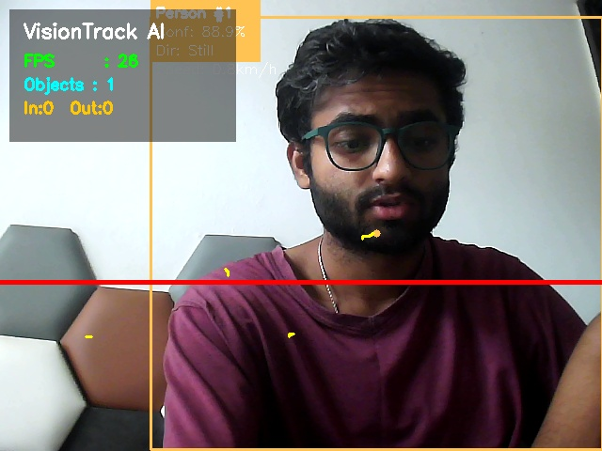
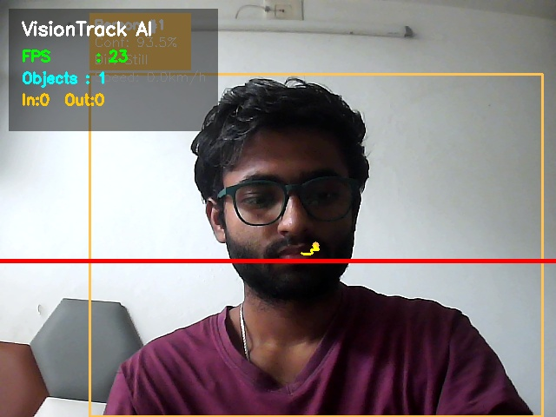
Working Demonstration — Live Detection & Tracking
Actual capture frames from a running VisionTrack AI session (captures/ folder)
Live HUD Overlay
Trail & Session Stats
Bounding boxes with track IDs, FPS counter and running object count drawn directly on the webcam feed via the Drawer + FPSCounter modules.
Trajectory trail rendered from the last 30 tracked positions, alongside a live-updating session statistics panel in the corner overlay.

Slide 13
Working Demonstration — Session Reports
Every run auto-exports a CSV summary that feeds the dashboard
SAMPLE SESSION REPORT — reports/session_20260731_195912.csv
Metric | Value
Session Time | 01:32
Frames Processed | 1,125
Average FPS | 12.08
Max Objects (simultaneous) | 4
Unique Objects Tracked | 25
Average Speed (km/h) | 1.93
Screenshots Taken | 0
Videos Recorded | 0
WHAT THIS DEMONSTRATES
25 distinct objects picked up unique, stable track IDs in a 92-second run
Detection + tracking sustained ~12 FPS on CPU inference with YOLOv8n
Speed estimation stayed in a believable low range for indoor motion
4 recorded sessions in total, each producing its own timestamped CSV

Slide 14
Repository & Quick Start
The project runs locally end-to-end — not just slides
PROJECT LAYOUT
QUICK START
src/ — detection, tracking, analytics, visualization, api, config
dashboard/app.py — Streamlit reporting dashboard
database/ — SQLAlchemy models & engine
configs/ — settings.yaml, tracker.yaml
reports/ — auto-exported session CSVs
captures/, outputs/ — saved screenshots & recordings
docker/ — Dockerfile & docker-compose for containerised runs
1
pip install -r requirements.txt
2
python run.py # launches the live webcam pipeline
3
streamlit run dashboard/app.py # opens the reports dashboard
4
docker compose up # optional containerised run
Config-driven, not hard-coded: camera, model, thresholds and line position all live in config/settings.py and configs/settings.yaml.

Slide 15
Testing and Validation
Automated test scaffolding plus manual validation across real recorded sessions
AUTOMATED TESTS (pytest)
MANUAL VALIDATION — LIVE SESSIONS
src/tests/ currently holds import-level smoke tests for the detector, tracker and API modules — confirming every core module loads cleanly. This scaffolding is the entry point for the deeper unit and integration tests planned next (see Future Scope).
Beyond unit tests, the pipeline was run and validated live against a real webcam across 4 independent sessions, with every run's metrics captured automatically by ReportExporter rather than eyeballed:
Detection confirmed across varying object counts (2–4 simultaneous)
Tracking IDs remained stable long enough to compute direction & speed
Line-crossing counter validated against manual enter/exit counts
CSV export verified to match the on-screen HUD at session end
test_detector.py
YOLOv8n loads & module imports cleanly
test_tracker.py
ByteTrack tracker module imports cleanly
test_counter.py
Analytics/counter module imports cleanly
test_api.py
FastAPI app module imports cleanly

Slide 16
Methodology / Algorithms Used
From detection-level CNN inference to rule-based motion analytics
YOLOv8n Object Detection
ByteTrack Association
Single-stage CNN detector (ultralytics) run per frame; confidence-thresholded at 0.50 before boxes reach the tracker.
Associates detections across frames into persistent tracks using motion + IoU cues, exposed via model.track(persist=True).
Exponential Moving Average
Rule-Based Direction
PositionSmoother blends the previous smoothed point and the new point with α = 0.70 to damp jitter in the drawn trail.
Compares position 10 frames apart against a 20px threshold on each axis to classify heading as N / S / E / W or Still.
Calibrated Speed Estimation
Zone-Based Line Crossing
CameraCalibrator converts a known real-world distance and its pixel-span into a pixels-per-metre ratio, used with elapsed time to estimate km/h.
LineCounter tracks each object's side of a horizontal line with a ±30px buffer zone, requiring 5+ history points before confirming a crossing.

Slide 17
Tools and Technologies
The stack behind detection, tracking, analytics and the dashboard
Computer Vision & Detection
Tracking
OpenCV (opencv-python) · Ultralytics YOLOv8 · PyTorch & Torchvision
ByteTrack (via ultralytics tracker configs)
Data & Analytics
Dashboard & Visualization
pandas · NumPy · Python collections (Counter, defaultdict)
Streamlit · Plotly Express · Matplotlib
Persistence & API
Testing & Ops
SQLAlchemy · SQLite · FastAPI · Pydantic
pytest · Docker & docker-compose
Config-driven, not hard-coded: model path, confidence threshold, frame size, smoothing factor and line position all live in config/settings.py.

Slide 18
Results and Outcomes
What the pipeline actually produced, verified against exported session CSVs
4
2,092
12–24
25
4
100%
Recorded
Sessions
Total Frames
Processed
FPS Range
(CPU inference)
Max Unique Objects
in One Session
Max Simultaneous
Objects Tracked
Sessions with
Auto CSV Export
ALL 4 VALIDATION SESSIONS
Session | Duration | Frames | Avg FPS | Max Objects | Unique Objects | Avg Speed (km/h)
2026-07-14 14:25 | 00:06 | 130 | 24.52 | 3 | 3 | 2.33
2026-07-31 19:59 | 01:32 | 1,125 | 12.08 | 4 | 25 | 1.93
2026-07-31 20:15 | 00:48 | 577 | 12.07 | 3 | 6 | 0.98
2026-07-31 20:28 | 00:23 | 260 | 12.04 | 2 | 6 | 1.80

Slide 19
Challenges Faced & Solutions
Real engineering problems encountered while building the pipeline
Challenge | Solution
CPU-only inference limited FPS on heavier frames | Used the lightweight YOLOv8n variant and fixed frame size (1280×720) to keep detection real-time
Jittery bounding-box centres made trails look noisy | Added PositionSmoother with EMA smoothing (α = 0.70) before drawing trajectories
Track IDs sometimes appeared before being confirmed | main.py explicitly skips any box where box.id is None before feeding downstream modules
Speed estimates need a real-world reference, not just pixels | Built CameraCalibrator to convert a known real-world distance into a pixels-per-metre ratio
False line-crossings from single noisy frames | LineCounter requires 5+ history points and a ±30px tolerance zone before confirming a crossing
Several analytics modules (heatmap, intrusion, dwell time) were needed but out of scope for this pass | Scaffolded as clear extension points, deliberately deferred to Future Scope rather than rushed

Slide 20
Future Scope / Enhancements
Deliberately scaffolded, not yet implemented — the natural next iterations
Heatmap Generation
Intrusion Detection
build_heatmap() is stubbed — accumulate track density into a spatial heatmap overlay
detect_intrusion() is stubbed — flag tracks entering a restricted polygon zone
Dwell-Time Analysis
DeepSORT Alternative
calculate_dwell_time() is stubbed — measure how long each track stays in a zone
DeepSort class is a placeholder — appearance-based tracking as a ByteTrack alternative
Complete REST API
Broader Automated Testing
Flesh out the FastAPI router with live detection/analytics endpoints beyond the current schema
Expand src/tests/ from import smoke tests into real unit & integration coverage
SQLite-Backed History
Cloud / Edge Deployment
Wire ReportExporter to also persist into the existing Detection SQLAlchemy model
Containerise with the existing Dockerfile and deploy to a cloud or edge device for 24×7 monitoring

Slide 21
Conclusion
Over the course of this internship, VisionTrack AI grew into a working real-time video analytics pipeline: a webcam feed flows through YOLOv8n detection, ByteTrack tracking, and custom motion-analytics modules, producing live on-screen insight and an automatically exported session report — validated across 4 real recorded sessions rather than left as a design on paper.
KEY TAKEAWAYS
End-to-end ownership: camera capture → detection → tracking → analytics → reporting → dashboard
Config-driven engineering discipline: thresholds, sizes and calibration live in settings, not scattered in code
Hands-on with the modern CV/analytics stack: YOLOv8, ByteTrack, OpenCV, Streamlit, FastAPI, SQLAlchemy
This internship strengthened my practical skills in computer vision, real-time systems engineering and full-stack analytics delivery — exactly the toolkit a working AI engineer needs.

Slide 22
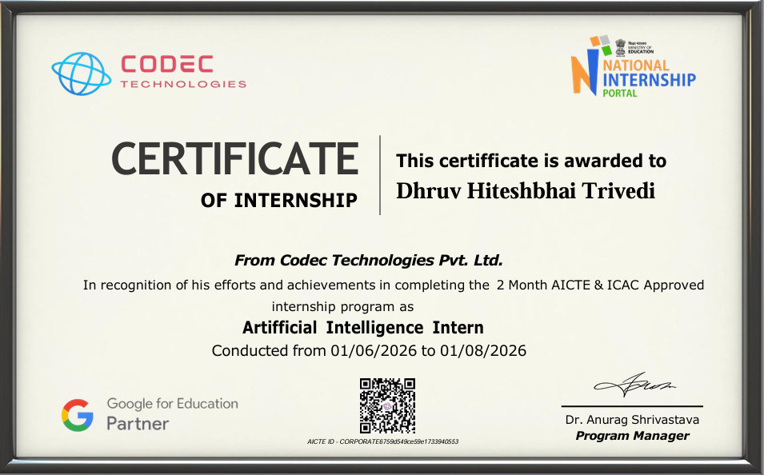
Certificate — Internship Completion
Codec Technologies · Artificial Intelligence Internship
Offer Summary
Name: Dhruv Hiteshbhai Trivedi
Position: Artificial Intelligence Intern
Issued On: 25 June 2026
Duration: 1 Jun – 1 Aug
Mode: Remote,Flexible hours

Slide 23
Thank You
Questions & Discussion Welcome
Project VisionTrack AI — Intelligent Real-Time Video Analytics Internship Codec Technologies — Artificial Intelligence Intern Dhruv Hiteshbhai Trivedi Department of Computer Science and Engineering
23

