Slide 1





Rule-Based IDS: The Website
See forward and backward chaining work, step by step, in your browser
Mohit Jha | Pranav Tanikaivelan | Rajalakshmi Engineering College, Chennai
Logs
Facts
Rules
Alerts
Proof
Notes:
Introduce the website as the visual front end of the project: it shows the reasoning instead of just printing results.

Slide 2

The project in one minute
0
training samples or labelled datasets needed
The usual way
Most intrusion detectors use machine learning. They need large labelled datasets and act as black boxes: hard to say why an alert fired.
2
inference modes: forward (auto-alerts) and backward (queries)
Our approach
100%
of alerts trace back to exact rules and facts
Hand-written IF-THEN rules plus a logical inference engine. Every alert comes with a proof. No ML and no generative AI anywhere.
Notes:
Numbers come from the first review deck. The constraint from faculty: only concepts from class, so classical AI only.

Slide 3
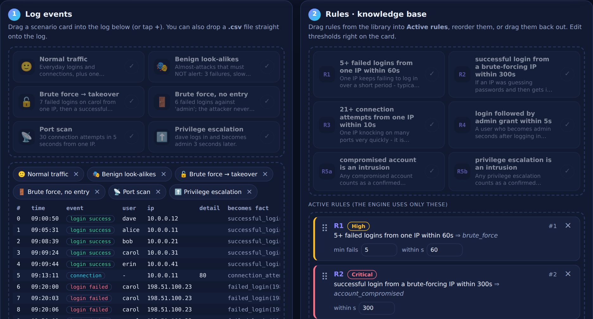
The website at a glance
1
Log events
Scenario cards and a log table: what the system sees.
2
Rules
Active rules with editable thresholds: what the system knows.
3
Inference
Run it and watch the engine reason: what the system concludes.
Live screenshot: scenario cards and the log on the left, rule cards on the right.
One page, one file, all in your browser.
Notes:
Screenshot is the live site. Panel 3 (inference) is shown on a later slide.

Slide 4
Following one attack through the engine
Log rows
Facts
R1 fires
R2 fires
R5a fires
7 x LOGIN_FAILED
user carol
failed_login
(IP, carol)
brute_force
(IP)
account_compromised
(carol)
is_intrusion
(carol)
Each row becomes a fact
IP is 198.51.100.23; 5 fall within 12 s
5+ failures inside 60 s
Successful login 18 s later
Alert, with the whole chain as proof
Facts feed rules, rules create new facts, and those facts feed more rules. That chain is the proof.
Notes:
This exact chain is what the site shows when you ask is_intrusion(carol) or run forward chaining.

Slide 5
The rule base
Rule | IF | THEN | Detects
R1 | 5+ failed_login(IP, _) within 60 s | brute_force(IP) | Brute-force login
R2 | brute_force(IP), then successful_login(IP, U) within 300 s | account_compromised(U) | Compromised account
R3 | 21+ connection_attempt(IP, _) within 10 s | port_scan(IP) | Port scanning
R4 | login(U), then privilege_change(U, admin) within 5 s | privilege_escalation(U) | Privilege escalation
R5a | account_compromised(U) | is_intrusion(U) | Overall intrusion flag
R5b | privilege_escalation(U) | is_intrusion(U) | Overall intrusion flag
Small additions to the review deck: R2 has a 300 s window, R3 means "more than 20" (21+), and R5 is split in two because "OR" is written as two rules.
Notes:
Thresholds are editable on the website: each rule card has number boxes.

Slide 6

Two ways to ask the engine
Forward chaining
Backward chaining
Like a detective: from evidence to conclusions
Like a lawyer: from a claim to its proof
Starts from the log facts
Fires every rule that applies, again and again
Stops when a full pass finds nothing new
Result: every alert, each with its proof
Starts from a question you type
Works back through the rules to the log
Result: YES with a proof tree, or NO
Try "why not 192.0.2.50?" to see the closest miss
On the site: Run forward chaining
On the site: is_intrusion(carol)
Both modes reach the same conclusions on the demo log: a built-in test checks it.
Notes:
Forward = data driven, finds everything. Backward = goal driven, explains one claim and can say why not.

Slide 7
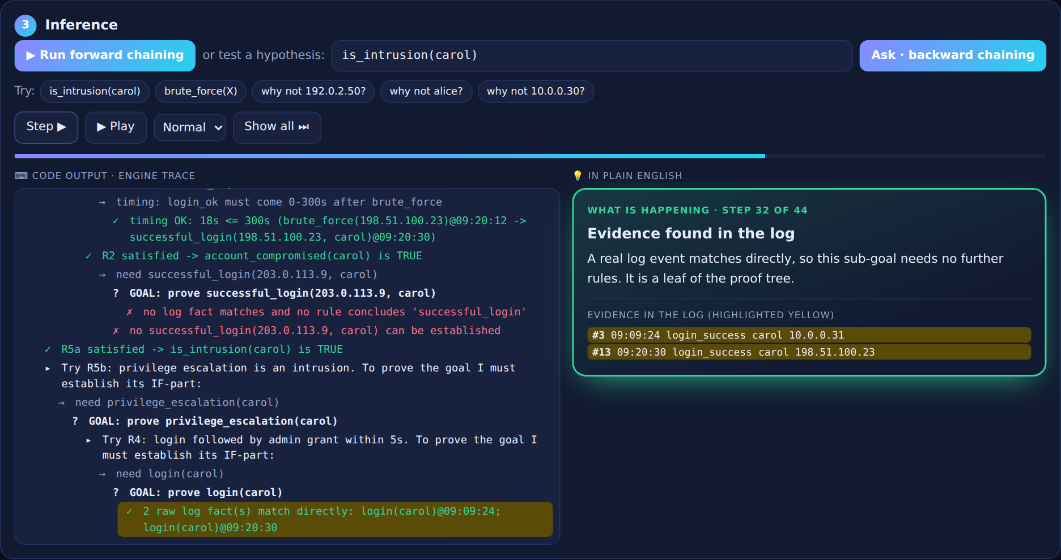



Watching the engine think
Left: code output
The engine's own trace, line by line.
Right: plain English
The same step explained for humans.
Yellow rows
The log evidence behind the step.
Controls: Step moves one line, Play animates it, Show all jumps to the final result.
Notes:
This is a real screenshot of the site while proving is_intrusion(carol) by backward chaining.

Slide 8





What you can do on the page
Drag logs in
Bring your own CSV
Drag rules in and out
Drop scenario cards (normal traffic, attacks, look-alikes) into the log, or remove them.
Import or drop a .csv file with timestamp, event, user, ip, detail.
Activate, reorder or remove rules, and edit their thresholds on the card.
Step through
Plain English
Ask why not
Step, Play or Show all: you control the pace of the explanation.
Every step is explained next to the code output, with a final summary.
Query a near-miss and see the closest miss that stopped the alert.
Notes:
Drag and drop works with a mouse; on a touch screen use the plus and cross buttons on each card.

Slide 9
Try it: a two-minute demo
1
Open the site
WHAT STEP 2 SHOULD GIVE
Look at the three panels: log, rules, inference.
7 conclusions in 2 rounds
brute_force for 2 IPs
account_compromised(carol)
port_scan and privilege_escalation(dave)
is_intrusion for carol and dave
2
Click "Run forward chaining"
Press Play and follow the trace and the plain-English box.
3
Click "is_intrusion(carol)"
See the proof tree: the same chain as the worked example.
Click "why not alice?"
Why step 5?
It shows rules depend on each other. The site even warns "needs R1 active" on R2.
4
See why a late admin grant is not an escalation.
5
Drag rule R1 out, run again
R2 loses its input, so carol is no longer flagged.
Notes:
This is a good live demo order for the review: it covers forward, backward, why-not and drag-and-drop in two minutes.

Slide 10


What the demo data shows
99
109
7
2
log events
facts
conclusions
rounds to finish
Caught
Correctly ignored
Brute force on carol, then login: takeover and intrusion
Brute force on admin: flagged, but no intrusion
Port scan from one IP: 30 attempts in 5 s
dave becomes admin 3 s after login: escalation
Only 3 failed logins from one IP
5 failed logins spread over 2 minutes
15 connections in 8 s (needs 21)
Admin grant hours after login
Notes:
Numbers come from the sample log in the site. The look-alikes show the thresholds working: close but not an alarm.

Slide 11





How it is built and where it runs
HTML
CSS
JavaScript
Page structure: three panels, tables, buttons, drop zones.
The look: light and dark themes, phone-friendly layout.
The brain: engine code for facts, rules and chaining, plus page logic.
All three live inside one index.html (about 71 KB). No framework, no libraries, no server code.
WHERE IT RUNS
index.html
Cloudflare
Your browser
uploaded as a static site
serves it over HTTPS
runs the whole engine
Logs and CSV files you add never leave your browser.
Notes:
The site is static: Cloudflare only hands out the file. All reasoning runs on the visitor's device, which is why it needs no backend.

Slide 12

Key takeaways
Logic, not ML
Reasoning made visible
Known limits
Every alert has a proof built from exact rules and facts.
Step, highlight and plain-English text show how it decides.
Fixed thresholds and known patterns only: a slow attacker can slip under a rule.
Next steps
Add more rules, for example data exfiltration, and feed the engine live logs instead of a CSV.
Notes:
The deck mentioned data exfiltration as an attack type; a new rule only needs a new entry in the rule list.

