Slide 1

CS23533 — Foundations of Artificial Intelligence
Rule-Based IDS: Forward & Backward Chaining Explorer
Department of Cyber Security — Rajalakshmi Engineering College
III Year / V Semester — Odd 2026–2027
Final Review — 03.11.2026
Notes:
Introduce the project: a rule-based intrusion detector whose reasoning is visible on a web page.

Slide 2
Project Team & Supervision
Batch Members
Supervisor
1. Mohit Jha — 241901056
2. Pranav Tanikaivelan — 241901079
Mrs. Divya R
Assistant Professor, CSE (Cyber Security)
Rajalakshmi Engineering College — Department of Cyber Security
Notes:
Team and supervisor.

Slide 3
Outline
01
02
03
Abstract & Objectives
Literature & Existing System
Proposed System & Methodology
Problem statement and project goals.
Related work and the gaps this project addresses.
Facts, IF-THEN rules, and forward and backward chaining.
04
05
Implementation & Evaluation
Hardware / Software & Future Plan
The website, the demo log, and what it shows.
Requirements, limits and next steps.
The deck moves from motivation to the working website, with a live demo that anyone can repeat in the browser.
Notes:
Roadmap of the presentation.

Slide 4
Abstract
Most intrusion detectors rely on machine learning: they need large labelled datasets and cannot say why an alert fired. This project uses classical AI instead: hand-written IF-THEN rules and a logical inference engine that shows its reasoning.
Facts from logs
IF-THEN rules
Chaining with proof
Every log row becomes a fact, such as failed_login(IP, carol), with its time stamp.
Six rules (R1 to R5b) detect brute force, account compromise, port scan and privilege escalation. Thresholds are editable.
Forward chaining finds every alert. Backward chaining proves one claim or explains why not. Each answer comes with its proof.
No machine learning and no generative AI: every alert traces back to exact rules and facts.
Notes:
Constraint from faculty: only concepts from class, so classical AI only.

Slide 5
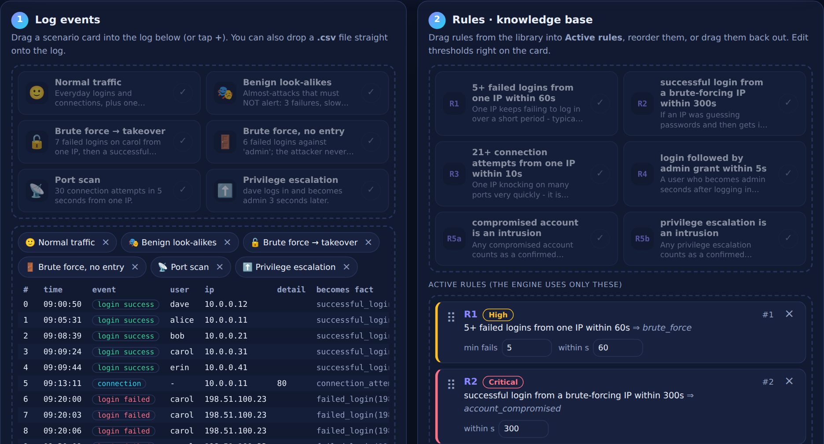
Objective
Build an intrusion detector that explains every alert.
Turn log rows into facts and detect attacks with IF-THEN rules.
Forward chaining finds every alert; backward chaining proves or refutes one claim.
Show each step as engine trace, plain English and highlighted log evidence.
Drag logs and rules in and out, import CSV, and edit thresholds on the page.
Run entirely in the browser with classical AI only: no ML.
Live screenshot: scenario cards and log on the left, rule cards on the right.
Notes:
Objectives of the project.

Slide 6
Literature Survey — Key References
TITLE | YEAR | AUTHOR | TECHNIQUE
An Intrusion-Detection Model | 1987 | Dorothy E. Denning | Audit-record profiles with rule-based and statistical detection
State Transition Analysis: A Rule-Based Intrusion Detection Approach | 1995 | Koral Ilgun, Richard A. Kemmerer, Phillip A. Porras | Attack signatures written as rules over state transitions
Snort: Lightweight Intrusion Detection for Networks | 1999 | Martin Roesch | Signature rules matched against network traffic
Bro: A System for Detecting Network Intruders in Real-Time | 1999 | Vern Paxson | Event engine with policy scripts for real-time detection
Outside the Closed World: On Using Machine Learning for Network Intrusion Detection | 2010 | Robin Sommer, Vern Paxson | Analysis of why ML is hard to use for intrusion detection
Classic rule-based systems are explainable; this project adds a visible, step-by-step inference trace on top of that idea.
Notes:
Please verify each reference against the original source before the review.

Slide 7




Existing System — Limitations
Needs labelled data
Black-box alerts
Hard to adjust
No “why not” answer
Machine-learning detectors depend on large labelled datasets that are hard to collect.
It is hard to say why an alert fired, so an analyst cannot verify the decision.
Changing behaviour means retraining, not editing a threshold or a rule.
A near miss gives no explanation of which condition stopped the alert.
These shortcomings motivate an approach that is rule-based, visible step by step, and fully explainable.
Notes:
Limitations of the usual ML-based approach, which the rule-based design addresses.

Slide 8
Proposed System — Architecture Overview
Log Events
CSV file or scenario cards: timestamp, event, user, ip, detail.
Facts
Each row becomes a fact, such as failed_login(IP, carol).
Rule Base (R1 to R5b)
Six IF-THEN rules with editable thresholds and time windows.
Inference & Proof
Forward and backward chaining, with trace and proof tree.
The pipeline goes from raw logs to facts, rules and finally a proof. Every stage is visible on the page.
Notes:
Four stages, left to right.

Slide 9
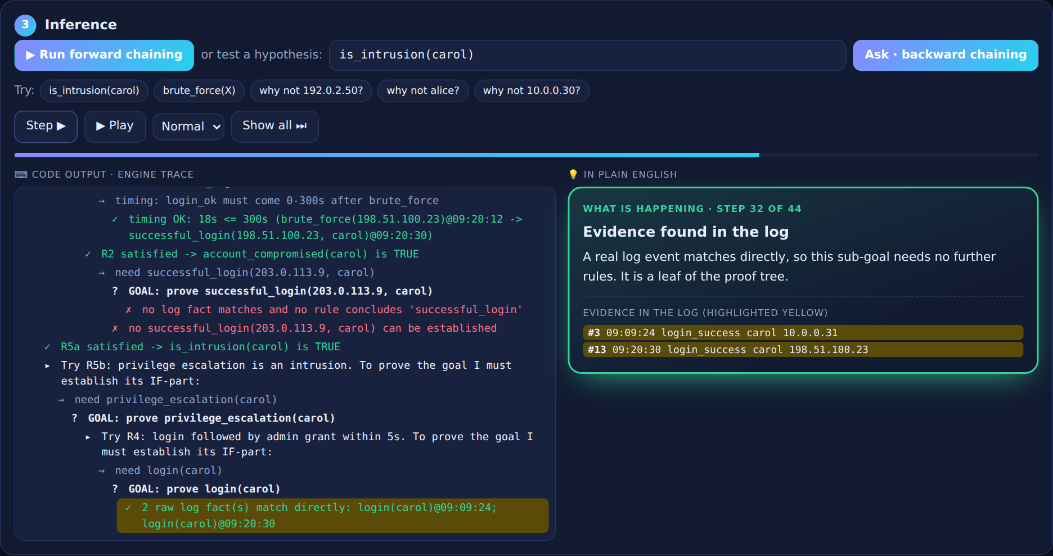
Methodology & Implementation Details
Log Ingestion — CSV rows (timestamp, event, user, ip, detail); each row becomes a fact.
Rule Base — R1 brute force (5+ failures in 60 s), R2 account compromise (login within 300 s), R3 port scan (21+ attempts in 10 s), R4 privilege escalation (admin within 5 s), R5a/R5b intrusion flag.
Forward Chaining — fires every applicable rule until a full pass finds nothing new.
Backward Chaining — starts from a query such as is_intrusion(carol); returns YES with a proof tree or NO, and “why not” shows the closest miss.
Inference panel: engine trace on the left, plain English on the right.
Step moves one line, Play animates the trace, and Show all jumps to the final result. Logs you add stay in your browser.
Notes:
Real screenshot of the site while proving is_intrusion(carol) by backward chaining.

Slide 10

Novelty, Evaluation Plan & Next Steps
1
2
3
Novelty
Evaluation
Next Steps
Reasoning made visible: every alert comes with a proof built from exact rules and facts, plus “why not” answers for near misses. No ML and no training data.
The demo log has 99 events, which give 109 facts and 7 conclusions in 2 rounds. Look-alike cases are correctly ignored, and forward and backward chaining agree.
Add rules such as data exfiltration
Feed live logs instead of a CSV file
Catch slow attackers that stay under a threshold
Key takeaway: logic, not ML. Every alert is explained by rules the user can read, edit and run again.
Known limit: fixed thresholds and known patterns only, so a slow attacker can slip under a rule.
Notes:
Numbers come from the sample log in the site.

Slide 11
Proposed System — Block Diagram
Logs enter as facts; the rule base and the chaining engine derive new facts; results appear as alerts with a proof. Blue: input and reasoning. Orange: output and explanation.
Log Events
CSV file or scenario cards
Fact Builder
Each row becomes a fact
Rule Base
R1 to R5b, editable thresholds
Inference Engine
Forward and backward chaining
Hosted as one static page on Cloudflare; the whole engine runs on the visitor's device.
Three-Panel Web Page
Log, rules and inference views
Plain-English Text
Same step, explained for humans
Alerts & Proof Tree
is_intrusion(...) with its chain
Rajalakshmi Engineering College — Department of Cyber Security
Notes:
Static site: Cloudflare only hands out the file; all reasoning runs in the browser.

Slide 12




Implementation Overview
Page Structure (HTML)
Look & Feel (CSS)
Engine (JavaScript)
Hosting
Three panels (log, rules, inference), tables, buttons and drop zones. Touch screens use plus and cross buttons.
Light and dark themes with a phone-friendly layout.
Hand-written code for facts, rules, forward and backward chaining, plus the page logic.
One index.html (about 71 KB) uploaded as a static site on Cloudflare and served over HTTPS.
No framework, no libraries and no server code. Logs and CSV files you add never leave your browser.
Notes:
All three languages live inside one index.html.

Slide 13
Hardware & Software Requirements
Hardware
Practical Notes for Reproducibility
Standard PC, laptop or phone with a modern web browser
No GPU needed: the reasoning is classical and symbolic
No backend server: all reasoning runs on the visitor's device
Import or drop a .csv file with the columns timestamp, event, user, ip, detail. Scenario cards (normal traffic, attacks, look-alikes) can be dragged into the log. Thresholds are editable on each rule card.
Software
HTML, CSS and JavaScript in a single index.html
Any code editor, plus a modern browser
Cloudflare for static hosting over HTTPS
Tip: run the built-in test to confirm that forward and backward chaining reach the same conclusions on the demo log.
Notes:
The site is static and needs no install.

Slide 14
Future Work & Research Directions
Expanded Rule Base
Live Log Feeding
Slow Attackers
Add rules such as data exfiltration; a new rule is just a new entry in the rule list.
Feed the engine live logs instead of a CSV file.
Use longer or adaptive time windows so attacks that stay under a threshold are still caught.
These directions widen what the engine can detect while keeping every alert explainable.
Exportable Proofs
Benchmarking
Export proof trees and plain-English summaries as a report for analysts.
Compare alerts and false positives with Snort or Zeek rules on the same logs.
Each item adds rules or inputs; the inference engine itself does not need to change.
Notes:
Future items are proposals, not completed work.

Slide 15
References & Next Steps
[1] D. E. Denning, “An Intrusion-Detection Model,” IEEE Trans. Software Engineering, vol. SE-13, no. 2, 1987.
[2] K. Ilgun, R. A. Kemmerer and P. A. Porras, “State Transition Analysis: A Rule-Based Intrusion Detection Approach,” IEEE Trans. Software Engineering, vol. 21, no. 3, 1995.
[3] M. Roesch, “Snort: Lightweight Intrusion Detection for Networks,” USENIX LISA, 1999.
[4] V. Paxson, “Bro: A System for Detecting Network Intruders in Real-Time,” Computer Networks, vol. 31, no. 23–24, 1999.
[5] R. Sommer and V. Paxson, “Outside the Closed World: On Using Machine Learning for Network Intrusion Detection,” IEEE Symposium on Security and Privacy, 2010.
Next Steps
Run the two-minute live demo
Add more rules, such as data exfiltration
Prepare the final report with the rule list and CSV format
Rajalakshmi Engineering College — Department of Cyber Security
Notes:
Thank you. Questions.

