Slide 1

Department of Cyber Security
2026-2027 - Odd Semester
III Year / V Sem
CS23533 - FOUNDATIONS OF ARTIFICIAL INTELLIGENCE
Final Review – 03.11.2026
Rajalakshmi Engineering College, Department of Cyber Security

Slide 2
Rule-Based IDS: Forward & Backward Chaining Explorer
Batch Members :
1. Mohit Jha – 241901056
2. Pranav Tanikaivelan – 241901079
Supervisor:
Mrs. Divya R
Assistant Professor
Rajalakshmi Engineering College, Department of Cyber Security

Slide 3
OUTLINE
Abstract
Objective
Literature Survey
Existing System
Proposed System & Novelty
Block Diagram
Methodology
Implementation
Evaluation & Results
HW/SW Requirements
Future Work
References
Rajalakshmi Engineering College, Department of Cyber Security

Slide 4
ABSTRACT
Most intrusion detectors rely on machine learning: they need large labelled datasets and cannot explain why an alert fired.
This project uses classical AI instead: hand-written IF-THEN rules and a logical inference engine that shows its reasoning.
Every log row becomes a fact, and six rules (R1 to R5b) detect brute force, account compromise, port scan and privilege escalation.
Forward chaining finds every alert; backward chaining proves one claim or explains why not. No ML and no generative AI.
Rajalakshmi Engineering College, Department of Cyber Security

Slide 5
OBJECTIVE
Primary – Build an intrusion detector that explains every alert, using classical AI only (no ML)
Turn log rows into facts and detect attacks with IF-THEN rules
Forward chaining finds every alert; backward chaining proves or refutes one claim
Show each step as engine trace, plain English and highlighted log evidence
Drag logs and rules in and out, import CSV, and edit thresholds on the page
Run entirely in the browser: no server and no training data
Rajalakshmi Engineering College, Department of Cyber Security

Slide 6
LITERATURE SURVEY
TITLE | YEAR | AUTHOR | TECHNIQUE
An Intrusion-Detection Model | 1987 | Dorothy E. Denning | Audit-record profiles with rule-based and statistical detection
State Transition Analysis: A Rule-Based Intrusion Detection Approach | 1995 | Ilgun, Kemmerer, Porras | Attack signatures written as rules over state transitions
Snort: Lightweight Intrusion Detection for Networks | 1999 | Martin Roesch | Signature rules matched against network traffic
Bro: A System for Detecting Network Intruders in Real-Time | 1999 | Vern Paxson | Event engine with policy scripts for real-time detection
Outside the Closed World: On Using Machine Learning for Network Intrusion Detection | 2010 | Robin Sommer, Vern Paxson | Analysis of why ML is hard to use for intrusion detection
Rajalakshmi Engineering College, Department of Cyber Security

Slide 7
EXISTING SYSTEM
Machine-learning detectors need large labelled datasets that are hard to collect
Alerts are a black box: it is hard to say why an alert fired
Changing behaviour means retraining, not editing a rule or a threshold
A near miss gives no explanation of which condition stopped the alert
Signature tools such as Snort match known patterns but show no reasoning trace
Analysts cannot verify a decision without reading the raw logs
Rajalakshmi Engineering College, Department of Cyber Security

Slide 8
PROPOSED SYSTEM
Log Ingestion – CSV file or scenario cards become time-stamped facts
Rule Base – six IF-THEN rules (R1 to R5b) with editable thresholds and time windows
Forward Chaining – fires every applicable rule until a full pass finds nothing new
Backward Chaining – proves a query such as is_intrusion(carol), or answers “why not”
Explanation – engine trace, plain-English text and highlighted log evidence
Web Interface – three panels (log, rules, inference) running fully in the browser
Rajalakshmi Engineering College, Department of Cyber Security

Slide 9
NOVELTY IN PROPOSED SYSTEM
Research Question – Can a non-ML, rule-based system with a visible inference trace give effective, explainable intrusion detection?
Reasoning made visible: every alert comes with a proof built from exact rules and facts
“Why not” answers for near misses, showing the closest miss
Editable rules and thresholds: no retraining and no training data
Forward and backward chaining on one page, cross-checked by a built-in test
Runs in the browser: logs and CSV files never leave the device
Rajalakshmi Engineering College, Department of Cyber Security

Slide 10
BLOCK DIAGRAM (PROPOSED SYSTEM)
Log Events
CSV file or scenario cards
Fact Builder
Each row becomes a fact
Rule Base
R1 to R5b, editable thresholds
Inference Engine
Forward and backward chaining
Hosted as one static page on Cloudflare; the whole engine runs on the visitor’s device.
Three-Panel Web Page
Log, rules and inference views
Plain-English Text
Same step, explained for humans
Alerts & Proof Tree
is_intrusion(…) with its chain
Blue: input and reasoning Orange: output and explanation
Rajalakshmi Engineering College, Department of Cyber Security

Slide 11
METHODOLOGY
Log Ingestion – CSV rows (timestamp, event, user, ip, detail); each row becomes a fact
Rule Base – R1 brute force (5+ failures in 60 s), R2 account compromise (login within 300 s), R3 port scan (21+ attempts in 10 s), R4 privilege escalation (admin within 5 s), R5a/R5b intrusion flag
Forward Chaining – fires every applicable rule until a full pass finds nothing new
Backward Chaining – starts from a query such as is_intrusion(carol); returns YES with a proof tree or NO, and “why not” shows the closest miss
Rajalakshmi Engineering College, Department of Cyber Security

Slide 12
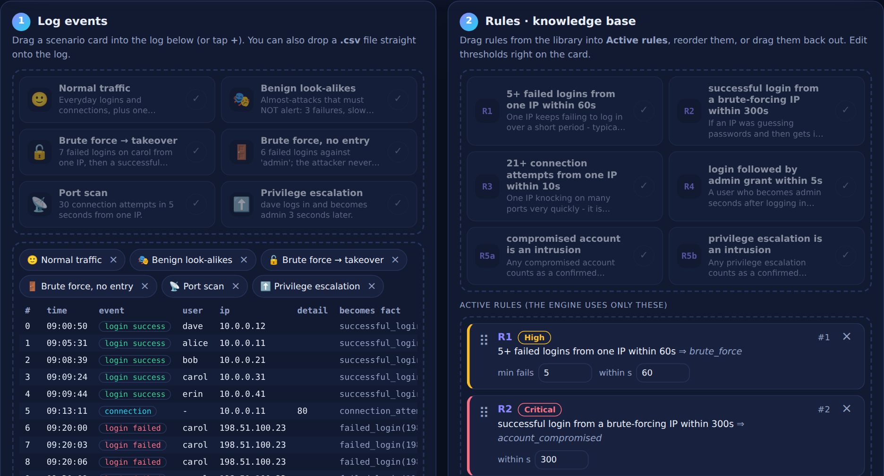
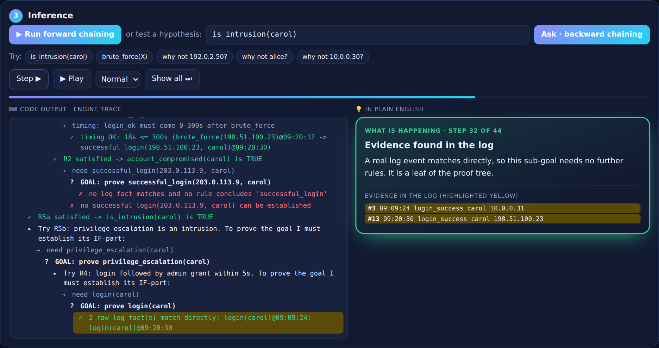
IMPLEMENTATION
Log events on the left, rule cards on the right
Engine trace on the left, plain English on the right
Step, Play and Show all let you control the pace of the trace
One index.html (about 71 KB): HTML, CSS, JavaScript, no framework
Rajalakshmi Engineering College, Department of Cyber Security

Slide 13
EVALUATION & RESULTS
Demo log – 99 events give 109 facts and 7 conclusions in 2 rounds of forward chaining
Caught – brute force on carol then login (takeover and intrusion), a port scan of 30 attempts in 5 s, and dave’s admin grant 3 s after login
Correctly ignored – only 3 failed logins, 5 failures spread over 2 minutes, 15 connections in 8 s (needs 21), an admin grant hours after login
Cross-check – forward and backward chaining reach the same conclusions on the demo log
Rajalakshmi Engineering College, Department of Cyber Security

Slide 14
HARDWARE/SOFTWARE REQUIREMENTS
Hardware Requirement:
Standard PC, laptop or phone with a modern web browser
No GPU needed: the reasoning is classical and symbolic
No backend server: all reasoning runs on the visitor’s device
Software Requirement:
HTML, CSS and JavaScript in a single index.html; no framework or libraries
Any code editor and a modern browser
Cloudflare for static hosting over HTTPS
Rajalakshmi Engineering College, Department of Cyber Security

Slide 15
FUTURE WORK
Expanded Rule Base – add rules such as data exfiltration; a new rule is a new list entry
Live Log Feeding – feed the engine live logs instead of a CSV file
Slow Attackers – longer or adaptive time windows to catch attacks that stay under a threshold
Exportable Proofs – export proof trees and plain-English summaries as an analyst report
Benchmarking – compare alerts and false positives with Snort or Zeek rules on the same logs
Known Limit – fixed thresholds and known patterns only, so a slow attacker can slip under a rule
Rajalakshmi Engineering College, Department of Cyber Security

Slide 16
REFERENCES
[1] D. E. Denning, “An Intrusion-Detection Model,” IEEE Trans. Software Engineering, vol. SE-13, no. 2, 1987.
[2] K. Ilgun, R. A. Kemmerer and P. A. Porras, “State Transition Analysis: A Rule-Based Intrusion Detection Approach,” IEEE Trans. Software Engineering, vol. 21, no. 3, 1995.
[3] M. Roesch, “Snort: Lightweight Intrusion Detection for Networks,” USENIX LISA, 1999.
[4] V. Paxson, “Bro: A System for Detecting Network Intruders in Real-Time,” Computer Networks, vol. 31, no. 23–24, 1999.
[5] R. Sommer and V. Paxson, “Outside the Closed World: On Using Machine Learning for Network Intrusion Detection,” IEEE Symposium on Security and Privacy, 2010.
Rajalakshmi Engineering College, Department of Cyber Security

