Slide 1
Twitter Sentiment Analysis on Apache Spark in Cluster Mode
Kartik Deshpande
Mohit Joshi
Sagar Rikame

Slide 2
Outline
Introduction
Sentiment Analysis
Spark vs Hadoop
Apache Spark
Apache Spark : Modes
Apache Spark Setup
PySpark
RDD
Sample Output
Future work
Challenges
References

Slide 3
What is sentiment Analysis?
Emotions on Social Media
Vast amount of Information for predictions
It is the classification of polarity of any word or sentence
Natural Language Processing to identify the sentiment
Objective is to determine if it is positive/ negative/ neutral

Slide 4
Sentiment Analysis
The problem is we have a huge data set and computation is to be done in a short duration
How to achieve this?
Parallel Processing on same machine
Distributed computing on multiple nodes

Slide 5
Spark vs Hadoop
Spark
Hadoop
In-Memory hence Real Time Data Processing
Disk Bound hence Batch Processing engine
Well known for its ease of use
Comparatively Complex
Compatible with Hadoop modules
Spark is one of the modules
Cluster computing framework
Spark is Comparable to Hadoop Map Reduce

Slide 6
Apache Spark
It is a fast and general-purpose cluster computing system
It provides high-level APIs in Java, Scala, Python and R, and an optimized engine that supports general execution graphs
Supports a rich set of higher-level tools like Spark SQL, MLlib, GraphX and Spark Streaming.
Features
Real Time Processing
In-memory cluster computing
Advanced Analytics
Uses
Extract-transform-load (ETL) operations
Predictive analytics and machine learning
Data access operations, such as SQL queries and visualizations
Text mining and text processing

Slide 7
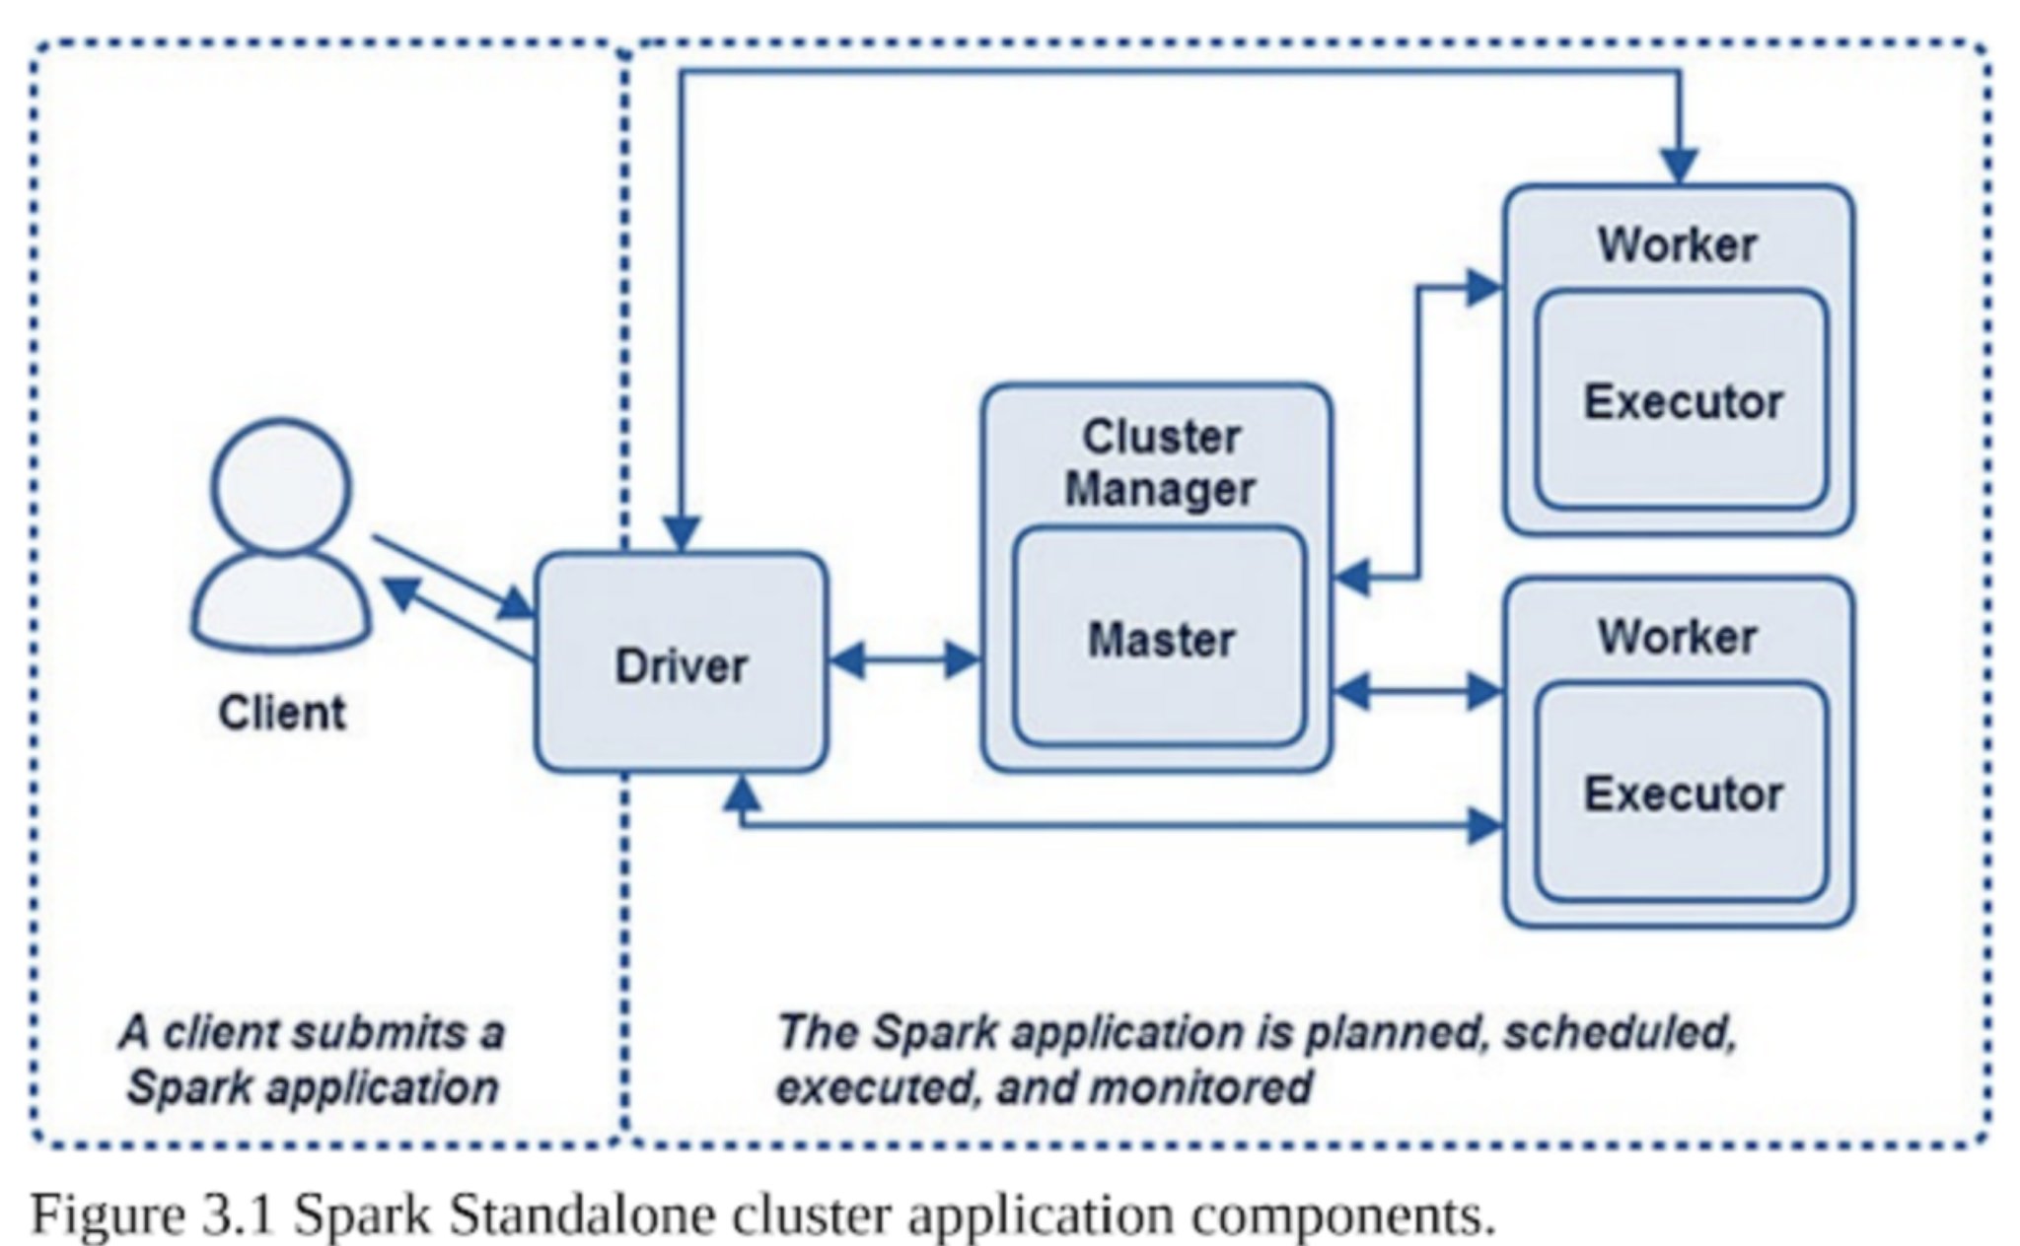
Apache Spark : Standalone Mode
Spark Driver
Driver is the process that clients use to submit applications in Spark
Spark Workers and Executors
Spark Executors are the processes on which Spark DAG tasks run
Worker node—which hosts the Executor process—has a finite or fixed number of Executors allocated at any point in time
The Spark Master and Cluster Manager
Spark Master is the process that requests resources in the cluster and makes them available to the Spark Driver
Cluster Manager is the process responsible for monitoring the Worker nodes and reserving resources on these nodes upon request by the Master

Slide 8
Apache Spark : Cluster Mode
Spark applications run as independent sets of processes on a cluster, coordinated by the SparkContext object in your main program (called the driver program).
To run on a cluster, the SparkContext can connect to several types of cluster managers (either Spark’s own standalone cluster manager, Mesos or YARN), which allocate resources across applications.
Once connected, Spark acquires executors on nodes in the cluster, which are processes that run computations and store data for your application.
Next, it sends your application code (defined by JAR or Python files passed to SparkContext) to the executors. Finally, SparkContext sends tasks to the executors to run.

Slide 9

Apache Spark : Cluster Mode
There are several useful things to note about this architecture:
Each application gets its own executor processes, which stay up for the duration of the whole application and run tasks in multiple threads
Spark is agnostic to the underlying cluster manager
The driver program must listen for and accept incoming connections from its executors throughout its lifetime
Driver schedules tasks on the cluster, it should be run close to the worker nodes

Slide 10
Apache Spark : Cluster Mode
Cluster Manager Types
YARN – Yet Another resource manager.
Standalone – a simple cluster manager included with Spark that makes it easy to set up a cluster.
Apache Mesos – a general cluster manager that can also run Hadoop MapReduce and service applications.
Kubernetes – an open-source system for automating deployment, scaling, and management of containerized applications.

Slide 11
Setting up Spark
Installing Spark Binaries and Open-JDK 8
Setting up Docker
Setting up /etc/hosts
Installing ssh and configuring password-less login between master and slaves
Exposing Port 7000 and ssh port of master and slave to the network.

Slide 12
Submit Jobs
Command
/bin/spark-submit --master spark://spark-master:7077 sentAnalysis.py /usr/local/spark/blacklivesmatter.json

Slide 13
PySpark
PySpark is the Python API for Spark.
Public classes:
SparkContext: Main entry point for Spark functionality
RDD: A Resilient Distributed Dataset (RDD), the basic abstraction in Spark
Accumulator: An “add-only” shared variable that tasks can only add values to
SparkConf: For configuring Spark
SparkSession: Current session in which the spark context runs.
StorageLevel: Finer-grained cache persistence levels

Slide 14
Apache Spark : RDD
Resilient Distributed Dataset (RDD) is the most fundamental data object used in Spark programming
Resilient
Meaning that if a node performing an operation in Spark is lost, the dataset can be reconstructed because Spark knows the lineage of each RDD, which is the sequence of steps to create the RDD
Distributed
Meaning the data in RDDs is divided into one or many partitions and distributed as in-memory collections of objects across Worker nodes in the cluster
Dataset
RDDs are datasets that consist of records which are uniquely identifiable data collections within a dataset

Slide 15
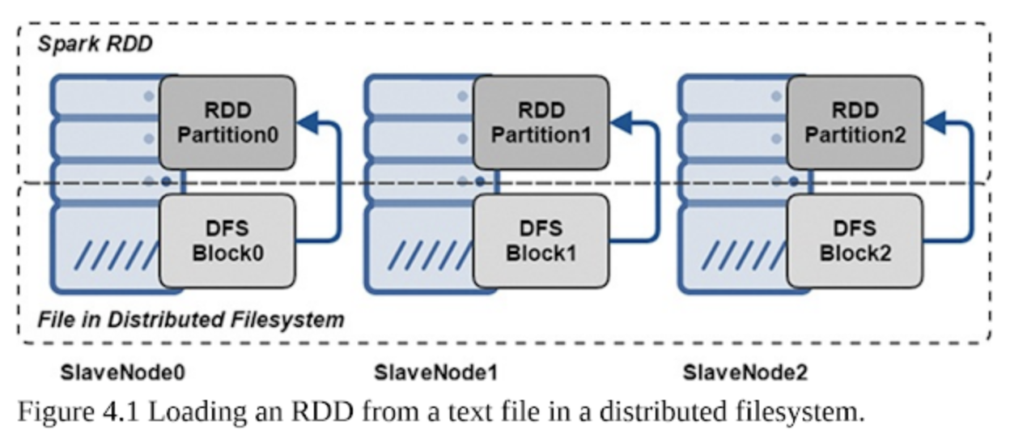
Apache Spark : Data Locality with RDDs
Spark tries to read data into an RDD from the nodes close to it
It creates partitions to hold the underlying blocks from the distributed filesystem
Figure depicts how blocks from a file in a distributed filesystem such as HDFS are used to create RDD partitions on Workers, which are collocated with the data

Slide 16
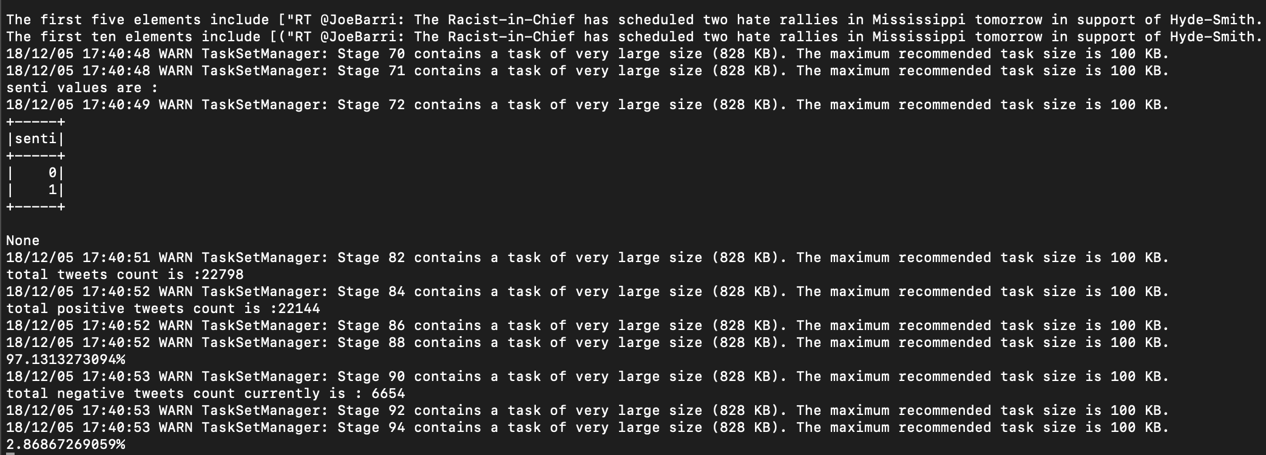
Sample Output

Slide 17
Future Work
To deploy application with the help of YARN and support of HDFS
Assessing the Spark framework different aspects.

Slide 18
Challenges
Started with the tweepy API, but it has rate limitation on it for the basic mode.
Used twarc tool to generate a big dataset.
Working with the rdd.

Slide 19
References
Data Analytics with Spark Using Python, First Edition
https://spark.apache.org/docs/0.9.0/index.html
https://www.datamation.com/data-center/hadoop-vs.-spark-the-new-age-of-big-data.html
https://hadoop.apache.org/docs/current/hadoop-yarn/hadoop-yarn-site/YARN.html
https://jaceklaskowski.gitbooks.io/mastering-apache-spark/yarn/

