Slide 1
Python Fundamentals
By:
Amit Sharma
Ambala College of Engineering and Applied Research
Ambala Cantt.
amit_rks@yahoo.com

Slide 2
Introduction
Python is a general purpose
Interpreted
Interactive
Object oriented
High level programming language.
Created by Guido van Rossum during 1985-1990
Solid foundation for Cloud Computing

Slide 3
Features
Easy-to-learn
Easy-to-read
Easy-to-maintain
Interactive mode
Multi-paradigm programming language
Procedure and Object Oriented programming
Portable
Broad library support
Database Connectivity
GUI Programming
Open Source

Slide 4
Broad Library Support
Django (Web application framework)
NumPy (Numerical methods, array processing)
SciPy (algorithms and mathematical tools)
Pandas (statistics, data analysis)
Scikit-learn (machine Learning & data mining)
Scrapy (for Web scraping)
Rpy (R-Programming)
And many more…..

Slide 5
Why Python?
Easy to learn, read and maintain
Code is 3-5 times shorter then java
Code is 5-10 times shorter than C and C++
Can be used in broad range of applications like Machine learning, data analysis, image processing.
Main language for Raspberry Pi
Rising demands for Python programmers in
Nokia, Disney, Yahoo, IBM, Google

Slide 6
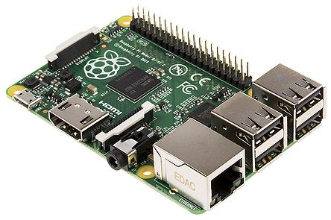
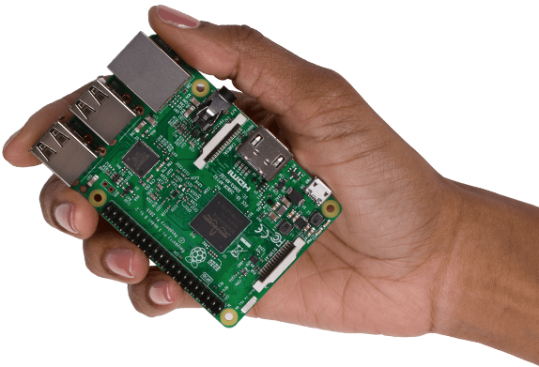
Raspberry Pi

Slide 7
Shorter Code
#include<stdio.h>
#include<conio.h>
int main()
{
printf(“HELLO WORLD”);
return 0;
}
print(“HELLO WORLD”)

Slide 8
Official languages
AT&T
C++
Sun Microsystem
JAVA
Microsoft
C#
Google
Python

Slide 9







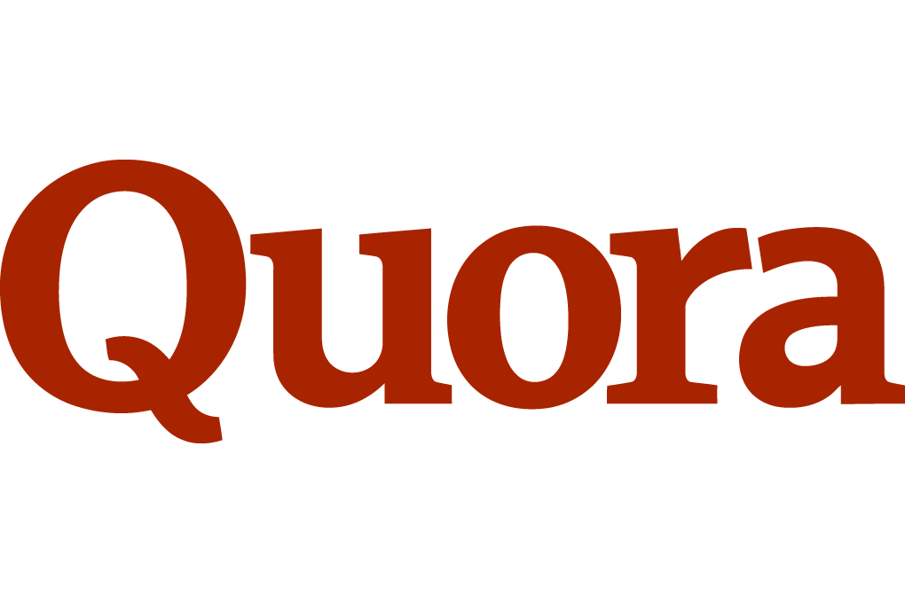

These applications are developed in PYTHON

Slide 10

Quiz Time??
1. Who created Python?
Guido Van Rossum
2. Is Python Open source?
Yes
3. Python support ______ & ______Programming
Procedure and Object Oriented
4. Main features of Python are:
a. Portable b. Multi paradigm Language
c. Interactive d. All of the above.
5. Python is main language for ____________.
Raspberry Pi

Slide 11
QUIZ Time??
6. Match the following:
1. Django A. R-Progamming
2. NumPy B. Algorithm and mathematical tools
3. SciPy C. Statistics, data analysis
4. Pandas D. Machine Learning & data mining
5. Scikit-learn E. Numerical methods, array processing
6. Scrapy F. Web application framework
7. Rpy G. Web Scraping
1-F, 2-E, 3-B, 4-C, 5-D, 6-G, 7-A

Slide 12
Quiz Time??
7. Python is an official language of :
a. AT&T b. Sun Microsystem
c. Microsoft d. Google
8. Which of the following is not developed in Python:
a. Google Map b. YouTube
c. Instagram d. Dropbox
9. Match the following:
1. AT&T A. Python
2. Sun microsystem B. C#
3. Microsoft C. Java
4. Google D. C++
1-D, 2-C, 3-B, 4-A

Slide 13
Python software
Windows 7 (32 bit)-----------> Python 3.3.0
Windows 7 (64 bit)-----------> Python 3.5.0
Windows 8 (32 bit)-----------> Python 3.3.0
Windows 8 (64 bit)-----------> Python 3.5.0
Windows 10 (64 bit)---------> Python 3.5.0
Download Python 3.3.0 from
www.python.org/download/release/3.3.0/
Download Python 3.5.0 from
www.python.org/download/release/python-350/

Slide 14
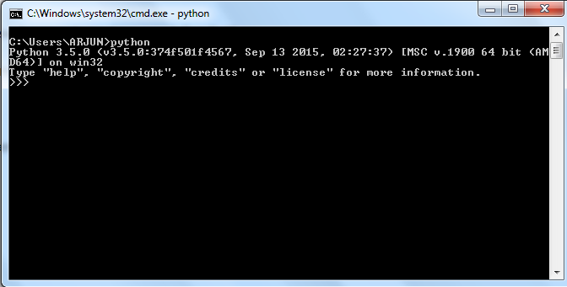
Python Installation
After installation, open command prompt
C:\>python

Slide 15
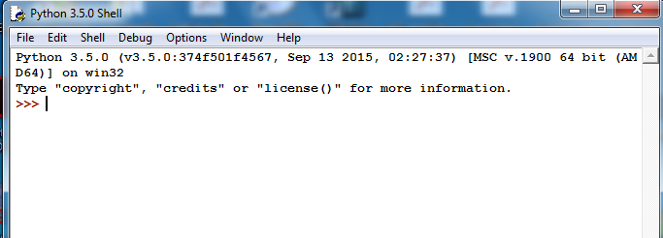
Python Installation
double click on Python IDLE icon, Python shell will open
Command prompt appears “>>>”
If none of this happened, that means something went wrong with installation.

Slide 16
Python First Program “HELLO WORLD”
Interactive mode programming
Open Python Shell and run
>>> print(“HELLO WORLD”)
HELLO WORLD
>>>
Script mode programming
Extension of python file is .py
Write code in notepad and run on CMD
Write code in file using python IDLE and run

Slide 17
Python variables
Can have A-Z, a-z, underscore(_), 0-9.
Must start with A-Z, or a-z, or an underscore(_)
Followed by any number of occurrence of alphabets, digits or underscore.
No special characters such as @, $ and % allowed.
Python is CASE SENSITIVE.
It should not matched with python reserve words.
No data type required.

Slide 18
Python Reserve Words
and | def | exec | if | not | return
assert | del | finally | import | or | try
break | elif | for | in | pass | while
class | else | from | is | print | with
continue | except | global | lambda | raise | yield

Slide 19
QUIZ Time??
Which of the following is/are true regarding Python IDLE?
a. It is an integrated development & Learning environment for Python
b. It is OS required for running Python
c. It is a Python Shell
d. It is only a run time environment for Python

Slide 20
QUIZ Time??
2. Which of the following confirms successful installation of Python on windows:
a. Open Python interpreter by typing ‘python’ on command prompt. You will get >>>
b. Open IDLE, A GUI open with prompt >>>.
c. Both a and b

Slide 21
QUIZ Time??
3. Which of the following statement False with respect to interpreter:
a. It translates and executes one instruction at a time.
b. Object code is saved for future use.
c. It is relatively slower than a compiler.

Slide 22
QUIZ Time??
4. Which of the following is/are not variable names in python?
a. _age
b. _1234
c. in
d. 100_emp
e. abc$

Slide 23
QUIZ Time??
4. Observe the following Python code snippet:
1. print(“This will print the value of my variable”)
2. my_variable = 10
3. print(“Value is : ”,my_Variable)
What will be the output of the code?
a. Value is: 10
b. Error in Line 3
c. Error in line 2
d. Error in line 1

Slide 24
Observe the output
10 + 15
print(“Hello World”)
45 – 34
8 * 2
print(“Rahul’s age is”,45)
print(“I have ”,10,”mangoes and”,12,” apples”)
print(“I have %d mangoes”%10)

Slide 25
Observe the output
emp_number = 1233
print(“Employee Number:”,emp_number)
emp_salary = 16745.50
emp_name = “AMIT SHARMA”
print(“Salary and NAME:”,emp_salary,emp_name)

Slide 26
Quotation in Python
Single Quote (‘)
print(‘Hello World’)
Double Quote(“)
print(“Hello World”)
Triple Single Quote(‘’’) // used for Multiline String
print(‘’’ Hello
World’’’)
Triple Double Quote(“””)// used for Multiline String
print(“”” Hello
World”””)

Slide 27
Comment in Python
Single Line comment using (#)
# This is a comment line
Multi line comment using either(‘’’) or (“””)
‘’’
All this lines are commented using Triple Single Quote
These will not be executed by Python
‘’’
“””
All this lines are commented using Triple double Quote
These will not be executed by Python
“””

Slide 28
Data Types
No need to define data type of variable.
Data type of variable depends upon its value
Basic data types are: (all are immutable)
int
float
complex
Boolean
String

Slide 29
Built in Function
type()
Use to identify data type of any variable
id()
Use to find the address of object
input()
Use to accept the value from user
Default type is string.

Slide 30
Operators in Python
Arithmetic Operator
Addition (+)
Subtraction (-)
Multiplication (*)
Division (/) ……..floating point division
Quotient (//)
Remainder (%)
Raise to power (**)
Assignment Operator
=, +=, -=, /=, *=, %=

Slide 31
Operators in Python
Relational Operators
Equal to (==)
Not equal to (!=)
Greater than (>)
Less than (<)
Greater than equal to (>=)
Less than Equal to (<=)
Logical Operators
and, or, not
Membership Operators
in, not in
Identity Operators
is, is not

Slide 32
Operator in Python
Bitwise Operators
AND (&)
OR (|)
XOR (^)
NOT (~)
SHIFT LEFT (<<)
SHIFT RIGHT (>>)

Slide 33
QUIZ Time??
What is the output of this code?
x = 4 + 5.6j
y = x.imag + 6
print(“x.real = “,x.real)
print(“y = “,y)
x.real = ?
y = ?
4.0
11.6

Slide 34
QUIZ Time??
Guess the data type if id() function is used ?
a. x = 30
is_true = true
name = “AMIT”
amount = 160.50
y = 3 + 5j
temp = “True”
is_even = False
marital_status = ‘M’
z = 5 + 10i
int
Error
string
float
complex
string
boolean
string
Error

Slide 35
QUIZ Time??
Choose the Correct Output
a = 10
a = “XYZ”
print(a)
10
XYZ
Syntax Error
None of the above

Slide 36
QUIZ Time??
What is the output of the following code:
a = 10
print(a)
a +=2
print(a)
A. 10 2
10 10
10 12
None of the above

Slide 37
QUIZ Time??
Consider the following code and select the correct answer:
a,b,c = 10, “ABC”, True
print(a,b,c)
10 “ABC” True
Syntax Error

Slide 38
QUIZ Time??
Which of the following will give output 8?
2*3
2**3
2^^3
None of the above

Slide 39
String
Collection of characters in order
No limit in the number of characters in string
Strings are immutable
First character will be at index 0

Slide 40
Operation on Strings
Concatenation
>>> a = “23”
>>> b = “5”
>>> a + b
Repitition
>>> a = “AMIT”
>>> a * 3
Indexing
>>> a = “AMIT”
>>> a[0]
>>> a[1]
>>> a[-1]
>>> a[-4]

Slide 41
Operation on Strings
Length of string
>>> a = “AMIT”
>>> len(a)
Upper and lower
>>> a = “Amit”
>>> a.upper()
>>> a.lower()
Type conversion
>>> a = “10”
>>> b = 5
>>> int(a) + b

Slide 42
Operation on Strings
Slicing (accessing substring)
S[start:end] where start < end
>>> s = “programming”
>>> s[4:9] # from 4th to 8th character
>>> s[4:] # from 4th to last character
>>> s[:4] # from 0th to 3rd character
>>> s[:] # from 0th to last character
>>> s[10:4] # null string
>>> s[-10:-3] # from -10th to -2nd character
>>> s[-6:-10]
>>> s[-10:10]
>>>s[-8:]

Slide 43
QUIZ Time??
What is the output of the following code?
>>> “40” + 7
407
47
Error
Garbage Value

Slide 44
QUIZ Time??
Which of the following give the output as 23? (Choose all applicable)
>>> int(“20”) + 3
>>> “20” + str(3)
>>> int(20) + int(“3”)
>>> str(20+3)

Slide 45
QUIZ Time??
Consider the following code:
x = input(“Enter the first number”)
y = input(“Enter the second number”)
z = x + y
print(“sum of two number is “,z)
Let user enter for x as 10 and y as 5, output ?
Sum of two number is 105
Sum of two number is 15
Syntax Error
None of the above

Slide 46
If statement
Single if statement
if(condition):
statement 1
statement 2
statement 3 # This is not the part of if, no error shown
if-else statement
If(condition):
statement 1
statement 2
else:
statement 4
statement 5
statement 6 # This is not the part of else, no error shown

Slide 47
Python Data Structure
List
Values/Items enclosed in []
Tuple
Values/Items enclosed in ()
Dictionary
Key-Value pair separated by : and enclose in {}

Slide 48
LIST
Most versatile data structure.
Comma-separated values (items)
Enclosed in square brackets [].
Items need not to be of same type.
Mutable
Heterogeneous data structure

Slide 49
Working with List
Creating empty list
>>> fruits = []
>>> type(fruits)
>>> fruits
Creating list with some items
>>> fruits = [“apple”,”orange”,”mango”,”banana”]
>>> len(fruits)
>>> fruits[1]
>>> fruits[1:3]
>>> fruits[1:]

Slide 50
Working with List
Appending item in a list
>>> fruits.append(“pear”)
Removing item from a list
>>> fruits.remove(“mango”)
Inserting an item into a list
>>> fruits.insert(1,”MANGO”)
Updating an item in a list
>>> fruits[1]=23
Combining list
>>> vegetable = [“potato”,”onion”,”beans”]
>>> eat = fruits + vegetables
Check item is present in the list or not
>>> “potato” in eat

Slide 51
Tuples
Tuples are just like Lists
Heterogeneous data structure
Difference is
Tuples are immutable
Comma-separated items enclosed in parentheses () whereas List uses square brackets []

Slide 52
Working with Tuple
Creating empty tuple
>>> fruits = ()
>>> type(fruits)
>>> fruits
Creating tuple with some items
>>> fruits = (“apple”,”orange”,”mango”,”banana”)
>>> len(fruits)
>>> fruits[1]
>>> fruits[1:3]
>>> fruits[1:]
Combining tuple
>>> vegetable = (“potato”,”onion”,”beans”)
>>> eat = fruits + vegetables

Slide 53
Dictionary
Key-Value pair
Keys can be of any data type (number and strings are commonly used)
Values can be of any data type
Keys and values are separated by “:”
Key-value pairs are separated by comma and enclosed in {}
Mutable.
Heterogeneous data structure

Slide 54
Working with Dictionary
Creating empty dictionary
>>> student = {}
>>> type(student)
Creating dictionary with items
>>> student = {“id”:1001}
Adding new key-value pair
student[key name] = value
>>> student[“name”] = “AMIT”
>>> student[“branch”] = “CSE”
Length of dictionary
>>> len(student)

Slide 55
Working with Dictionary
Value of a particular key
>>> student[“name”]
Get all items from dictionary
>>> student.items()
Get all keys from dictionary
>>> student.keys()
Get all values from dictionary
>>> student.values()
Combine one dictionary with other
>>> b = {“addr”:”CHD”, ”Phone”:9050345451}
>>> student.update(b)

Slide 56
Loop control structure
while Loop
while(condition):
statement 1
statement 2
statement 3 # this is not the part of while loop
break and continue same as that of C language in while as well as for loop

Slide 57
Loop Control Structure
for Loop
for variable in sequence:
statement 1
statement 2
statement 3 # this is not the part of for loop

Slide 58
For loop Example
Example 1
for x in (1,2,3,4):
print(“AMIT”,x)
Example 2
name=“AMIT”
for x in name:
print(x)
Example 3
for x in range(5):
print(“AMIT”,x)

Slide 59
For loop Example
Example 4
for x in range(1,5):
print(x)
Example 5
for x in range(1,10,2):
print(x)
Example 6
for x in range(10,1,-2):
print(“AMIT”,x)

Slide 60
For loop Example
Example 7
fruits = [“mango”, “banana”, “orange”]
for x in fruits:
print(x)
Example 8
for x in fruits:
print(x)
for y in x:
print(y)
Example 9
for x in range(5):
print(“AMIT”,x)

Slide 61
For loop Example
Example 10
student = {“id”:1001,”name”:”AMIT”,”branch”:”CSE”}
for x in student:
print(x)
Example 10
for x in student.items():
print(x)
Example 11
for x,y in student.items():
print(x,y)

Slide 62
For loop Example
Example 12
student = {“id”:1001,”name”:”AMIT”,”branch”:”CSE”}
for x in student.keys():
print(x,” “,student[x])
Example 13
for x in student.values():
print(x)

Slide 63
Functions in Python
Example 1
def add(a,b):
c = a+b
return(c)
sum = add(2,3)
print(sum)

Slide 64
Functions in Python
Example 2 (Keyword arguments)
Order of actual parameters does not matter
def add(a,b):
c = a+b
return(c)
sum = add(b=10,a=20)
print(sum)

Slide 65
Functions in Python
Example 3 (Default arguments)
def add(a,b=6):
c = a+b
return(c)
sum = add(10)
print(sum)
sum = add(10,20)

Slide 66
Functions in Python
Example 3 (variable length arguments)
Variable length argument must be the last one
Only one variable length arguments are allowed
def show(name, *b):
print(name)
for x in b:
print(x)
show(“AMIT”)
show(“AMIT”,”CSE”,”CHD”,9050345451)

Slide 67
Future Learning
Working with Eclipse IDE
File handling
Python GUI programming
Python database integration
Object oriented concepts using Python
Working with different library support
Django Web framework in Python
Python-Android integration
And many more……

Slide 68
Certification
Python for beginners certification
Advanced Python certification
Machine Learning with Python
Data scientist with Python
And many more….

Slide 69
References
www.coursera.org
www.edx.org
www.tutorialspoint.com/python
Learning python: The hard way (BOOK)

Slide 70
Thank You

