Slide 1
Online Exam
Guided by: Richa Mam
Presented by : Mohit, Neelu, Abhiskek and Suman

Slide 2
Tools to be Used in Project
Front End Tools:
1. HTML 5
2. CSS
3. JAVASCRIPT
4. PHP
Back End Tools:
1. MY SQL

Slide 3
Modules of Project
Admin
User

Slide 4
Module Admin
The module admin contain following forms:-
Login
Profile
Add test
Add subject
Add question

Slide 5
Module User
The module user contain following forms:-
User login
Profile
Online Test
Result

Slide 6
Table Structure
I have created a database. Name of database is naam (Neelu Abhishek and Mohit).
It contain following tables
Admin (Admin login table)
UserId (user id login table)
subject (Add Subject)
Test (Add test)
Addque (Add Question)
extra (On user login page)
Result (Result of student)

Slide 7
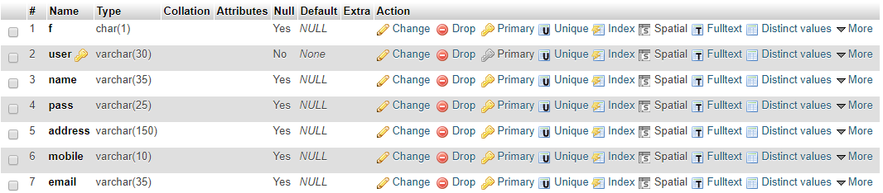
Admin Login
This table will contain the data regarding the registration of different admin
Here, user field have unique id of Each Teachers, F field contain Admin type (HOD or Teacher), as shown bellow

Slide 8
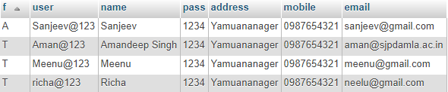
I have f field to confirm that it is HOD or Teacher in Admin Login page
Flag A represents HOD
Flag T represents Teacher

Slide 9
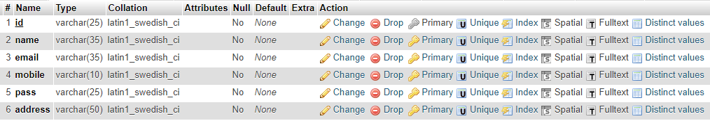
User Login
This table will contain the data regarding the registration of different users

Slide 10
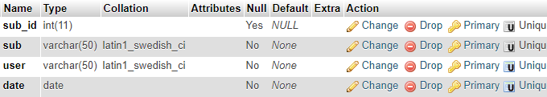
Add Subject
This table will contain the data regarding the subjects of quiz.
Here sud_id field contain unique subject id, sub field contain name of subject, user field contain user id(who creates this subject), date field contain date (when subject is created).

Slide 11
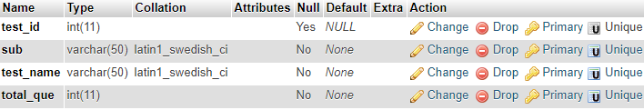
Add Test
This table will contain the data regarding tests of Subject
Here, test_id field contains unique test id , sub field contain subject name, test_name field contain name of test, total_que field contain total number of question.

Slide 12
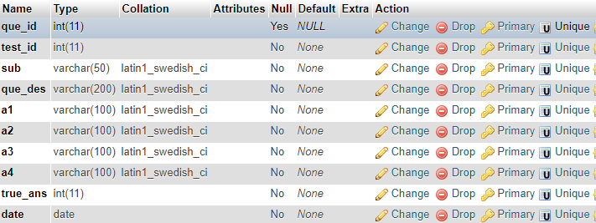
Add Question
This table will contain the data regarding the questions of the tests and subjects.

Slide 13
Codes
In login Page
I have used session variables for logging page because they are used to store user-specific information that needs to be accessed by multiple pages in a web application
I have used two Session variables.
$_SESSION[‘user’] – for user login
$_SESSION[‘admin’] – for admin login

Slide 14
Working of Session Variable
Run Query for logging.
$a=mysql_query(Select *from userid where id=’$_POST[login]’ and pass=’$_POST[pass]’);
2. If above query will true then session variable will get value
If(mysql_num_rows($a)>0){
$_SESSION[‘user’] = ’$_POST[login]’;
}
3. If session got value then you have logged in
If(isset($_SESSION[‘user’])){
echo “You have logged in”;
}

Slide 15
In Header
I have divided each web page in three parts
1. Header
2. Section
3. Footer
In Header of Admin page I have Used Above used code (working of Session variable) with more codes like this : -
//To Confirm that it is Admin or Teacher
$mk1 = mysql_query(“Select * from Admin where f=’A’ and user= ‘$_SESSION[admin]’ “);
//check that above query (variable mk1’s query) will true or not;
If(mysql_num_rows($mk1)>0){
echo “<a href=’new admin’><button>New Admin</button></a>”;
}

Slide 16
Snapshots

