Slide 1



Slide 2

Printers fall into two categories:
Impact printers use a device to strike an inked ribbon, pressing ink from the ribbon onto the paper.
Non-impact printers use different methods to place ink (or another substance) on the page.

Slide 3
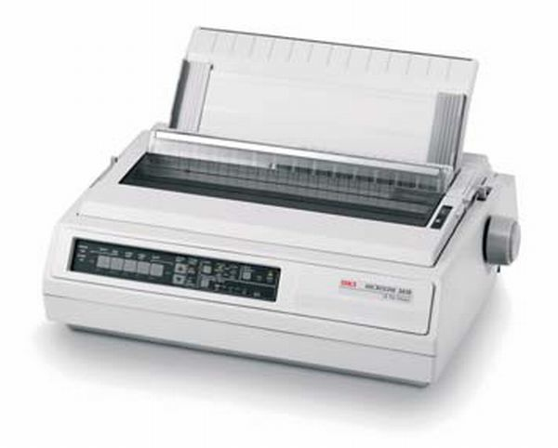
Dot Matrix Printers

Slide 4
How Do Dot Matrix Printers Work?
Dot matrix printers are a common type of impact printer.
A dot matrix printer's print head contains a cluster of pins. The printer can push the pins out to form patterns in rapid sequence.
The pins press an inked ribbon against the paper, creating an image.

Slide 5
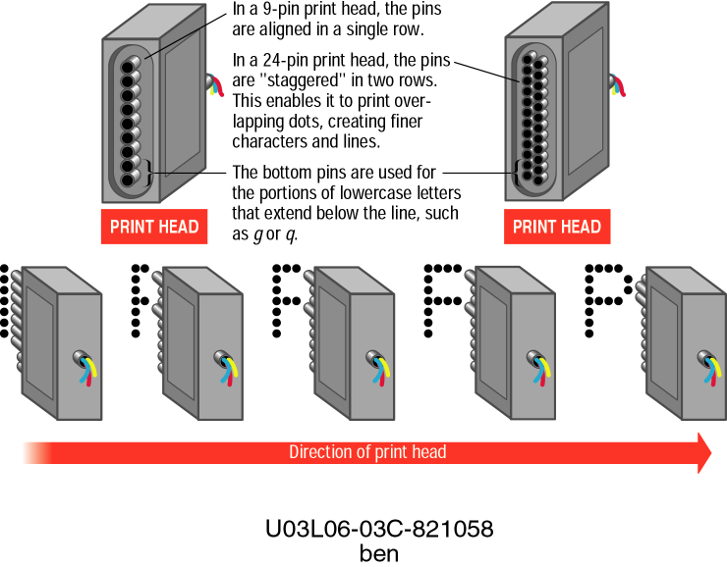

Slide 6
Dot Matrix Printers - Performance
Lower-resolution dot matrix printers use nine pins. Higher-resolution models have 24 pins.
Speed is measured in characters per second (cps). Some dot matrix printers print 500 cps.

Slide 7
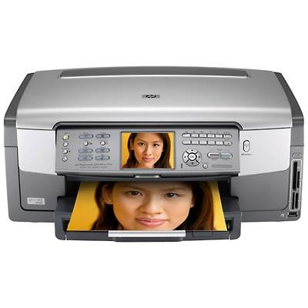
Ink Jet Printers

Slide 8
How Do Ink Jet Printers Work?
Ink jet printers are an example of non-impact printers.
The printer sprays tiny droplets of ink onto the paper.
Ink dots are extremely small (between 50 and 60 microns). A human hair is 70 microns.
Ink jet printers are available for color and black-and-white printing.

Slide 9
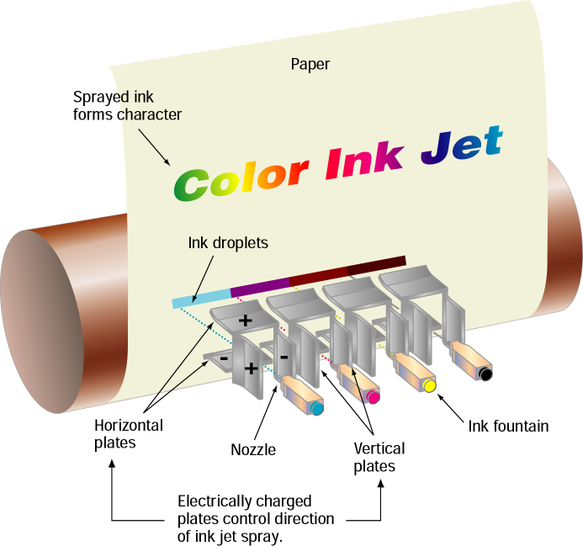

Slide 10
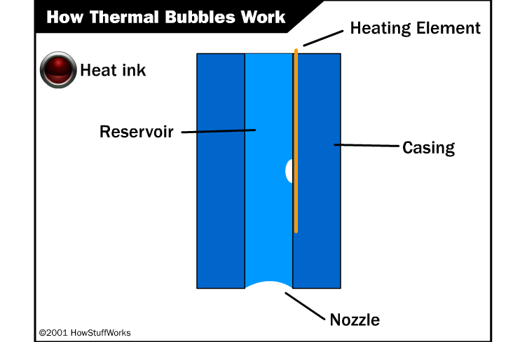

Slide 11
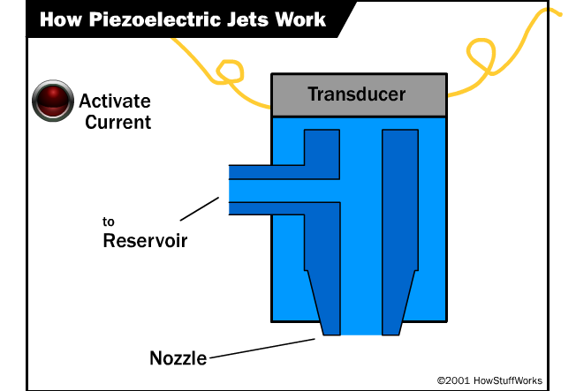

Slide 12
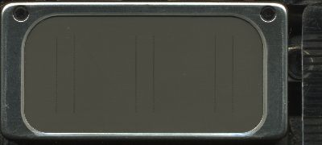
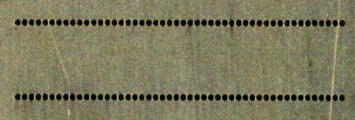
Epson printer print head

Slide 13
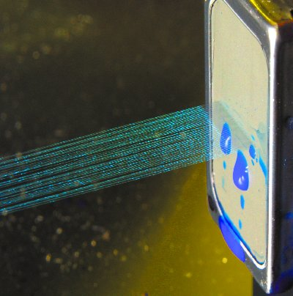

Slide 14
Ink Jet Printers - Performance
Ink jet printers offer speeds of (2 – 4 pages per minute ppm) and resolution (300 – 600 dots per inch dpi), comparable to low-end laser printers.
Ink jet printers are inexpensive and have low operating costs.

Slide 15

Ink Jet Printers - Quality
Quality is dependant on the type of paper used.
Can be used with a range of special coated papers.

Slide 16
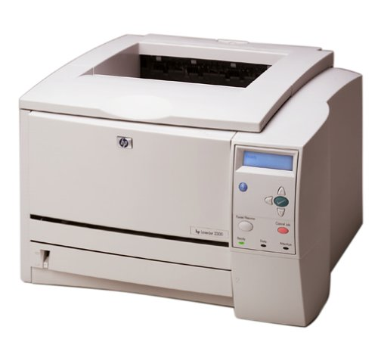
Laser Printers

Slide 17
How Do Laser Printers Work?
Laser printers are non-impact printers.
They use heat and pressure to bond particles of toner to paper.
Laser printers are available for color and black-and-white printing.

Slide 18
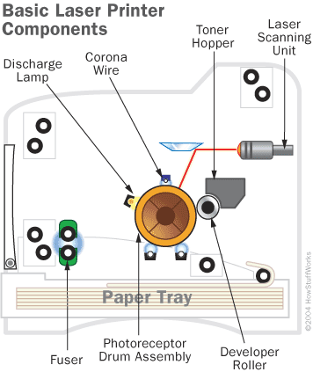

Slide 19
The drum is given a positive charge by the corona wire.
The laser draws the image by discharging certain points.
The drum is coated with toner which sticks to the negatively charged points.

Slide 20
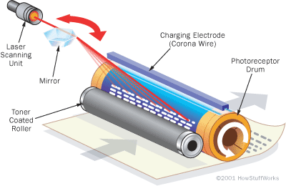

Slide 21
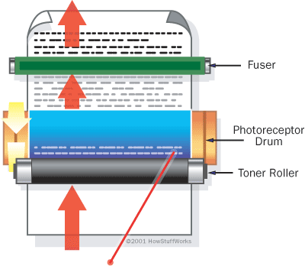
The paper then passes through the fuser which bonds the toner to the paper.

Slide 22
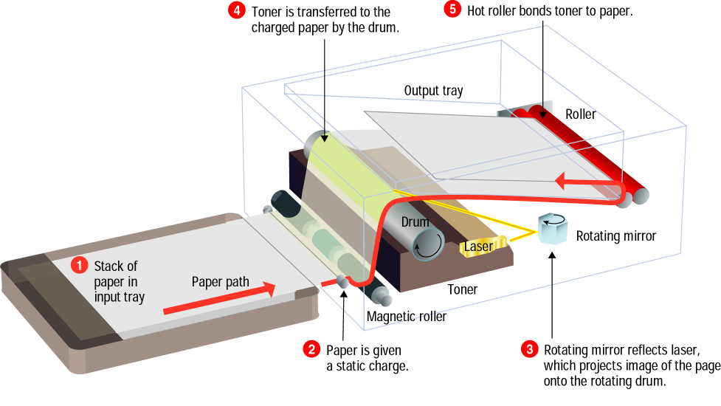

Slide 24
Laser Printers - Performance
Laser printers provide resolutions from 300 – 1200 dpi and higher.
Black-and-white laser printers usually produce 4 – 16 ppm.
Laser printers produce higher-quality print than ink jet printers, but are more expensive.

Slide 25
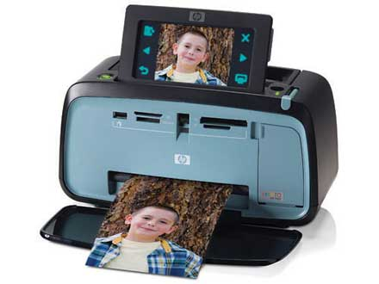
Snapshot Printers

Slide 26
Snapshot Printers
Snapshot printers are specialized, small-format printers that print digital photographs.
Snapshot printers are fairly slow, and can be more expensive to operate

Slide 27
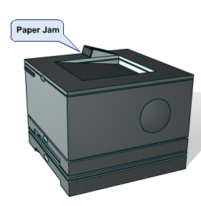
Printer problems
A large majority of printer problems are paper jams.
Many of the problems are related to the paper itself.
Fragments of paper that are torn in the printing process often must be removed from the paper path.
A paper jam can occur when the wrong type of paper is used.

Slide 28
Stripped and Broken Drive Gears
When clumping or other jam failures occur, the drive system can overload.
This can result in teeth being stripped from a gear or a broken gear.
The only solution is to replace the gear.
Care must be taken due to the timing of the paper movement.

Slide 29
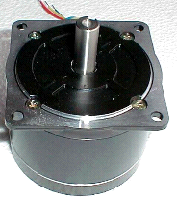
Stepper Motor Problems
Stepper motors are used in printers to position the head and move paper through the printer.
Overloading, however, can damage the motor. In this situation, replacement of the motor is required.

Slide 30
Feed Roller Problems
The rubber used on feed rollers becomes hardened over time.
Paper slippage on these rollers can cause jams.
Solutions that clean and soften rubber are available as a remedy for this problem.
If this does not correct the problem, then the rollers should be replaced with new ones.

Slide 31
Wrong Type of Paper
Most printers are designed for a specific type and certain weight of paper.
When problems occur such as clumping or folding, the type of paper should be checked to see if it is in compliance with the recommendations of the manufacturer.
http://computer.howstuffworks.com/inkjet-printer.htm
http://computer.howstuffworks.com/laser-printer.htm

