Slide 1
TITLE PAGE
Problem Statement ID –
Problem Statement Title- Autonomous Production Choke Controller for a Single Naturally Flowing Oil Well
Theme-
PS Category- Software
Student Name (Registered on portal)
Student ID

Slide 2
IDEA TITLE
Proposed Solution (Describe your Idea/Solution/Prototype)
Detailed explanation of the proposed solution
How it addresses the problem
Innovation and uniqueness of the solution

Slide 3
TECHNICAL APPROACH
Technologies to be used (e.g. programming languages, frameworks, hardware)
Methodology and process for implementation (Flow Charts/Images/ working prototype)

Slide 4
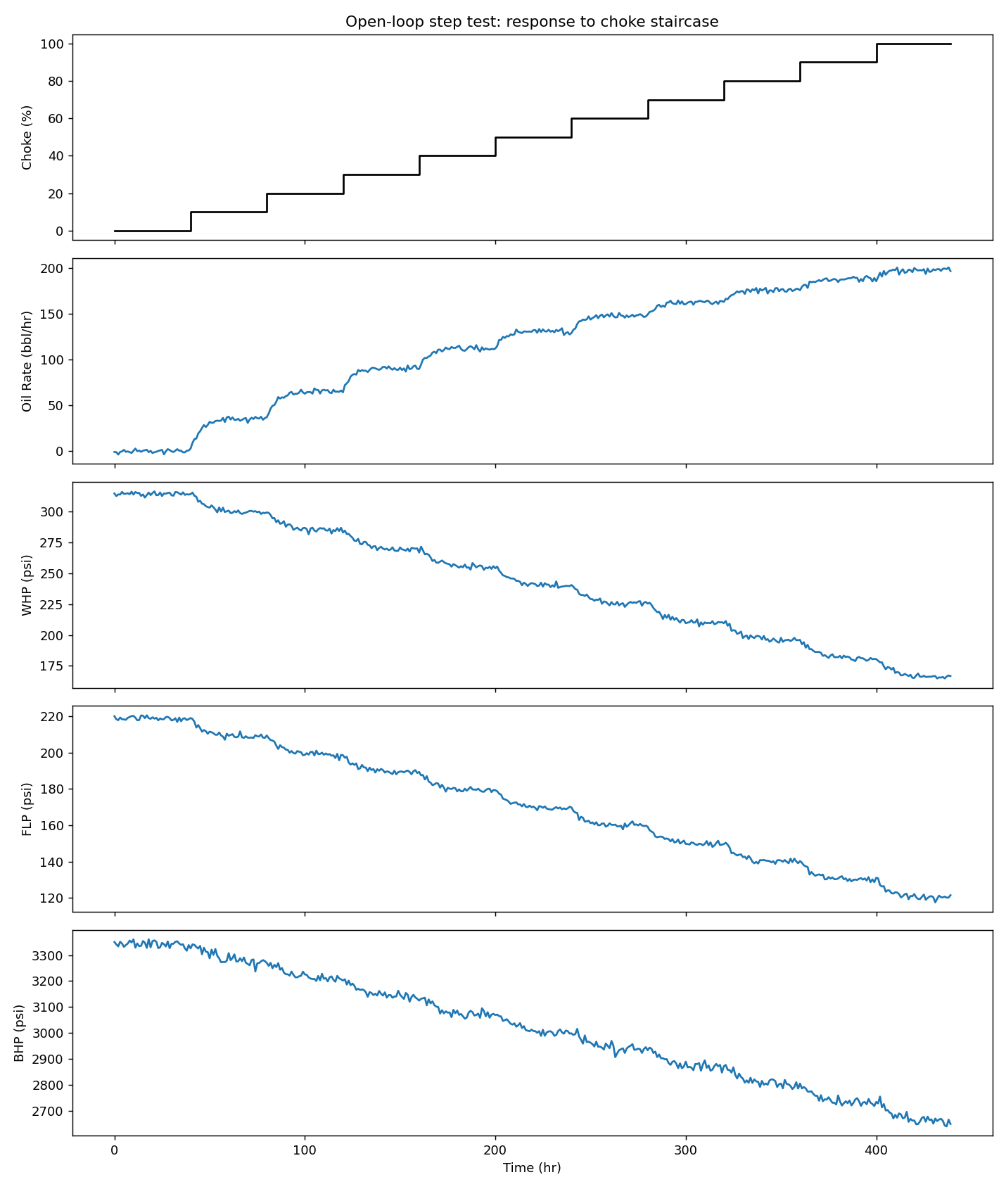
TECHNICAL APPROACH — PROCESS UNDERSTANDING & MODEL (I)
No official simulator was provided — data/simulator.py is a calibrated substitute fit to the reference CSV (30–65% choke tested).
Steady-state map y_ss(u) = A + B·u/(u+uh) per channel, driving first-order-plus-dead-time dynamics with exact zero-order-hold discretization.
A fresh open-loop step test — our own staircase experiment, not the reference CSV — identifies the model the controller predicts with.
A timing bug in the fitting code was found and fixed: dead time now matches ground truth exactly in all 20 seed/channel checks (right).
Channel | True τ | Ident. τ | Error | Range
Q | 5.00 | 4.95 | 3.0% | 0.0–5.0%
WHP | 7.50 | 7.20 | 4.0% | 0.0–6.7%
FLP | 7.00 | 6.95 | 3.6% | 0.0–7.1%
BHP | 9.00 | 8.25 | 8.3% | 2.8–13.9%
Notes:
The original fitting code (_simulate_fopdt) advanced the simulated state using the steady-state target from the previous sample instead of the current one -- a one-sample lag versus how the live Simulator.step() actually evolves state. Fixing this timing bug resolved Q's previously unexplained ~19% tau bias (now ~3%) and made dead time match exactly in all 20 seed x channel combinations, up from 2 of 4 channels matching before the fix. See docs/report.md Section 1.2 for the full derivation.

Slide 5
TECHNICAL APPROACH — PROCESS UNDERSTANDING & MODEL (II)
Hybrid physics + learned-correction layer, kept per channel only where it demonstrably improves held-out accuracy — not applied by default.
WHP/FLP/BHP safety limits are one-sided (floor-only or ceiling-only), matching the brief's own description of each variable's risk direction: WHP ≥ 205 psi, BHP ≥ 2830 psi, FLP ≤ 200 psi.
Two monitored-but-not-constrained channels — Wellhead Temperature and Annulus Pressure — add situational awareness without ever entering the safety filter.
Channel | Physics-only RMSE | +Correction RMSE | Kept?
Q | 1.66 | 1.63 | ✅ used
WHP | 1.30 | 1.30 | ❌ skipped
FLP | 0.92 | 0.89 | ✅ used
BHP | 9.85 | 9.81 | ✅ used

Slide 6
TECHNICAL APPROACH — CONTROL STRATEGY (I): THE ALGORITHM
A one-step receding-horizon search evaluates 11 candidate choke moves (±5% per interval) every control cycle — named precisely, not oversold as a full trajectory-optimizing MPC.
Each candidate is held constant over a derived lookahead horizon and simulated forward with the identified model.
Feasible candidates are ranked by closeness to target production, with a move-suppression term that prevents valve chatter once near target.
Notes:
This is receding-horizon in the classic sense -- it re-runs every interval with fresh measurements -- but the per-step search itself is a one-step decision screened by a hold-constant forward simulation, not a genuine multi-step trajectory optimization. Horizon length is derived, not hand-tuned: ceil(3 x max(tau)/Ts), clipped to [3,12]h. See docs/report.md Section 2.1.

Slide 7
TECHNICAL APPROACH — CONTROL STRATEGY (II): SAFETY GUARANTEES
Every candidate is screened against the safety envelope, tightened by 3σ of identified measurement noise, before being considered.
If nothing fully satisfies every limit, the controller falls back to the move minimizing predicted violation — it never freezes.
Empirically strong, not formally guaranteed: there's no recursive feasibility proof that today's safe choice keeps one available tomorrow.
Example — Scenario C (400 bbl/hr, unreachable): settles at 162.8 bbl/hr @ 66% choke, the max the envelope allows, 0/100 violations.
Notes:
Safety-fallback frequency in Scenario C is 23.6% of steps in the 30-seed sweep -- high because that scenario deliberately runs the choke at the edge of the tightened feasible envelope for its entire duration; 0 actual violations means the fallback branch is doing its job, not failing to. See docs/report.md Sections 2.1-2.2 and 3.3.

Slide 8
TECHNICAL APPROACH — CONTROL STRATEGY (III): EXPLAINABILITY
Every choke decision logs a one-sentence, human-readable rationale — a real output field, not just a design principle — directly answering operator distrust of opaque automation.
Dashboard/output structure echoes Honeywell Uniformance's PHD / KPI / Asset Sentinel layering: a small-scale proof-of-concept of the same wellhead-to-control-room problem Honeywell's UPPS addresses at scale (echoes, not replicates).

Slide 9
TECHNICAL APPROACH — ACTUATOR ACTIVITY & CHATTERING FIX
Move-suppression fix: candidates were originally ranked by predicted target error alone, so once near target, noise-sized differences between near-tied candidates chattered the valve.
Added cost = target_error + λ·|move size| (λ = 1.0 bbl/hr required per %-point moved) to both the normal and safety-fallback branches:
Scenario | Moves | Total valve travel
A | 5 / 80 | 16.0 %-pts
B | 7 / 140 | 29.0 %-pts
C | 53 / 100 | 129.0 %-pts (was 154.0 pre-fix)

Slide 10
FEASIBILITY AND VIABILITY
Analysis of the feasibility of the idea
Potential challenges and risks
Strategies for overcoming these challenges

Slide 11
ARTIFACTS
Relevant artifacts, such as :
Copy of the Code Embedded
Snaps of the solution proposal
Dashboard snaps

Slide 12
ARTIFACTS — RESULTS: SCENARIO OVERVIEW
Scenario A — Startup to Target: 15% choke → 100 bbl/hr target.
Scenario B — Target Tracking: ~34% choke start, 100 → 150 bbl/hr step.
Scenario C — Infeasible Target: ~34% choke start, 400 bbl/hr requested (deliberately unreachable).
Full time-series trends for A/B/C, and Scenario D, follow on their own slides.
Scenario | Setup | Final | Constraint violations
A — Startup to Target | 15% choke, 80h run | 99.9 bbl/hr @ 34% choke | 4/80
B — Target Tracking | 34.2% choke, 140h run | 150.4 bbl/hr @ 61% choke | 0/140
C — Infeasible Target | 34.2% choke, 100h run | 160.8 bbl/hr @ 66% choke | 0/100

Slide 13
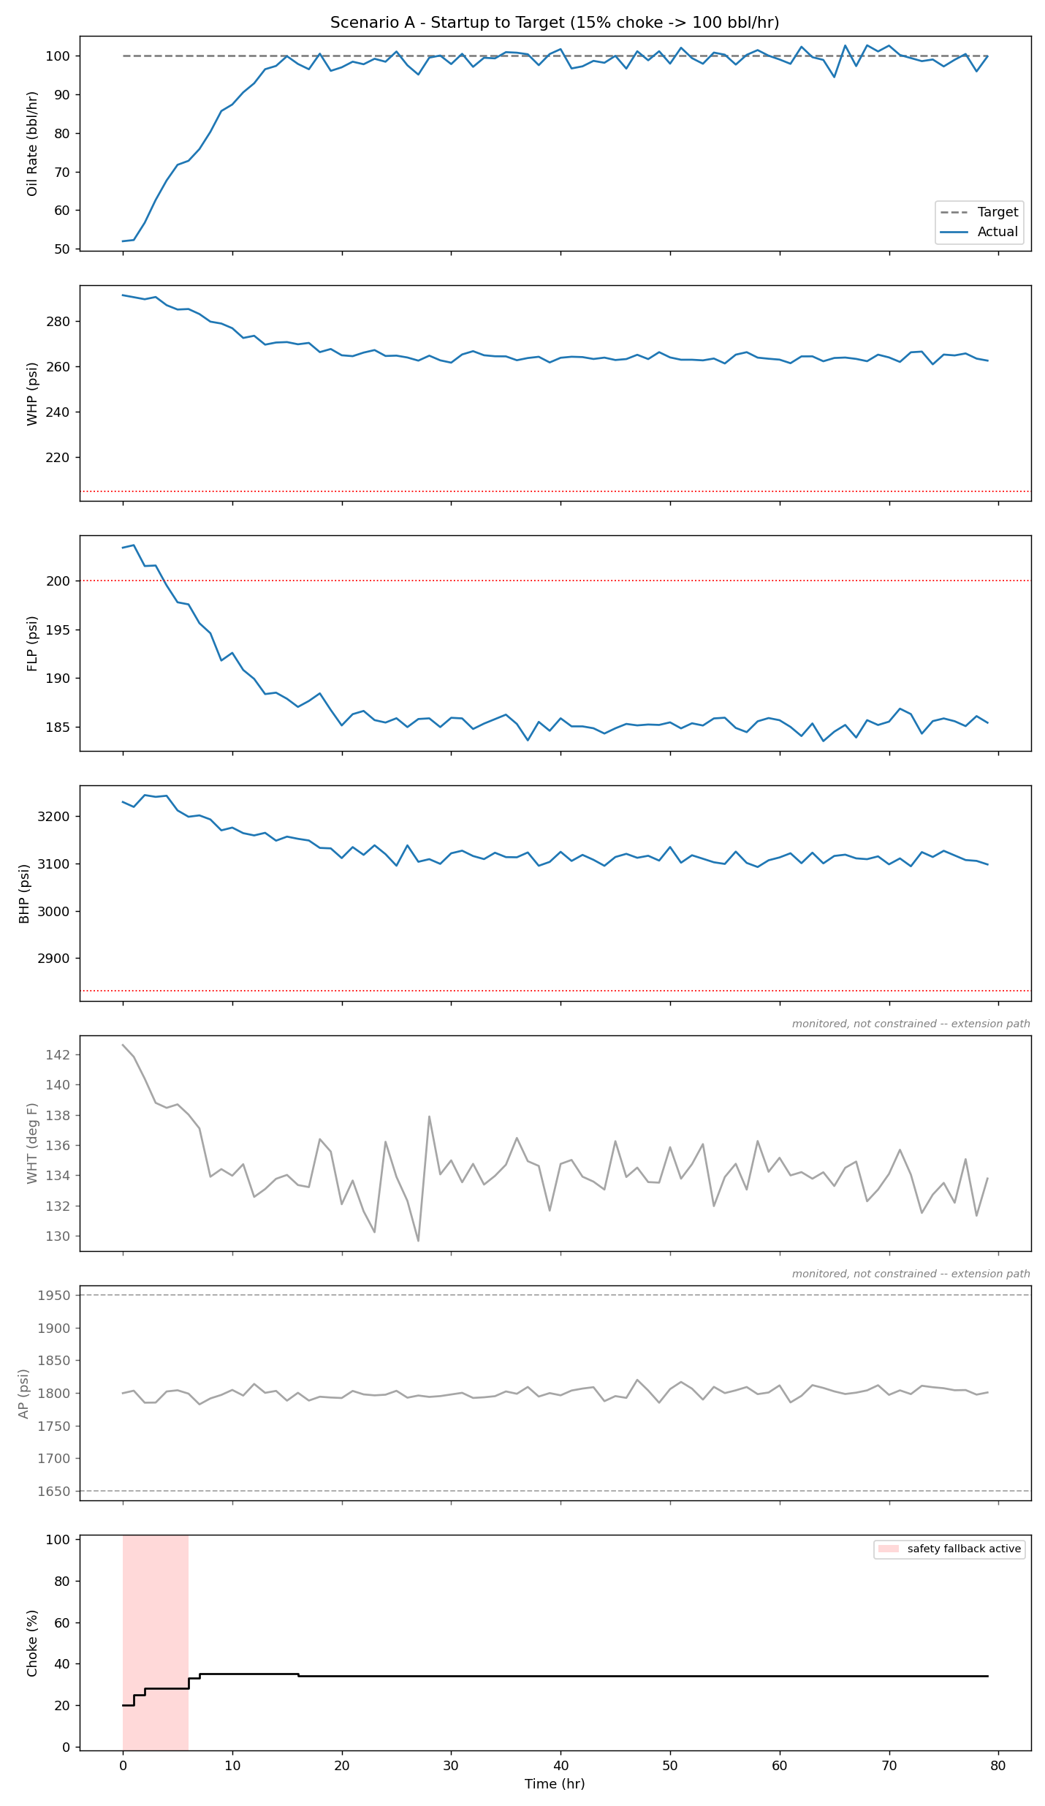
ARTIFACTS — RESULTS: SCENARIO A — STARTUP TO TARGET
15% choke start, 100 bbl/hr target, 80h run. Trailing 10h mean settles at 99.3 bbl/hr @ 34% choke.
FLP starts above its own steady-state ceiling at 15% choke, so early violations are a deterministic consequence of the ramp-rate limit, not sensor noise or model guesswork.
Safe by hour 4; 30-seed sweep: violations in every seed (mean 3.97/80), always resolved within 3–5 hours.
Notes:
This is not an 'extrapolation uncertainty' artifact -- computing the identified FLP steady-state curve directly shows it exceeds the 200 psi ceiling below ~19% choke, a concrete fact about the current model, not a hedge about untested territory. See docs/report.md Section 2.3.

Slide 14
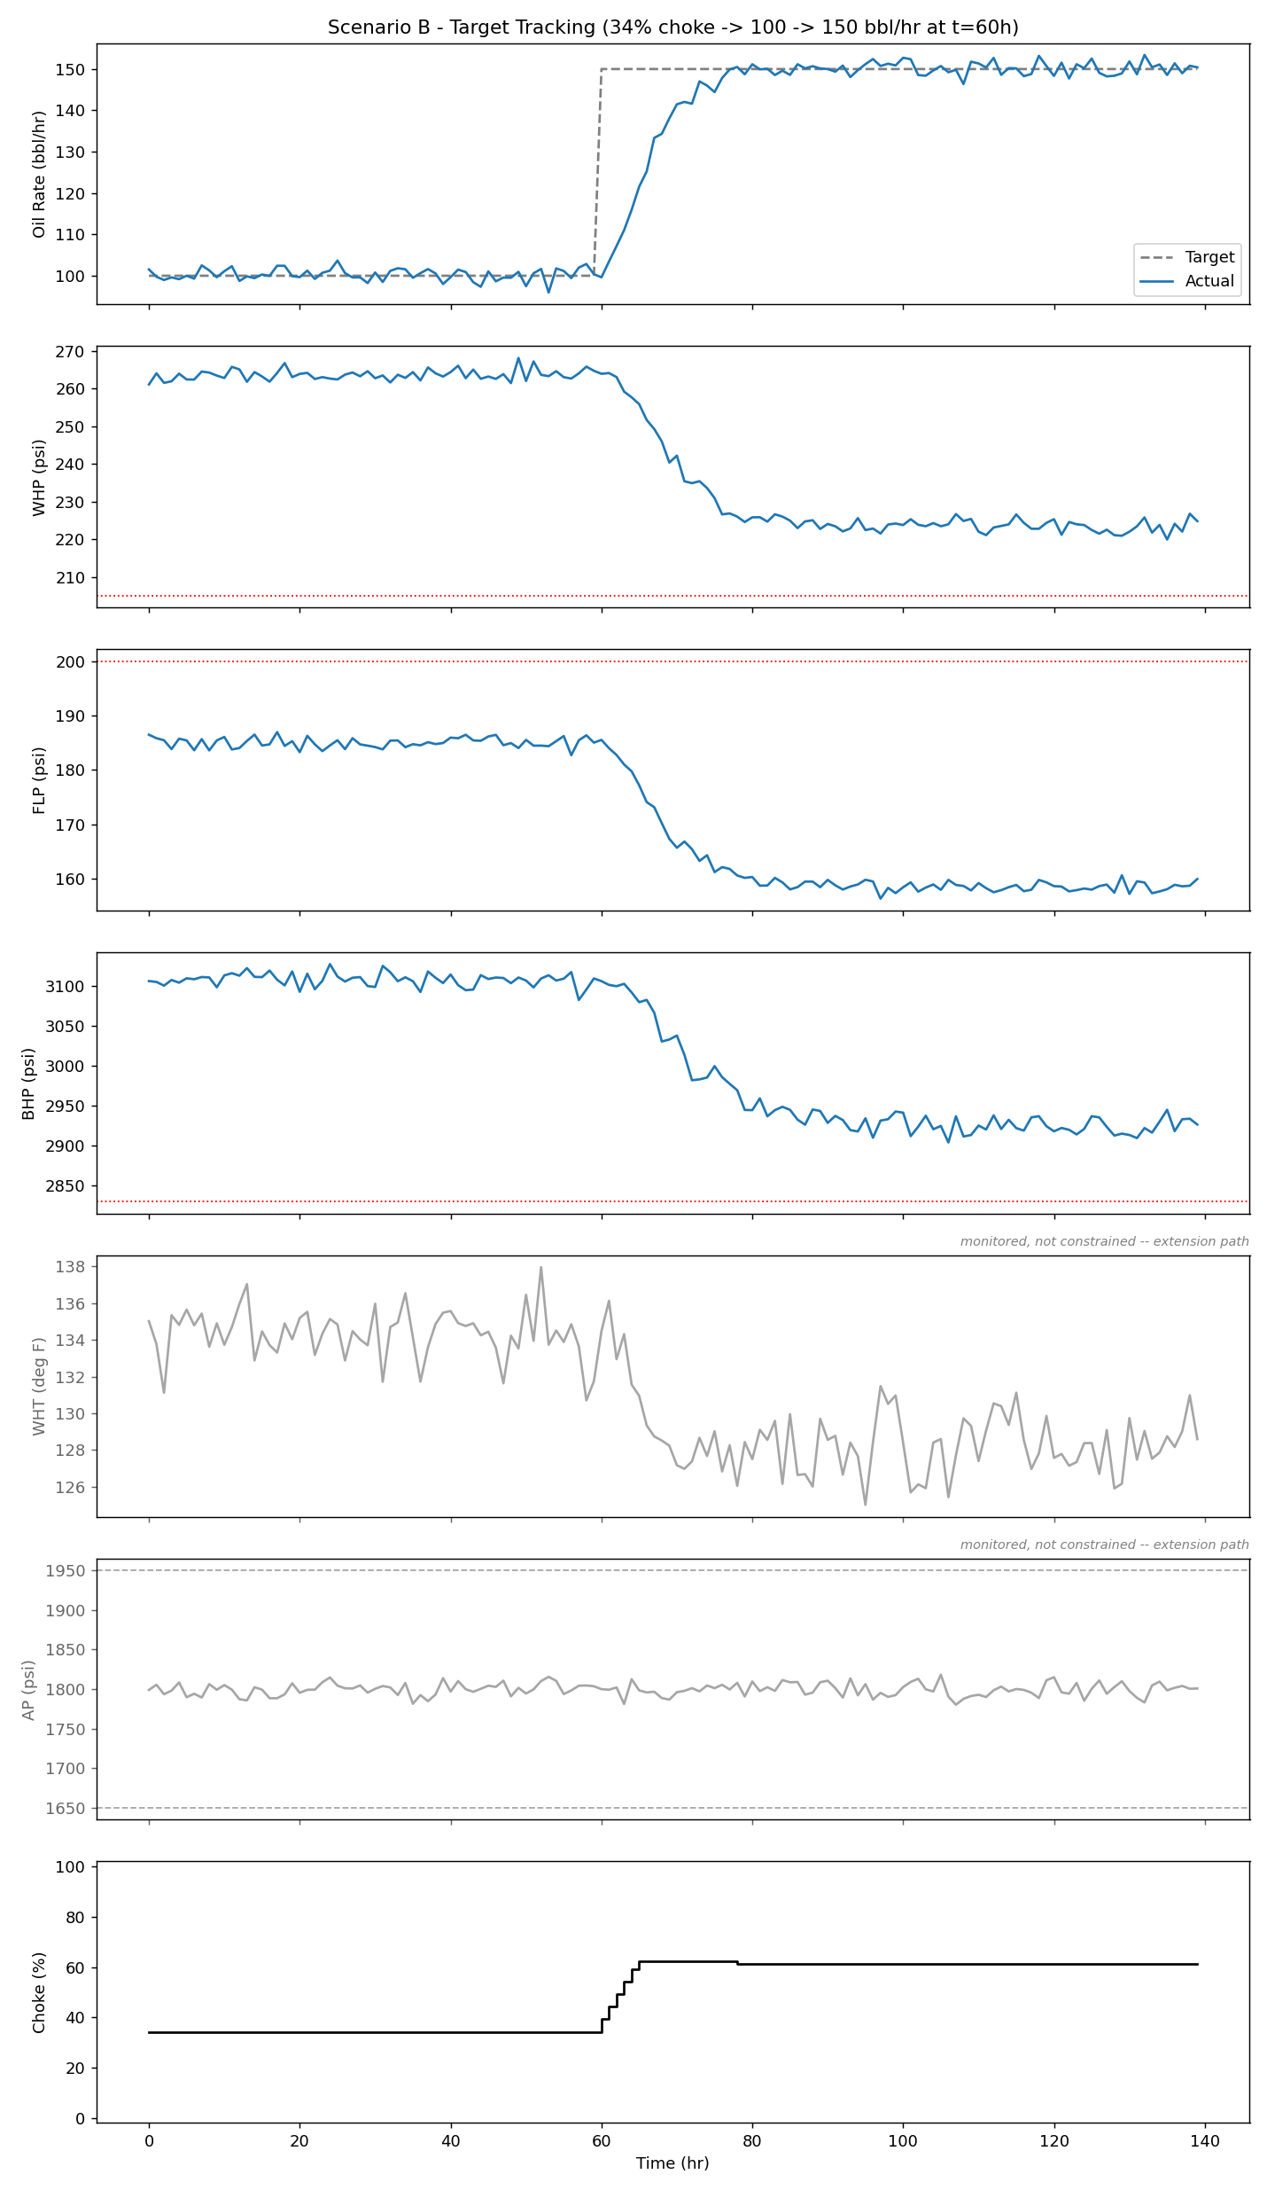
ARTIFACTS — RESULTS: SCENARIO B — TARGET TRACKING
34% choke start, target steps 100 → 150 bbl/hr at hour 60, 140h run. Settles at 150.6 bbl/hr @ 61% choke.
Zero constraint violations in the representative run and in all 30 seeds — the only scenario with a perfectly clean safety sweep.
Clean because it never leaves the calibration's supported 30–65% choke band.

Slide 15
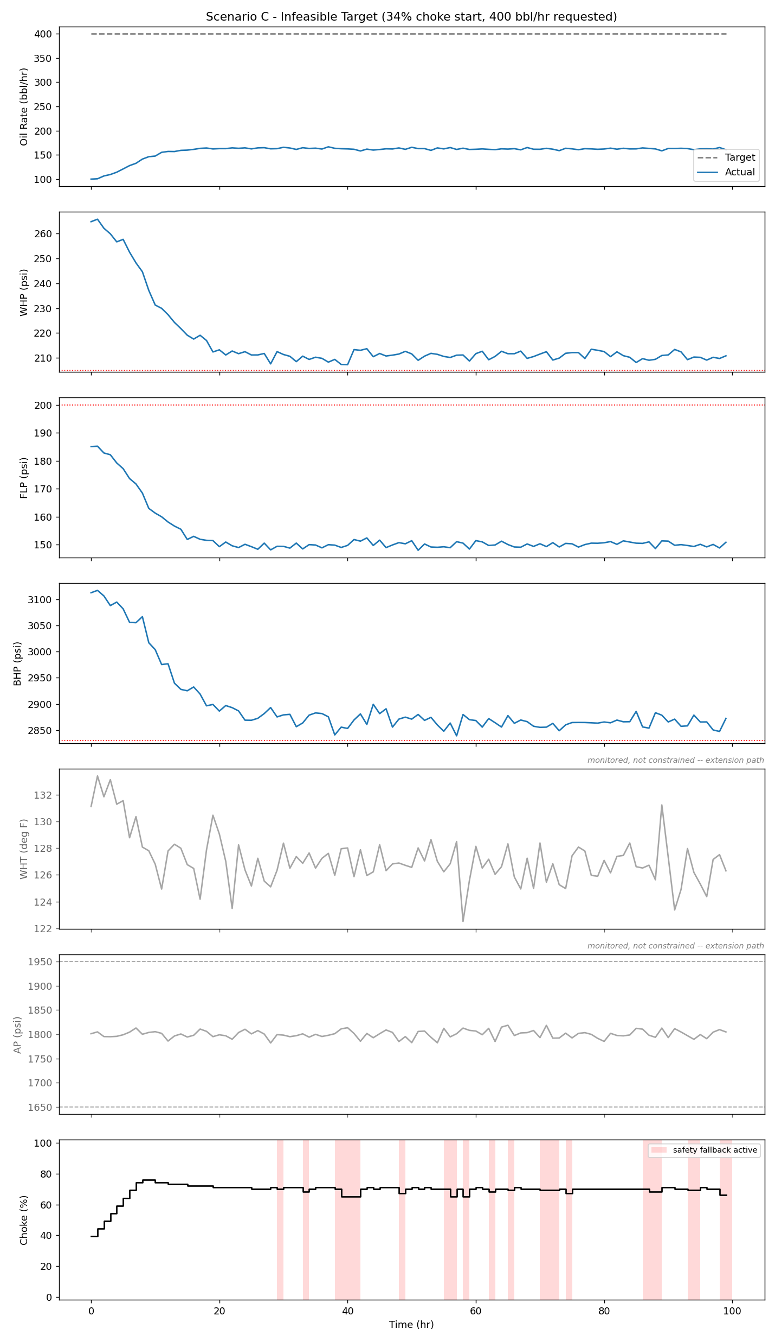
ARTIFACTS — RESULTS: SCENARIO C — INFEASIBLE TARGET
34% choke start, 400 bbl/hr requested — deliberately unreachable.
The controller does not chase it into a violation: settles at 162.8 bbl/hr @ 66% choke, the maximum the tightened safety envelope allows.
0/100 violations in the representative run and in all 30 seeds.

Slide 16
ARTIFACTS — RESULTS: SEED-SWEEP SAFETY DISTRIBUTION
30-seed distribution per scenario — not a single cherry-picked run.
Reports mean/max constraint violations and safety-fallback frequency per scenario.
Scenario | Mean violations | Max violations | Seeds w/ ≥1 violation | Mean fallback rate
A — Startup to Target | 3.97 / 80 | 5 | 30 / 30 | 8.58%
B — Target Tracking | 0.00 / 140 | 0 | 0 / 30 | 0.00%
C — Infeasible Target | 0.00 / 100 | 0 | 0 / 30 | 23.57%

Slide 17
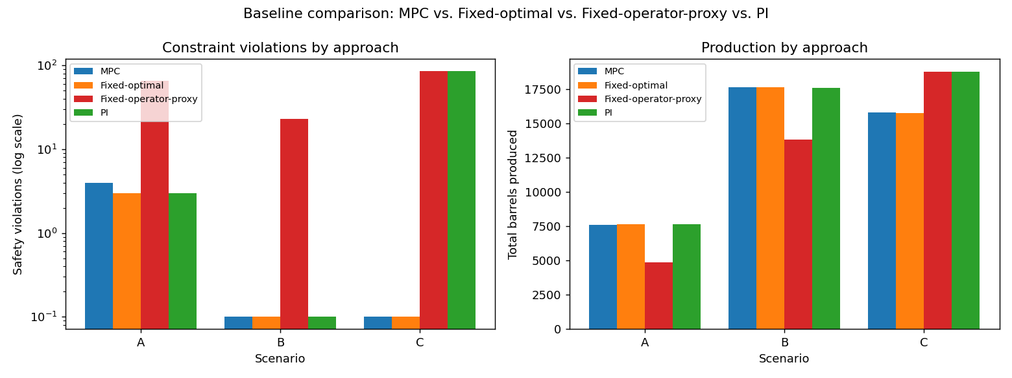
ARTIFACTS — RESULTS: BASELINE COMPARISON
MPC vs. Fixed-optimal vs. Fixed-operator-proxy vs. PI — identical scenarios, model, limits, and simulator seeds.
Fixed-operator-proxy models a real operator with no model and no envelope knowledge: a naive linear read off the raw reference CSV, backed off 15 points.
Headline: MPC and Fixed-optimal both stay safe in every scenario; the operator-proxy and safety-blind PI both rack up major violations chasing Scenario C's infeasible target.
Notes:
Full numbers (violations/total steps, total barrels):
A: MPC 4/80, 7590.4 | Fixed-optimal 3/80, 7657.6 | Fixed-operator-proxy 66/80, 4852.4 | PI 3/80, 7652.1
B: MPC 0/140, 17676.4 | Fixed-optimal 0/140, 17642.0 | Fixed-operator-proxy 23/140, 13824.5 | PI 0/140, 17591.0
C: MPC 0/100, 15806.2 | Fixed-optimal 0/100, 15769.0 | Fixed-operator-proxy 85/100, 18778.3 | PI 85/100, 18778.3
(C's operator-proxy and PI rows match because both independently saturate the choke to 100% under the same noise seed, not a bug.)

Slide 18
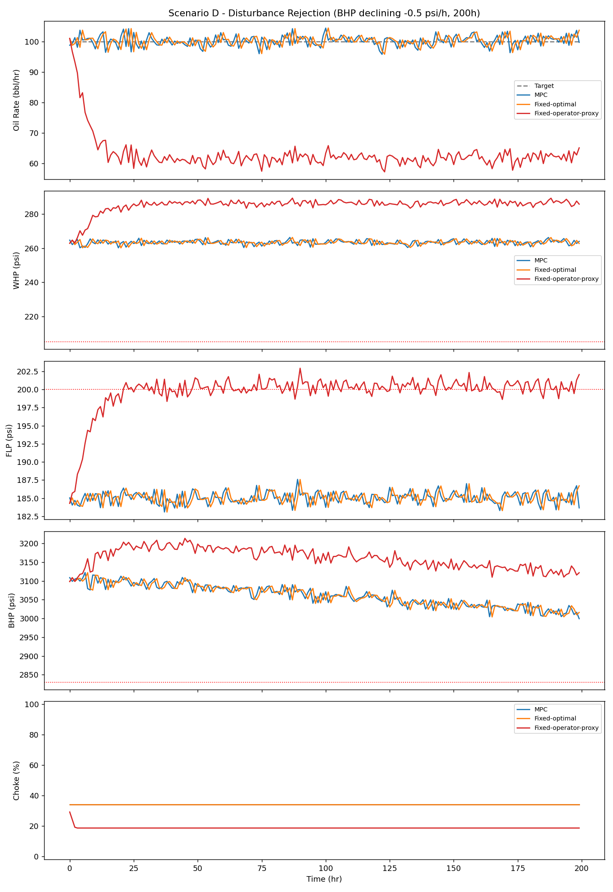
ARTIFACTS — RESULTS: SCENARIO D — DISTURBANCE REJECTION
Deliberate relaxation of “no changing reservoir properties”: BHP's steady-state offset drifts −0.5 psi/h for 200h at a constant 100 bbl/hr target.
Tests whether live re-planning beats a static setpoint once the plant genuinely drifts.
Result: MPC ties Fixed-optimal — BHP and Q are uncoupled here, so re-planning has nothing extra to correct. The real, consistent win is envelope-awareness itself vs. the operator-proxy (right).
Approach | Violations | Barrels | 1st violation
MPC | 0/200 | 20,040.9 | never
Fixed-optimal | 0/200 | 20,048.3 | never
Fixed-op.-proxy | 121/200 | 12,594.2 | 21h

Slide 19
RESEARCH AND REFERENCES
Details / Links of the reference and research work

