Slide 1
Log Analytics -POC
Big data analytics Mohit kumar

Slide 2
Brief info of the POC
Technology used – HDFS and SPARK
In Turbo Charging Product we investigate many CM/RPL issue.
During investigation in most of the times we check ABPAuditLog files which contains the transaction level logging for each CM/RPL API.
During investigation we often write scripts ranging from very simple to complex to identify a pattern for the issue.
Here if we get some framework where these logs can be investigated using queries like sql etc it can give better analysis result –by using sql like framework we can use join ,group by ,order to name a few very basic sql functions.
Thus the sql level analysis will help developer with faster investigation and lead to quicker RCAs
Small POC was done to investigate Dummy ABPAuditLogs created in Turbo charging product for checking CM /RPL.

Slide 3
ABPAuditLogs Info
Logs contains first five lines as headers
Logs structure is as below field wise.
thread_id;event-UTC-time (YYYY-MM-DD HH24:MI::SS.SSS);user-name;api-name;api-return-status (S=success/F=failure);component-name;customisation-level;cpu-time-in-millisec;run-mode(EJB, Batch_Mode);error-code-if-failure;input-parameters(Separated by <<<);
Logs contains first five lines as headers
A small section of logs is shown in the next slide.

Slide 4
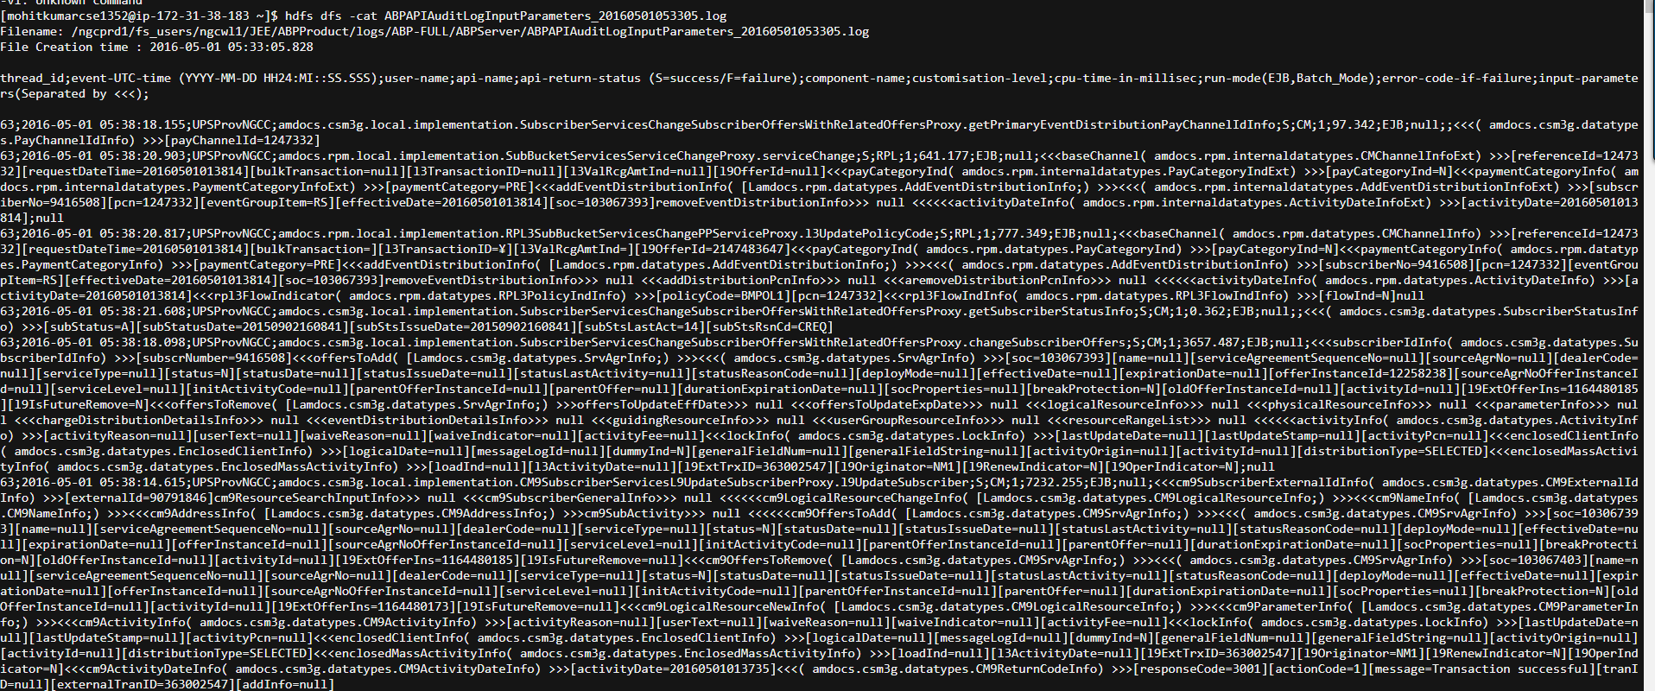
Sample ABPAuditLogs

Slide 5
Metadata
Log Data fields thread_id; event-UTC-time (YYYY-MM-DD HH24:MI::SS.SSS); user-name; api-name; api-return-status (S=success/F=failure); component-name; customisation-level; cpu-time-in-millisec; run-mode(EJB, Batch_Mode); error-code-if-failure; input-parameters(Separated by <<<);

Slide 6
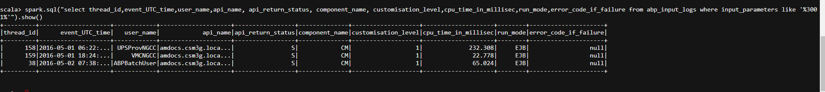
Querying Logs just as SQL
Get details of all transaction which Passed –Below simple spark sql was used to get details

Slide 7
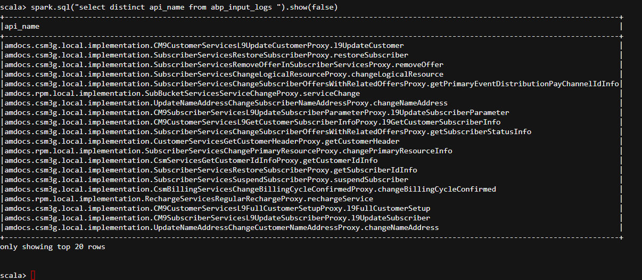
Querying Logs just as SQL
Get List of all APIs–Below simple spark sql was used to get details

Slide 8
Logic written in SPARK-BigDataTech
Getting Framework ready – One time step val logs=sc.textFile("/user/mohitkumarcse1352/ABPAPIAuditLogInputParameters_20160501053305.log") val first =logs.first val data1 =logs.filter(_ != first) val header2 =data1.first val data2 =data1.filter(_ != header2) val header3 =data2.first val data3 =data2.filter(_ != header3) val header4 =data3.first val data4 =data3.filter(_ != header4) case class LogCC(thread_id:Integer,event_UTC_time:String,user_name:String,api_name:String, api_return_status:String, component_name:String, customisation_level:String,cpu_time_in_millisec:Double,run_mode:String,error_code_if_failure:String, input_parameters:String) val logApplyCC1=data4.map(_.split(";")).map(row =>LogCC(row(0).trim.toInt,row(1),row(2),row(3),row(4),row(5),row(6),row(7).trim.toDouble,row(8),row(9),row(10))).toDF() logApplyCC1.createOrReplaceTempView("abp_input_logs")

Slide 9
Firing SPARK-SQLs to get results
Get details of all transaction which Passed –Below simple spark sql was used to get details spark.sql("select thread_id,event_UTC_time,user_name,api_name, api_return_status, component_name, customisation_level,cpu_time_in_millisec,run_mode,error_code_if_failure from abp_input_logs where input_parameters like '%3001%'").show() Get List of all APIs–Below simple spark sql was used to get details spark.sql("select distinct api_name from abp_input_logs ").show(false)

Slide 10
THANK You !

