Slide 1
Bike System Travel Domain
Big data analytics track Mohit kumar-upx1131
Mohitkumar.cse@gmail.com

Slide 2
Brief info of the project
Domain :Travel/Bike share program
Technology Used: Spark SQL ; Spark MLLib(Machine Learning library)
As part of this project we would be analyzing travel data collected from citibike website.
The data was collected by citibike research.
The dataset contains information like tripduration ,starttime,stoptime,start station id,start station name,start station latitude,start station longitude,end station id end station name,end station latitude etc.
Analyzing above data will provide greater Business intelligence to this domain to understand the different locations ,timings biker prefer and plan accordingly
This will in turn help them generate better revenue and get better ROI.

Slide 3
Dataset Description
We have dataset taken from citibike site.
Dataset contains movie rating information such as.
tripduration , starttime stoptime
start station id,start station name,start station latitude
bikeid ,usertype,birth year,gender.
As part of this project I will be
Analyzing this data to get various insights and analyze trend of bikers and pertaining to other specifics using Spark SQL
Developing a gender prediction model using Spark MLLib.

Slide 4
Metadata
Bike Data Trip Duration (seconds) Start Time and Date Stop Time and Date Start Station Name End Station Name Station ID Station Lat/Long Bike ID User Type (Customer = 24-hour pass or 3-day pass user; Subscriber = Annual Member) Gender (Zero=unknown; 1=male; 2=female) Year of Birth

Slide 5
Business questions identified
Step 1- Load users ,movie and ratings data to Hadoop:
Bike Data :
val bikeData1=sc.textFile("/user/mohitkumarcse1352/Bike2.csv")
val header1 =bikeData1.first
val data1 =bikeData1.filter(_ != header1)
Step 2- Create Case classes:
Bike Data :
case class bikeCC1(tripduration:Integer,starttime:String,stoptime:String,start_station_id:Integer, start_station_name:String, start_station_latitude:Double, start_station_longitude:Double,end_station_id:String,end_station_name:String,end_station_latitude:String, end_station_longitude:String,bikeid:Integer,usertype:String,birth_year:String,gender:Integer)

Slide 6
Business questions identified
Step 3- Apply Case classes:
Bike Case Class
val bikeApplyCC1=data1.map(_.split(",")).map(row =>bikeCC1(row(0).trim.toInt,row(1),row(2),row(3).trim.toInt,row(4),row(5).toDouble,row(6).trim.toDouble,row(7),row(8),row(9),row(10),row(11).trim.toInt,row(12),row(13),row(14).trim.toInt)).toDF()
Create temp table
bikeApplyCC1.createOrReplaceTempView("bikestable1")

Slide 7
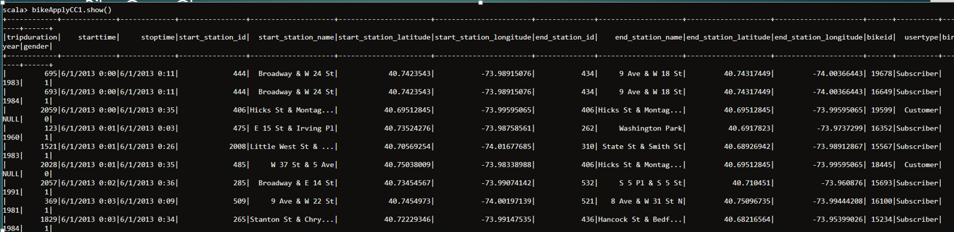
Business questions identified
Step 4- Test Case classes:
Bike Case Class

Slide 8
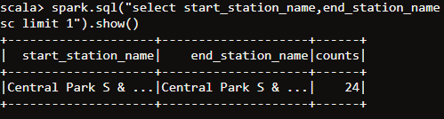
Business questions identified
Q1: Which route bikers ride the most:
Approach:Find the higher start station and end station grouping.
Spark SQL: spark.sql("select start_station_name,end_station_name ,count(*) as counts from bikestable1 where end_station_latitude!='NULL' and end_station_longitude!='NULL' group by start_station_name,end_station_name order by counts desc limit 1").show()
Visualization:

Slide 9
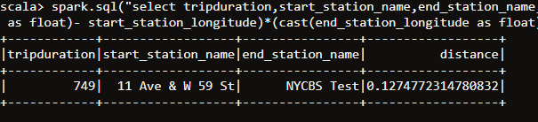
Business questions identified
Q2:Find the biggest trip and its duration:
Approach: cast end stating latitude and longitude to double and then calculate distance b/w 2 co-ordinates as square root of (x2-x1)^2+(y2-y1)^2
Spark SQL : spark.sql("select tripduration,start_station_name,end_station_name,sqrt((cast(end_station_latitude as float)- start_station_latitude)*(cast(end_station_latitude as float)- start_station_latitude)+(cast(end_station_longitude as float)- start_station_longitude)*(cast(end_station_longitude as float)- start_station_longitude)) as distance from bikestable1 where end_station_latitude !='NULL' order by distance desc limit 1").show()
Visualization:

Slide 10
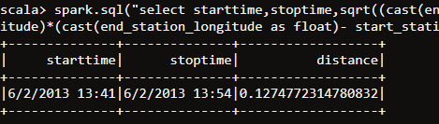
Business questions identified
Q3:When do they ride
Approach : Use approach same as point 2 and add select of starttime and stoptime
Spark SQLs: spark.sql("select starttime,stoptime,sqrt((cast(end_station_latitude as float)- start_station_latitude)*(cast(end_station_latitude as float)- start_station_latitude)+(cast(end_station_longitude as float)- start_station_longitude)*(cast(end_station_longitude as float)- start_station_longitude)) as distance from bikestable1 where end_station_latitude !='NULL' order by distance desc limit 1").show()
Visualization:

Slide 11
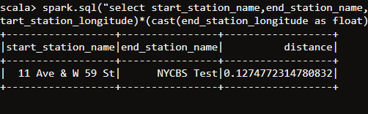
Business questions identified
Q4:how far do they go.
Approach: Use approach same as point 2 and add select of start station and endstation
Spark SQL : spark.sql("select start_station_name,end_station_name,sqrt((cast(end_station_latitude as float)- start_station_latitude)*(cast(end_station_latitude as float)- start_station_latitude)+(cast(end_station_longitude as float)- start_station_longitude)*(cast(end_station_longitude as float)- start_station_longitude)) as distance from bikestable1 where end_station_latitude !='NULL' order by distance desc limit 1").show()
Visualisation

Slide 12
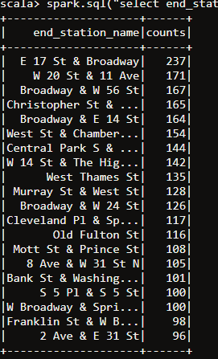
Business questions identified
Q5:Which stations are most popular.
Approach: select end station based on the counts and pick up top 20 stations.
Spark SQL : spark.sql("select end_station_name,count(*) as counts from bikestable1 where end_station_name !='NULL' group by end_station_name order by counts desc limit 20").show()
Visualization

Slide 13
SPARK MLLib Portion
(Machine Learning)

Slide 14
Business questions identified
Step 1- Import Spark MLlib packages:
import org.apache.spark.mllib.recommendation.ALS
import org.apache.spark.mllib.recommendation.Rating
import org.apache.spark.SparkConf
import org.apache.spark.SparkContext
import org.apache.spark.SparkContext._
import org.apache.spark.rdd._

Slide 15
Business questions identified
Step 2- Load Bike data to Hadoop:
Bike Data :
val bikeData1=sc.textFile("/user/mohitkumarcse1352/Bike2.csv")
val header1 =bikeData1.first
val data1 =bikeData1.filter(_ != header1)

Slide 16
Business questions identified
Step 3- Split Bike data by ‘,’ and get tripduration,start_station_id,gender based on index
val rawBike =data1.map(_.split(",")).map(x=>Array(x(0),x(3),x(14)))
Step 4- Map the Split fields to MLlib ‘Rating’ object.
val ratings = rawBike.map {case Array(tripduration,start_station_id,gender) => Rating(tripduration.toInt , start_station_id.toInt , gender.toDouble)}

Slide 17
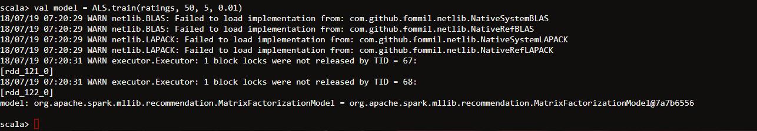
Business questions identified
Step 5- Train the model
val model = ALS.train(ratings, 50, 5, 0.01)

Slide 18
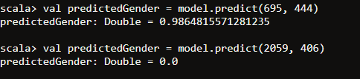
Business questions identified
Q1:Predict gender for when tripduration is 695 and start station id is # 444
Approach : val predictedRating = model.predict(789, 2997)
Visualization:

