Slide 1
Movie Recommender System Entertainment Domain
Big data analytics track Mohit kumar-upx1131
Mohitkumar.cse@gmail.com

Slide 2
Brief info of the project
Domain :Entertainment
Technology Used: Spark SQL ; Spark MLLib(Machine Learning library)
As part of this project we would be analyzing movie data collected from Movie Lens website.
The data was collected by Group lens research.
The dataset contains information like movie name, user ,rating ,review etc.
Analyzing above data will provide greater Business intelligence to Entertainment domain to understand the changing mindsets of viewers and will help them movies in similar direction.
This will in turn help them generate better revenue and get better ROI.

Slide 3
Dataset Description
We have dataset taken from grouplens site.
Dataset contains movie rating information such as.
Movie Id, MovieName
User Id,Gender,Age
Rating ,Reviews.
As part of this project I will be
Analyzing this data to get various insights and analyze trend with the changing mindset of viewers and pertaining to other specifics using Spark SQL
Developing a rating prediction model using Spark MLLib.

Slide 4
Metadata
Ratings Data user id -range between 1 and 6040 movie id -range between 1 and 3952 Rating -made on a 5-star scale (whole-star ratings only) Timestamp (in UNIX time)

Slide 5
Metadata
User Data UserID Gender-denoted by a "M" for male and "F" for female Age Occupation Zip-code Age is chosen from the following ranges: * 1: "Under 18" * 18: "18-24" * 25: "25-34" * 35: "35-44" * 45: "45-49" * 50: "50-55" * 56: "56+“ | Occupation is chosen from the following choices: * 0: "other" or not specified * 1: "academic/educator" * 2: "artist" * 3: "clerical/admin" * 4: "college/grad student" * 5: "customer service" * 6: "doctor/health care" * 7: "executive/managerial" * 8: "farmer" * 9: "homemaker" * 10: "K-12 student" * 11: "lawyer" * 12: "programmer" * 13: "retired" * 14: "sales/marketing" * 15: "scientist" * 16: "self-employed" * 17: "technician/engineer" * 18: "tradesman/craftsman" * 19: "unemployed" * 20: "writer"

Slide 6
Metadata
Movies Data MovieID Title Genres Titles are identical to titles provided by the IMDB (including year of release) Some MovieIDs do not correspond to a movie due to accidental duplicateentries and/or test entries Movies are mostly entered by hand, so errors and inconsistencies may exist | Genres are pipe-separated and are selected from the following genres: * Action * Adventure * Animation * Children's * Comedy * Crime * Documentary * Drama * Fantasy * Film-Noir * Horror * Musical * Mystery * Romance * Sci-Fi * Thriller * War * Western

Slide 7
Business questions identified
Step 1- Load users ,movie and ratings data to Hadoop:
User Data :
val user=sc.textFile("/user/mohitkumarcse1352/users.dat")
Ratings Data
val ratings=sc.textFile("/user/mohitkumarcse1352/ratings.dat")
Movies Data
val movies=sc.textFile("/user/mohitkumarcse1352/movies.dat")

Slide 8
Business questions identified
Step 2- Create Case classes:
User Case Class
case class userCC(UserID:Integer,Gender:String, Age:Integer, Occupation:Integer, Zip_code:String)
Ratings Case Class
case class ratingCC(UserID:Integer, MovieID:Integer, Rating:Integer, Timestamp:Integer)
Movie Case Class
case class movieCC(MovieID:Integer, Title:String, Genres:String)

Slide 9
Business questions identified
Step 3- Apply Case classes:
User Case Class
val userApplyCC=user.map(_.split("::")).map(row =>userCC(row(0).trim.toInt,row(1),row(2).trim.toInt,row(3).trim.toInt,row(4))).toDF()
Ratings Case Class
val ratingApplyCC=ratings.map(_.split("::")).map(row =>ratingCC(row(0).trim.toInt,row(1).trim.toInt,row(2).trim.toInt,row(3).trim.toInt)).toDF()
Movie Case Class
val moviewApplyCC=movies.map(_.split("::")).map(row =>movieCC(row(0).trim.toInt,row(1),row(2))).toDF()

Slide 10
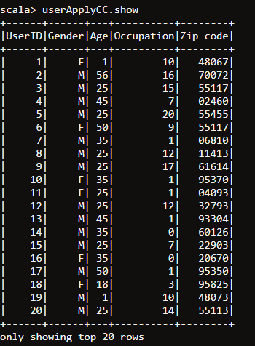
Business questions identified
Step 4- Test Case classes:
User Case Class

Slide 11
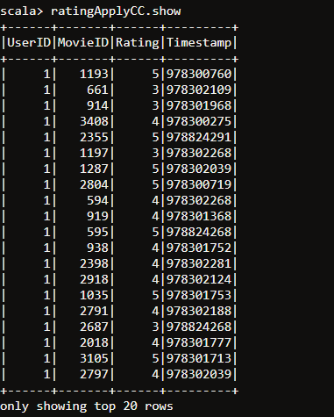
Business questions identified
Rating Case Class

Slide 12
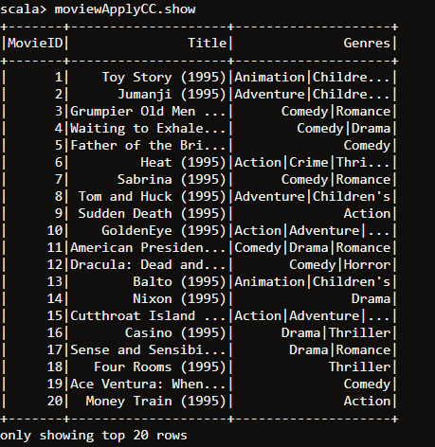
Business questions identified
Movie Case Class

Slide 13
Business questions identified
Step 5- Create temporary tables for Case Class in Spark:
User Case Class
userApplyCC.createOrReplaceTempView("usertable")
Ratings Case Class
ratingApplyCC.createOrReplaceTempView("ratingstable")
Movie Case Class
moviewApplyCC.createOrReplaceTempView("moviestable")

Slide 14
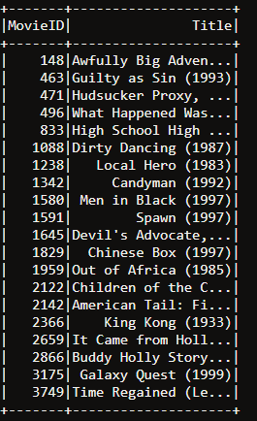
Business questions identified
Q1:Find out animated movies that are rated 4 or above :.
Approach: Do a join between moviestable & ratingstable based on movieID and filter rating>4
Spark SQL: spark.sql("select distinct t1.MovieID,Title from moviestable t1,ratingstable t2 where t1.MovieID=t2.MovieID and t2.Rating >=4").show()
Visualization:

Slide 15
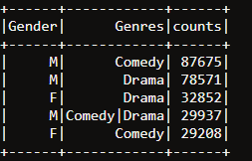
Business questions identified
Q2:Detect gender bias on movie ratings for a genre
Approach: Do a join between moviestable & usertable and join based on movieID/userId and group by Gender,Genres and order by this group count in descending order
Spark SQL : spark.sql("select Gender,Genres,count(*) as counts from moviestable t1,ratingstable t2 ,usertable t3 where t1.MovieID=t2.MovieID and t2.UserID=t3.UserID group by Gender,Genres order by counts desc limit 5").show()
Visualization:

Slide 16
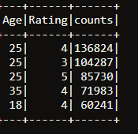
Business questions identified
Q3:Group the ratings by age
Approach : Do a join between usertable & ratingstable based on userID and calculate the counts by grouping Rating,Age
Spark SQLs: spark.sql("select Age,Rating,count(*) as counts from ratingstable t2 ,usertable t3 where t2.UserID=t3.UserID group by Rating,Age order by counts desc limit 5").show()
Visualization:

Slide 17
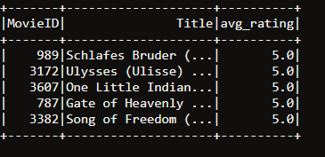
Business questions identified
Q4:Find out the average ratings for movies.
Approach: Do a join between moviestable & ratingstable and join based on movieID and group by MovieID,Title and order by avg(Rating) in descending order
Spark SQL : spark.sql("select t1.MovieID,Title,avg(Rating) as avg_rating from moviestable t1,ratingstable t2 where t1.MovieID=t2.MovieID group by t1.MovieID,Title order by avg_rating desc limit 5").show()
Visualisation

Slide 18
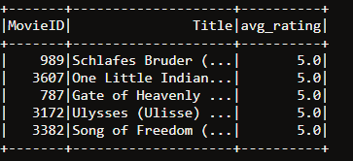
Business questions identified
Q5:Find out the titles for the best rated movies.
Approach: Do a join between moviestable & ratingstable and join based on movieID and group by MovieID,Title and order by avg(Rating) in descending order
Spark SQL : spark.sql("select t1.MovieID,Title,avg(Rating) as avg_rating from moviestable t1,ratingstable t2 where t1.MovieID=t2.MovieID group by t1.MovieID,Title order by avg_rating desc limit 5").show()
Visualisation

Slide 19
SPARK MLLib Portion
(Machine Learning)

Slide 20
Business questions identified
Step 1- Import Spark MLlib packages:
import org.apache.spark.mllib.recommendation.ALS
import org.apache.spark.mllib.recommendation.Rating
import org.apache.spark.SparkConf
import org.apache.spark.SparkContext
import org.apache.spark.SparkContext._
import org.apache.spark.rdd._

Slide 21
Business questions identified
Step 2- Load users ,movie and ratings data to Hadoop:
User Data :
val rawUserData=sc.textFile("/user/mohitkumarcse1352/users.dat")
Ratings Data
val rawRatingData=sc.textFile("/user/mohitkumarcse1352/ratings.dat")
Movies Data
val rawMoviedata=sc.textFile("/user/mohitkumarcse1352/movies.dat")

Slide 22
Business questions identified
Step 3- Split ratings data by ‘::’ and get first three fields.
val rawRatings =rawRatingData.map(_.split("::").take(3))
Step 4- Map the Split fields to MLlib ‘Rating’ object.
val ratings = rawRatings.map {case Array(user,movie,rating) => Rating(user.toInt,movie.toInt,rating.toDouble)}

Slide 23
Business questions identified
Step 5- Map the Split fields to MLlib ‘Rating’ object.
val ratings = rawRatings.map {case Array(user,movie,rating) => Rating(user.toInt,movie.toInt,rating.toDouble)}
Step 6- Train the model
val model = ALS.train(ratings, 50, 5, 0.01)

Slide 24

Business questions identified
Q1:Predict rating for user#789 and movie#2997
Approach : val predictedRating = model.predict(789, 2997)
Visualization:

Slide 25
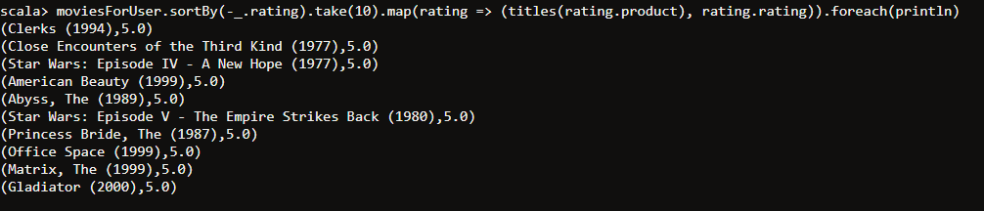
Business questions identified
Q2:Recommend Projects for user#789
Approach :
val userId = 789
val K = 10
val topKRecs = model.recommendProducts(userId, K)
println(topKRecs.mkString("\n")) – This will recommend products as Rating object for user#789
val titles = rawMoviedata.map(line => line.split("::").take(2)).map(array => (array(0).toInt,array(1))).collectAsMap()
val moviesForUser = ratings.keyBy(_.user).lookup(789)
println(moviesForUser.size)
moviesForUser.sortBy(-_.rating).take(10).map(rating => (titles(rating.product), rating.rating)).foreach(println) This will convert Rating object in required format which will contain movie name and the corresponding rating.
Visualization:

