Slide 1


COARCT: Crowdsourced, Open, Anonymous RCTs
Mohit Karnani (MIT)

Slide 2
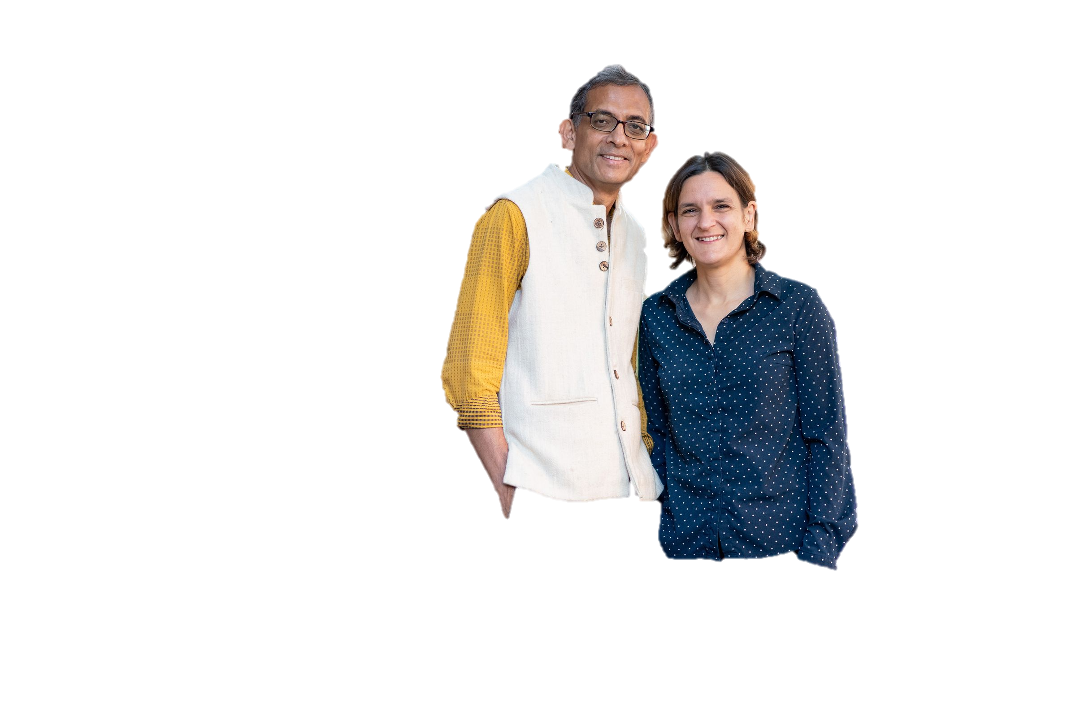
Randomized C. Trials
RCTs = Randomized Controlled/Clinical Trials
The “Gold Standard” to measure the effectiveness of a treatment (e.g. to get FDA approval for a new drug).
Large, Growing Market (FMI, 2023):
Clinical Trials valued at $115.4 bn, expected to grow to $177.7 bn in 10 years.
Market Shares: 54.7% by sponsors, 46.5% in US (US, non-sponsored=33.8 bn).
Beyond Clinical Trials:
Market Research: do my discounts attract foot traffic?
A/B Testing: does my feature improve user experience?
Public Policy: do lentils incentivize immunization?
Notes:
https://www.futuremarketinsights.com/reports/clinical-trials-market
https://www.fmiblog.com/2023/03/01/clinical-trials-market-is-a-valuation-of-us-177-7-billion-by-the-year-2033/
CAGR=4.10% between 2017 and 2022
https://www.bmj.com/content/340/bmj.c2220

Slide 3
A list of Problems in Randomized Trials

Slide 4
A list of Problems in Randomized Trials
Recruiting: expensive to recruit large samples → low statistical power
Diversity: hard to enroll diverse subjects → low external validity
Retention: subjects attrit from the trial → (differential) attrition bias
Tangible Expenses: physical capital, facilities, staff → operating costs
Privacy: holding sensitive information is a liability → compliance costs
Storage: data/files for replication ad-infinitum → (cold) storage costs
P-hacking: strategic misrepresentation of results → low transparency

Slide 5
Introducing Crowdsourced, Open, Annonymous RCTs

Slide 6



= PrivateKit $×$ DCTs
DCTs = Decentralized Clinical Trials; new industry standard popularized during the COVID-19 pandemic

Slide 7
























RaaS: Think Amazon’s mTurk, but Private!
(RaaS = Research as a Service)

Slide 8

Example Use Case: Mental Health in Ecuador

Slide 9
Problem: p-hacking

Slide 10
Solution
All transactions (e.g. computing CATEs) are logged in the blockchain

Slide 11
Problem: Research Transparency

Slide 12
Solution
All claims (e.g. in ads) are directly backed by a blockchain transaction
Improves on structure proposed by BITSS because replication data is not required.

Slide 13
PrivateKit x COARCT
Private Kit is already very good at collecting data from crowds in an anonymous way.
This vertical adds an additional randomization stage to provide “Research as a Service” RaaS.

Slide 14
Problem: subject recruiting

Slide 15

Problem: recruiting

Slide 16
Builds vertically over PrivateKit

Slide 17
think Amazon's MTurk or Cint's Lucid, but fully private

Slide 18
Problem: diversity

Slide 19
Lower Costs

Slide 20

Lower Costs

Slide 21
Lower Costs

Slide 22

Lower Costs
RCTs require minimal computing capacity
you don’t need to pay for large storage capacity as a by-product of privacy.

Slide 23
Data Compliance (e.g. IRBs)

Slide 24
How does it work?
Someone wants to test something.
Subjects pre-register to participate.
Aggregate descriptive statistics are reported:
Baseline variables (sample targeting, clusters, etc.)
Researchers can toggle sample size and baseline distributions.
Double-blind randomization takes place:
Treatment can be anything downloadable.
Researcher does not know the identity of treated units, only sample balance.
Anonymous results are reported back to researchers.

Slide 25
How does it work?
Someone wants to test something.
Subjects pre-register to participate.
Aggregate descriptive statistics are reported:
Baseline variables (sample targeting, clusters, etc.)
Researchers can toggle sample size and baseline distributions.
Double-blind randomization takes place:
Treatment can be anything downloadable.
Researcher does not know the identity of treated units, only sample balance.
Anonymous results are reported back to researchers.

Slide 26
Potential Competitors
Large Market Research conglomerates (e.g. Nielsen).
Pharma Consortiums.
Notes:
Medidata
IQVIA
Labcorp
PRA Health Sciences
Parexel
ICON
Oracle
CRF Health
Clinical Ink
Medable
Science 37
https://www.globenewswire.com/news-release/2022/04/29/2432218/0/en/Decentralized-Clinical-Trials-DCTs-Market-2022-2028-Share-Trend-Industry-News-Demand-Business-Growth-Top-Key-Players-Update-Business-Statistics-and-Research-Methodology.html#:~:text=The%20Major%20Players%20in%20the%20Decentralized%20Clinical%20Trials,ICON%207%20Oracle%208%20CRF%20Health%20More%20items

Slide 27
Potential Clients
Academic research centers (e.g. J-PAL).
Market research agencies (e.g. .
Political polling agencies.
Unconsorced Pharma*
Governments.
Businesses (does intervention A drive more foot traffic?)
UX Researchers (A/B testing)

Slide 28
Potential Clients
Academic researchers (e.g. J-PAL)
Market research agencies

Slide 29
Cold Start Problem
Platform relies heavily on having large samples of diverse subjects.
Tokens provide incentives:
For registration and baseline characteristics.
For specific tasks (e.g. answering new surveys).

Slide 30

Clients

Slide 31

No-Code Tools
https://webflow.com/no-code
https://www.framer.com/
https://www.adalo.com/pricing

