Slide 1

Wireless LAN
Presented By : Pooja Maheshwari
Guided By : Dr Jerry Gao

Slide 2



LAN/WLAN World
LANs provide connectivity for interconnecting computing resources at the local levels of an organization
Wired LANs
    Limitations because of physical, hard-wired infrastructure
Wireless LANs provide
    Flexibility
    Portability
    Mobility
    Ease of Installation

Slide 3


Wireless LAN Applications
Medical Professionals
Education
Temporary Situations
Airlines
Security Staff
Emergency Centers

Slide 4
IEEE 802.11 Wireless LAN Standard
In response to lacking standards, IEEE developed the first internationally recognized wireless LAN standard – IEEE 802.11
IEEE published 802.11 in 1997, after seven years of work
Most prominent specification for WLANs
Scope of IEEE 802.11 is limited to Physical and Data Link Layers.

Slide 5

Benefits of 802.11 Standard
Appliance Interoperability
Fast Product Development
Stable Future Migration
Price Reductions
The 802.11 standard takes into account the following significant differences between wireless and wired LANs:
    Power Management
    Security
    Bandwidth

Slide 6
IEEE 802 LAN Standards Family
IEEE 802.2
Logical Link Control (LLC)
OSI Layer 2
(Data Link)
IEEE 802.3
Carrier
Sense
IEEE 802.4
Token
Bus
IEEE 802.5
Token
Ring
IEEE 802.11
Wireless
Mac
OSI Layer 1
(Physical)
PHY

Slide 7

IEEE 802.11 Terminology
Access point (AP): A station that provides access to the DS.
Basic service set (BSS): A set of stations controlled by a single AP.
Distribution system (DS): A system used to interconnect a set of BSSs to create an ESS.
  DS is implementation-independent. It can be a wired 802.3 Ethernet LAN, 802.4 token bus, 802.5 token ring or another 802.11 medium.
Extended service set (ESS):Two or more BSS interconnected by DS
Portal: Logical entity where 802.11 network integrates with a non 802.11 network.

Slide 8
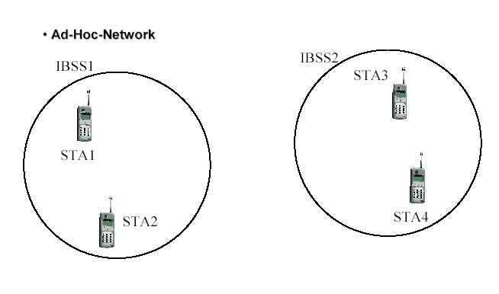
WLAN Topology
Ad-Hoc Network

Slide 9
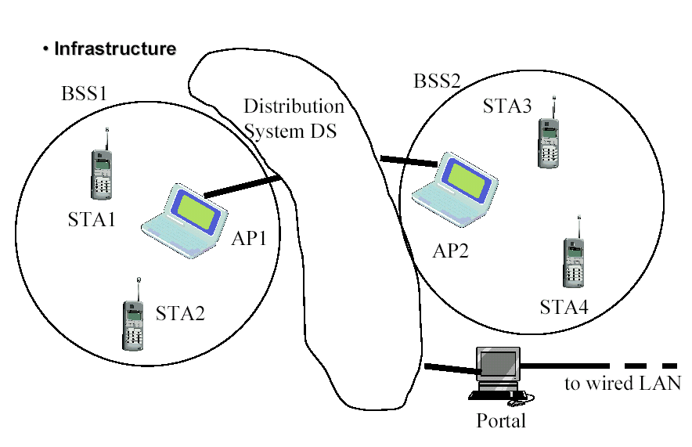
WLAN Topology
Infrastructure

Slide 10
IEEE 802.11 Services: Distribution of Messages
Distribution service (DS)
  Used to exchange MAC frames from station in one BSS to station in another BSS
Integration service
  Transfer of data between station on IEEE 802.11 LAN and station on integrated IEEE 802.x LAN

Slide 11
Association Related Services
Association
  Establishes initial association between station and AP
Re-association
  Enables transfer of association from one AP to another, allowing station to move from one BSS to another
Disassociation
  Association termination notice from station or AP

Slide 12
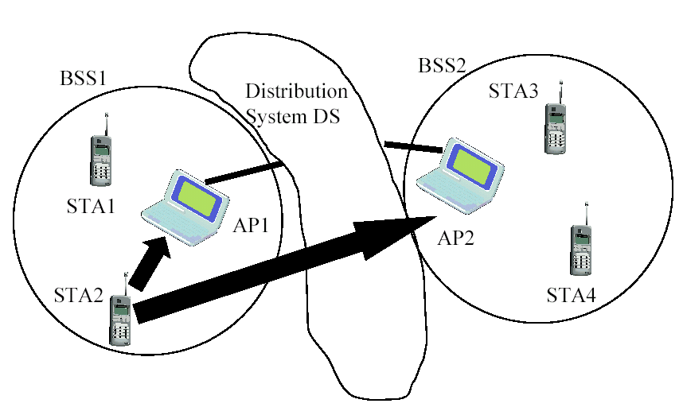
Re-Association

Slide 13
Access and Privacy Services
Authentication
  Establishes identity of stations to each other
De-authentication
  Invoked when existing authentication is terminated
Privacy
  Prevents message contents from being read by unintended recipient

Slide 14
IEEE 802.11 Medium Access Control
MAC layer covers three functional areas:
  Reliable data delivery
  Access control
  Security

Slide 15
Reliable Data Delivery
Loss of frames due to noise, interference, and propagation effects
Frame exchange protocol
  Source station transmits data
  Destination responds with acknowledgment (ACK)
  If source doesn’t receive ACK, it retransmits frame
Four frame exchange for enhanced reliability
  Source issues request to send (RTS)
  Destination responds with clear to send (CTS)
  Source transmits data
  Destination responds with ACK

Slide 16
Access Control
Distributed Coordination Function (DCF)
  Distributed access protocol
  Contention-Based
  Makes use of CSMA/CA rather than CSMA/CD
  Suited for ad hoc network and ordinary asynchronous traffic
Point Coordination Function (PCF)
  Alternative access method on top of DCF
  Centralized access protocol
  Contention-Free
  Works like polling
  Suited for time bound services like voice or multimedia

Slide 17
CSMA/CD vs. CSMA/CA
CSMA/CD – CSMA/Collision detection
  For wire communication
  No control BEFORE transmission
  Generates collisions
  Collision Detection-How?
CSMA/CA – CSMA/Collision Avoidance
  For wireless communication
  Collision avoidance BEFORE transmission
  Why avoidance on wireless?
  Difference in energy/power for transmit & receive
  Difficult to distinguish between incoming weak signals, noise, and effects of own transmission
Notes:
DIFS= Distributed interframe Space
PIFS=Point Coordination Interframe Space
SIFS=Short Coordination Interframe Space

Slide 18
Interframe Space (IFS)
Defined length of time for control
SIFS - Short Inter Frame Spacing
  Used for immediate response actions e.g ACK, CTS
PIFS - Point Inter Frame Spacing
  Used by centralized controller in PCF scheme
DIFS - Distributed Inter Frame Spacing
  Used for all ordinary asynchronous traffic
  DIFS (MAX) > PIFS > SIFS (MIN)

Slide 19
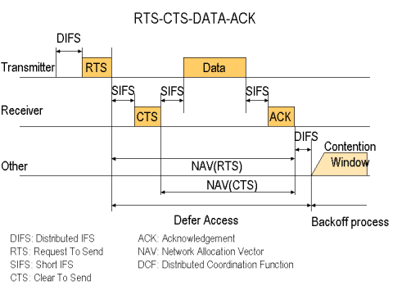
RTS-CTS-DATA-ACK
DIFS: Distributed IFS
RTS: Request To Send
SIFS: Short IFS
CTS: Clear To Send
ACK: Acknowledgement
NAV: Network Allocation Vector
DCF: Distributed Coordination Function

Slide 20
MAC Frame Format
2
2
6
6
6
2
6
0-2312
4
Frame
Duration
Addr 1
Addr 2
Addr 3
Sequence
Addr 4
Frame
CRC
Control
ID
Control
Body
802.11 MAC Header
Bits: 2
2
4
1
1
1
1
1
1
1
1
Protocol
To
From
More
Pwr
More
Type
SubType
Retry
WEP
Order
Version
DS
DS
Frag
Mgt
Data
Frame Control Field

Slide 21
MAC Layer Frames
Data Frames
Control Frames
    RTS,CTS,ACK and PS-POLL
Management Frames
  Authentication and De-Authentication
  Association, Re-Association, and Disassociation
  Beacon and Probe frames

Slide 22

IEEE 802.11 Security
Authentication provided by open system or shared key authentication (Authentication is used instead of wired media physical connection)
Privacy provided by WEP (Privacy is used to provide the confidential aspects of closed wired media)
An Integrity check is performed using a 32-bit CRC

Slide 23
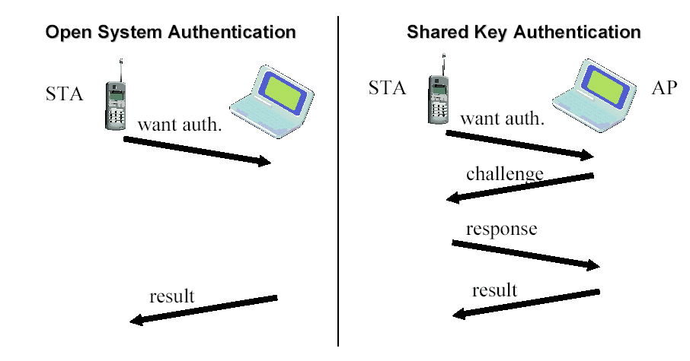
Authentication

Slide 24
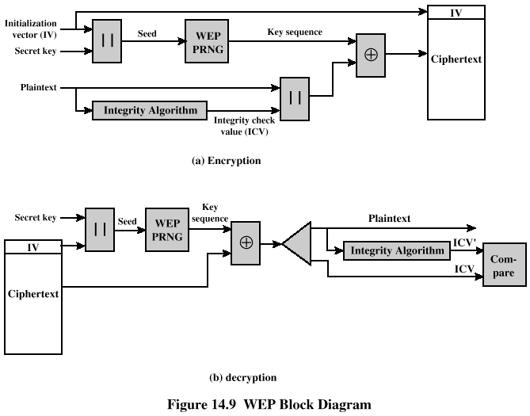
WEP Encryption/Decryption

Slide 25
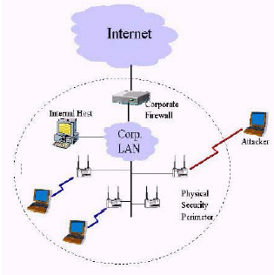
Is WLAN Secure ?
The Parking Lot attack
Man in the middle attack
Freely available tools like Air Snort, WEP crack to snoop into a WLAN

Slide 26
Physical Media Defined by Original 802.11 Standard
Frequency-hopping spread spectrum
  Operating in 2.4 GHz ISM band
  Lower cost, power consumption
  Most tolerant to signal interference
Direct-sequence spread spectrum
  Operating in 2.4 GHz ISM band
  Supports higher data rates
  More range than FH or IR physical layers
Infrared
  Lowest cost
  Lowest range compared to spread spectrum
  Doesn’t penetrate walls, so no eavesdropping

Slide 27
Frequency Hopping Spread Spectrum
Signal is broadcast over seemingly random series of radio frequencies
Signal hops from frequency to frequency at fixed intervals
Receiver, hopping between frequencies in synchronization with transmitter, picks up message
Advantages
  Efficient utilization of available bandwidth
  Eavesdropper hear only unintelligible blips
  Attempts to jam signal on one frequency succeed only at knocking out a few bits

Slide 28
Direct Sequence Spread Spectrum
Each bit in original signal is represented by multiple bits in the transmitted signal
Spreading code spreads signal across a wider frequency band
DSSS is the only physical layer specified for the 802.11b specification
  802.11a and 802.11b differ in use of chipping method
  802.11a uses 11-bit barker chip
  802.11b uses 8-bit complimentary code keying (CCK) algorithm

Slide 29
IEEE 802.11a and IEEE 802.11b
IEEE 802.11a
  Makes use of 5-GHz band
  Provides rates of 6, 9 , 12, 18, 24, 36, 48, 54 Mbps
  Uses orthogonal frequency division multiplexing (OFDM)
IEEE 802.11b
  802.11b operates in 2.4 GHz band
  Provides data rates of 5.5 and 11 Mbps
  Complementary code keying (CCK) modulation scheme
  For more information: http://home.no.net/coverage/rapport/80211.htm

Slide 30
Other Standards
Japan has introduced Millimeter Wave Wireless LAN (MWWL).
Europe has introduced HIPERLAN (High Performance Radio Local Area Network)
  Features,capabilities, and technology similar to those of IEEE 802.11 used in US
  Developed by ETSI (European Telecommunications standards institute)
  Provides high speed communications (20Mbps)
  Has technical advantages such as inclusion of Quality of Service

Slide 31
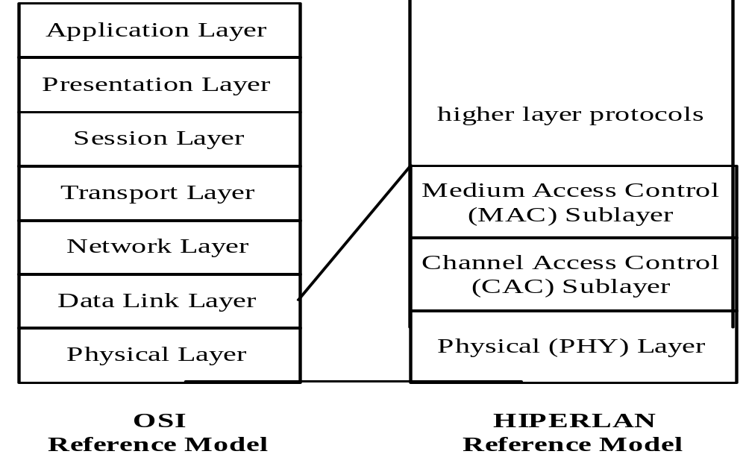
HIPERLAN-reference model
For more information: http://www.hiperlan.uk.com/
http://www.netplan.dk/hip.htm

Slide 32

Future of WLAN
WLANs move to maturity
  Higher Speeds
  Improved Security
  Seamless end-to-end protocols
  Better Error control
  Long distances
  New vendors
  Better interoperability
  Global networking
  Anywhere, anytime,any-form connectivity…

Slide 33

References
Geier, Jim (1999). Wireless LANs. Macmillan Technical Publishing.
Held, Gil (2001). Data over Wireless Networks. McGraw Hill.
Stallings, William (2001). Wireless Communications and Networks. Prentice Hall.
http://www.wlana.org/
http://www.intel.com/network/connectivity/resources/doc_library/documents/pdf/np1692-01.pdf

