Slide 1
Wireless LAN
Karen Chou
Randall Okamoto
Sheng Shan Zhao
Andrew Armada

Slide 2
What is a Wireless LAN
A wireless local area network(LAN) is a flexible data communications system implemented as an extension to, or as an alternative for, a wired LAN.
  Using radio frequency (RF) technology, wireless LANs transmit and receive data over the air, minimizing the need for wired connections.
    Thus, combining data connectivity with user mobility.

Slide 3
Developing a Wireless LAN
Pros and cons of a wireless LAN and its practical uses.
Configurations, components, and hardware functions.
Total cost of ownership, return on investment, and pricing.
Standards, security, client/server interaction, and specifications.

Slide 4
The Advantages and Disadvantages of Using a Wireless LAN and its Practical Uses
By: Karen Chou

Slide 5
Benefits of Wireless LAN
Productivity, convenience, and cost advantages
  Installation speed and simplicity.
  Installation flexibility.
  Reduced cost-of-ownership.
  Mobility.
  Scalability.

Slide 6
Benefits of Wireless LAN
Installation speed and simplicity
  No cable to pull.
  Eliminates current architecture obstacles.
  Few transmitters/receivers for multiple for users.

Slide 7
Benefits of Wireless LAN
Installation flexibility
  The network goes where wires cannot.
  Not constrained by expensive walls.
  Easy to add more computers and devices.

Slide 8
Benefits of Wireless LAN
Reduced cost-of-ownership
  Mobile devices are less expensive than computer workstations.
  Can “Run Errands” and stay in touch.
  No need to build wiring closets.

Slide 9
Benefits of Wireless LAN
Mobility
  Access to real-time information.
  Supports productivity.
  Provides service opportunities.
  Promotes flexibility.

Slide 10
Benefits of Wireless LAN
Scalability
  Spans a variety of topologies.
  Configurations are easily changed.
  Works over great distances.
  Effective for wide range of user communities.
    Small number of users with local needs.
    Full infrastructure networks roaming over a broad area.
    http://www.WirelessLAN.com

Slide 11
Disadvantage of Wireless LAN
Cost
  Wireless network cards cost 4 times more than wired network cards.
  The access points are more expensive than hubs and wires.
Signal Bleed Over
  Access points pick up the signals of adjacent access points or overpower their signal.

Slide 12
Disadvantage of Wireless LAN
Environmental Conditions
  Susceptible to weather and solar activity.
  Constrained by buildings, trees, terrain.
Less Capacity
  Slower bandwidth.
  Limit to how much data a carrier wave can transmit without lost packets impacting performance.
      http://www.Compaq.com

Slide 13
Practical Use of Wireless LAN
Corporate
  Mobile networking for e-mail, file sharing, and web browsing.
Education
  Connectivity to the University Network for collaborative class activities.
  Ability to access research sources without requiring a hard point.

Slide 14
Practical Use of Wireless LAN
Finance
  Traders can receive up-to-the-second pricing information.
  Facilitates electronic payments for goods and services.
  Improve the speed and quality of trades.

Slide 15
Practical Use of Wireless LAN
Hospitality and Retail
  Electronic food orders for pickup or from table. (Then Pay Electronically)
  Setting up temporary registers for special events.
  Check public transportation.
  Send notice to hotel of arrival.

Slide 16
Practical Use of Wireless LAN
Manufacturing
  Link factory floor workstations to servers.
  Remote data collections.
  Tracking of goods.
Healthcare
  Emergency medical information readily available.
  Access to schedule information.

Slide 17
Building Your Own Wireless LAN
By: Randall Okamoto

Slide 18
How to Configure Wireless LANs
Five ways to configure a wireless LAN
  Peer-to-peer network
  Client and access point
  Multiple access points and roaming
  Using an extension point
  Using a directional antenna
www.Proxim.com

Slide 19
Basic Hardware of a Wireless LAN
Access points (AP)
Adapter cards
Directional antenna
Extension points (EP)
Wired network
For a glossary of vocabulary used:
http://www.proxim.com/wireless/glossary/index.shtml#a

Slide 20
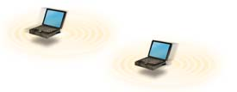
A Basic Wireless Peer to Peer Network
Two PCs equipped with wireless adapter cards can be set up as an independent network whenever they are within range of one another.
http://www.proxim.com

Slide 21
Peer to Peer Network
Requires no administration or configuration.
Each client has access to only the resources shared by the other client and not to a central server.

Slide 22
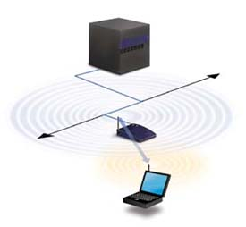
Client and Access Point
Installing an access point can extend the range of the network, effectively doubling the range at which the PC’s can communicate.
http://www.proxim.com
Wired network
Access Point

Slide 23
Client and Access Point
Each client would have access to server resources (ie:shared printer) as well as to other clients.
Each access point can accommodate many clients depending on the number and nature of the transmissions involved.
  Generally, more access points means more clients can be accommodated.
    Multiple access points and roaming.

Slide 24
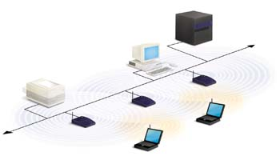
Multiple Access Points and Roaming
Shared Printer
Multiple Access Points
At a large facility, such as a college campus or warehouse, more than one Access Point may be needed. http://www.proxim.com

Slide 25
Multiple Access Points and Roaming
Access points have limited range:
  500ft. Indoors.
  1000ft. Outdoors.
Goal is to blanket the coverage area with overlapping access points so that clients will never lose network contact.
  Roaming.
Access point positioning accomplished by a site survey.

Slide 26
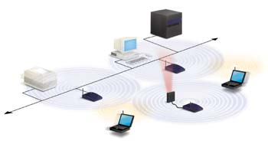
Using an Extension Point
Extension Point
Extension Points may be used lieu of multiple Access Points
http://www.proxim.com

Slide 27
Using an Extension Point (EP)
EP’s function like access points, but they are not tethered to the wired network as are access points.
Extend the range of the network by relaying signals from a client to an access point or another extension point.

Slide 28
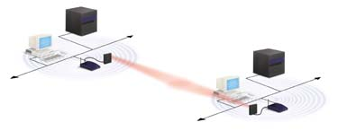
Using a Directional Antenna
Data Relayed Here
Directional Antennas
In the case of having a wireless LAN in one building and wanting to extend it to a nearby building, one mile away, use directional antennas. http://www.proxim.com

Slide 29
Using a Directional Antenna
One directional antenna situated on each building, each antenna targeting the other.
The antenna on the first building is connected to a wired network via an access point, and the other is connected to an access point in that building, which enables wireless LAN connectivity in that building.

Slide 30
Total Cost of Ownership, Return on Investment, and Pricing
By: Sheng Shan Zhao

Slide 31
Building the Wireless Workplace
What do we need to build a wireless LAN.
Speed of wireless LANs.
Distance of wireless LANs.
How much cost to build a wireless LAN.
When can we get back the investment.

Slide 32
What do we need to build a wireless LAN
Wireless LAN cards
  Information poachers
    Access points
      Software
      Hardware
Bridges– directional antennas

Slide 33
Wireless LANS cards from 3com
The 3Com Air Connect wireless LAN PC Card is a 16-bit, 5-volt, Type II PC Card for notebooks. It transmits data to and from the network over the access point with which it is associated at any given time. Each PC Card features an extended antenna for optimal reception.
Price:$ 219.00
Model Number: 3CRWE737A

Slide 34
Wireless LANs cards from Symbol
Product: LA 41X1 PC Card
Description: IEEE 802.11b Ethernet-speed Connectivity for Wireless Mobile and Portable Computing
http://www.symbol.com/products/wireless/wireless_products_lit.html

Slide 35
Access Point form Symbol 1
Product: AP 41X1 Access Point
Description: 802.11b Ethernet-Speed Wireless Bridge Between Wired LANs and Computing Devices
http://www.symbol.com/products/

Slide 36
Access Point form Symbol 2
Product: AP 3021 Access Point
Description: IEEE 802.11 Seamless, Wireless Connection Between Wired Ethernet LANs and Computing Devices

Slide 37
Access point from
3com
A user-friendly, manageable wireless hub that connects a wired Ethernet LAN to a wireless LAN, serving up to 63 simultaneous users (with wireless PC Card-equipped notebooks) within a radius of 300 feet (91 m).
Model Number: 3CRWE747A
List Price: $ 1195.00
http://www.3com.com/mobile/wireless/product.html#

Slide 38
Speed of WLAN
Older 802.11b : 2Mbps
New 802.11b: 100Mbps;
or 10000Mbps

Slide 39
Distance of WLAN
LAN: must have a phone line and be inside a wired office.
WLAN: any where you want, no phone line, campus between campus, building between building.

Slide 40
Cost of building a WLAN1 using Product of CISCO
Cisco Aironet 340 Series Wireless Access Point is list priced at U.S. $1,299.00.
Cisco Aironet 340 Series Wireless PC Card is list priced at U.S. $249.00.
Cisco Aironet 340 Series Wireless ISA Adapter is list priced at U.S. $349.00.

Slide 41
Cost of building a WLAN2 using Product of CISCO
Cisco Aironet 340 Series Wireless PCI Adapter is list priced at U.S. $349.00.
Cisco Aironet 340 Series Wireless Bridge is priced at U.S. $1,949.00.
Total cost:$3846.
http://www.cisco.com/

Slide 42
Return on the investment
For example : using T1 to compare
T1:$1000 a month for 24 lines.
Average :$42/month/line.
Total investment: $3800 for WLAN.
Return in 90 months.
http://www2.apc.net/apcdocs/dsl.htm

Slide 43
Standards, Security, Client/Server Interaction, and Specifications
By: Andrew Armada

Slide 44
Wireless LAN
Topics discussed:
Standards
  IEEE
  HomeRF
Security
Client/Server Interaction
  Infrastructure
  Peer to Peer
Connection Process
Capacity
Technologies Used
Distance Covered
Components

Slide 45
IEEE Standard
802.11b
  Uses DSSS.
    Direct-Sequence Spread-Spectrum.
  11 Channels over 2.4 GHz to 2.4835 GHz frequency.
  Allows for 11 Mbps transmission rate.
  Business Applications.

Slide 46
HomeRF Standard
Uses FHSS Modulation
  Frequency-Hopping Spread Spectrum.
  1 MHz bandwidth.
Maximum 2 Mbps transmission rate
Cost Considerations.
Data and voice connections.
Home Applications.

Slide 47
Security
WEP
  Wired Equivalent Privacy.
  40 bit encryption.
  Prevents eavesdropping.

Slide 48
Client/Server Interaction
Client End
  Infrastructure
    User sends/receive radio signals to/from access point. Access point connected to a wired network receives the radio signal from client and converts it digital format that network understands for processing.

Slide 49
Client/Server Interaction
Client End
  Peer to Peer
    Users connect to other PCs that have the IEEE 802.11b High Rate wireless products. This mode is used when there is no wired network or when group of users want to set up their own network to collaborate and share files.

Slide 50
Client/Server Interaction
Server
  Required to install software package to the server. Software will configure, manage, and track wireless traffic across the network.

Slide 51
Connection Process between Client and access point
SSID
  Both have to have the same SSID. SSID entered locally on the client PC. Access Point SSID entered through the network software utility.

Slide 52
Connection Process between Client and Access Point
Channels
  Represents a specific frequency where client and access point communicate with each other.
  Access point is set to a specific channel.
  Client channel is variable.
  Client searches for and associates with access point that has the strongest signal. Client scans all the channels and sets itself to the channel of the access point.

Slide 53
Capacity
Speed
  11 Mbps. Overhead prevents network from reaching this maximum speed.
Users
  150 Nominal
    Mostly idle
    Occasionally check e-mail
  100 Mainstream
    Use a lot of e-mail
    Down/up load moderate size files
  50 Power
    Constantly on the network
    Access large files
To Increase Capacity
  Add more access points to allow more users to enter the network

Slide 54
Technologies Used
Narrowband
  Transmits and receives information on a specific radio frequency. Signal frequency is kept as narrow as possible just to pass information.
  Drawback is end-user must obtain FCC license.
Infrared
  use very high frequencies, just below visible light to carry data. Little used in commercial WLAN.
  Direct technology used in personal area networks. Limited to 3 ft range.
  diffuse technology do not require line of sight but cells are limited to individual rooms.

Slide 55
Technologies Used
Spread Spectrum Technology
  Widely used technology. Developed by the military.
  More bandwidth consumed than narrowband.
  Produces a louder signal.
  Reliability, integrity and security.

Slide 56
Technologies Used
Two types of Spread Spectrum Technology
  Frequency-Hopping
    Uses narrowband carrier that changes frequency in a pattern known to both transmitter and receiver.
    To maintain a single logical channel.
  Direct-Sequence
    Generates redundant bit pattern for each bit to be transmitted known as a chip.
    The longer the chip the greater the probability original data can be recovered.

Slide 57
Distance Covered
Distance from Access Point | Data Transmission Rate
Up to 100 ft | Up to 11 Mbps
Up to 150 ft | Up to 5.5 Mbps
Up to 300 ft | Up to 2 Mbps
Inverse relationship between data transmission and distance from access point

Slide 58
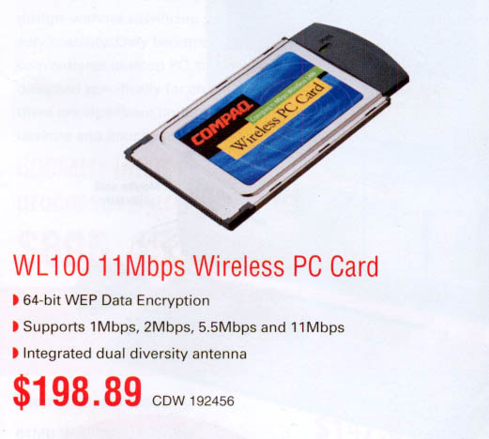
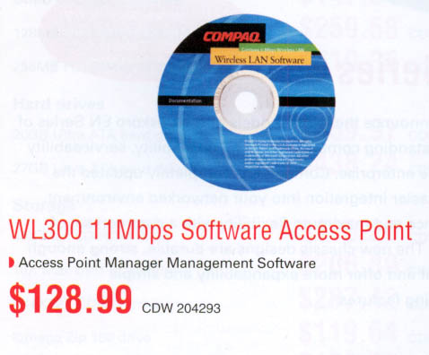
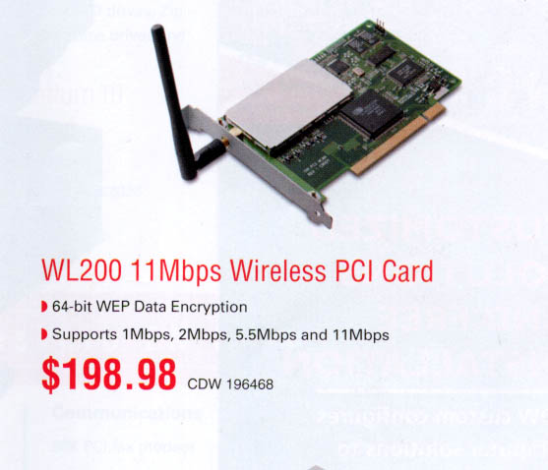
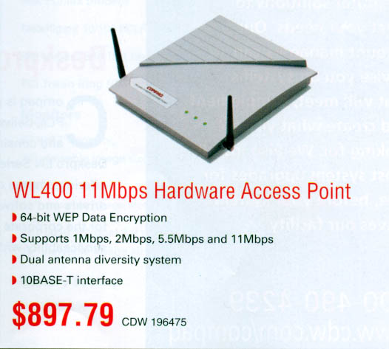
Wireless LAN Components
Source: CDW
www.wirelesslan.com
www.compaq.com

Slide 59
Internet Sources
www.wirelesslan.com
www.compaq.com

