Slide 1

Learning Non-Linear Constraitns for Scheduling Problems
Mohit Kumar

Slide 2
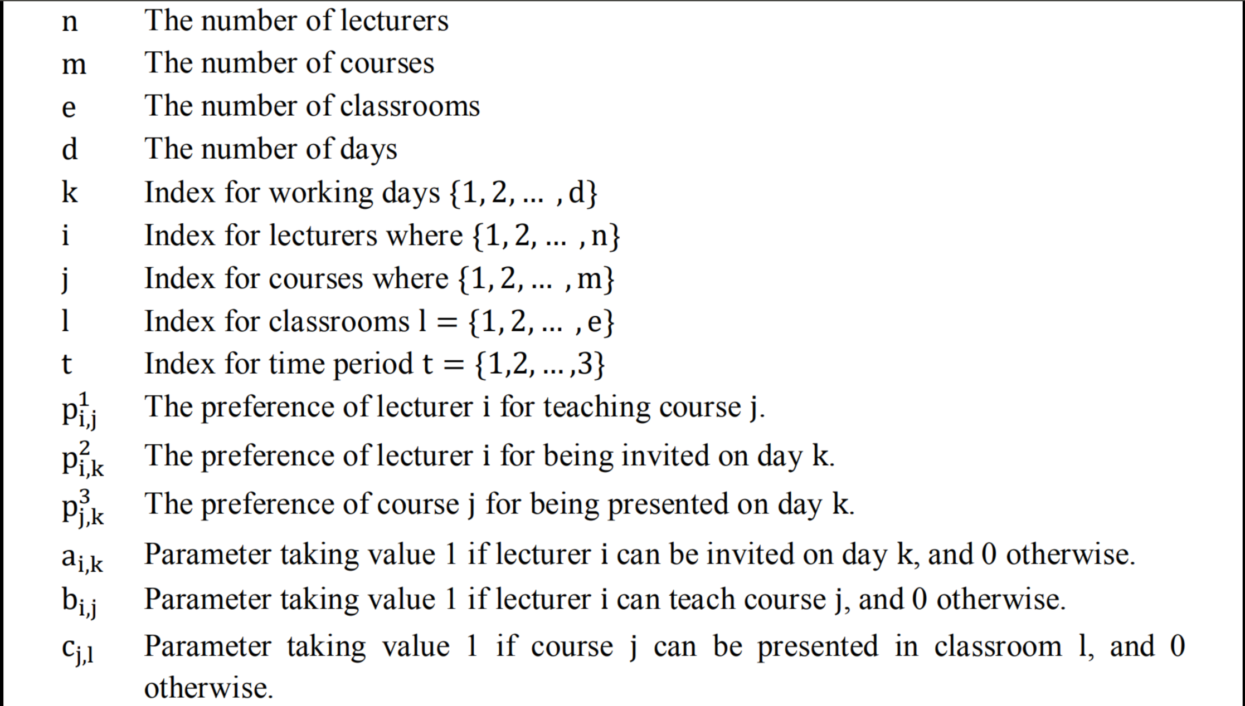
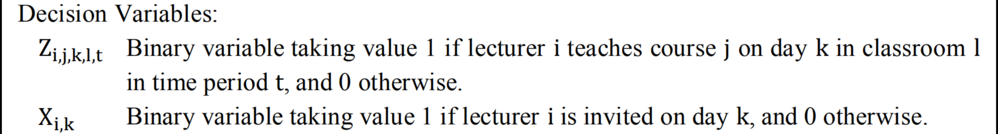
Problem Specification
Input Variables
Model
Decision Variables
<number>
DTAI, Computer Science
Notes:
For big organizations, generating schedules manually is a complicated task, having a constraint learner removes the dependency on domain experts and thus saves a lot of time and money, and at the same time reduces the chances of making any error
<number>

Slide 3
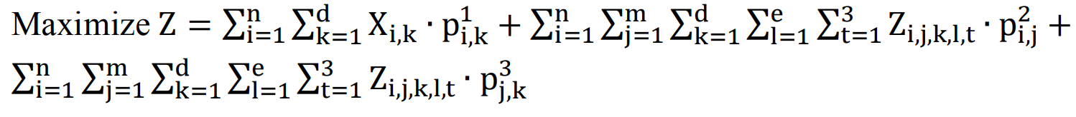
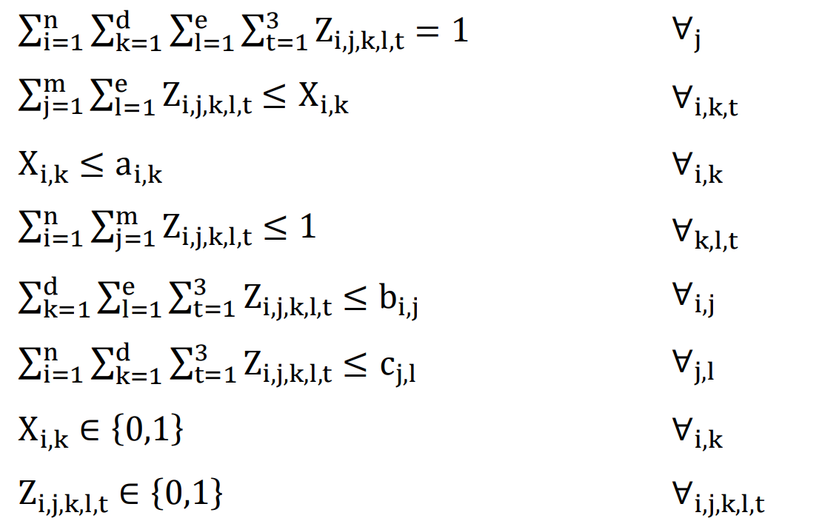
Problem Specification
Input Variables
Model
Decision Variables
Objective Function
Constraints
<number>
DTAI, Computer Science
Notes:
For big organizations, generating schedules manually is a complicated task, having a constraint learner removes the dependency on domain experts and thus saves a lot of time and money, and at the same time reduces the chances of making any error
<number>

Slide 4
Problem Specification
Input Variables
Model
Decision Variables
<number>
DTAI, Computer Science
Notes:
For big organizations, generating schedules manually is a complicated task, having a constraint learner removes the dependency on domain experts and thus saves a lot of time and money, and at the same time reduces the chances of making any error
<number>

Slide 5

Non-Linear Constraint Structure
Number of Dimensions: m
Number of Variables: n
Total Combinations: 4^{m} * n⁵
For m=3 and n=10
Total Combinations: 6.4 Million
We can reduce the number of combinations by introducing signatures for our structure
<number>
DTAI, Computer Science
Notes:
For big organizations, generating schedules manually is a complicated task, having a constraint learner removes the dependency on domain experts and thus saves a lot of time and money, and at the same time reduces the chances of making any error
<number>

Slide 6
Enumerating Constraints
Filter the set of constraints C, using the signatures
Check validity of the first 100 constraints through all examples and reorder the set of examples by increasing satisfiability
With the reordered set of examples, start with one constraint and keep checking until not satisfied
This method utilizes the fail first approach
 | E1 | E2 | E3 | E4 | E5 | E6 | - | - | -
C1 | 1 | 0 |  |  |  |  | - | - | -
C2 | 1 | 1 | 0 |  |  |  | - | - | -
C3 | 0 |  |  |  |  |  | - | - | -
C4 | 1 | 1 | 1 | 1 | 1 | 1 | - | - | -
Enumerate Slices?
Learning the Bounds?
Structure?
Implementing Signatures?
<number>
DTAI, Computer Science
Notes:
For big organizations, generating schedules manually is a complicated task, having a constraint learner removes the dependency on domain experts and thus saves a lot of time and money, and at the same time reduces the chances of making any error
<number>

Slide 7
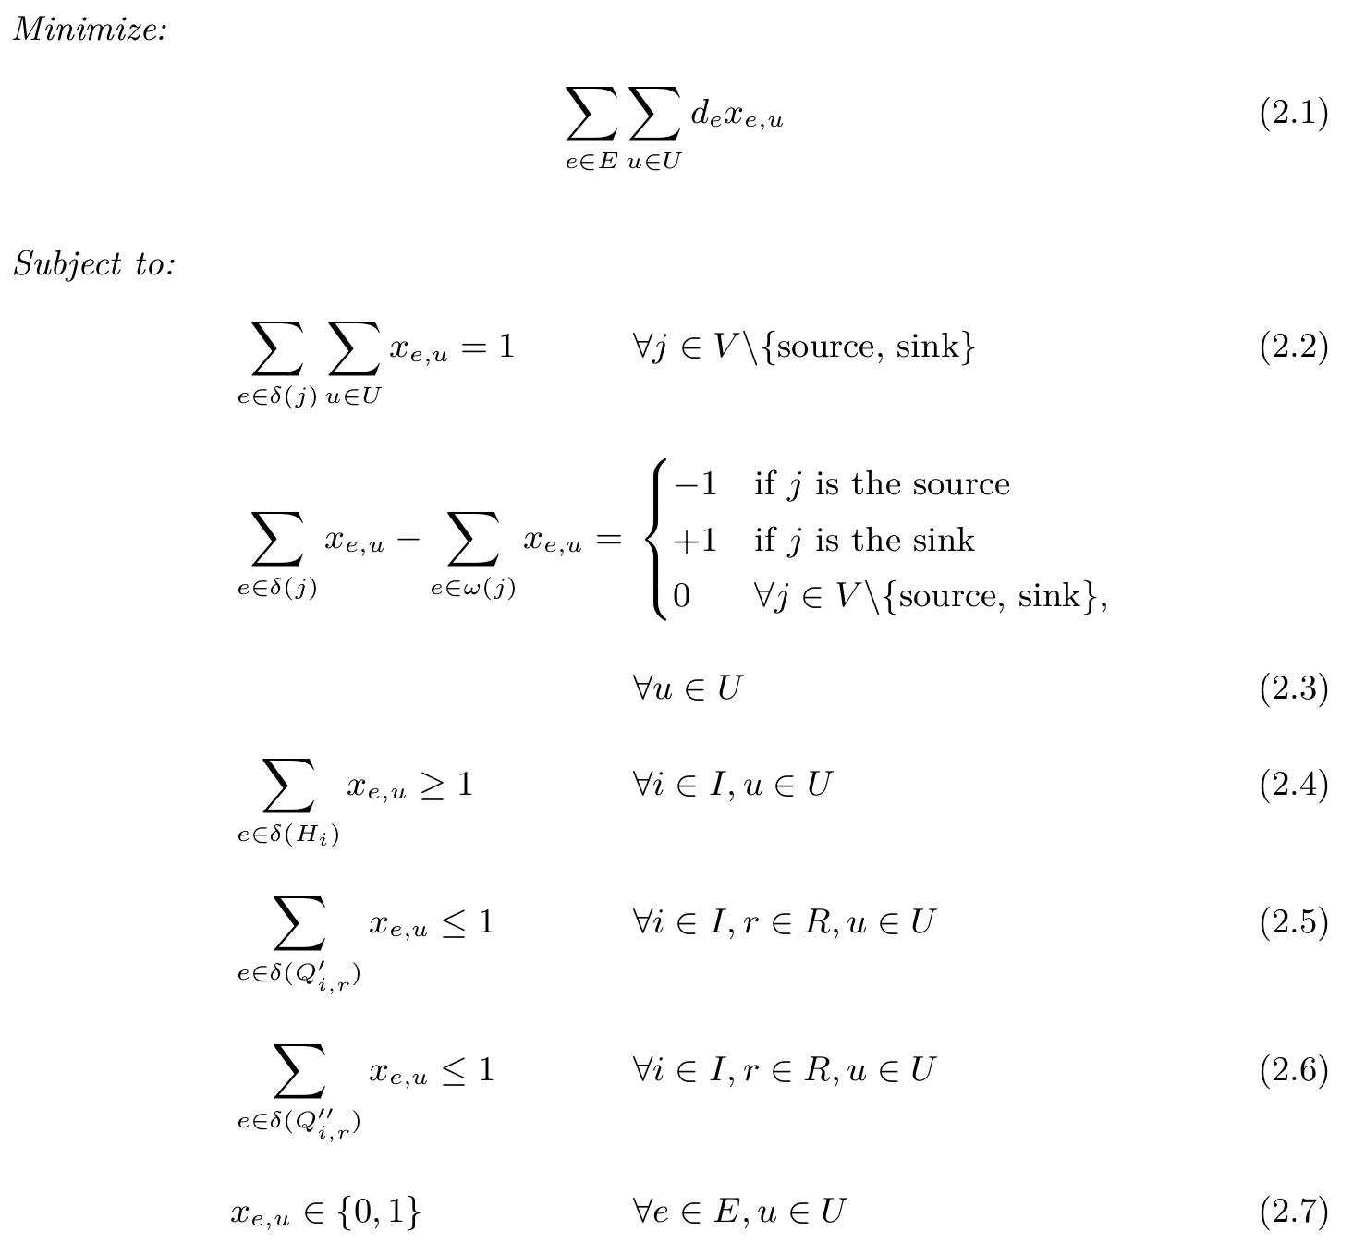
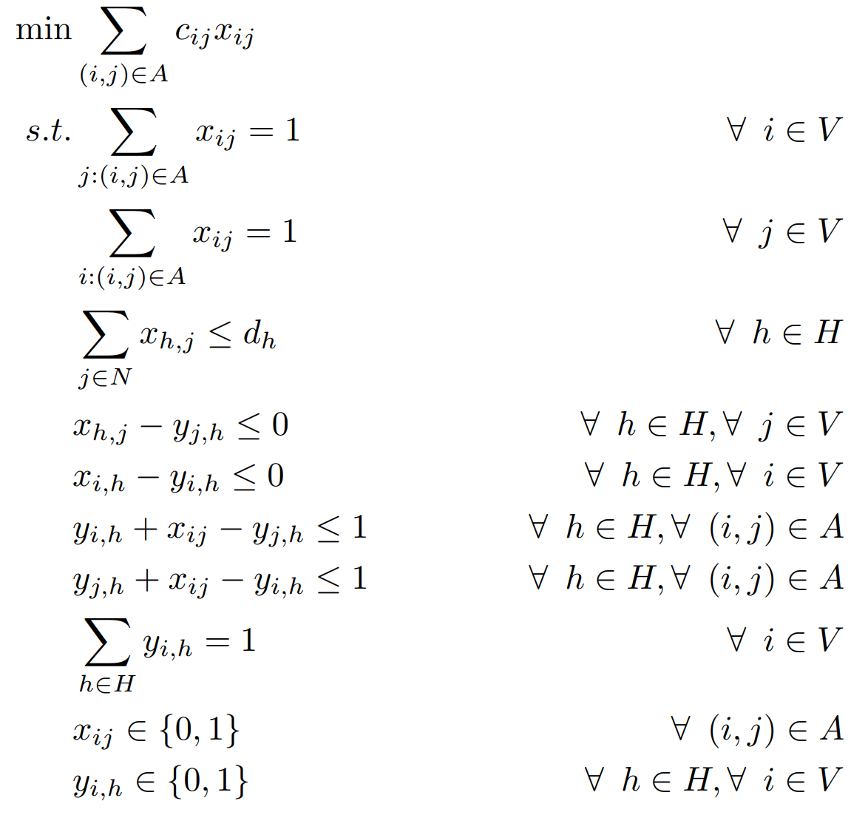
Learning the Index Set?
Traveling Umpire Scheduling
Vehicle Scheduling
<number>
DTAI, Computer Science
Notes:
For big organizations, generating schedules manually is a complicated task, having a constraint learner removes the dependency on domain experts and thus saves a lot of time and money, and at the same time reduces the chances of making any error
<number>

Slide 8
THANK YOU
<number>
DTAI, Computer Science

