Slide 1
Learning Constraints For Personnel Rostering Problems
Using Tensors
Mohit Kumar, Stefano Teso, Luc De Raedt, Patrick De Causmaecker

Slide 2
Overview
Problem Introduction
COUNT-OR
Experiments
Results

Slide 3
Objective
 | Mon |  |  | Tue |  |  | -
Nurse | S1 | S2 | S3 | S1 | S2 | S3 | - | - | -
Sophie | 1 | 0 | 1 | 0 | 0 | 0 | - | - | -
Hanna | 0 | 1 | 0 | 0 | 0 | 0 | - | - | -
Ruben | 1 | 0 | 1 | 0 | 0 | 0 | - | - | -
Sam | 0 | 0 | 0 | 1 | 0 | 0 | - | - | -
Constraints
Max/Min number of working days
Max/Min number of employees each day/shift
Max/Min number of consecutive working days
Max/Min number of shifts per day
COUNT-OR

Slide 4
Data Representation
 | Mon |  |  | Tue |  |  | -
Nurse | S1 | S2 | S3 | S1 | S2 | S3 | - | - | -
Sophie | 1 | 0 | 1 | 0 | 0 | 0 | - | - | -
Hanna | 0 | 1 | 0 | 0 | 0 | 0 | - | - | -
Ruben | 1 | 0 | 1 | 0 | 0 | 0 | - | - | -
Sam | 0 | 0 | 0 | 1 | 0 | 0 | - | - | -
$$D=\left\{Nurses,Days,Shifts\right\}$$
X =

Slide 5
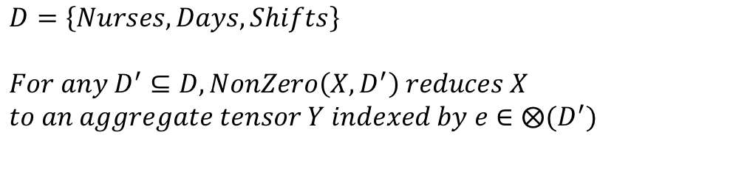
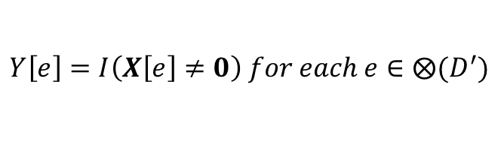

Function Definition - NonZero
 | Mon |  |  | Tue |  |  | -
Nurse | S1 | S2 | S3 | S1 | S2 | S3 | - | - | -
Sophie | 1 | 0 | 1 | 0 | 0 | 0 | - | - | -
Hanna | 0 | 1 | 0 | 0 | 0 | 0 | - | - | -
Ruben | 1 | 0 | 1 | 0 | 0 | 0 | - | - | -
Sam | 0 | 0 | 0 | 1 | 0 | 0 | - | - | -
$$D=\left\{Nurses,Days,Shifts\right\}$$
$$For any D^{′}⊆D, NonZero\left(X,D^{′}\right) reduces X$$
$$to an aggregate tensor Y indexed by e∈⨂(D^{′})$$
X =
$$Y\left[e\right]=I\left(X\left[e\right]≠0\right) for each e∈⨂(D^{′})$$
$$D^{′}=\left\{Nurses, Days\right\}$$

Slide 6
Function Definition - NonZero
 | Mon |  |  | Tue |  |  | -
Nurse | S1 | S2 | S3 | S1 | S2 | S3 | - | - | -
Sophie | 1 |  |  | 0 | 0 | 0 | - | - | -
Hanna | 0 | 1 | 0 | 0 | 0 | 0 | - | - | -
Ruben | 1 | 0 | 1 | 0 | 0 | 0 | - | - | -
Sam | 0 | 0 | 0 | 1 | 0 | 0 | - | - | -
$$D=\left\{Nurses,Days,Shifts\right\}$$
$$For any D^{′}⊆D, NonZero\left(X,D^{′}\right) reduces X$$
$$to an aggregate tensor Y indexed by e∈⨂(D^{′})$$
X =
$$Y\left[e\right]=I\left(X\left[e\right]≠0\right) for each e∈⨂(D^{′})$$
$$D^{′}=\left\{Nurses, Days\right\}$$

Slide 7
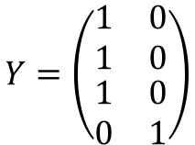
Function Definition - NonZero
 | Mon |  |  | Tue |  |  | -
Nurse | S1 | S2 | S3 | S1 | S2 | S3 | - | - | -
Sophie | 1 |  |  | 0 |  |  | -
Hanna | 1 |  |  | 0 |  |  | -
Ruben | 1 |  |  | 0 |  |  | -
Sam | 0 |  |  | 1 |  |  | -
$$D=\left\{Nurses,Days,Shifts\right\}$$
$$For any D^{′}⊆D, NonZero\left(X,D^{′}\right) reduces X$$
$$to an aggregate tensor Y indexed by e∈⨂(D^{′})$$
X =
$$Y\left[e\right]=I\left(X\left[e\right]≠0\right) for each e∈⨂(D^{′})$$
$$Y=\left(\begin{matrix}1 & 0 \\ 1 & 0 \\ \begin{aligned}1 \\ 0\end{aligned} & \begin{aligned}0 \\ 1\end{aligned}\end{matrix}\right)$$
$$D^{′}=\left\{Nurses, Days\right\}$$

Slide 8

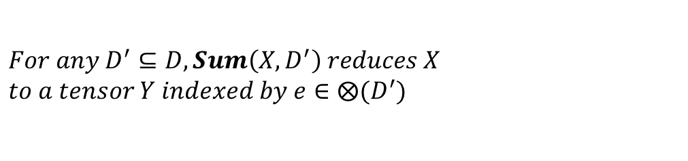
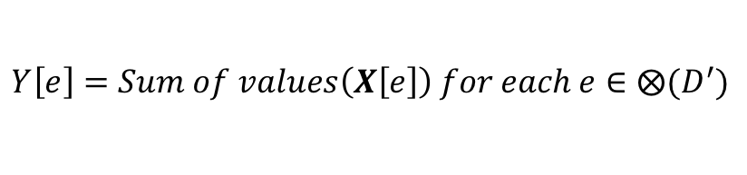
Function Definition - Sum
 | Mon |  |  | Tue |  |  | -
Nurse | S1 | S2 | S3 | S1 | S2 | S3 | - | - | -
Sophie | 1 | 0 | 1 | 0 | 0 | 0 | - | - | -
Hanna | 0 | 1 | 0 | 0 | 0 | 0 | - | - | -
Ruben | 0 | 0 | 1 | 0 | 0 | 0 | - | - | -
Sam | 0 | 0 | 0 | 1 | 0 | 0 | - | - | -
$$For any D^{′}⊆D, Sum\left(X,D^{′}\right) reduces X$$
$$to a tensor Y indexed by e∈⨂(D^{′})$$
X =
$$Y\left[e\right]=Sum of values\left(X\left[e\right]\right) for each e∈⨂(D^{′})$$
$$D^{′}=\left\{Nurses, Days\right\}$$

Slide 9
Function Definition - Sum
 | Mon |  |  | Tue |  |  | -
Nurse | S1 | S2 | S3 | S1 | S2 | S3 | - | - | -
Sophie | 2 |  |  | 0 | 0 | 0 | - | - | -
Hanna | 0 | 1 | 0 | 0 | 0 | 0 | - | - | -
Ruben | 0 | 0 | 1 | 0 | 0 | 0 | - | - | -
Sam | 0 | 0 | 0 | 1 | 0 | 0 | - | - | -
$$For any D^{′}⊆D, Sum\left(X,D^{′}\right) reduces X$$
$$to a tensor Y indexed by e∈⨂(D^{′})$$
X =
$$Y\left[e\right]=Sum of values\left(X\left[e\right]\right) for each e∈⨂(D^{′})$$
$$D^{′}=\left\{Nurses, Days\right\}$$

Slide 10
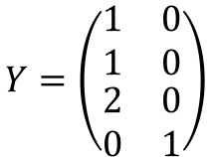
Function Definition - Sum
 | Mon |  |  | Tue |  |  | -
Nurse | S1 | S2 | S3 | S1 | S2 | S3 | - | - | -
Sophie | 2 |  |  | 0 |  |  | -
Hanna | 1 |  |  | 0 |  |  | -
Ruben | 1 |  |  | 0 |  |  | -
Sam | 0 |  |  | 1 |  |  | -
$$For any D^{′}⊆D, Sum\left(X,D^{′}\right) reduces X$$
$$to a tensor Y indexed by e∈⨂(D^{′})$$
X =
$$Y\left[e\right]=Sum of values\left(X\left[e\right]\right) for each e∈⨂(D^{′})$$
$$D^{′}=\left\{Nurses, Days\right\}$$
$$Y=\left(\begin{matrix}1 & 0 \\ 1 & 0 \\ \begin{aligned}2 \\ 0\end{aligned} & \begin{aligned}0 \\ 1\end{aligned}\end{matrix}\right)$$

Slide 11
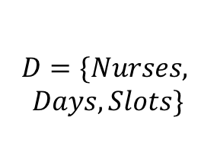



Function Definitions - Count
 | Mon |  |  | Tue |  |  | -
Nurse | S1 | S2 | S3 | S1 | S2 | S3 | - | - | -
Sophie | 1 | 0 | 1 | 0 | 0 | 0 | - | - | -
Hanna | 0 | 1 | 0 | 0 | 0 | 0 | - | - | -
Ruben | 0 | 0 | 1 | 0 | 0 | 0 | - | - | -
Sam | 0 | 0 | 0 | 1 | 0 | 0 | - | - | -
$$M=\{Nurses\}$$
$$D=\{Nurses,$$
$$Days,Slots\}$$
$$M∩S=∅$$
$$S=\{Days\}$$
X =
$$COUNT\left(X,M,S\right)=Sum(NonZero\left(X,M∪S\right),S)$$

Slide 12
Function Definitions
 | Mon |  |  | Tue |  |  | -
Nurse | S1 | S2 | S3 | S1 | S2 | S3 | - | - | -
Sophie | 1 |  |  | 0 |  |  | -
Hanna | 1 |  |  | 0 |  |  | -
Ruben | 1 |  |  | 0 |  |  | -
Sam | 0 |  |  | 1 |  |  | -
$$M=\{Nurses\}$$
$$D=\{Nurses,$$
$$Days,Slots\}$$
$$M∩S=∅$$
$$S=\{Days\}$$
X =
$$COUNT\left(X,M,S\right)=Sum(NonZero\left(X,M∪S\right),S)$$

Slide 13
Function Definitions
 | Mon |  |  | Tue |  |  | -
Nurse | S1 | S2 | S3 | S1 | S2 | S3 | - | - | -
Count | 3 |  |  | 1 |  |  | -
$$M=\{Nurses\}$$
$$D=\{Nurses,$$
$$Days,Slots\}$$
$$M∩S=∅$$
$$S=\{Days\}$$
X =
$$COUNT\left(X,M,S\right)=Sum(NonZero\left(X,M∪S\right),S)$$

Slide 14
Function Definitions
 | Mon |  |  | Tue |  |  | -
Nurse | S1 | S2 | S3 | S1 | S2 | S3 | - | - | -
Count | 3 |  |  | 1 |  |  | -
$$M=\{Nurses\}$$
$$D=\{Nurses,$$
$$Days,Slots\}$$
$$M∩S=∅$$
$$S=\{Days\}$$
X =
$$COUNT\left(X,M,S\right)=Sum(NonZero\left(X,M∪S\right),S)$$
M | S | Count
{Days} | {Nurses} | # of working days/Nurse
{Days, Shifts} | {Nurses} | # of working shifts/Nurse
{Days} | {Nurses} | # of employees / day
{Shifts} | {Days} | # of shifts for each day with at least one nurse working
{Slots} | {Nurses, Days} | # of working shifts per day / nurse
{Days} | {Nurses, Slots} | # of working days in the same shift / nurse
{Nurses} | {Days, Shifts} | # of nurses pre shift per day

Slide 15


Background Knowledge
 | Mon
Nurse | S1 | S2 | S3
Sophie | 1 | 0 | 1
Hanna | 0 | 1 | 0
Ruben | 0 | 0 | 1
Sam | 0 | 0 | 0
Tue
S1 | S2 | S3
0 | 1 | 0
0 | 1 | 0
0 | 0 | 1
0 | 0 | 0
Nurses | Skill Level
Sophie | High
Hanna | Low
Ruben | Low
Sam | High
$$\left[1,0,0,1\right]$$
$$\left[ \begin{aligned}1,0,0,0 \\ 0,0,0,1 \end{aligned}\right]$$
$$\left[ \begin{aligned}1,0,0,0 \\ 0,0,0,1 \end{aligned}\right]×$$
H
L
$$\left[0,1,1,0\right]$$
$$\left[\begin{aligned} 0,1,0,0 \\ 0,0,1,0\end{aligned}\right]$$
 | Mon
Nurse | S1 | S2 | S3
Sophie | 1 | 0 | 1
Sam | 0 | 0 | 0
Tue
S1 | S2 | S3
0 | 1 | 0
0 | 0 | 0

Slide 16
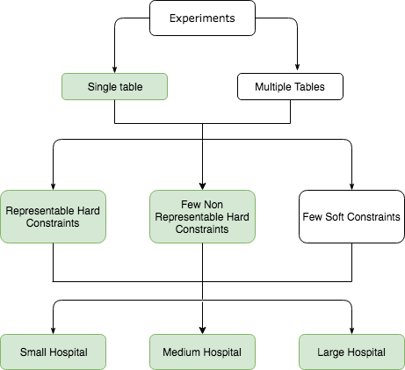
Experiments
Target Model
Generate Solutions
Learned Model
Precision & Recall

Slide 17
Results – Representable Hard Constraint

Slide 18
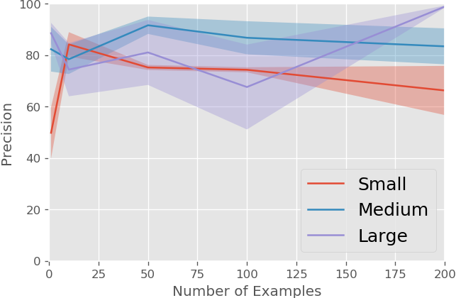
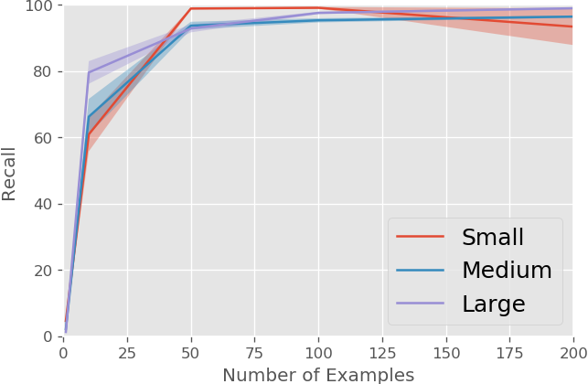
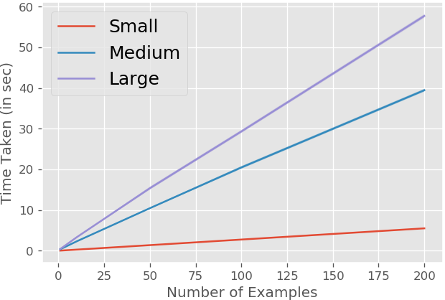
Results – Non-Representable Hard Constraint

Slide 19
THANK YOU

Slide 20
QUESTIONS ?

Slide 21
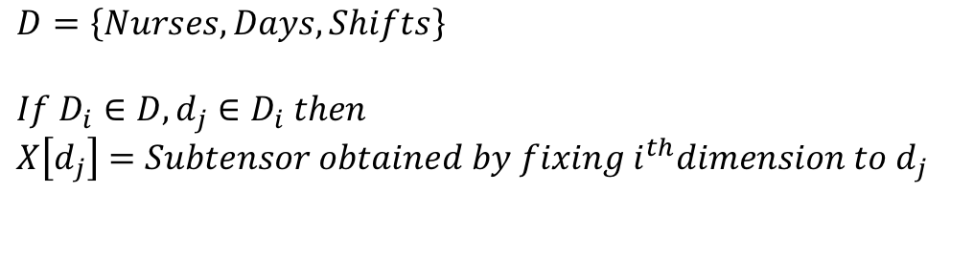
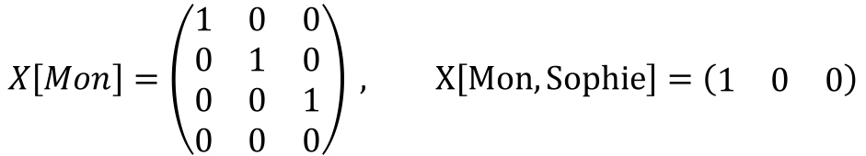
COUNT-OR (Constraints UsiNg TensORs)
 | Mon |  |  | Tue |  |  | -
Nurse | S1 | S2 | S3 | S1 | S2 | S3 | - | - | -
Sophie | 1 | 0 | 0 | 0 | 0 | 0 | - | - | -
Hanna | 0 | 1 | 0 | 0 | 0 | 0 | - | - | -
Ruben | 1 | 0 | 1 | 0 | 0 | 0 | - | - | -
Sam | 0 | 0 | 0 | 1 | 0 | 0 | - | - | -
$$D=\left\{Nurses,Days,Shifts\right\}$$
$${If D}_{i}∈D, d_{j}∈D_{i} then$$
$$X\left[d_{j}\right]=Subtensor obtained by fixing {i^{th}dimension to d}_{j}$$
X =
$$X\left[Mon\right]=\left(\begin{matrix}1 & 0 & 0 \\ 0 & 1 & 0 \\ 0 & 0 & 1 \\ 0 & 0 & 0\end{matrix}\right) , X\left[Mon,Sophie\right]=\left(\begin{matrix}1 & 0 & 0\end{matrix}\right)$$

Slide 22
Nurse Scheduling - Constraints
 | Mon |  |  | Tue |  |  | Wed |  |  | Thu |  |  | Fri |  |  | Sat |  |  | Sun
Nurse | S1 | S2 | S3 | S1 | S2 | S3 | S1 | S2 | S3 | S1 | S2 | S3 | S1 | S2 | S3 | S1 | S2 | S3 | S1 | S2 | S3
Sophie | 1 | 0 | 0 | 0 | 0 | 0 | 1 | 0 | 0 | 0 | 0 | 0 | 1 | 0 | 0 | 0 | 0 | 0 | 0 | 0 | 1
Hanna | 0 | 1 | 0 | 0 | 0 | 0 | 0 | 1 | 0 | 0 | 0 | 0 | 0 | 1 | 0 | 0 | 0 | 0 | 0 | 0 | 0
Ruben | 0 | 0 | 1 | 0 | 0 | 0 | 0 | 0 | 1 | 0 | 0 | 0 | 0 | 0 | 1 | 0 | 0 | 0 | 0 | 0 | 0
Sam | 0 | 0 | 0 | 1 | 0 | 0 | 0 | 0 | 0 | 1 | 0 | 0 | 0 | 0 | 0 | 1 | 0 | 0 | 0 | 0 | 0
M = {Nurses, Days} S={Slots}
$${Max}_{M}\left(\sum_{S}{I(X[M∪S]≠0)}\right)=Max number of working slots for a Nurse in a Day$$

Slide 23
Nurse Scheduling - Constraints
 | Mon |  |  | Tue |  |  | Wed |  |  | Thu |  |  | Fri |  |  | Sat |  |  | Sun
Nurse | S1 | S2 | S3 | S1 | S2 | S3 | S1 | S2 | S3 | S1 | S2 | S3 | S1 | S2 | S3 | S1 | S2 | S3 | S1 | S2 | S3
Sophie | 1 | 0 | 0 | 0 | 0 | 0 | 1 | 0 | 0 | 0 | 0 | 0 | 1 | 0 | 0 | 0 | 0 | 0 | 0 | 0 | 1
Hanna | 0 | 1 | 0 | 0 | 0 | 0 | 0 | 1 | 0 | 0 | 0 | 0 | 0 | 1 | 0 | 0 | 0 | 0 | 0 | 0 | 0
Ruben | 0 | 0 | 1 | 0 | 0 | 0 | 0 | 0 | 1 | 0 | 0 | 0 | 0 | 0 | 1 | 0 | 0 | 0 | 0 | 0 | 0
Sam | 0 | 0 | 0 | 1 | 0 | 0 | 0 | 0 | 0 | 1 | 0 | 0 | 0 | 0 | 0 | 1 | 0 | 0 | 0 | 0 | 0
M = {Slots, Days} S={Nurses}
$${Max}_{M}\left(\sum_{S}{I(X[M∪S]≠0)}\right)=Max number of employees in a slot$$

Slide 24
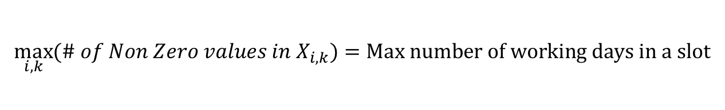
Nurse Scheduling - Constraints
 | Mon |  |  | Tue |  |  | Wed |  |  | Thu |  |  | Fri |  |  | Sat |  |  | Sun
Nurse | S1 | S2 | S3 | S1 | S2 | S3 | S1 | S2 | S3 | S1 | S2 | S3 | S1 | S2 | S3 | S1 | S2 | S3 | S1 | S2 | S3
Sophie | 1 | 0 | 0 | 0 | 0 | 0 | 1 | 0 | 0 | 0 | 0 | 0 | 1 | 0 | 0 | 0 | 0 | 0 | 0 | 0 | 1
Hanna | 0 | 1 | 0 | 0 | 0 | 0 | 0 | 1 | 0 | 0 | 0 | 0 | 0 | 1 | 0 | 0 | 0 | 0 | 0 | 0 | 0
Ruben | 0 | 0 | 1 | 0 | 0 | 0 | 0 | 0 | 1 | 0 | 0 | 0 | 0 | 0 | 1 | 0 | 0 | 0 | 0 | 0 | 0
Sam | 0 | 0 | 0 | 1 | 0 | 0 | 0 | 0 | 0 | 1 | 0 | 0 | 0 | 0 | 0 | 1 | 0 | 0 | 0 | 0 | 0
$$\max_{i,k}{(\# of Non Zero values in X_{i,k})}=Max number of working days in a slot$$

Slide 25
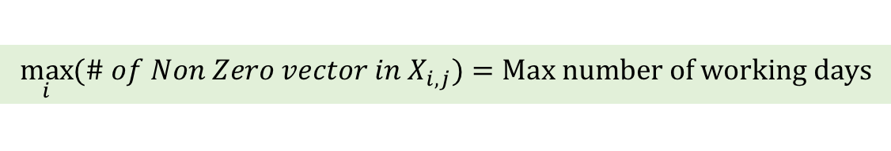
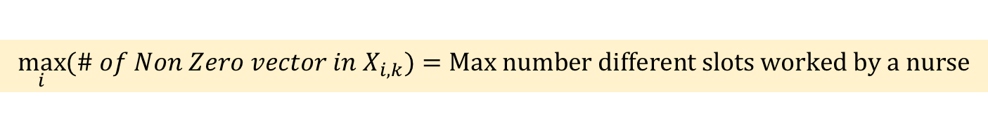
Data Format – Nurse Scheduling
 | Mon |  |  | Tue |  |  | Wed |  |  | Thu |  |  | Fri |  |  | Sat |  |  | Sun
Nurse | S1 | S2 | S3 | S1 | S2 | S3 | S1 | S2 | S3 | S1 | S2 | S3 | S1 | S2 | S3 | S1 | S2 | S3 | S1 | S2 | S3
Sophie | 1 | 0 | 0 | 0 | 0 | 0 | 1 | 0 | 0 | 0 | 0 | 0 | 1 | 0 | 0 | 0 | 0 | 0 | 0 | 0 | 1
Hanna | 0 | 1 | 0 | 0 | 0 | 0 | 0 | 1 | 0 | 0 | 0 | 0 | 0 | 1 | 0 | 0 | 0 | 0 | 0 | 0 | 0
Ruben | 0 | 0 | 1 | 0 | 0 | 0 | 0 | 0 | 1 | 0 | 0 | 0 | 0 | 0 | 1 | 0 | 0 | 0 | 0 | 0 | 0
Sam | 0 | 0 | 0 | 1 | 0 | 0 | 0 | 0 | 0 | 1 | 0 | 0 | 0 | 0 | 0 | 1 | 0 | 0 | 0 | 0 | 0
$$\max_{i}{(\# of Non Zero vector in X_{i,j})}=Max number of working days$$
$$\max_{i}{(\# of Non Zero vector in X_{i,k})}=Max number different slots worked by a nurse$$

