Slide 1

Learning Constraints for Personnel Rostering Problems Using Tensors
Mohit Kumar, Stefano Teso, Luc De Raedt, Patrick De Causmaecker

Slide 2
Overview
Problem Introduction
Algorithm – COUNT-OR
Experiments
Results
Submissions
Future Work

Slide 3
Problem Introduction

Slide 4
Objective
 | Mon |  |  | Tue |  |  | -
Nurse | S1 | S2 | S3 | S1 | S2 | S3 | - | - | -
Sophie | 1 | 0 | 1 | 0 | 0 | 0 | - | - | -
Hanna | 0 | 1 | 0 | 0 | 0 | 0 | - | - | -
Ruben | 1 | 0 | 1 | 0 | 0 | 0 | - | - | -
Sam | 0 | 0 | 0 | 1 | 0 | 0 | - | - | -
Constraints
Max/Min number of working days
Max/Min number of employees each day/shift
Max/Min number of consecutive working days
Max/Min number of shifts per day
COUNT-OR

Slide 5

Why is it useful?
Removes the dependency on domain experts
Saves a lot of time and money
Reduces the chances of making any error
Notes:
For big organizations, generating schedules manually is a complicated task, having a constraint learner removes the dependency on domain experts and thus saves a lot of time and money, and at the same time reduces the chances of making any error

Slide 6
Algorithm – COUNT-OR

Slide 7
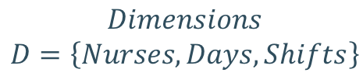
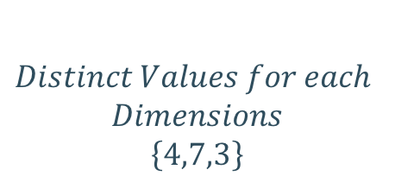
Data Representation
Rank
$$Dimensions$$
$$D=\left\{Nurses,Days,Shifts\right\}$$
 | Mon |  |  | Tue |  |  | -
Nurse | S1 | S2 | S3 | S1 | S2 | S3 | - | - | -
Sophie | 1 | 0 | 1 | 0 | 0 | 0 | - | - | -
Hanna | 0 | 1 | 0 | 0 | 0 | 0 | - | - | -
Ruben | 1 | 0 | 1 | 0 | 0 | 0 | - | - | -
Sam | 0 | 0 | 0 | 1 | 0 | 0 | - | - | -
X
$$Distinct Values for each$$
$$Dimensions$$
$$\left\{4,7,3\right\}$$
Shape

Slide 8

Tensor Slices
$$D′=\left\{Nurses,Days\right\}$$
 | Mon |  |  | Tue |  |  | -
Nurse | S1 | S2 | S3 | S1 | S2 | S3 | - | - | -
Sophie | 1 | 0 | 1 | 0 | 0 | 0 | - | - | -
Hanna | 0 | 1 | 0 | 0 | 0 | 0 | - | - | -
Ruben | 1 | 0 | 1 | 0 | 0 | 0 | - | - | -
Sam | 0 | 0 | 0 | 1 | 0 | 0 | - | - | -

Slide 9

Tensor Slices
$$D′=\left\{Shifts,Days\right\}$$
 | Mon |  |  | Tue |  |  | -
Nurse | S1 | S2 | S3 | S1 | S2 | S3 | - | - | -
Sophie | 1 | 0 | 1 | 0 | 0 | 0 | - | - | -
Hanna | 0 | 1 | 0 | 0 | 0 | 0 | - | - | -
Ruben | 1 | 0 | 1 | 0 | 0 | 0 | - | - | -
Sam | 0 | 0 | 0 | 1 | 0 | 0 | - | - | -

Slide 10

Tensor Slices
$$D′=\left\{Days\right\}$$
 | Mon |  |  | Tue |  |  | -
Nurse | S1 | S2 | S3 | S1 | S2 | S3 | - | - | -
Sophie | 1 | 0 | 1 | 0 | 0 | 0 | - | - | -
Hanna | 0 | 1 | 0 | 0 | 0 | 0 | - | - | -
Ruben | 1 | 0 | 1 | 0 | 0 | 0 | - | - | -
Sam | 0 | 0 | 0 | 1 | 0 | 0 | - | - | -

Slide 11
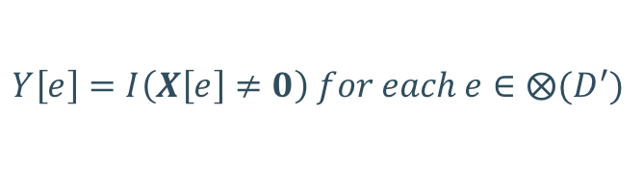
Function Definitions – NonZero
$$D′=\left\{Nurses,Days\right\}$$
 | Mon |  |  | Tue |  |  | -
Nurse | S1 | S2 | S3 | S1 | S2 | S3 | - | - | -
Sophie | 1 | 0 | 1 | 0 | 0 | 0 | - | - | -
Hanna | 0 | 1 | 0 | 0 | 0 | 0 | - | - | -
Ruben | 1 | 0 | 1 | 0 | 0 | 0 | - | - | -
Sam | 0 | 0 | 0 | 1 | 0 | 0 | - | - | -
$$Y\left[e\right]=I\left(X\left[e\right]≠0\right) for each e∈⨂(D^{′})$$

Slide 12
Function Definitions – NonZero
$$D′=\left\{Nurses,Days\right\}$$
 | Mon |  |  | Tue |  |  | -
Nurse | S1 | S2 | S3 | S1 | S2 | S3 | - | - | -
Sophie | 1 |  |  | 0 |  |  | - | - | -
Hanna | 1 |  |  | 0 |  |  | - | - | -
Ruben | 1 |  |  | 0 |  |  | - | - | -
Sam | 0 |  |  | 1 |  |  | - | - | -
$$Y\left[e\right]=I\left(X\left[e\right]≠0\right) for each e∈⨂(D^{′})$$

Slide 13
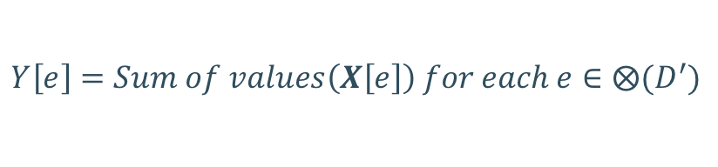
Function Definitions – Sum
$$D′=\left\{Nurses,Days\right\}$$
 | Mon |  |  | Tue |  |  | -
Nurse | S1 | S2 | S3 | S1 | S2 | S3 | - | - | -
Sophie | 1 | 0 | 1 | 0 | 0 | 0 | - | - | -
Hanna | 0 | 1 | 0 | 0 | 0 | 0 | - | - | -
Ruben | 1 | 0 | 1 | 0 | 0 | 0 | - | - | -
Sam | 0 | 0 | 0 | 1 | 0 | 0 | - | - | -
$$Y\left[e\right]=Sum of values\left(X\left[e\right]\right) for each e∈⨂(D^{′})$$

Slide 14
Function Definitions – Sum
$$D′=\left\{Nurses,Days\right\}$$
 | Mon |  |  | Tue |  |  | -
Nurse | S1 | S2 | S3 | S1 | S2 | S3 | - | - | -
Sophie | 2 |  |  | 0 |  |  | - | - | -
Hanna | 1 |  |  | 0 |  |  | - | - | -
Ruben | 2 |  |  | 0 |  |  | - | - | -
Sam | 1 |  |  | 1 |  |  | - | - | -
$$Y\left[e\right]=Sum of values\left(X\left[e\right]\right) for each e∈⨂(D^{′})$$

Slide 15




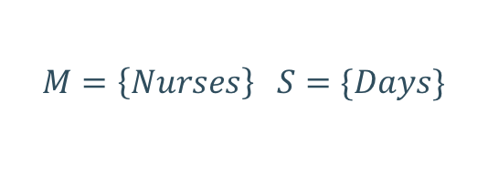
Function Definitions – Count
$$M$$
$$M=\left\{Nurses\right\} S=\{Days\}$$
$$D$$
$$M∩S=∅$$
$$S$$
 | Mon |  |  | Tue |  |  | -
Nurse | S1 | S2 | S3 | S1 | S2 | S3 | - | - | -
Sophie | 1 | 0 | 1 | 0 | 0 | 0 | - | - | -
Hanna | 0 | 1 | 0 | 0 | 0 | 0 | - | - | -
Ruben | 1 | 0 | 1 | 0 | 0 | 0 | - | - | -
Sam | 0 | 0 | 0 | 1 | 0 | 0 | - | - | -
$$COUNT\left(X,M,S\right)=Sum(NonZero\left(X,M∪S\right),S)$$

Slide 16
Function Definitions – Count
$$M=\left\{Nurses\right\} S=\{Days\}$$
 | Mon |  |  | Tue |  |  | -
Nurse | S1 | S2 | S3 | S1 | S2 | S3 | - | - | -
Sophie | 1 |  |  | 0 |  |  | - | - | -
Hanna | 1 |  |  | 0 |  |  | - | - | -
Ruben | 1 |  |  | 0 |  |  | - | - | -
Sam | 0 |  |  | 1 |  |  | - | - | -
$$COUNT\left(X,M,S\right)=Sum(NonZero\left(X,M∪S\right),S)$$

Slide 17
Function Definitions – Count
$$M=\left\{Nurses\right\} S=\{Days\}$$
 | Mon |  |  | Tue |  |  | -
Nurse | S1 | S2 | S3 | S1 | S2 | S3 | - | - | -
Sophie | 1 |  |  | 0 |  |  | - | - | -
Hanna | 1 |  |  | 0 |  |  | - | - | -
Ruben | 1 |  |  | 0 |  |  | - | - | -
Sam | 0 |  |  | 1 |  |  | - | - | -
$$COUNT\left(X,M,S\right)=Sum(NonZero\left(X,M∪S\right),S)$$

Slide 18
Function Definitions – Count
$$M=\left\{Nurses\right\} S=\{Days\}$$
 | Mon |  |  | Tue |  |  | -
Nurse | S1 | S2 | S3 | S1 | S2 | S3 | - | - | -
Count | 3 |  |  | 1 |  |  | - | - | -
$$COUNT\left(X,M,S\right)=Sum(NonZero\left(X,M∪S\right),S)$$

Slide 19
Constraints List
M | S | Count
{Days} | {Nurses} | # of working days/Nurse
{Days, Shifts} | {Nurses} | # of working shifts/Nurse
{Days} | {Nurses} | # of employees / day
{Shifts} | {Days} | # of shifts for each day with at least one nurse working
{Slots} | {Nurses, Days} | # of working shifts per day / nurse
{Days} | {Nurses, Slots} | # of working days in the same shift / nurse
{Nurses} | {Days, Shifts} | # of nurses pre shift per day
$$COUNT\left(X,M,S\right)=Sum(NonZero\left(X,M∪S\right),S)$$

Slide 20



Background Knowledge
 | Mon
Nurse | S1 | S2 | S3
Sophie | 1 | 0 | 1
Hanna | 0 | 1 | 0
Ruben | 0 | 0 | 1
Sam | 0 | 0 | 0
Tue
S1 | S2 | S3
0 | 1 | 0
0 | 1 | 0
0 | 0 | 1
0 | 0 | 0
Nurses | Skill Level
Sophie | High
Hanna | Low
Ruben | Low
Sam | High
$$\left[1,0,0,1\right]$$
$$\left[ \begin{aligned}1,0,0,0 \\ 0,0,0,1 \end{aligned}\right]$$
$$\left[ \begin{aligned}1,0,0,0 \\ 0,0,0,1 \end{aligned}\right]×$$
H
L
$$\left[0,1,1,0\right]$$
$$\left[\begin{aligned} 0,1,0,0 \\ 0,0,1,0\end{aligned}\right]$$
 | Mon
Nurse | S1 | S2 | S3
Sophie | 1 | 0 | 1
Sam | 0 | 0 | 0
Tue
S1 | S2 | S3
0 | 1 | 0
0 | 0 | 0

Slide 21
Experiments

Slide 22
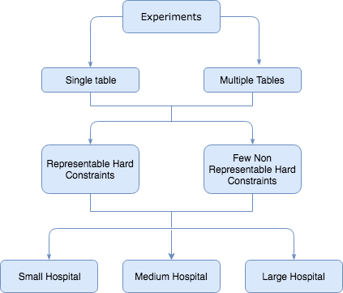
Experiments
Generate Solutions
Learn Model
Precision & Recall
Target Model

Slide 23
Results

Slide 24
Results – Representable Hard Constraint

Slide 25
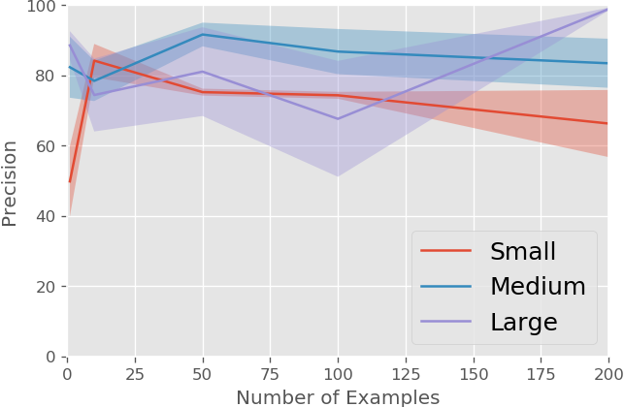
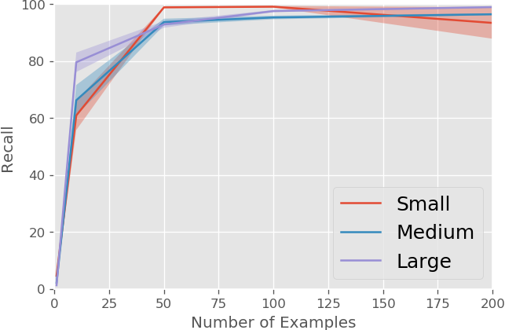
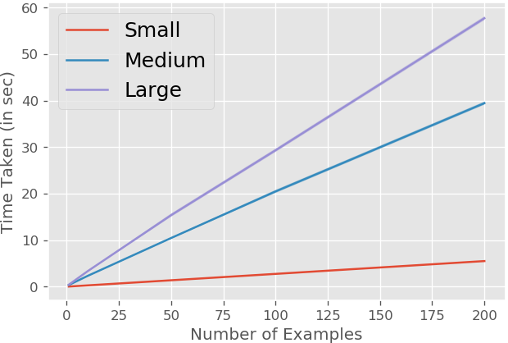
Results – Non-Representable Hard Constraint

Slide 26
Submissions & Future Work

Slide 27
Submissions
Abstract accepted in EURO 2018 – 29th European Conference on Operational Research
Workshop paper accepted in IJCAI 2018 – Data Science meets Optimization

Slide 28

Future Work
Extend the algorithm to support other problems
Make the algorithm interactive
Learning Soft
Constraints
Careful omission of constraints

Slide 29
THANK YOU

Slide 30
QUESTIONS ?

