Slide 1




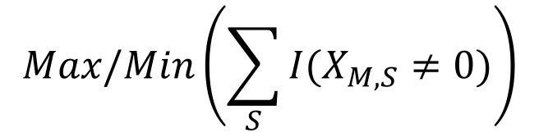
Constraint Learner Using Tensors
Aim: Given a working schedule for employees, learn the constraints underlying the schedule
$$Max/Min\left(\sum_{S}{I(X_{M,S}≠0)}\right)$$
$$Dim=\{Nurses, Days, Slots\}$$
 | Mon |  |  | Tue
Nurse | S1 | S2 | S3 | S1 | S2 | S3
Sophie | 1 | 0 | 0 | 0 | 0 | 0
Hanna | 0 | 1 | 0 | 0 | 0 | 0
Ruben | 0 | 0 | 1 | 0 | 0 | 0
Sam | 0 | 0 | 0 | 1 | 0 | 0
$$M=\{Nurses\}$$
$$S=\{Days\}$$
Extract Dimensions
M | S | Definition
{Nurses} | {Days} | # of working days
{Nurses} | {Days, Slots} | # of working slots
{Days} | {Nurses, Slots} | # of employees each day
{Nurses, Days} | {Slots} | # of working slots / day
{Days, Slots} | {Nurses} | # of employees / slot
Convert to a 3d tensor
$$X_{N,D,S}$$

Slide 2
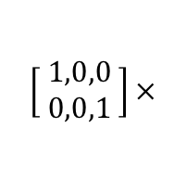
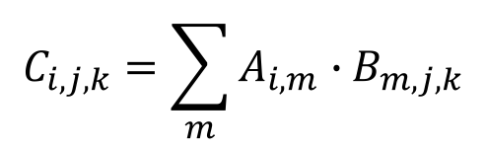
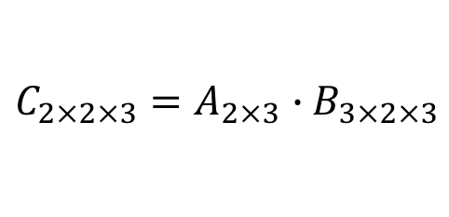



Filtering Data: Multiple Tables
Nurses | Skill Level
Nurse1 | High
Nurse2 | Low
Nurse3 | High
$$A_{2×3}$$
$$B_{3×2×3}$$
Tue
S1 | S2 | S3
0 | 1 | 0
0 | 1 | 0
0 | 0 | 1
 | Mon
Nurses | S1 | S2 | S3
Nurse1 | 1 | 0 | 0
Nurse2 | 0 | 1 | 0
Nurse3 | 0 | 0 | 1
$$\left[ \begin{aligned}1,0,0 \\ 0,0,1 \end{aligned}\right]×$$
$$C_{2×2×3}=A_{2×3}{ ∙B}_{3×2×3}$$
$$C_{2×2×3}$$
Tue
S1 | S2 | S3
0 | 1 | 0
0 | 0 | 0
 | Mon
Nurses | S1 | S2 | S3
Nurse1 | 1 | 0 | 0
Nurse3 | 0 | 0 | 0
$$C_{i,j,k}=\sum_{m}{A_{i,m}{ ∙B}_{m,j,k}}$$

