Slide 1
Structure of Expert System
Mohit Kumar Agrahari

Slide 2
What is Expert System ?
An expert system, is an interactive computer-based decision tool that uses both facts and heuristics to solve difficult decision making problems, based on knowledge acquired from an expert.
Inference engine + Knowledge = Expert system
First expert system, called DENDRAL, was developed
in the early 70's at Stanford University.

Slide 3
Human Expert Behaviors
Recognize and formulate the problem
Solve problems quickly and properly
Explain the solution
Learn from experience
Restructure knowledge
Break rules
Determine relevance
Degrade gracefully

Slide 4
Examples Of ES
Diagnostic applications
Play chess
Make financial planning decisions
Configure computers
Monitor real time systems
Underwrite insurance policies
Perform many services which previously required human expertise.

Slide 5
Expert System Shells
Many expert system s are built with products called
expert system shells.
A shell is a piece of software which contains the user interface, a format for declarative knowledge in the knowledge base, and an inference engine. The knowledge and system engineers uses these shells in making expert
systems.
Knowledge engineer : uses the shell to build a
system for a particular problem domain.
System engineer : builds the user interface, designs
the declarative format of the knowledge base, and
implements the inference engine.
Depending on the size of the system, the knowledge
engineer and the system engineer might be the
same person.

Slide 6
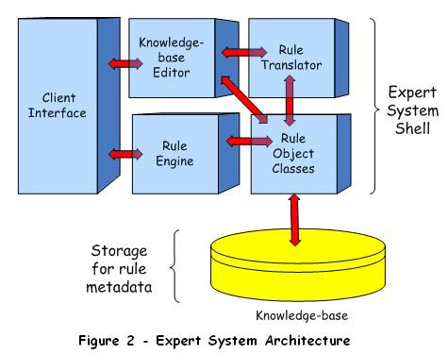
Expert System Architecture

Slide 7
The Client Interface processes requests for service
from system-users and from application layer
components.
The Knowledge-base Editor is a simple editor that
enable a subject matter expert to compose and add
rules to the Knowledge-base.
Rule Translator converts rules from one form to
another i.e; their original form to a machine-readable
form.
The Rule Engine(inference engine) is responsible for
executing Knowledge-base rules.
The shell component, Rule Object Classes, is a
container for object classes supporting.

Slide 8
Roles of Individuals who interact with the system
Domain expert : The individuals who currently are
experts in solving the problems; here the system is
intended to solve.
Knowledge engineer : The individual who
encodes the expert's knowledge in a declarative
form that can be used by the expert system.
User : The individual who will be consulting with the
system to get advice which would have been
provided by the expert.
System engineer : builds the user interface, designs
the declarative format of the knowledge base, and
implements the inference engine.

Slide 9
Expert System Benefits
Increased Output and Productivity
Decreased Decision Making Time
Increased Process and Product Quality
Reduced Downtime
Capture Scarce Expertise
Flexibility
Easier Equipment Operation
Elimination of Expensive Equipment

Slide 10
Expert System Limitations
Knowledge is not always readily available
Expertise can be hard to extract from Humans
Each expert’s approach may be different, yet correct
Hard, even for a highly skilled expert, to work under time pressure
Expert system users have natural cognitive limits
ES work well only in a narrow domain of knowledge
Most experts have no independent means to validate their conclusions
Experts’ vocabulary often limited and highly technical
Knowledge engineers are rare and expensive
Lack of trust by end-users
Knowledge transfer subject to a host of perceptual and judgmental biases
ES may not be able to arrive at valid conclusions
ES sometimes produce incorrect recommendations

Slide 11
Thank You

