Slide 1

Hindi Vidya Prachar Samiti’s
RAMNIRANJAN JHUNJHUNWALA COLLEGE
DEPARTMENT OF INFORMATION TECHNOLOGY
Features and Reports of FTK
- Mohit Kumar Agrahari

Slide 2
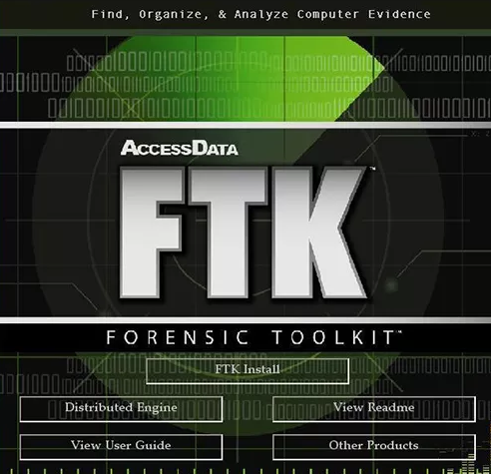
Forensic Toolkit
FTK is an award-winning, court-cited digital investigations solution built for speed, stability and ease of use. It quickly locates evidence and forensically collects and analyzes any digital device or system producing, transmitting or storing data by using a single application from multiple devices. Known for its intuitive interface, email analysis, customizable data views, processing speeds and stability, FTK also lays the framework so your solution can grow with your organization’s needs for a smooth expansion.
The toolkit also includes a standalone disk imaging program called FTK Imager. The FTK Imager is a simple but concise tool. It saves an image of a hard disk in one file or in segments that may be later on reconstructed. It calculates MD5 hash values and confirms the integrity of the data before closing the files. The result is an image file(s) that can be saved in several formats, including DD raw.

Slide 3
Unmatched Speed And Stability
FTK uses distributed processing and is the only forensics solution to fully leverage multi-thread/multi-core computers. While other forensics tools waste the potential of modern hardware solutions, FTK uses 100 percent of its hardware resources, helping investigators find relevant evidence faster.
Faster Searching
Since indexing is done up front, filtering and searching are completed more efficiently than with any other solution. Whether you’re investigating or performing document review, you have a shared index file, eliminating the need to recreate or duplicate files.
Database Driven
FTK is truly database driven, using one shared case database. All data is stored securely and centrally, allowing your teams to use the same data. This reduces the cost and complexity of creating multiple data sets.

Slide 4
Remote Machine Analysis
With the single-node enterprise, users can preview, acquire and analyze evidence remotely from computers on your network.
Visualization
Automatically construct timelines and graphically illustrate relationships among parties of interest in a case. With Email, Social and File Visualization you can view data in multiple display formats, including timelines, cluster graphs, pie charts, geolocations and more, to help you determine relationships and find key pieces of information. Then generate reports that are easily consumed by attorneys, CIOs or other investigators.
Internet Browser and Web-Based Email Evidence
Almost every investigation involves the analysis of Internet artifacts. Web browsing caches store records of sites a
suspect has visited, web-based emails may help to prove intent or correlate other events and instant message
conversations or social media sites can contain evidence. When evidence is processed, artifact files are categorized and organized so that you can easily see them.
Password Cracking and Recovery
Unlock files when you don’t know the password with market leading decryption password cracking and recovery.

Slide 5
Explicit Image Detection (EID)
Image detection technology recognizes flesh tones and auto-identifies more than 30,000 potentially pornographic images.
Malware Triage & Analysis
Available as an option to FTK, Cerberus is an automated malware triage platform solution designed to integrate
with FTK. It’s a first layer of defense against the risk of imaging unknown devices and allows you to identify
risky files after processing your data in FTK. Then you can see which files are potentially infected and can avoid
exporting them. Cerberus is one tool in your malware arsenal and helps you identify potentially malicious files.
Teams can:
Determine both the behavior and intent of security breaches sooner by providing complex analysis prior
to a full-blown malware attack.
Strengthen security defenses and prevent malicious software from running with state-of-the-art technology
called whitelisting.
Take action sooner when security breaches occur; unlike other competitors, Cerberus doesn’t rely on a sandbox or signature-based solutions.

Slide 6
Creating a Report
Enter basic case information.
Decide how to handle bookmarks.
Select the properties of bookmarks.
Decide how to handle graphic thumbnails.
Decide if you want a file path list.
Decide if you want a file properties list.
Select the properties of the file properties list.
Add supplementary files and the case log.
Add the Registry Viewer report or a custom graphic to the report and select the report location.
Let’s watch out this
https://www.youtube.com/watch?v=tePbvjGvrcI

Slide 7
Thank You

