Slide 1
Hindi Vidya Prachar Samiti’s
RAMNIRANJAN JHUNJHUNWALA COLLEGE
DEPARTMENT OF INFORMATION TECHNOLOGY
Storage Area Network
- Mohit Kumar Agrahari

Slide 2
Problems we were facing
Scalability
Connectivity
24/7 availability
High performance
Easy management

Slide 3
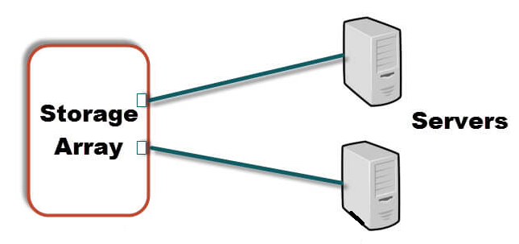
Solutions
Direct attached storage
Direct-attached storage is digital storage directly attached to the computer accessing it.
Advantages
Low Cost Solution
Simple to Configure
De-Centralized Storage
No Storage Consolidation
No High Availability
Low Performance

Slide 4
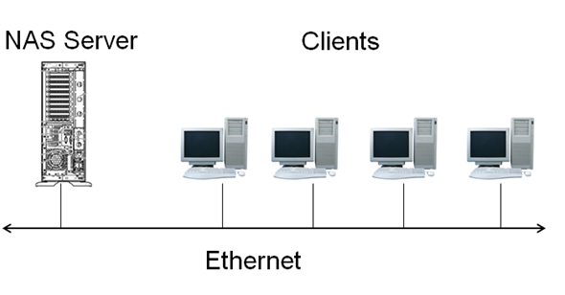
Network Attached Storage
A Network Attached Storage (NAS) device is a storage device connected to a network that allows storage and retrieval of data from a centralized location for authorized network users and heterogeneous clients.
Advantages
Heterogeneous Environment
Centralized Storage
Low Performance
Limited scalability
Network Congestion during backups & Restore
Ethernet Limitations

Slide 5
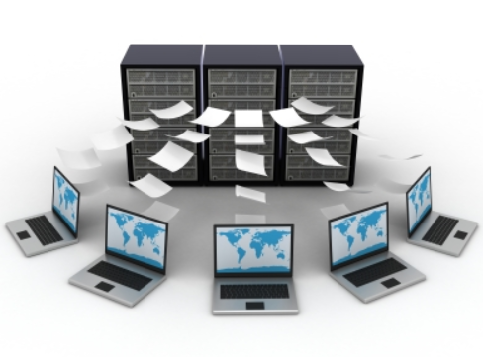
Storage Area Network
A storage area network (SAN) is a Computer network which provides access to consolidated, block level data storage. SANs are primarily used to enhance storage devices, such as disk arrays and tape libraries, accessible to servers so that the devices appear to the operating servers as locally attached devices.
Deals with
How to Store Data
How to Access Data
How to Manage Data Storage

Slide 6
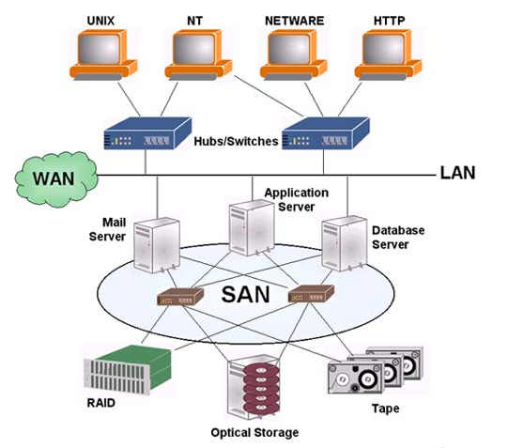
Advantages SAN Architecture
Heterogeneous environment
Centralized Storage Management
High Degree of Fault Tolerance
Best and superior performance
Storage Consolidation
Fast and efficient backups and restores
Dynamic Scalability
Expensive solution for small setups

Slide 7
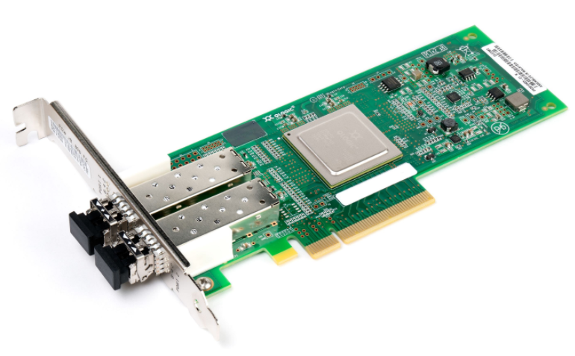
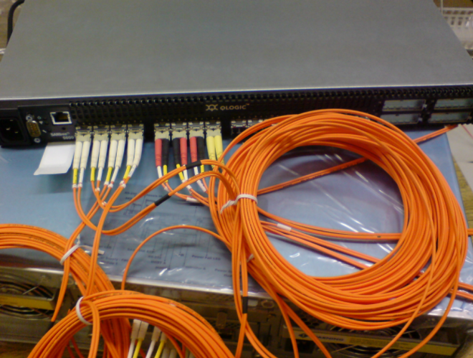
SAN components
Host layer
Servers that allow access to the SAN and its storage devices are said to form the host layer of the SAN. Such servers have host bus adapters (HBAs), which are hardware cards that attach to slots on the server mainboard, and the corresponding firmware and drivers.
Fabric layer
The SAN networking devices are called fabric layers and include SAN switches, but also routers, protocol bridges, gateway devices and cables. SAN network devices move data within the SAN, or between an initiator, such as an HBA port of a server, and a target, such as the port of a storage device.

Slide 8
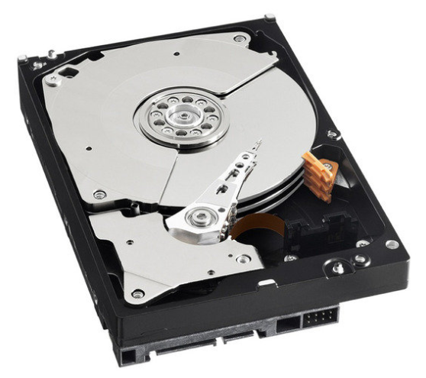
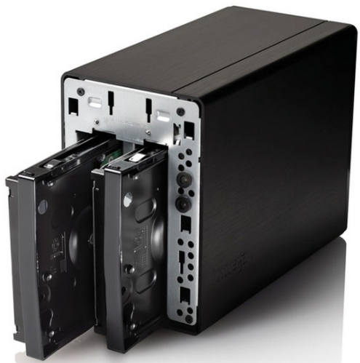
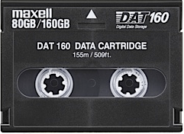
Storage layer
The various storage devices in a SAN are said to form the storage layer. It can include a variety of hard disk and magnetic tape devices that store data. In SANs disk arrays are joined through a RAID, which makes a lot of hard disks look and perform like one big storage device. Every storage device, or even partition on that storage device, has a logical unit number (LUN) assigned to it.

Slide 9
SAN Protocols
Most storage networks use the SCSI protocol for communication between servers and disk drive devices
ATA over Ethernet (AoE), mapping of ATA over Ethernet
Fibre Channel Protocol (FCP), the most prominent one, is a mapping of SCSI over Fibre Channel
Fibre Channel over Ethernet (FCoE)
ESCON over Fibre Channel (FICON), used by mainframe computers
HyperSCSI, mapping of SCSI over Ethernet
iFCP or SANoIP mapping of FCP over IP
iSCSI, mapping of SCSI over TCP/IP
iSCSI Extensions for RDMA (iSER), mapping of iSCSI over InfiniBand
Examples of stacked protocols using SCSI:
Applications
SCSI Layer
FCP | FCP | FCP | FCP | iSCSI
 |  | FCIP | iFCP
 |  | TCP
 | FCoE | IP
FC | Ethernet

Slide 10
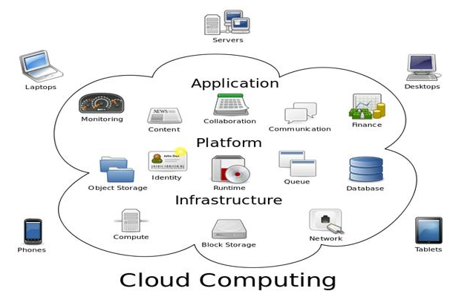
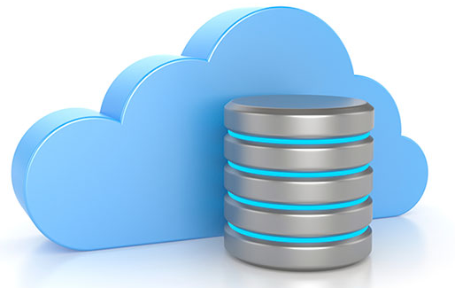

Uses
Cloud Computing
Hybrid Cloud Storage
Media Services

Slide 11
Thank You

