Slide 1
Hindi Vidya Prachar Samiti’s
RAMNIRANJAN JHUNJHUNWALA COLLEGE
DEPARTMENT OF INFORMATION TECHNOLOGY
Security Risk Assessment And Management
- Mohit Kumar Agrahari

Slide 2
RISK:
Risk is an undesired event or circumstance
RISK MANAGEMENT:
It aims at reducing the impact of risk that may effect a project by identifying, analyzing and managing it
SECURITY RISK ASSESSMENT
Information security risk assessment is an on-going process of discovering, correcting and preventing security problems. The risk assessment is an integral part of a risk management process designed to provide appropriate levels of security for information systems
SECURITY RISK MANAGEMENT
Risk management is the identification, assessment and prioritization of risks to minimize, monitor, and control the probability and impact of unforeseen events.

Slide 3




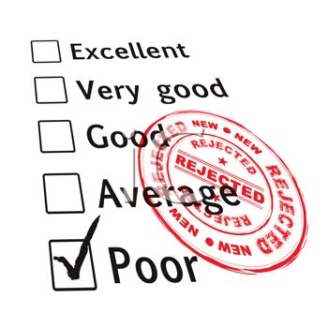
NEED OF SRAM
Confidentiality
Integrity
Availability
Performance
Economic growth
CAUSES OF SECURITY RISKS
Training deficiencies
Poor Product Design
Lack of Resources
Poor Communications
Poor Safety Culture
Gaps in Supervision
Inadequate Tools and Equipment
Hacktivism

Slide 4

STRATEGIES OF SRAM
Proactive
Proactive is forward looking. Proactive utilizes data to identify threats and put measures in place to mitigate the level of risk of the identified threats and hazards. Proactive safety anticipates things…it is forward looking…proactive safety allows an organization to mitigate risk of an identified threat BEFORE that threat causes an incident or accident.
Reactive
Reactive is forensic…it is investigative in nature…something has happened and now an investigation needs to be done so that lessons can be learned and action can be taken to ensure it doesn’t happen again.

Slide 5





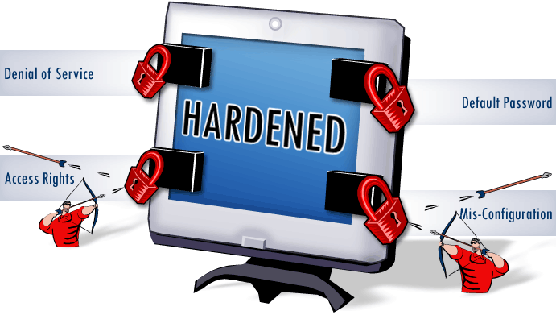
SRAM SOFTWARE AND TECHNIQUES
Antivirus
Firewalls
Encryptions And Encodings
Password Protection
Hardening Operating Systems
Hardening Software Systems
Hardening Network Devices
Employee Awareness

Slide 6
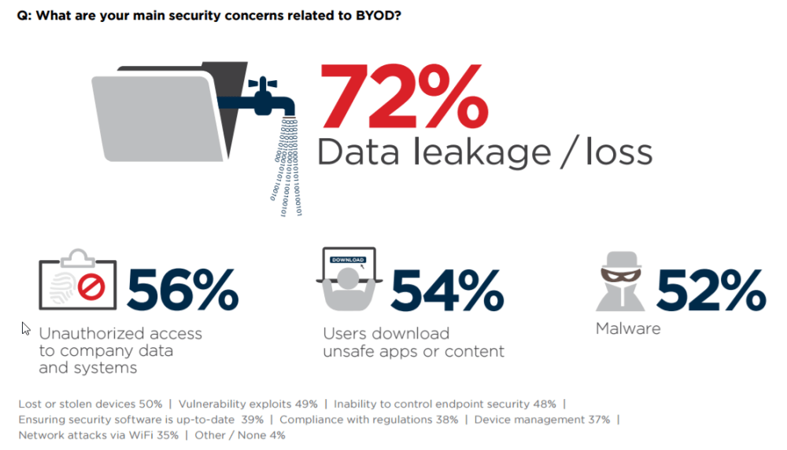
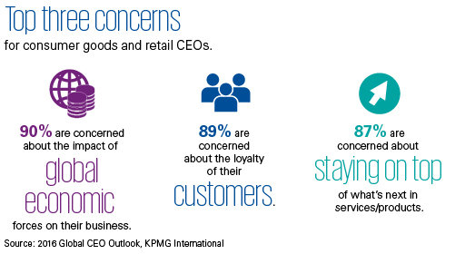
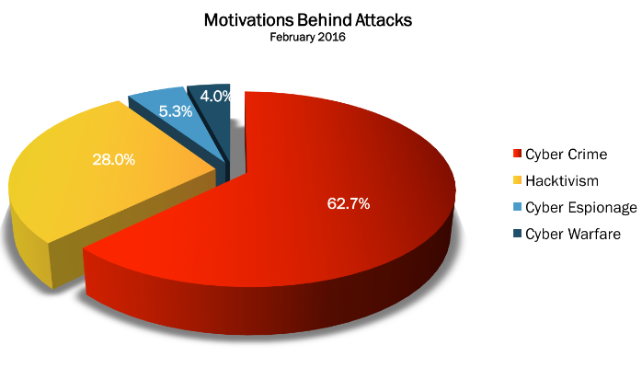
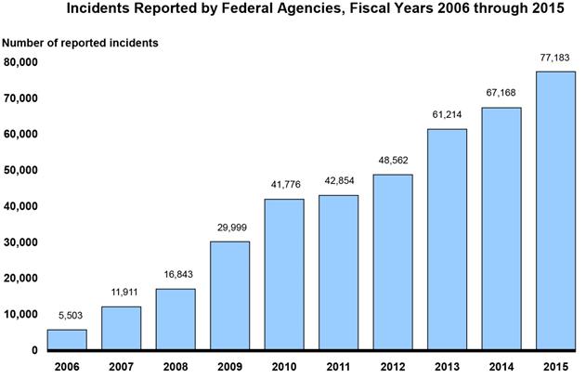
Facts and Trends

Slide 7
Thank you all,
Any QUERIES !!!

