Slide 1
Hindi Vidya Prachar Samiti’s
RAMNIRANJAN JHUNJHUNWALA COLLEGE
DEPARTMENT OF INFORMATION TECHNOLOGY
Continual Service Improvement
- Mohit Kumar Agrahari

Slide 2
What are Services ?
IT Service –
“A service provided to one or more Customers by an IT Service Provider. An IT Service is based on the use of Information Technology and supports the Customer’s Business Processes. An IT Service is made up from a combination of People, Process and Technology and should be defined in a Service Level Agreement”
Business Service –
“An IT Service that directly supports a Business Process, as opposed to an Infrastructure Service, which is used internally by the IT Service Provider and is not usually visible to the Business”
Infrastructure Service –
“An IT Service that is not directly used by the Business, but is required by the IT Service Provider so they can provide other IT Services. For example directory services, naming services, or communication services.”

Slide 3
A Service Centric Viewpoint
$ell Insurance
Market
Sell
Onboard
Support
Application1
Business Process
Application3
Application4
Application3
IT Service 1
IT Service 2
IT Service 3
Infrastructure
Service 1
Infrastructure
Service 2
Infrastructure
Service 3
C I 1
CI 2
CI 3
C I 4

Slide 4
What is Continual Service Improvement?
The goal of Continual Service Improvement is to align and realign IT Services to changing business needs by identifying and implementing improvements to the IT services that support the Business Processes.
The perspective of CSI on improvement is the business perspective of service quality, even though CSI aims to improve process effectiveness, efficiency and cost effectiveness of the IT processes through the whole lifecycle.
In order to manage improvement, CSI should clearly define what should be controlled and measured.

Slide 5
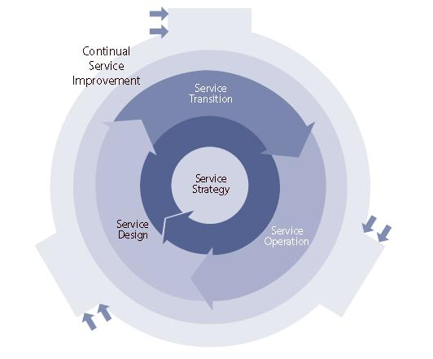
What is Continual Service Improvement?

Slide 6
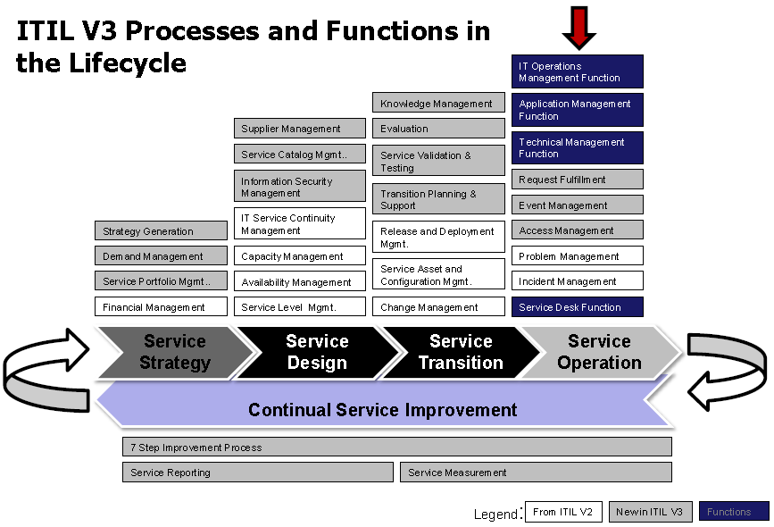

Slide 7
7 Steps of CSI
Define what you should measure
Define what you can measure
Gather the data
Process the data
Analyze the data
Present/assess the data
Implement corrective actions

Slide 8
Define what you should measure
What should be measured based upon:
Business Requirements
Functional Requirements
Expected outcomes of Business Processes
Existing Service Improvement Plans
Defined Service/Process KPIs and Metrics
Should provide a balanced View
Qualitative - what does your customer think of the quality of the product being delivered?
Quantitative – What do your Technology and Process metrics tell you about how your product is being delivered?

Slide 9
Define what you can measure
What data is available to you?
How are you going to collect that data?
From an existing tool?
From a new tool?
Manually tallied?
What if you can’t measure something?
Establish a Data Capture Plan
How are you going to get this data, and what gaps do you need to overcome if any?
Determine which metrics are the most important.
What is important to your customer and their business processes?
What KPIs and Metrics align to the highest priority Business and Functional Requirements?

Slide 10
Gather the data
Gather all of your relevant data
Execute your data capture plan
Depending on whether your data is “Quick Turn” (lots of transactions resulting in a large amount of data in a short period of time) or “Slow Turn” (minimal transactions occurring over a long period of time), combined with availability and quality of your historical data will determine your sample data size and time period.
Process the data
Validate the data:
Is the data what you expected?
Is the quality of the data sufficient?
Do all of the data sources validate one another?
Ensure that all data is in a format that can be worked with while analyzed.

Slide 11
Analyze the data
Create reports that display the relevant data points.
Be able to understand and articulate the meaning of data points, and trend information.
Understand any special cause data, which is outside the norms.
Present / Assess the data
Identify opportunities to improve service based upon the analyzed data
Present the data and recommendations to key stakeholders / decision makers
Determine which Corrective actions should be taken (follow standard release management planning and change management processes)
Implement corrective actions
Implement Corrective actions
Execute according to standard Release and Change Management processes.

Slide 12
Thank You

