Slide 1
Continual Service Improvement:
Why good enough, is NEVER good enough.
17 October 2008

Slide 2
What are Services?
IT Service –
  “A service provided to one or more Customers by an IT Service Provider. An IT Service is based on the use of Information Technology and supports the Customer’s Business Processes. An IT Service is made up from a combination of People, Process and Technology and should be defined in a Service Level Agreement”
Business Service –
  “An IT Service that directly supports a Business Process, as opposed to an Infrastructure Service, which is used internally by the IT Service Provider and is not usually visible to the Business”
Infrastructure Service –
  “An IT Service that is not directly used by the Business, but is required by the IT Service Provider so they can provide other IT Services. For example directory services, naming services, or communication services.”
All definitions from: ITIL “Service Design” book © Crown Copyright 2007 (OCG)
Capgemini Public

Slide 3
A Service Centric Viewpoint
$ell Insurance
Market
Sell
Onboard
Support
Application1
Business Process
Application3
Application4
Application3
IT Service 1
IT Service 2
IT Service 3
Infrastructure
Service 1
Infrastructure
Service 2
Infrastructure
Service 3
C I 1
CI 2
CI 3
C I 4
Capgemini Public

Slide 4
What is Continual Service Improvement?
Aligning and realigning IT services to changing business needs
The goal of Continual Service Improvement is to align and realign IT Services to changing business needs by identifying and implementing improvements to the IT services that support the Business Processes.
The perspective of CSI on improvement is the business perspective of service quality, even though CSI aims to improve process effectiveness, efficiency and cost effectiveness of the IT processes through the whole lifecycle.
In order to manage improvement, CSI should clearly define what should be controlled and measured.
Capgemini Public

Slide 5
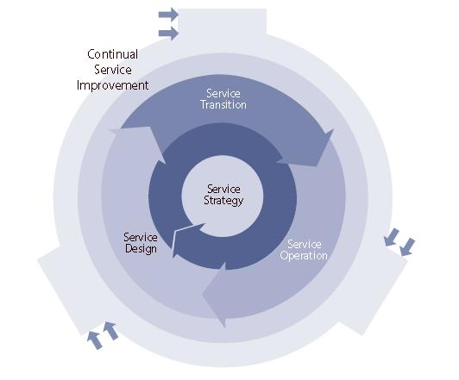
What is Continual Service Improvement?
Capgemini Public

Slide 6
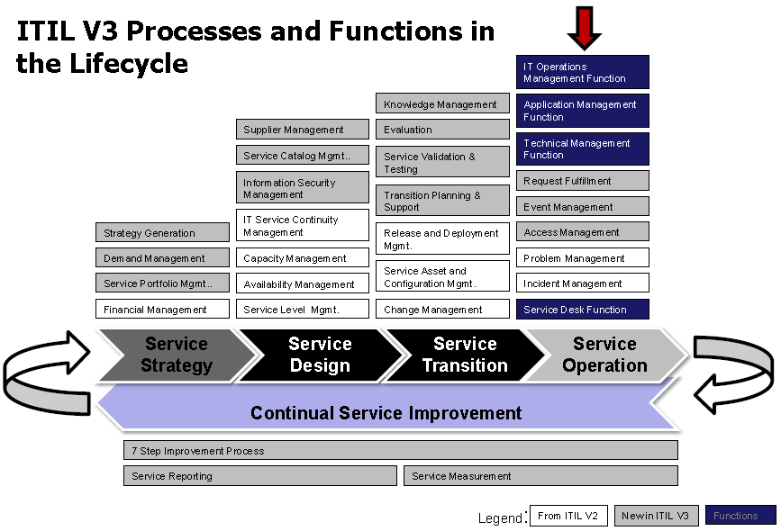
Capgemini Public

Slide 7
What does ITIL say about CSI
Focused on all aspects of the ITIL Core processes
Applies to service improvement and process improvement for related processes.
Should be systematically applied throughout the entire Service Lifecycle
Identifies 3 metric types:
  Technology – (How is the technology performing – Monitoring, Uptime, etc)
  Service – (How is the service performing relative to the needs of the business)
  Process – (How is the process performing – Cycle Times, Customer Satisfaction, etc)
Capgemini Public

Slide 8
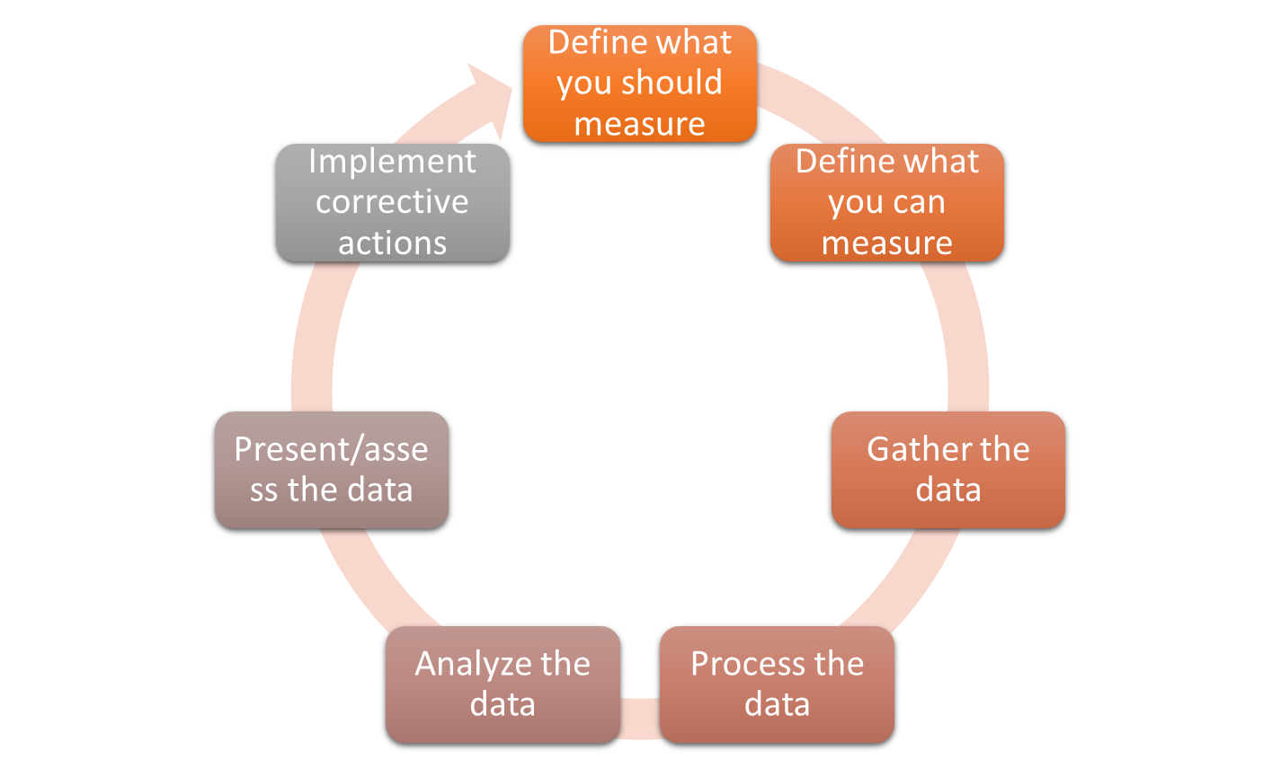
7 Steps
Capgemini Public

Slide 9
Define what you should measure
What should be measured based upon:
  Business Requirements
  Functional Requirements
  Expected outcomes of Business Processes
  Existing Service Improvement Plans
  Defined Service/Process KPIs and Metrics
Should provide a balanced View
  Qualitative - what does your customer think of the quality of the product being delivered?
  Quantitative – What do your Technology and Process metrics tell you about how your product is being delivered?
Capgemini Public

Slide 10
Define what you can measure
What data is available to you?
How are you going to collect that data?
  From an existing tool?
  From a new tool?
  Manually tallied?
What if you can’t measure something?
  Establish a Data Capture Plan
    How are you going to get this data, and what gaps do you need to overcome if any?
Determine which metrics are the most important.
  What is important to your customer and their business processes?
  What KPIs and Metrics align to the highest priority Business and Functional Requirements?
Capgemini Public

Slide 11
Gather the data
Gather all of your relevant data
Execute your data capture plan
Depending on whether your data is “Quick Turn” (lots of transactions resulting in a large amount of data in a short period of time) or “Slow Turn” (minimal transactions occurring over a long period of time), combined with availability and quality of your historical data will determine your sample data size and time period.
Capgemini Public

Slide 12
Process the data
Validate the data:
  Is the data what you expected?
  Is the quality of the data sufficient?
  Do all of the data sources validate one another?
  Ensure that all data is in a format that can be worked with while analyzed.
Capgemini Public

Slide 13
Analyze the data
Create reports that display the relevant data points.
Be able to understand and articulate the meaning of data points, and trend information.
Understand any special cause data, which is outside the norms.
Capgemini Public

Slide 14
Present / Assess the data
Identify opportunities to improve service based upon the analyzed data
Present the data and recommendations to key stakeholders / decision makers
Determine which Corrective actions should be taken (follow standard release management planning and change management processes)
Capgemini Public

Slide 15
Implement corrective actions
Implement Corrective actions
Execute according to standard Release and Change Management processes.
Capgemini Public

Slide 16
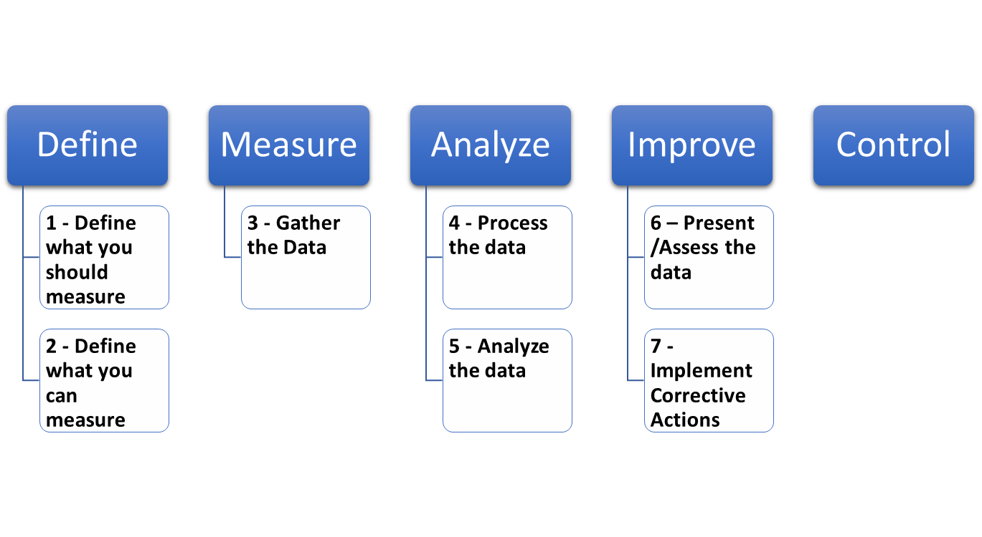
Aligning to CSI to Six Sigma (DMAIC)
Capgemini Public

Slide 17
Key Process Elements
Process Diagram Defines the inputs, outputs, providers, receivers, activities and critical success factors of the process
Benefits Explanation of the benefits you will receive from implementing this process.
Controls By knowing the control objectives and being able to monitor and measure performance of achieving those objectives, IT will be able to better manage and improve operations, security and their audit processes. A control objective will define the enforcement of a process and will avert high-risk activities.
Goal Document the goal of the process. Make it SMART:
  Specific – your goal should have its expected outcome stated as simply, concisely and explicitly as possible. This answers questions such as; how much, for whom, for what?
  Measurable – a measurable goal has an outcome that can be assessed either on a sliding scale (1-10), or as a hit or miss, success or failure.
  Achievable – an achievable goal has an outcome that is realistic given your current situation, resources and time available. Goal achievement may be more of a “stretch” if the outcome is tough or you have a weak starting position.
  Relevant – a relevant goal should help you on your mission.
  Time-bound – a time-bound goal includes realistic timeframes.
Capgemini Public

Slide 18
Key Process Elements (Cont.)
Metrics The metrics by which you will measure the success of your process implementation. This page defines your Key Performance Indicators and your Critical Success Factors.
Policies The management polices that will govern the use of this process and all of its procedures.
Process Team The members of the process team and their contact information.
Roles The process’ roles that will be involved with the process activities. HR should be involved in the development, approval and assignment of all process roles.
Scope Defines what the process covers (the extent and/or scale), the inputs, the basic activities and the output, including the scope of responsibility of the process owner.
Specification Summarization of the customizable process options and lists. (ex. severity codes, closure codes, status codes, etc).
Capgemini Public

