Slide 1

Zomato
Data set – Indian_restaurant
Prepared by - Mohitt

Slide 2
Executive Summary
3
This zomato dataset provides a comprehensive overview of over 2.1 lakh (211,944) restaurants across multiple cities in India. It contains 26 features capturing detailed information about restaurant identity, location, pricing, services, and customer feedback.

Slide 3
Data Source
3
source | Details
Primary data set | Zomato – Indian Resturant
Analysis Tool | Jupyter Notebook with Pandas and NumPy
Visualization | Plotly Express ,Matplotlib and seaborn

Slide 4
Dataset Overview

Slide 5
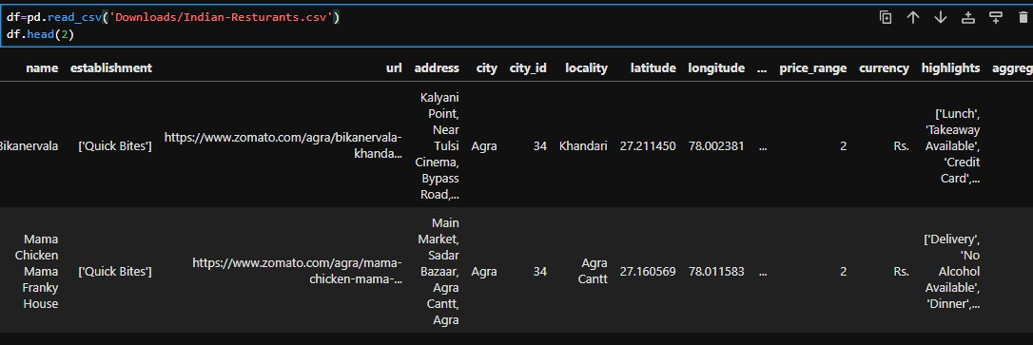
Imorting the dataset
Data loaded using pd.read_csv
Preview column using df.head
key columns
. name
. city
. price_range
. Average_cost_for_two
. Aggregate_rating

Slide 6
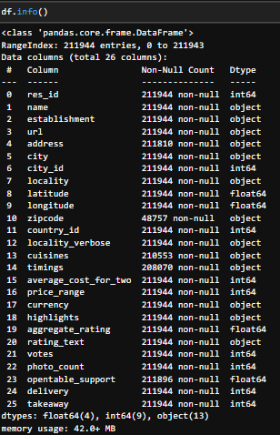
Info of the data set
Total entries: 211944
Columns: 26
Data types:
13 columns are type of object
9 columns are int type
and 4 columns is float type
(address,zipode,timings)
has missing values

Slide 7
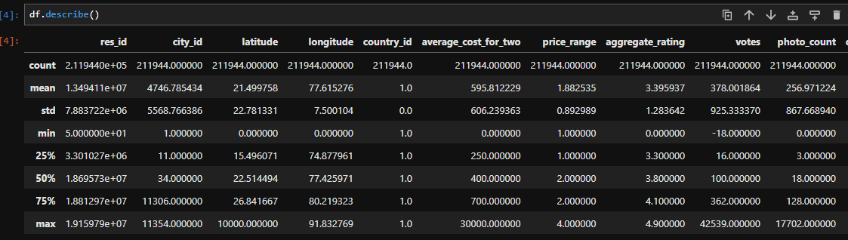
Statistical Analysis
Used df.describe for understanding descrictive statistic of the dataset
Key columns for further analysis
average_cost_for_two
price_range
Aggregate_rating

Slide 8
Statistical Analysis
Key Numerical Insights
Average Cost for Two: ₹595
Most restaurants fall between ₹250 – ₹700
Wide variation indicates both budget and premium options
Price Range:
Mostly between 1 and 2 (affordable to mid-range)
Maximum value of 4 shows presence of luxury dining
Ratings & Popularity
Average Rating: 3.39
Median rating is 3.8, indicating generally good customer satisfaction
Ratings mostly range between 3.3 – 4.1
Votes (Customer Engagement):
Average: 378 votes
Highly skewed with some restaurants getting 42,000+ votes
Photo Count:
Average: 256 photos per restaurant
Some restaurants have extremely high engagement (up to 17,702 photos)

Slide 9
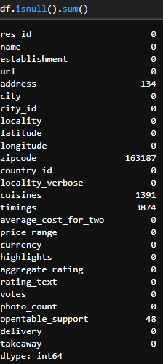
Identifying Null values
.isnull() method gives the null values
.sum().method gives the sum of values
Some columns contain missing data that require attention:
Zipcode: 163,187 missing values Majority of entries missing, may not be useful for analysis
Timings: 3,874 missing values Some restaurants lack operating hours
Cuisines: 1,391 missing values Minor gaps in cuisine
Address: 134 missing values Very small impact
OpenTable Support: 48 missing values
Negligible impact

Slide 10
Data Cleaning.

Slide 11
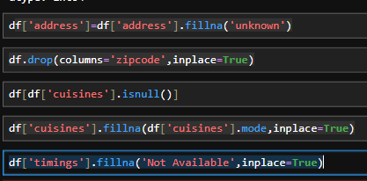
Handling Missing Values
Address Column
Missing values were replaced with "Unknown“ using .filna()
Ensures no empty entries in location details
Zipcode Column
Dropped completely due to excessive missing values by using .drop()
Helps reduce noise and improve dataset reliability

Slide 12
Handling Missing Values
Cuisines Column
Missing values filled using the most frequent (mode) cuisine using .fillna() and .mode()
Maintains consistency in cuisine categorization
Timings Column
Missing values replaced with "Not Available"
Preserves records without losing rows
OpenTable Support Column
Missing values filled using the mean value by using .mean()
Suitable for numerical type data to maintain distribution balance

Slide 13

Handling Duplicate Records
df[df.duplicated()] = This step checks for duplicate rows in the dataset Helps identify repeated entries that may distort analysis
Removing Duplicates
df.drop_duplicates(inplace=True)
Removes all duplicate records from the dataset
Keeps only the first occurrence of each entry

Slide 14

Handling Invalid Values
Value Replacement
Replaced -1 values with 0 in:
Delivery column
Takeaway column
Reason for This Step
In these columns:
1 = Available
0 = Not Available
-1 = Invalid / Incorrect entry
Replacing -1 with 0 ensures uniform binary representation

Slide 15
Basic Statistics:
Calculate and visualize the average rating of restaurants.
Average Restaurant Rating Analysis
Grouped data by restaurant name using .groupby()
Calculated the mean (average) rating for each using .mean()
restaurant
Selected top 20 records by using.head()
Renamed columns for better readability

Slide 16
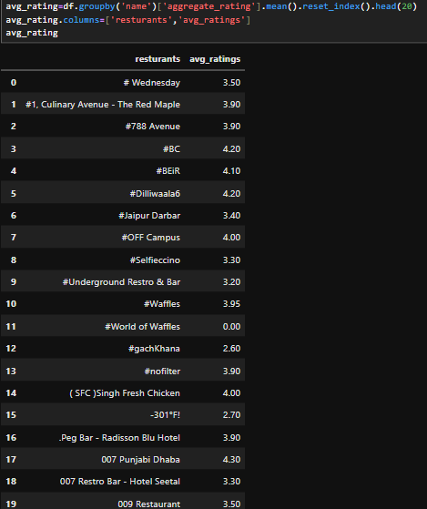
Basic Statistics:
Insights: Average Ratings of Restaurants
The dataset shows a wide variation in average ratings, ranging from 0.0 to 4.3.
Top-performing restaurants include:
007 Punjabi Dhaba (4.3)
#BC and #Dilliwaala6 (4.2)
#BEIR (4.1)
These indicate high customer satisfaction and strong service quality
Several restaurants have good ratings around
3.8 – 4.0, such as:
#1, Culinary Avenue - The Red Maple
#788 Avenue
Peg Bar - Radisson Blu Hotel

Slide 17
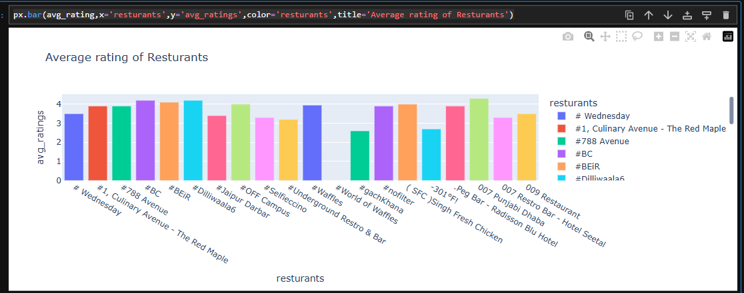
Basic Statistics:
plot the map using plotly
X-Axis→ ‘restaurant’
Y → ‘agg_rating’
Color → ‘restaurant’

Slide 18
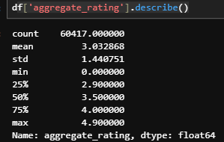
Basic Statistics:
Analyze the distribution of restaurant ratings to understand
the overall rating landscape.’
Restaurant Rating Distribution
Total Records: 60,417
Average Rating: 3.03
Median Rating: 3.5
Distribution Insights
Minimum Rating: 0.0 Indicates poor performance
Maximum Rating: 4.9 Shows presence of highly rated restaurants
25th Percentile (Q1): 2.9
75th Percentile (Q3): 4.0
Most ratings fall between 2.9 and 4.0

Slide 19
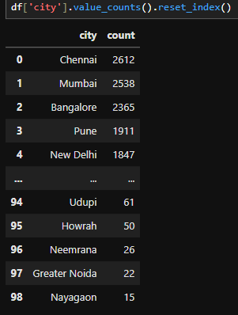
Location Analysis: :
Identify the city with the highest concentration of restaurants.
City-wise Distribution of Restaurants
.value_counts() counts how many time a value accour in data set
.reset_index() convert series into a data frame
Top Cities by Number of Restaurants
Chennai – 2,612 restaurants
Mumbai – 2,538 restaurants
Bangalore – 2,365 restaurants
Pune – 1,911 restaurants
New Delhi – 1,847 restaurants These cities have the highest concentration of restaurants, indicating strong food culture and demand.
Key Observations
There is a gradual decline in the number of restaurants as we move to smaller cities
Cities like:
Udupi (61)
Howrah (50)
Neemrana (26)
Greater Noida (22)
Nayagaon (15) have very low representation

Slide 20
Location Analysis: :
Visualize the distribution of restaurant ratings across different cities.
Grouped data by city by using .groupby()
Calculated the average (mean) rating for each city using .mean()
Sorted the results in descending order (highest ratings first) by sort_values()
Selected the top 20 cities by using .head()
Cities at the top have better overall dining experiences
Useful for understanding regional performance trends

Slide 21
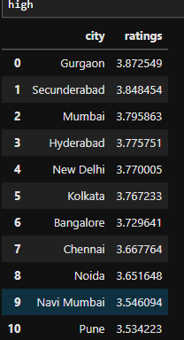
Location Analysis: :
Visualize the distribution of restaurant ratings across different cities.
City-wise Distribution of Restaurants Ratings
Top Performing Cities
Gurgaon – 3.87 (Highest)
Secunderabad – 3.85
Mumbai – 3.79
Hyderabad – 3.77
New Delhi – 3.77
Key Observations
All top cities have ratings between 3.5 and 3.9, indicating consistently good performance
Gurgaon and Secunderabad lead in customer satisfaction
Metro cities dominate, showing better service quality and competition
Differences in ratings are small, meaning competition is very close

Slide 22
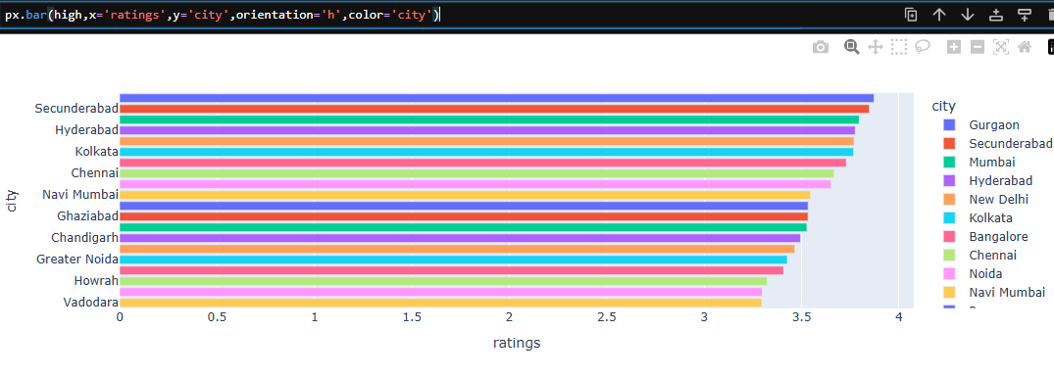
Location Analysis: :
Visualize the distribution of restaurant ratings across different cities.
Visualization:
plot the map using plotly
X-Axis→ ‘rating’
Y → ‘city’
Color → ‘city’

Slide 23
Cuisine Analysis:
Determine the most popular cuisines among the listed restaurants.
str.split(',')
Splits multiple cuisines in a single cell into a list
Example: "North Indian, Chinese" → ["North Indian", "Chinese"]
explode()
Converts each cuisine into a separate row
Helps in analyzing each cuisine individually
str.strip()
Removes extra spaces from cuisine names
Ensures clean and consistent values

Slide 24
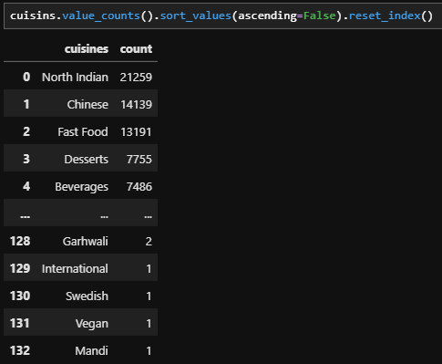
Cuisine Analysis:
Top Cuisines
North Indian – 21,259
Chinese – 14,139
Fast Food – 13,191
Desserts – 7,755
Beverages – 7,486
Key Observations
North Indian cuisine is the most popular by a large margin
Chinese and Fast Food are also highly preferred, indicating demand for quick and affordable meals
Desserts and Beverages highlight the importance of snacks and add-ons in dining

Slide 25
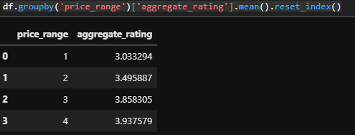
Price Range and Rating:
Analyze the relationship between price range and restaurant ratings.
Group price_range and aggregate_rating
Using .groupby()
Calculate average using .mean()
Converted into data frame using reset_index()
Key Results
Price Range 1 (Low Budget): 3.03
Price Range 2 (Affordable): 3.49
Price Range 3 (Mid-Range): 3.86
Price Range 4 (Premium): 3.93
Key Observations
Ratings increase as price range increases
Low-budget restaurants have the lowest average ratings
Premium restaurants receive the highest ratings

Slide 26
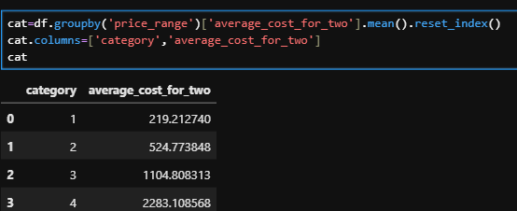
Price Range and Rating:
Visualize the average cost for two people in different price categories.
Key Results
Category 1 (Low Budget): ₹219
Category 2 (Affordable): ₹525
Category 3 (Mid-Range): ₹1,105
Category 4 (Premium): ₹2,283
Key Observations
There is a clear increase in cost as the price category rises
Each category shows a significant jump in pricing
The difference between Category 3 and 4 is very large, indicating premium dining is much more expensive

Slide 27
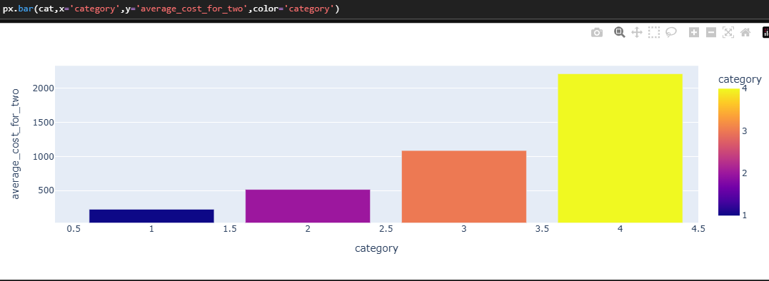
Price Range and Rating:
Visualization
Plot the map using plotly
X-Axis→ ‘category’
Y → ‘average_cost_for_two’
Color → ‘category’

Slide 28
Top Restaurant Chains:
Identify and visualize the top restaurant chains based on the number of outlets.
Grouped data by restaurant name
Counted the number of occurrences (outlets) for each restaurant
Sorted in descending order to get highest outlet counts
Selected top 10 restaurant chains
Renamed columns for better readability

Slide 29
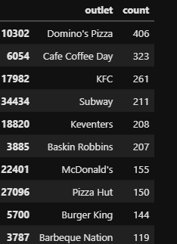
Top Restaurant Chains:
Identify and visualize the top restaurant chains based on the number of outlets.
Top Restaurant Chains by Number of Outlets
Top 10 Chains
Domino’s Pizza – 406 outlets
Cafe Coffee Day – 323 outlets
KFC – 261 outlets
Subway – 211 outlets
Keventers – 208 outlets
Baskin Robbins – 207 outlets
McDonald’s – 155 outlets
Pizza Hut – 150 outlets
Burger King – 144 outlets
Barbeque Nation – 119 outlets

Slide 30
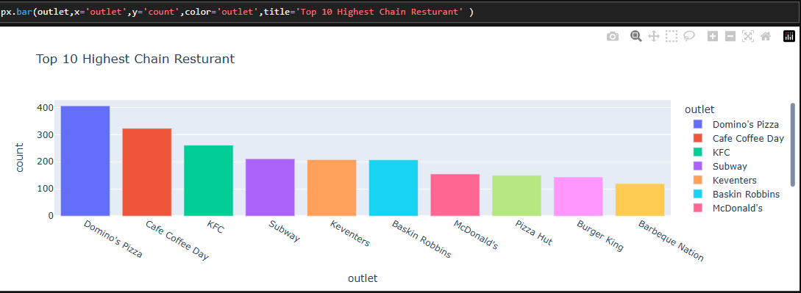
Top Restaurant Chains:
Key Observations
Domino’s Pizza leads by a large margin, showing strong market dominance
Most top chains belong to the fast food and quick service category
Beverage and dessert brands like Cafe Coffee Day, Keventers, Baskin Robbins also have strong presence
Global brands (KFC, McDonald’s, Subway, Burger King) are highly expanded

Slide 31
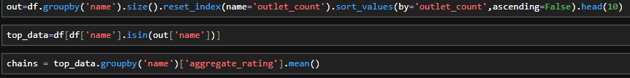
Top Restaurant Chains:
Explore the ratings of these top chains.
Identifies top 10 restaurant chains based on number of outlets
Filters the dataset to include only those top 10 chains by using .groupby() and .head()
Creates a new dataset focused on major brands using .reset_index
Calculates the average rating for each top chain
By using .mean()
Helps compare brand popularity vs customer satisfaction

Slide 32
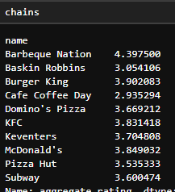
Top Restaurant Chains:
Explore the ratings of these top chains.
Key Observations
Barbeque Nation stands out with the highest rating, indicating excellent customer experience
Fast food giants like McDonald’s, KFC, Burger King maintain good and consistent ratings
Domino’s, Subway, Pizza Hut fall in the moderate rating range (3.5 – 3.7)
Cafe Coffee Day and Baskin Robbins have relatively lower ratings

Slide 33

Restaurant Features:
Analyze the distribution of restaurants based on features like Wi-Fi, Alcoholavailability, etc.
str.split(',')
Splits multiple features into a list
Example: "WiFi, Outdoor Seating" → ["WiFi", "Outdoor Seating"]
explode()
Converts each feature into a separate row
Allows detailed feature-level analysis
str.strip()
Removes extra spaces for clean data
value_counts()
Counts how often each feature appears
reset_index()
Converts the result into a structured table

Slide 34
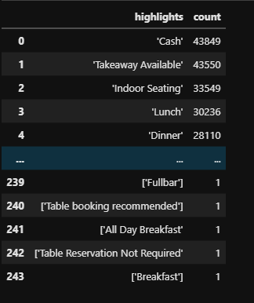
Restaurant Features:
Top Features
Cash Payment – 43,849
Takeaway Available – 43,550
Indoor Seating – 33,549
Lunch Availability – 30,236
Dinner Availability – 28,110
Key Observations
Cash payment is the most common method, indicating wide acceptance
Takeaway service is highly popular, reflecting demand for convenience
Indoor seating is a standard feature in most restaurants
Lunch and Dinner services dominate, showing focus on main meal times

Slide 35
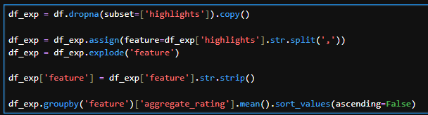
Restaurant Features:
Investigate if the presence of certain features correlates with higher ratings.
Removes rows where highlights are missing
Using dropna()
Ensures only valid feature data is used
Splits multiple features into a list by
str.split
Converts each feature into a separate row
Using reset_index()
Cleans feature names by removing extra spaces
Groups data by feature
Calculates average rating for each feature
Sorts results to find highest-rated features by using .sort_values()

Slide 36
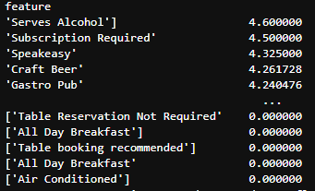
Restaurant Features:
Top High-Rated Features
Serves Alcohol – 4.60
Subscription Required – 4.50
Speakeasy – 4.32
Craft Beer – 4.26
Gastro Pub – 4.24
Key Observations
Restaurants offering alcohol and premium experiences tend to receive higher ratings
Features like craft beer and gastro pubs indicate specialized dining experiences
These services attract customers looking for quality ambience and unique experiences

Slide 37
Conclusion:
Key Findings & Insights
​
Customer Ratings
Average rating is around 3.0–3.5, indicating moderate satisfaction
Majority of restaurants fall between 3.0 to 4.0 ratings
Very few restaurants achieve premium ratings (above 4.5)
Pricing vs Ratings
Higher price ranges tend to have better ratings
Premium restaurants (price range 3–4) deliver better overall experience
Budget restaurants dominate in number but have slightly lower ratings

Slide 38
Conclusion:
​
City-wise Performance
Cities like Gurgaon, Secunderabad, and Mumbai show higher average ratings
Metro cities dominate in both restaurant count and quality
Smaller cities have limited but growing presence
Popular Cuisines
North Indian, Chinese, and Fast Food are the most popular
High demand for affordable and familiar food options
Niche cuisines exist but have low frequency

Slide 39
Conclusion:
​
Restaurant Chains
Top chains :
Domino’s Pizza
Cafe Coffee Day
KFC
Subway
Large chains dominate due to brand trust and wide presence
However, higher outlets ≠ higher ratings
Features Impact
High-rated features:
Serves Alcohol
Craft Beer / Gastro Pub
Speakeasy
Basic features (AC, takeaway, etc.) have low impact on ratings
Customers value experience over basic facilities

Slide 40
Conclusion:
​
Service Trends
Takeaway and indoor seating are widely available
Restaurants focus on convenience and accessibility
Premium services are less common but more impactful
Key Success Factors
Quality of experience (ambience, uniqueness)
Premium offerings (alcohol, specialty dining)
Strategic pricing
Strong brand presence
Location (metro cities perform better)

Slide 41
Recommendations:
​
For Restaurant Owners
Focus on enhancing customer experience, not just basic services
Introduce premium features (ambience, specialty menus, beverages)
Maintain consistent quality to improve ratings
Use pricing strategically—higher pricing should match better service
Expand in high-performing cities for better visibility

Slide 42
Recommendations:
​
For Zomato Users
Explore high-rated restaurants (above 4.0) for better experience
Try restaurants with unique features (e.g., craft beer, themed dining)
Don’t rely only on big brands—hidden gems may offer better quality
Consider price vs rating balance for best value
Check features and reviews, not just ratings

