Slide 1

S3 STATIC WEBSITE HOSTING : DEVELOPMENT-FIRST APPROACH 🎉🌐
S3 BUCKET WITHOUT POLYCY PROJECT DOCUMENTATION
BY MOHIT GADILOHAR

Slide 2

INTRODUCTION
This project demonstrates how to host a static website using AWS S3. It help beginner understand cloud hosting, deployment, and website management in a simple and cost-effective way
✅REQUIREMENTS
aws Account with S3 access
Basic HTML & CSS knowledge
Website files (HTML, CSS, Images)
Required AWS permission
Internet connection
web browser
S3 BUCKET WITHOUT POLYCY PROJECT DOCUMENTATION
BY MOHIT GADILOHAR

Slide 3
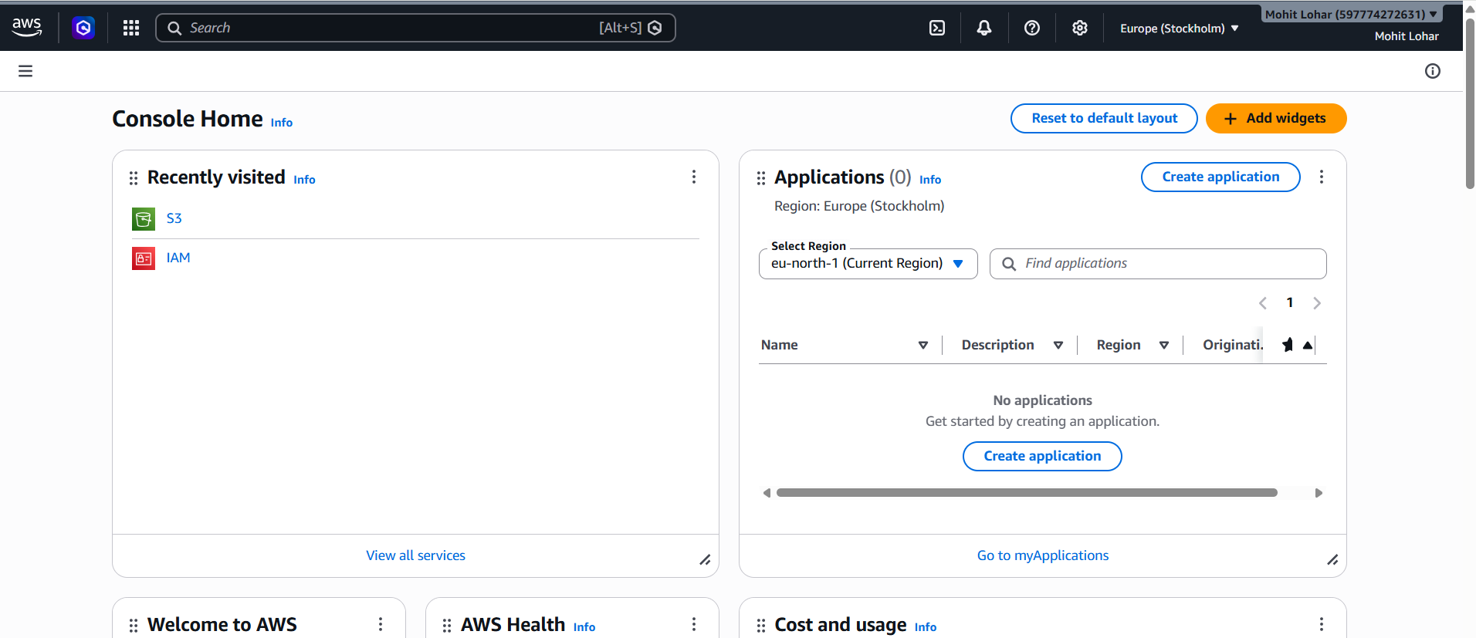
📌DETAILED IMPLEMENTATION GUIDE
1. AWS Management console Access 🗝️
Navigate to the AWS Management Console :
S3 BUCKET WITHOUT POLYCY PROJECT DOCUMENTATION
BY MOHIT GADILOHAR

Slide 4
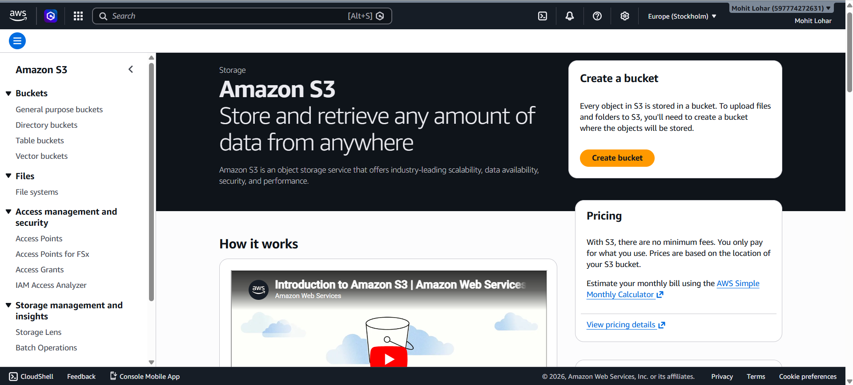
2. LOCATION S3 SERVICE📍
Access S3 Through :
- AWS Console Search : Type “S3” or “Simple Storage Service”
S3 BUCKET WITHOUT POLYCY PROJECT DOCUMENTATION
BY MOHIT GADILOHAR

Slide 5
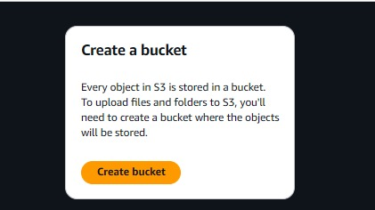
3. BUCKET CREATION AND CONFIGURATION
Essential Settings :
Bucket Naming Conventions
- Must be globally unique across all AWS
Should be DNS-compatible
3-63 characters long
Can contain lowercase letters, numbers, dots, and hyphens
Configuration steps :
. Click create bucket
S3 BUCKET WITHOUT POLYCY PROJECT DOCUMENTATION
BY MOHIT GADILOHAR

Slide 6
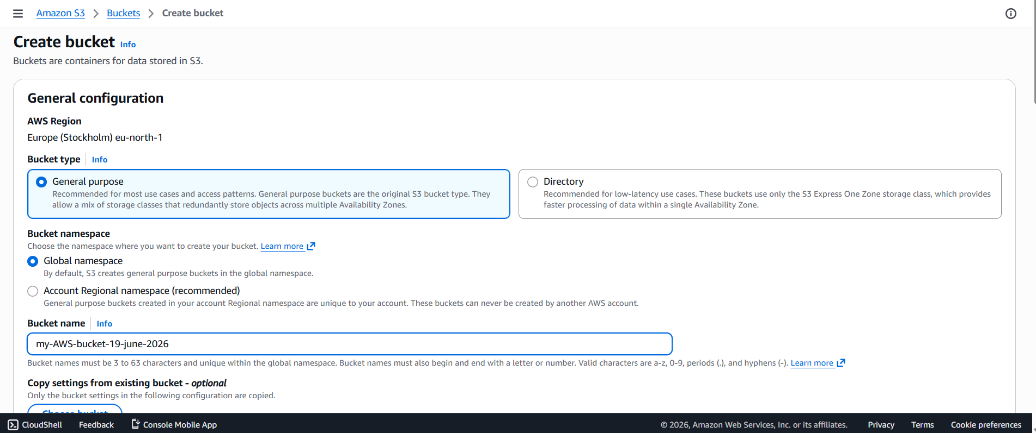
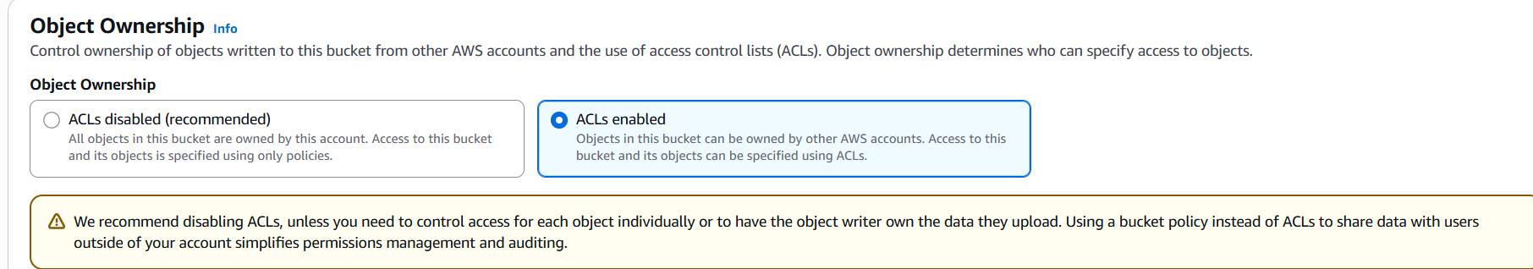
. Enter bucket name following conventions
. Configuration object ownership
- Select ALCs enable
S3 BUCKET WITHOUT POLYCY PROJECT DOCUMENTATION
BY MOHIT GADILOHAR

Slide 7
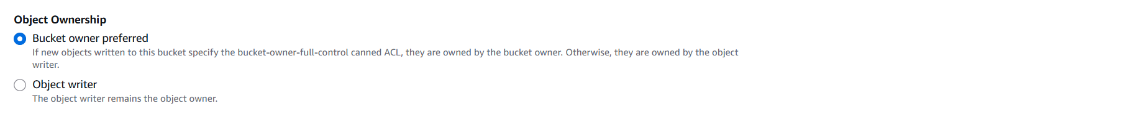
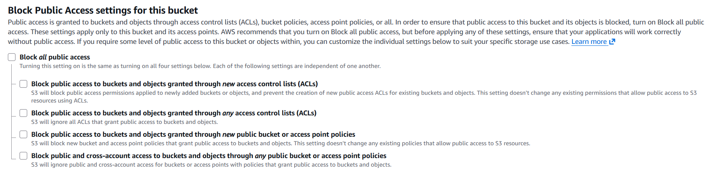
- Choose Bucket owner preferred
- Uncheck All Bolock Public Access Options
S3 BUCKET WITHOUT POLYCY PROJECT DOCUMENTATION
BY MOHIT GADILOHAR

Slide 8
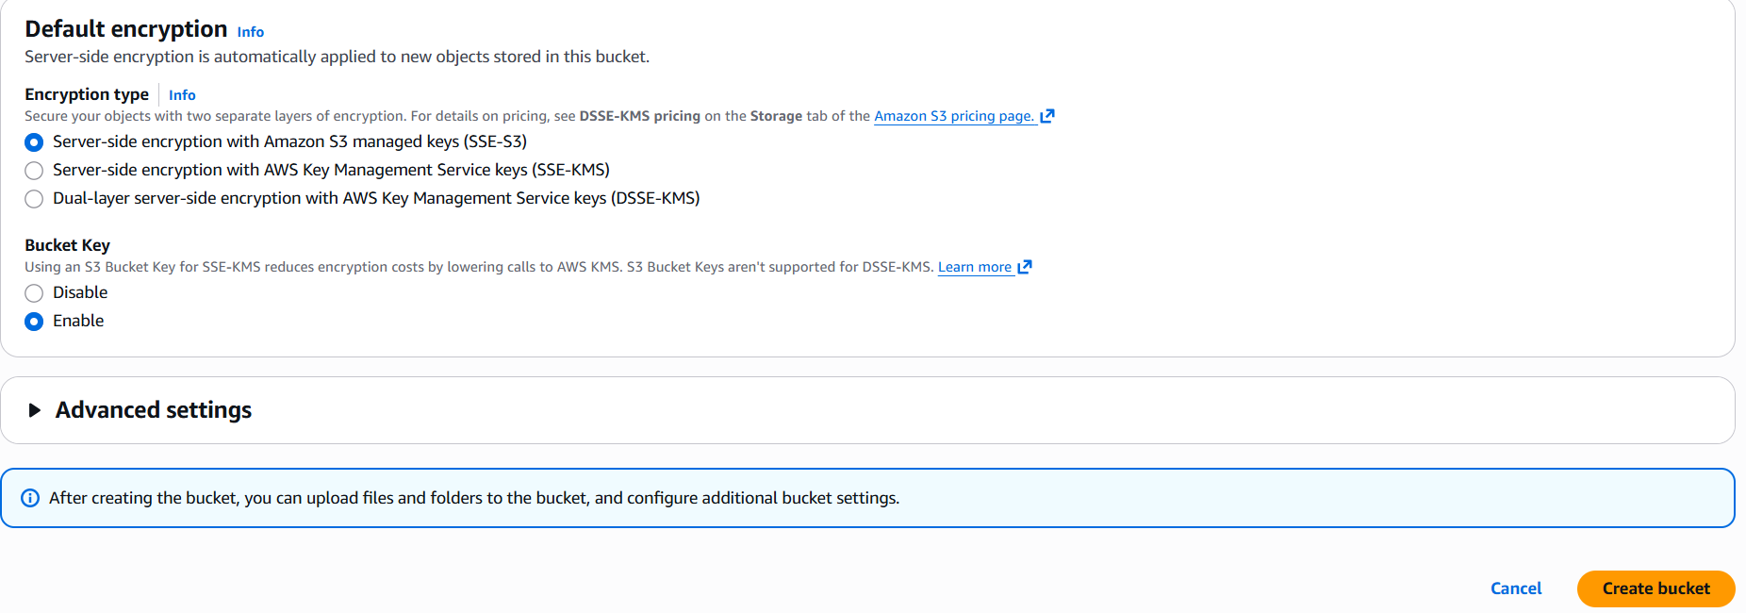
- Acknowledge The Public Access Warning
- Click the “create bucket” Button
S3 BUCKET WITHOUT POLYCY PROJECT DOCUMENTATION
BY MOHIT GADILOHAR

Slide 9
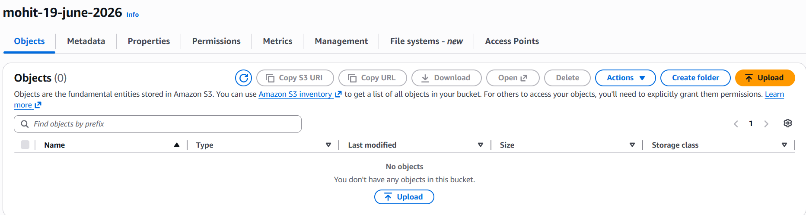
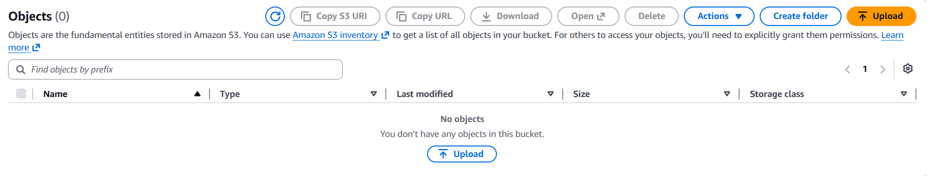
Upload Steps :
. Navigate to bucket contents
. Click Upload
S3 BUCKET WITHOUT POLYCY PROJECT DOCUMENTATION
BY MOHIT GADILOHAR

Slide 10
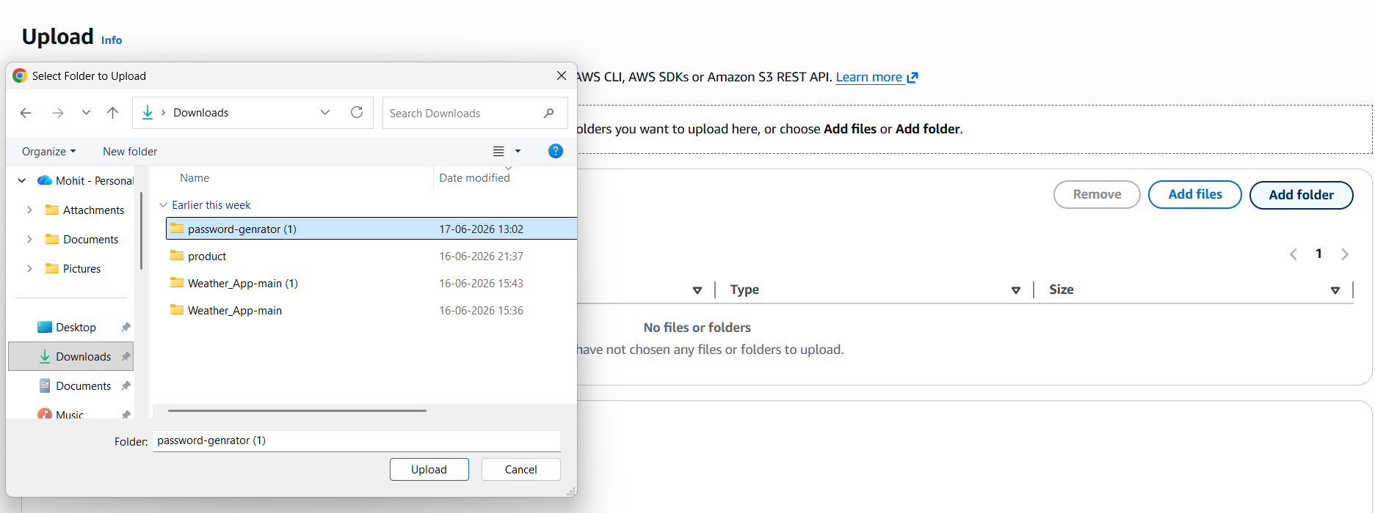
. Configuration upload settings
- Drage files or use file browser
S3 BUCKET WITHOUT POLYCY PROJECT DOCUMENTATION
BY MOHIT GADILOHAR

Slide 11
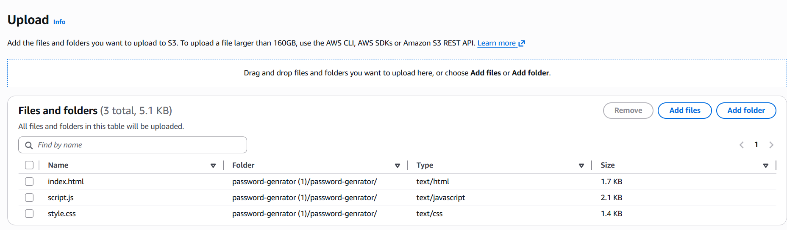
S3 BUCKET WITHOUT POLYCY PROJECT DOCUMENTATION
BY MOHIT GADILOHAR

Slide 12
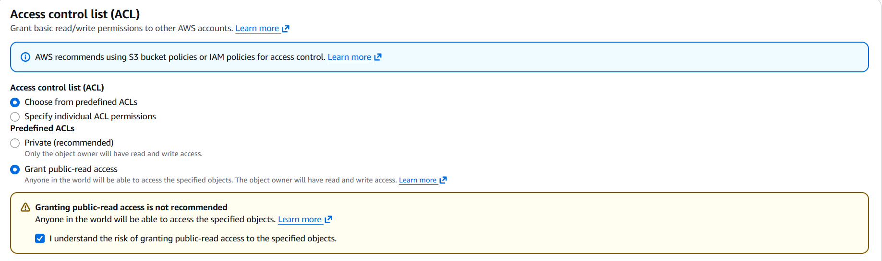
- Enable public-read access
- Aknowledge public Access Settings
. Uploading process
S3 BUCKET WITHOUT POLYCY PROJECT DOCUMENTATION
BY MOHIT GADILOHAR

Slide 13
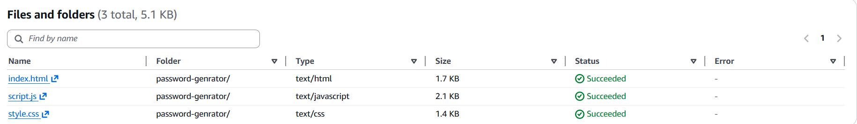
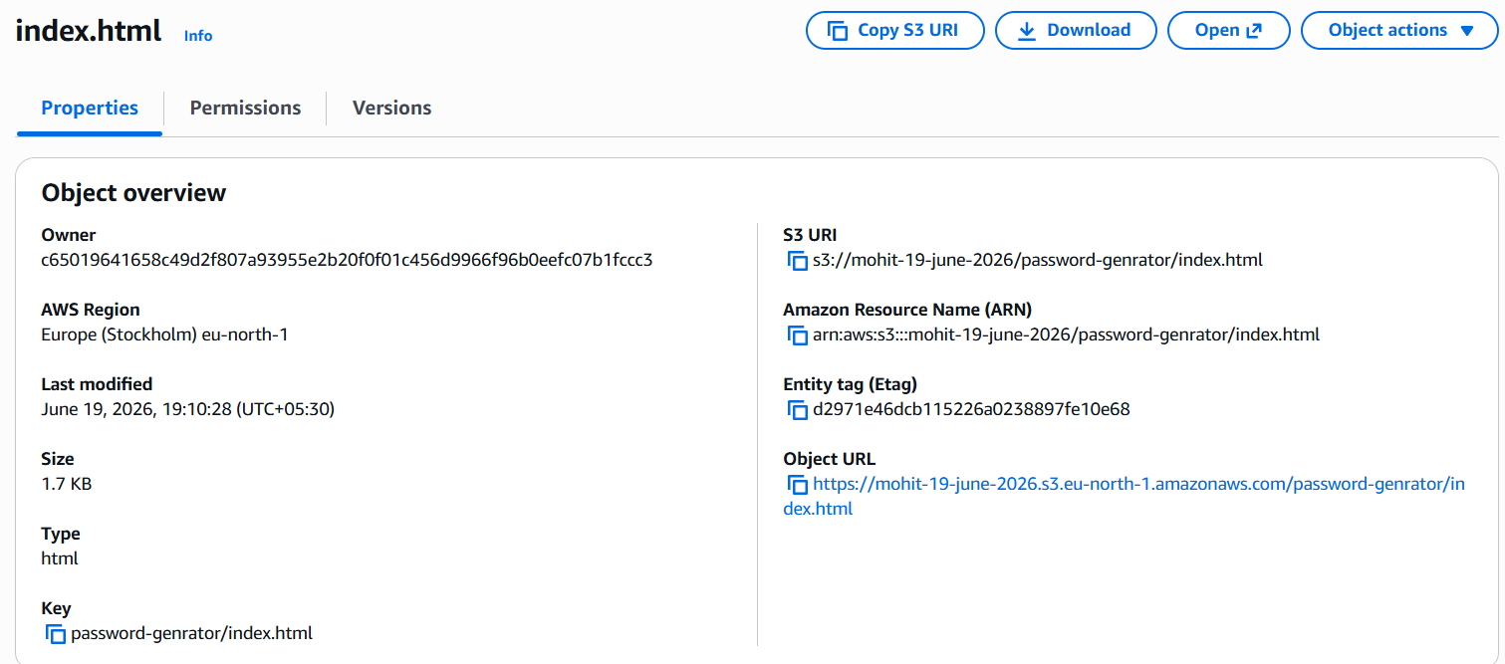
. Click on index.html
S3 BUCKET WITHOUT POLYCY PROJECT DOCUMENTATION
BY MOHIT GADILOHAR

Slide 14
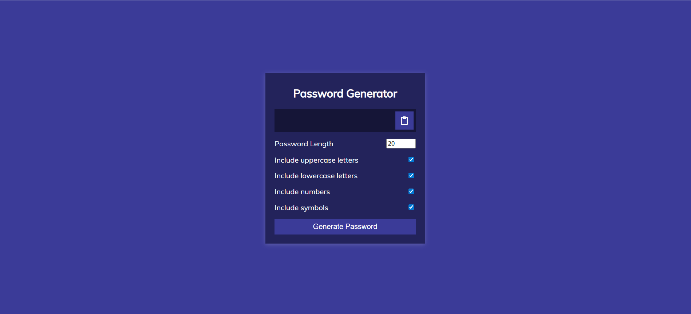
✅S3 Website Hosting Successfully
S3 BUCKET WITHOUT POLYCY PROJECT DOCUMENTATION
BY MOHIT GADILOHAR

