Slide 1
DATA ANALYTICS • BENGALURU • 2026
Bengaluru PG Market
Intelligence & Analysis
Decoding rent, ratings, amenities & occupancy trends across 30,000+ paying-guest accommodations
NAME
REGISTRATION NUMBER
BATCH
[Your Name]
[Registration Number]
[Batch Name]
Prepared for Data Analytics & Visualization | Capstone Project

Slide 2



ABSTRACT
Project Summary
Bengaluru PG Market Intelligence & Analysis
is a data-analytics capstone built on a synthetic dataset of 30,600 PG records spanning Bengaluru city.
The project analyzes rent, amenities, occupancy, ratings and location trends — combining rigorous data cleaning, preprocessing and exploratory data analysis (EDA) in Python to surface actionable market intelligence for tenants, PG owners and investors.
Dataset Size
30,600 rows × 44 columns
Analysis Scope
15 research questions
Toolkit
Python, Pandas, Seaborn
30,156
PG Records
116
Localities
40
Data Fields
02

Slide 3




PROBLEM STATEMENT
What Are We Solving?
Bengaluru's booming PG market lacks transparent, data-driven insight — tenants overpay, owners under-price, and investors guess. This project answers 15 targeted research questions grouped into four themes:
Pricing
Experience
Location
Amenities
Which localities & room types command the highest / fairest rent?
Do ratings, safety & value scores track with price paid?
How do metro & IT-park proximity shape rent and demand?
Which facilities are standard, and which set PGs apart?
15 research questions → data-backed answers across pricing, ratings, location & amenities
03

Slide 4



OBJECTIVES
What This Project Aims to Achieve
Clean & standardize
Explore rent drivers
Assess service quality
Transform 30,600 raw, inconsistent records into a validated, analysis-ready dataset.
Identify how locality, room type & distance shape monthly PG rent.
Examine how ratings, amenities & scores relate to tenant experience.
Map location impact
Segment the market
Enable decisions
Quantify how metro & IT-park proximity influence pricing and demand.
Profile occupancy patterns across rent bands and room categories.
Deliver clear, actionable recommendations for tenants, owners & investors.
04

Slide 5
DATASET OVERVIEW
Inside the Data
30,600
44
116
30,156
SAMPLE RECORD
Raw Records
Raw Columns
Area
HSR Layout
Unique Localities
Post-Cleaning Rows
Room Type
Double Sharing
Key Field Categories
Monthly Rent
Rs 24,500
Identity & Location PG_Name, Area, Zone, Latitude/Longitude, Pincode
Google Rating
4.2 ★ (86 reviews)
Pricing Monthly_Rent, Security_Deposit, Electricity/Water Charges, Maintenance_Fee
Nearest Metro
1.8 km
Occupancy
Almost Full
Experience Google_Rating, Review_Count, Safety/Commute/Value Scores
WiFi / AC / Gym
Yes / Yes / No
Proximity Nearest_Metro, Distance_to_Metro_km, Nearest_IT_Park
Amenities (14 flags) WiFi, AC, Gym, Lift, CCTV, Laundry, Housekeeping & more
Illustrative row — structure mirrors the cleaned dataset used for analysis.
05

Slide 6




DATA CLEANING
From Raw to Reliable
01
02
03
04
Drop Irrelevant Columns
Handle Missing Values
Standardize Formats
Validate & Deduplicate
Removed Zone, Sharing_Capacity, Amenities & Check_In_Date — not needed for analysis.
Filled charges with 0, categorical fields with mode; ratings rounded to 1 decimal.
Fixed currency text (₹999999, commas), unified Yes/No amenity flags, parsed dates.
Removed duplicate rows, corrected out-of-range ratings, reset a clean row index.
Outliers were detected via IQR but retained — they reflect genuine premium-market variation, not data errors.
06

Slide 7



METHODOLOGY
Analytical Workflow
Data
Collection
Cleaning &
Preprocessing
Exploratory
Analysis
Visualization
Insights &
Reporting
Import raw CSV (30,600 × 44)
Handle nulls, types, duplicates
Univariate & bivariate study
Charts across 15 questions
Findings → recommendations
Pipeline built in Jupyter Notebook using Python, Pandas, NumPy, Matplotlib & Seaborn — each stage documented with inline observations.
07

Slide 8




TOOLS & TECHNOLOGIES
Our Analytics Stack
Python
Jupyter Notebook
Pandas
Core analysis language
Interactive dev environment
Data wrangling & cleaning
NumPy
Matplotlib
Seaborn
Numerical computation
Static visualizations
Statistical graphics
08

Slide 9
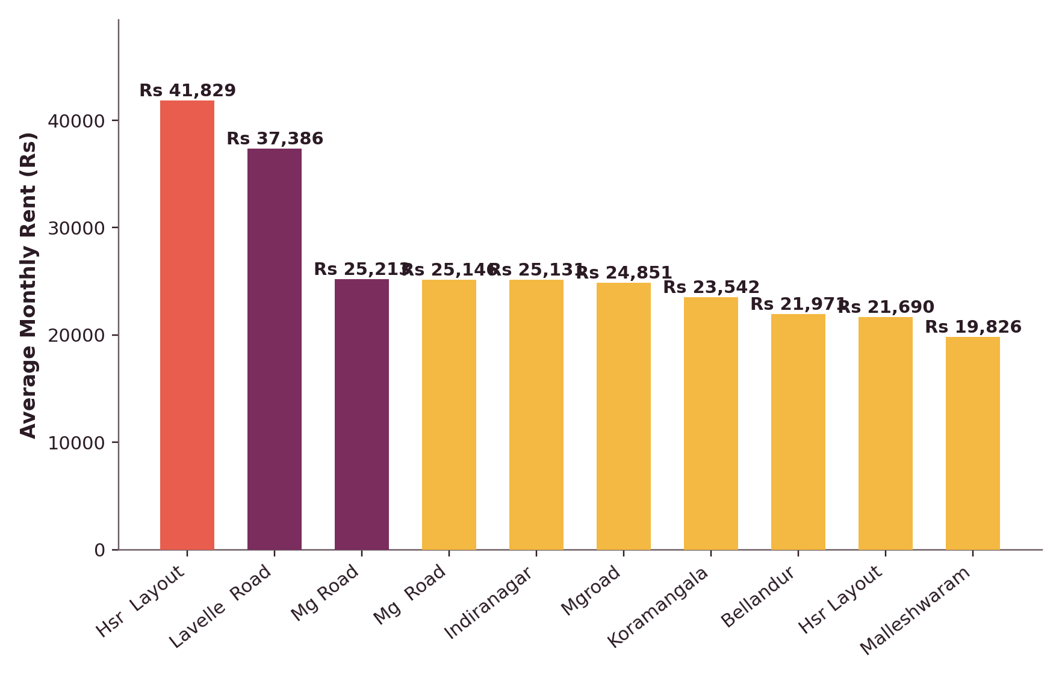
EXPLORATORY DATA ANALYSIS
Q1 — Where Does Rent Peak?
KEY OBSERVATIONS
₹41,829
HSR Layout — highest average monthly rent
₹37,386 — Lavelle Road ranks second.
Premium business & IT-centric localities command higher rent thanks to connectivity, employment access and amenities.
A wide gap separates top localities from the citywide average (₹14,969) — rent is highly location-driven.
09

Slide 10
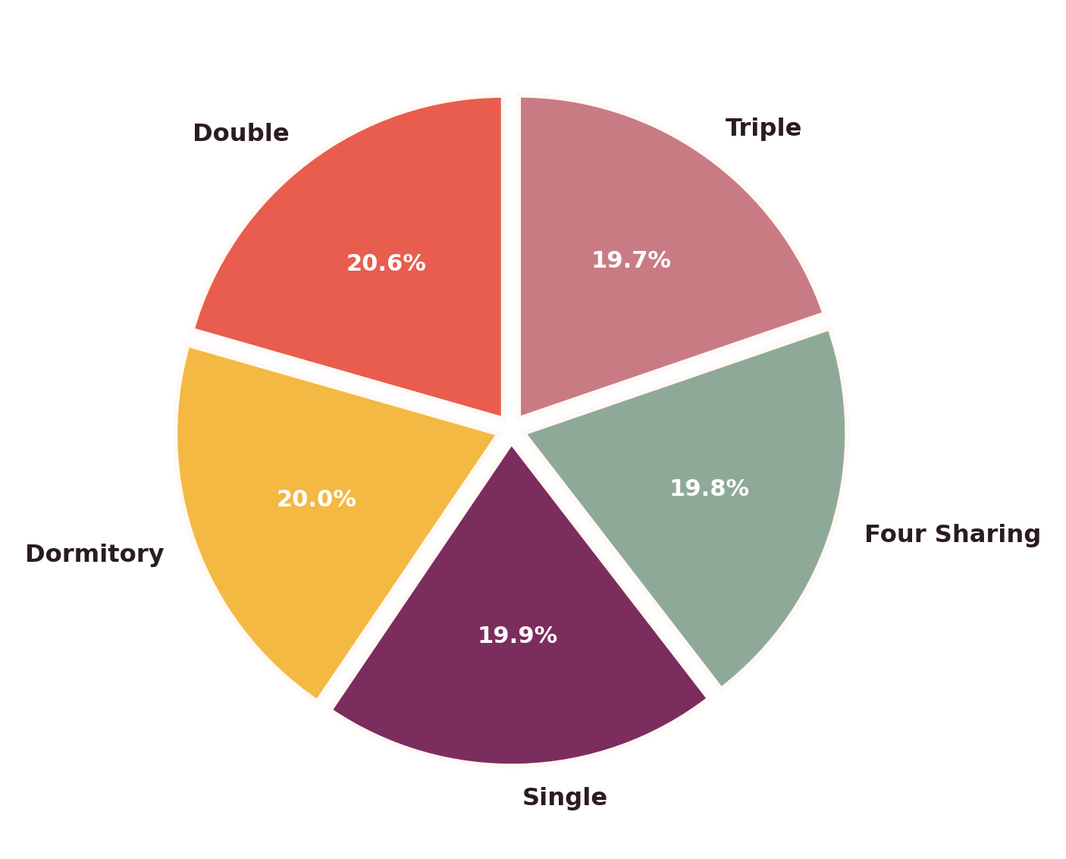
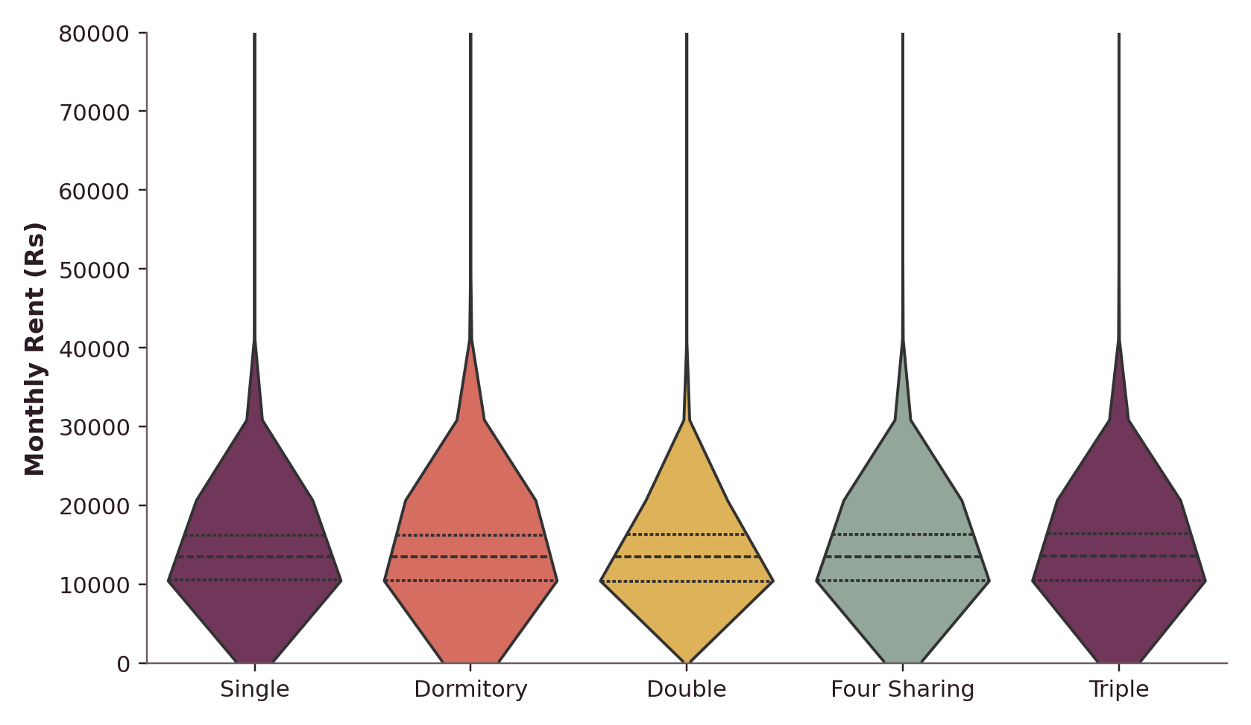
EXPLORATORY DATA ANALYSIS
Q2 & Q10 — Room Types & Rent Spread
Double rooms lead with 20.6% share (6,200 PGs); room-type shares are otherwise near-even. Rent distributions overlap heavily across types — a private single doesn't always cost more than a shared dorm.
10

Slide 11
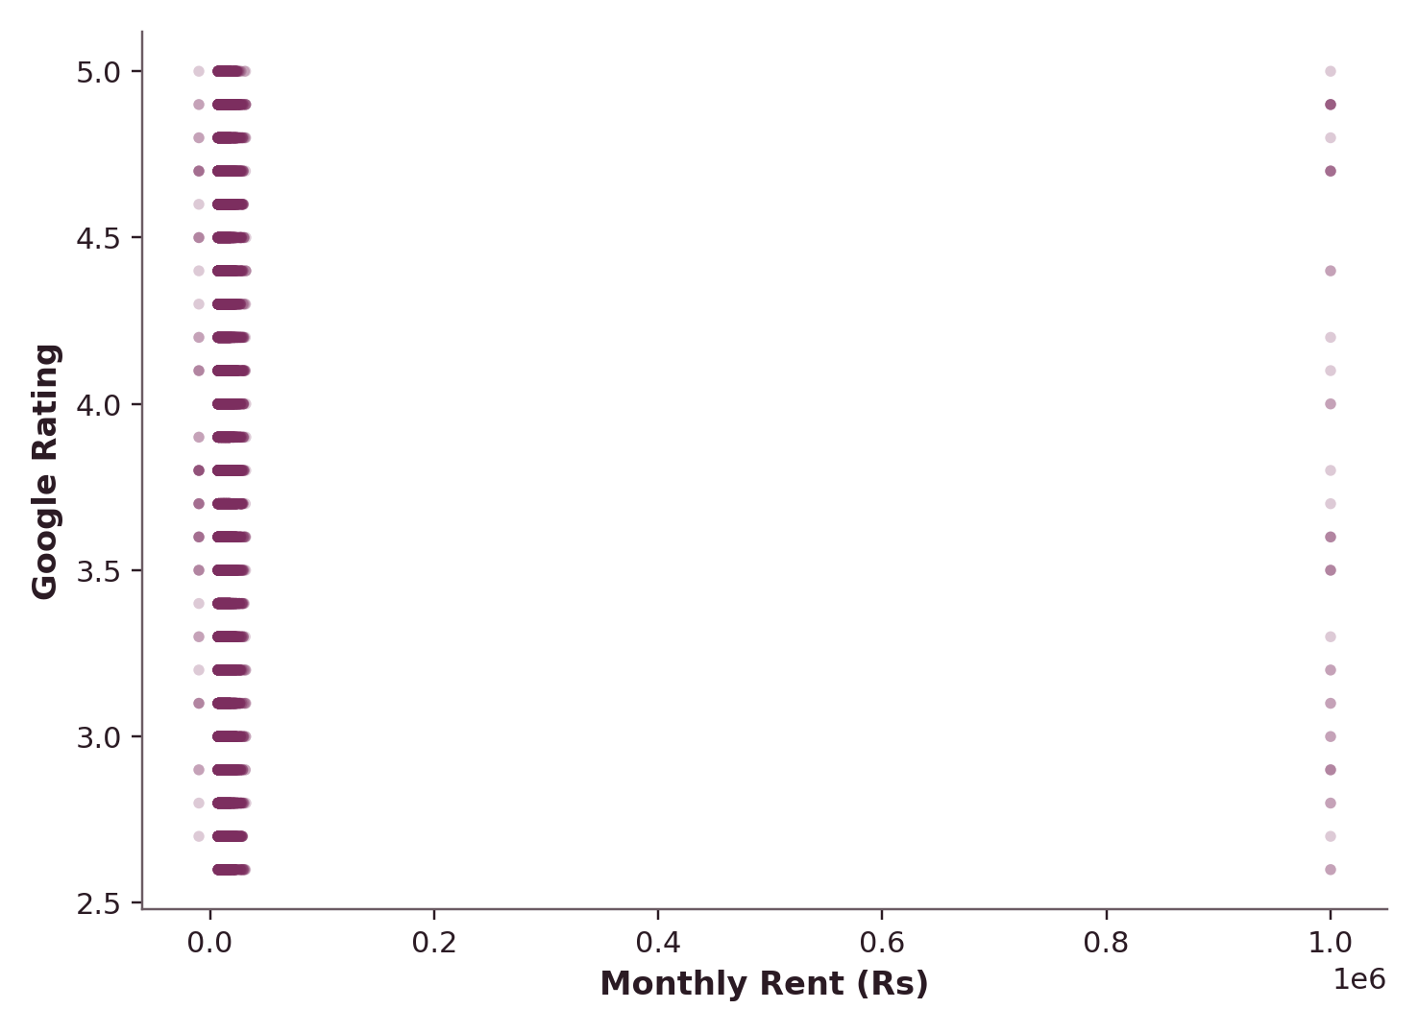
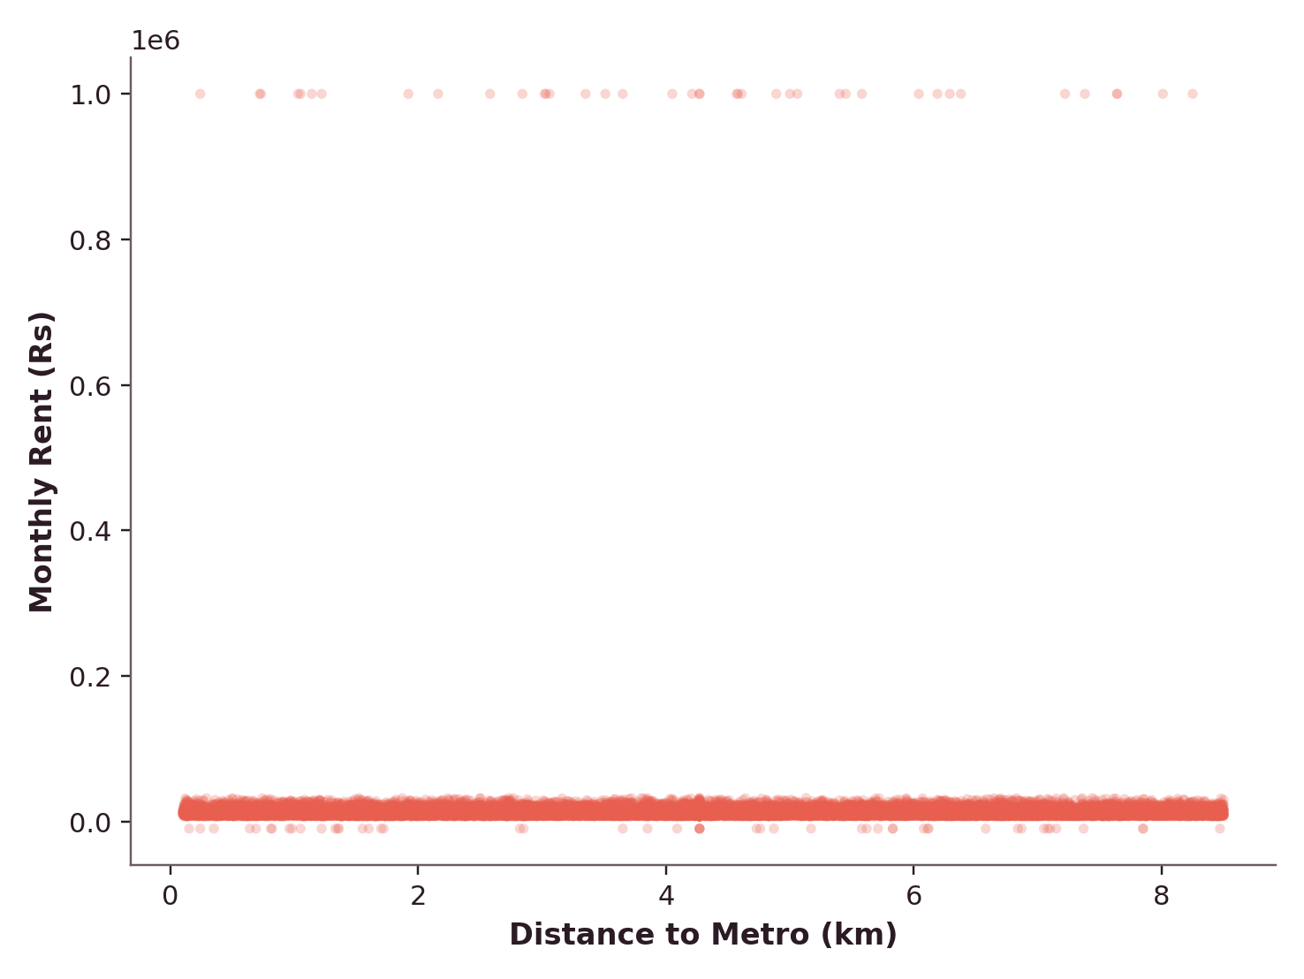
EXPLORATORY DATA ANALYSIS
Q3 & Q4 — Does Price Buy Better?
Rent vs. Google Rating
Distance to Metro vs. Rent
Correlation ≈ 0 in both cases — higher rent does not guarantee a better rating, and metro proximity alone doesn't drive price.
11

Slide 12
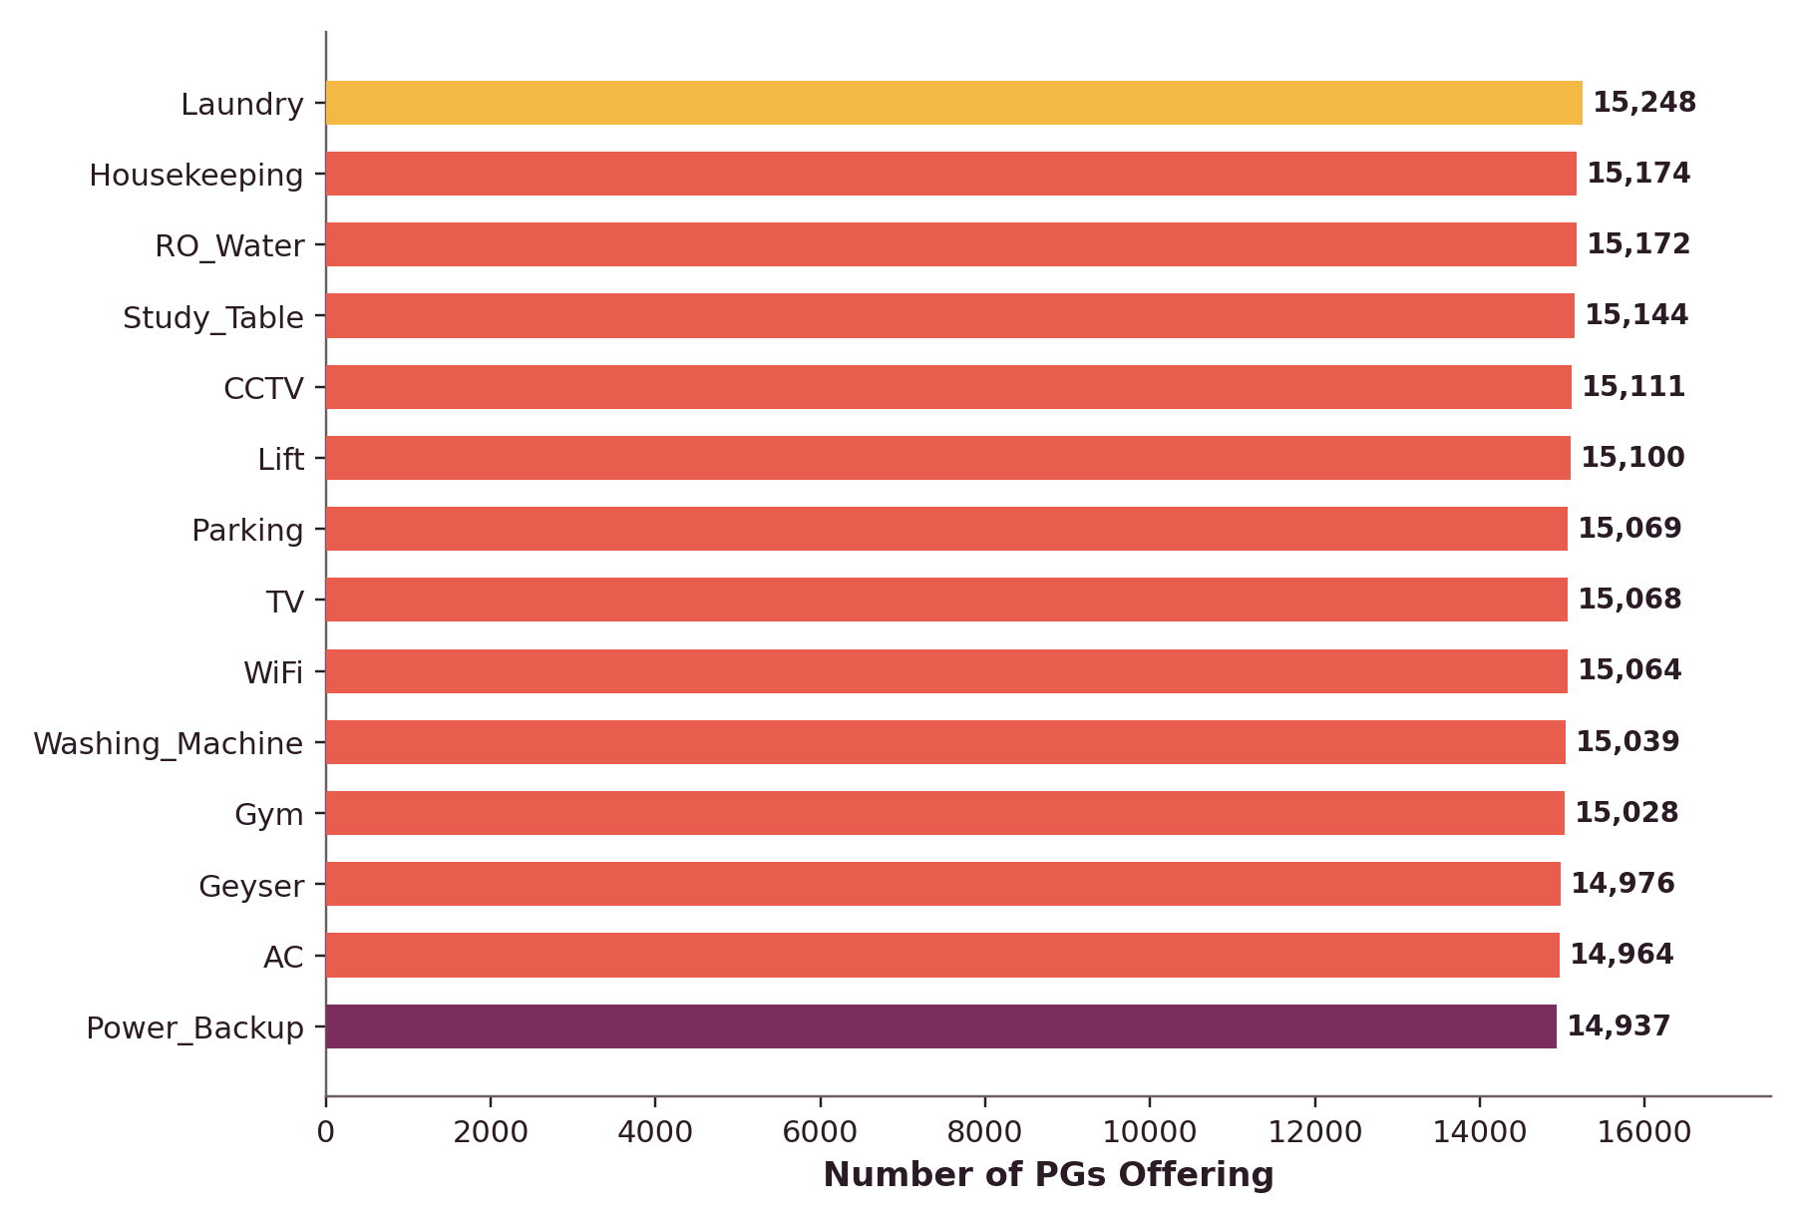
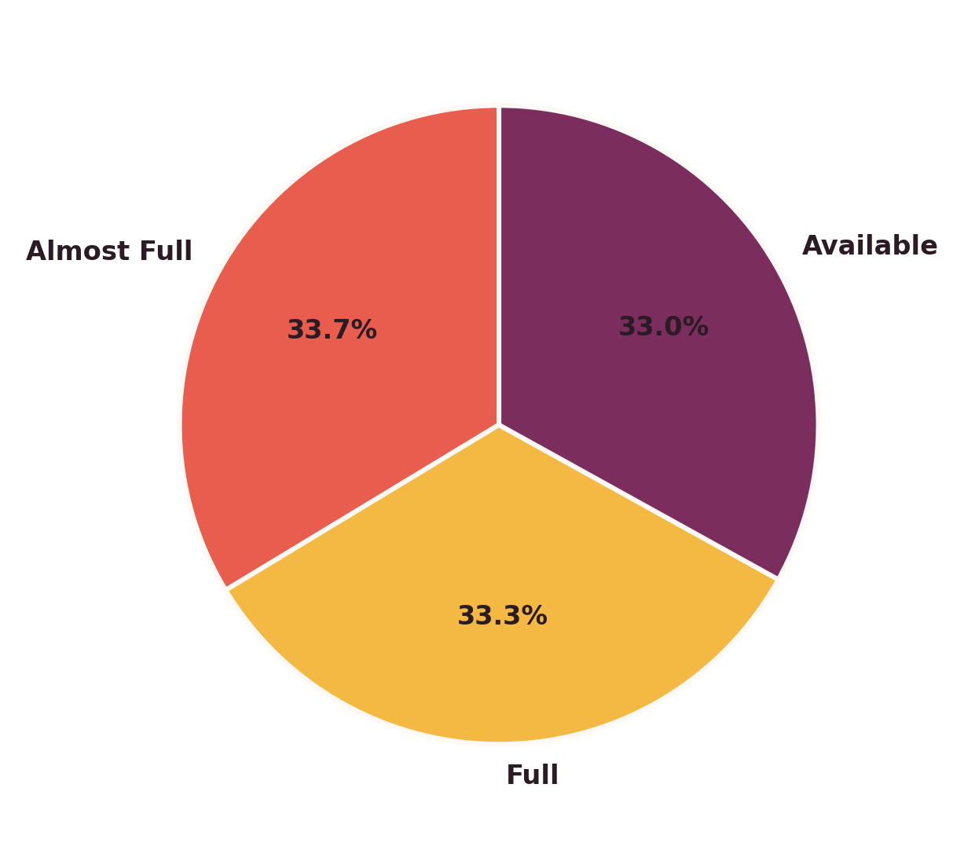
EXPLORATORY DATA ANALYSIS
Q6 & Q11 — Amenities & Occupancy
Laundry tops amenities (15,248 PGs); occupancy splits almost evenly across Full, Almost Full & Available.
12

Slide 13
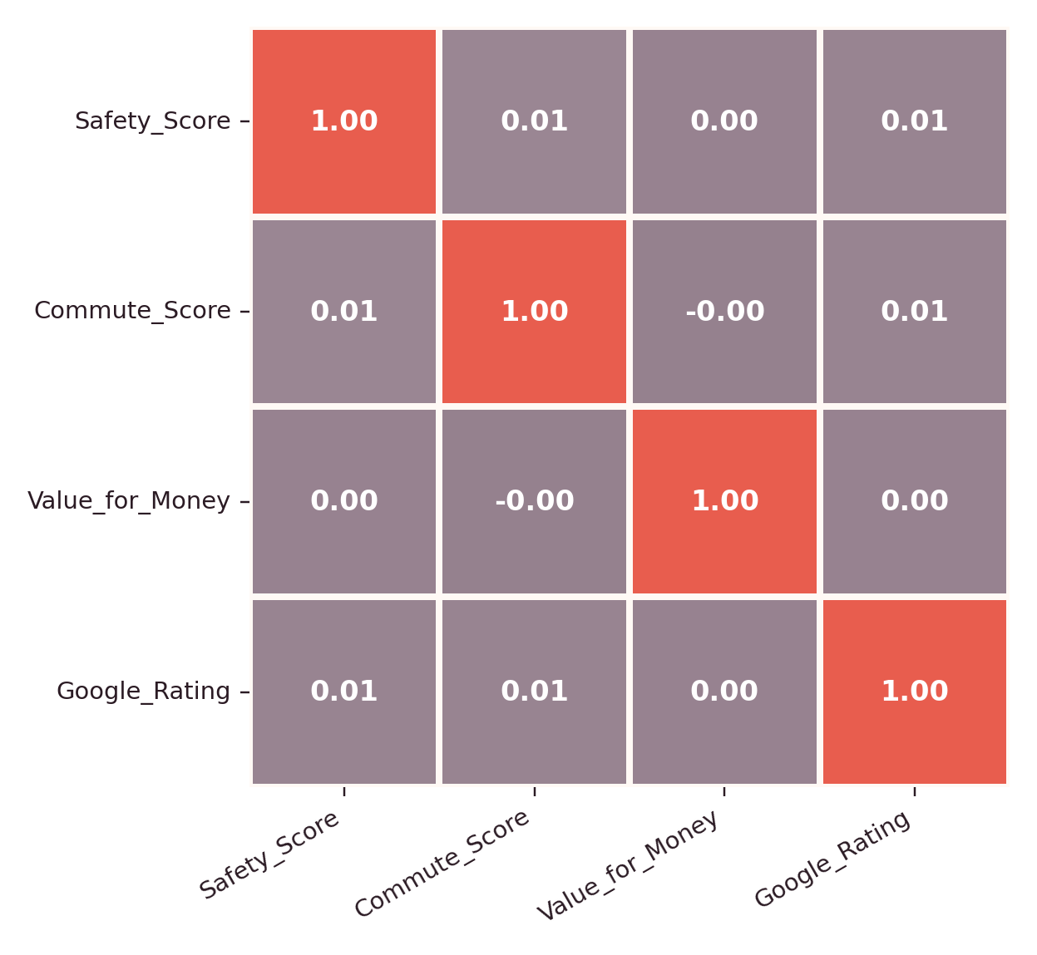
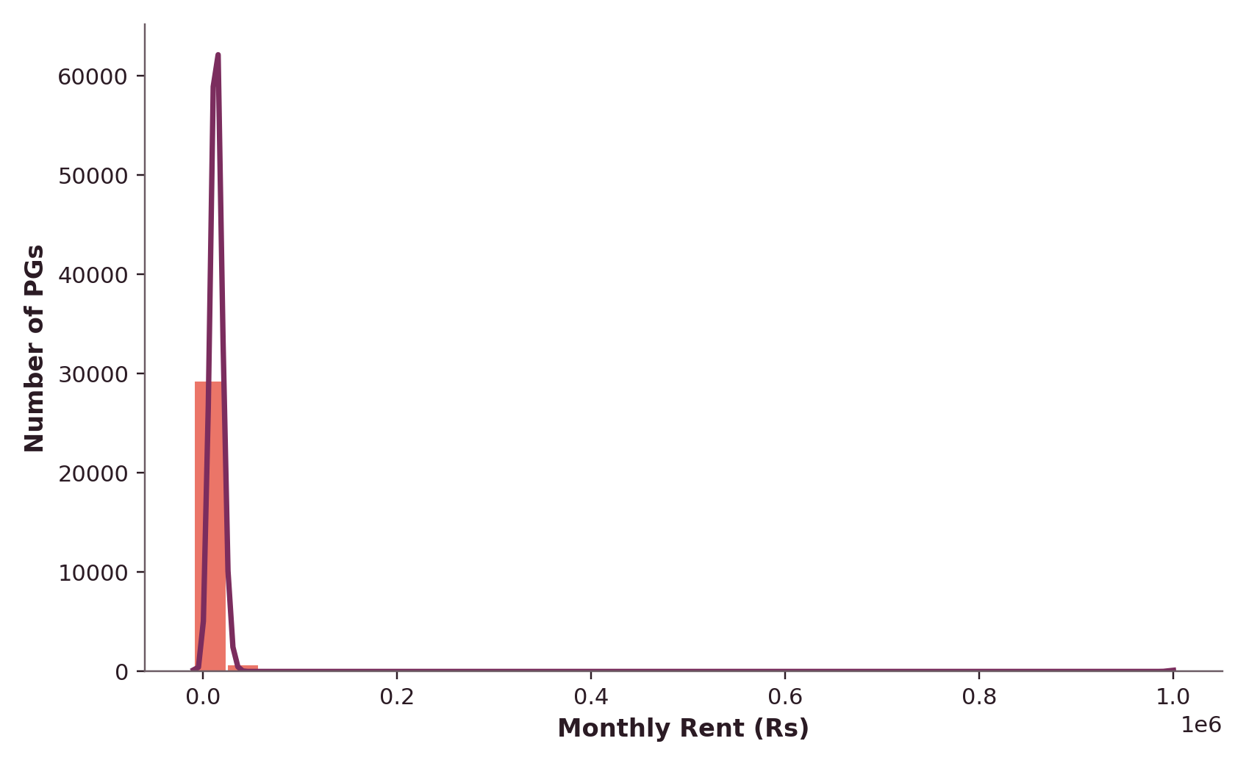
VISUALIZATIONS
Score Correlation & Rent Distribution
Q12 — Rent is Right-Skewed
Q13 — Safety, Commute, Value & Rating
A long right tail of premium listings pulls the average above the median.
13

Slide 14
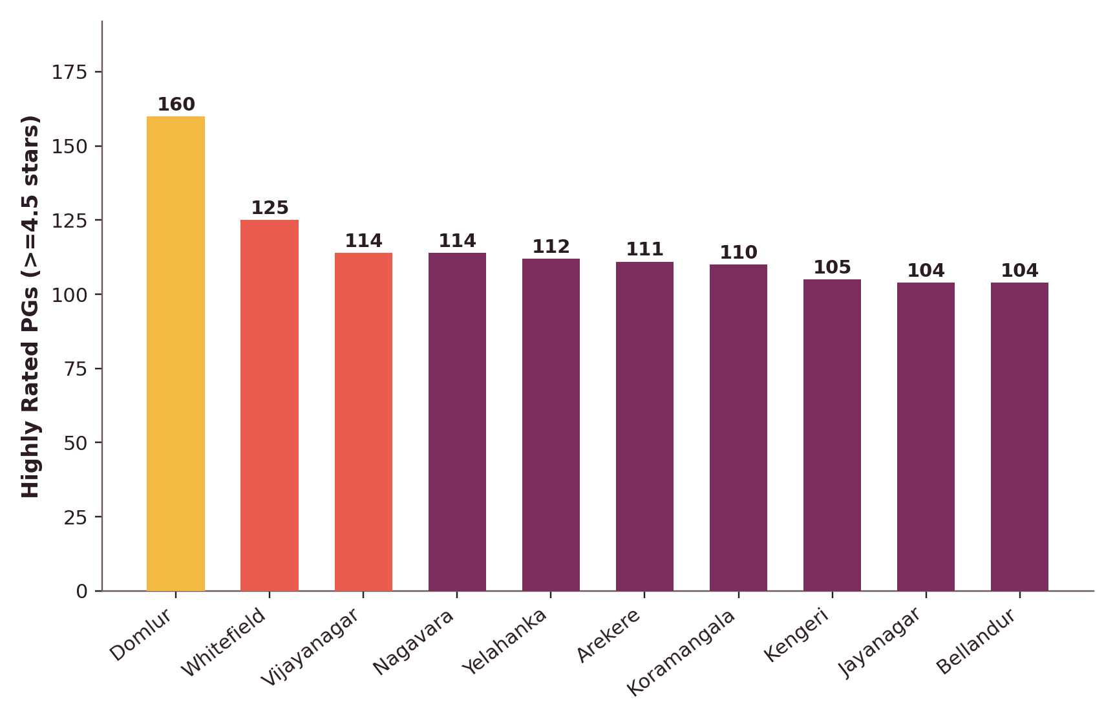
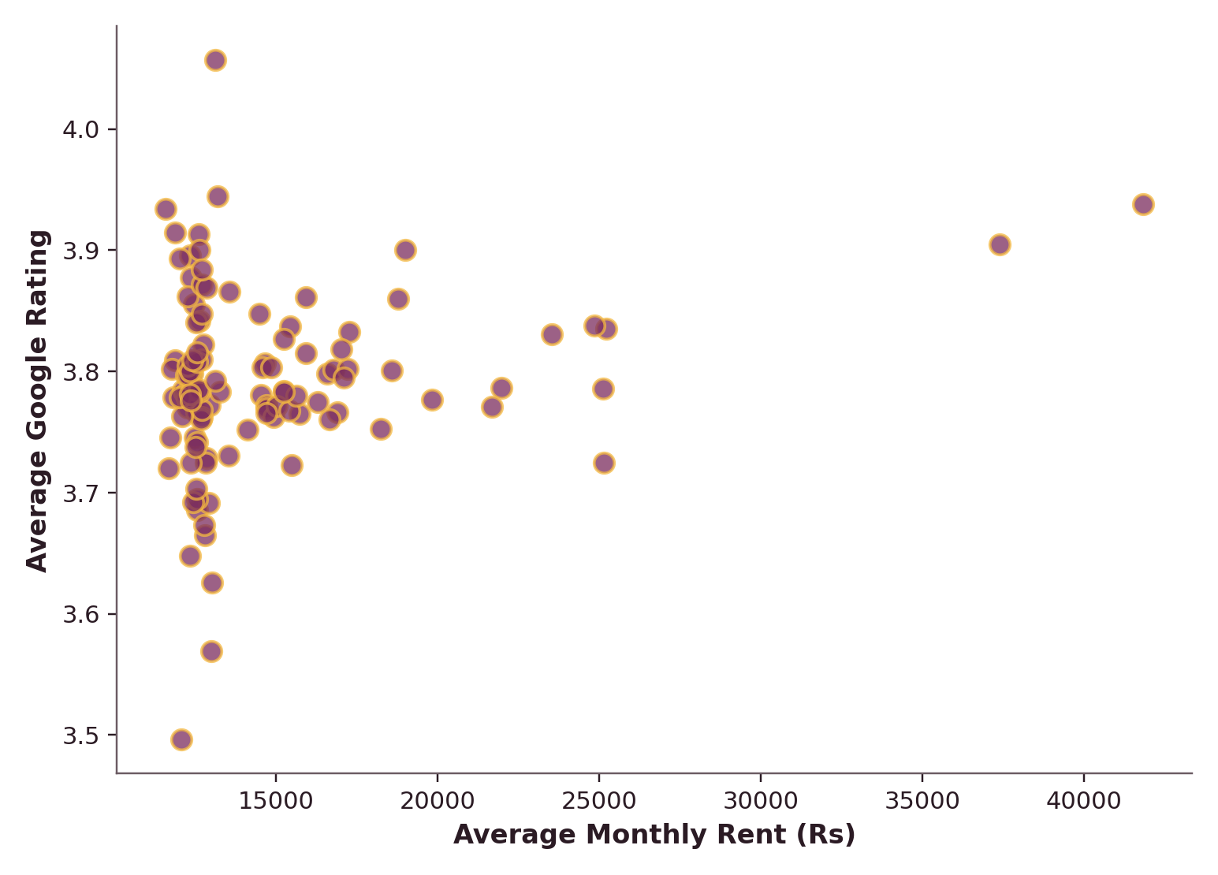
VISUALIZATIONS
Q8 & Q14 — Where Quality Concentrates
Domlur leads with 160 highly-rated PGs (≥4.5★), followed by Whitefield (125) and Vijayanagar (114) — quality hubs don't always match the priciest addresses.
14

Slide 15
IMPORTANT FINDINGS
What the Numbers Reveal
₹14,969
₹41,829
≈ 0.00
Citywide average monthly rent (median ₹13,479)
Peak average rent — HSR Layout
Correlation between rent and Google Rating
15,248
160
3.80 / 5
PGs offering Laundry — most common amenity
Highly-rated (≥4.5★) PGs in Domlur, the top locality
Average Google Rating across all PGs
15

Slide 16


PROJECT INSIGHTS
Patterns Behind the Data
Price ≠ Quality
Location Beats Distance
Rent shows near-zero correlation with rating, safety, commute or value-for-money scores — price is set by location, not service quality alone.
Neither metro nor IT-park distance meaningfully predicts rent or occupancy — locality identity and brand matter more than raw proximity.
Amenities Are Table Stakes
Skewed, Not Symmetric
Availability of amenities is fairly uniform (14–15k PGs each); no single facility strongly differentiates rating outcomes.
The right-skewed rent distribution shows a small premium segment inflating the average — median is the fairer 'typical rent' figure.
16

Slide 17


BUSINESS INSIGHTS
What This Means Commercially
For PG Owners
Competitive pricing alone won't win ratings — invest in service & upkeep. Additional charges (electricity ~₹965/mo avg) should be transparent, not padded.
For Tenants
Don't assume higher rent means better quality — compare ratings, safety & value scores directly rather than relying on price as a proxy.
For Investors
Locality brand (e.g., HSR Layout, Domlur) drives premium pricing more than raw metro/IT-park distance — target reputation-rich micro-markets.
17

Slide 18



RECOMMENDATIONS
Turning Insight Into Action
Benchmark by service, not just price
Highlight true differentiators
Build a rating-first search
Owners should track ratings, review volume & value scores as core KPIs alongside rent.
Market rare amenities (Gym, Power Backup) and safety scores, not generic Wi-Fi/AC claims.
Platforms should let tenants filter/sort by value-for-money and safety, not rent alone.
Standardize transparent billing
Target rising micro-markets
Monitor rent bands quarterly
Publish electricity, water & maintenance charges upfront to build tenant trust.
Investors should scout emerging high-rating areas like Whitefield & Vijayanagar early.
Track the right-skewed premium segment separately from median-market listings.
18

Slide 19
CONCLUSION & FUTURE SCOPE
Closing the Loop
CONCLUSION
FUTURE SCOPE
The Bengaluru PG market is driven more by service quality, amenities and customer experience than by rental price alone. Owners who invest in facilities and maintain competitive, transparent pricing are best positioned to boost satisfaction, occupancy and long-term profitability.
Build a predictive rent model using ML (regression / gradient boosting).
Integrate live listings via APIs for real-time market tracking.
Add sentiment analysis on tenant reviews for deeper quality signals.
Extend geospatial analysis with interactive maps & heat zones.
Develop a recommendation engine matching tenants to ideal PGs.
19

Slide 20

Thank You
Bengaluru PG Market Intelligence & Analysis
Questions & discussion welcome
Python • Pandas • Seaborn • 30,600 Records • 15 Research Questions
20

