Slide 1



Laravel Framework for Beginners
Name :- Mohit Kumhar
Enrollment id :-23000041

Slide 2

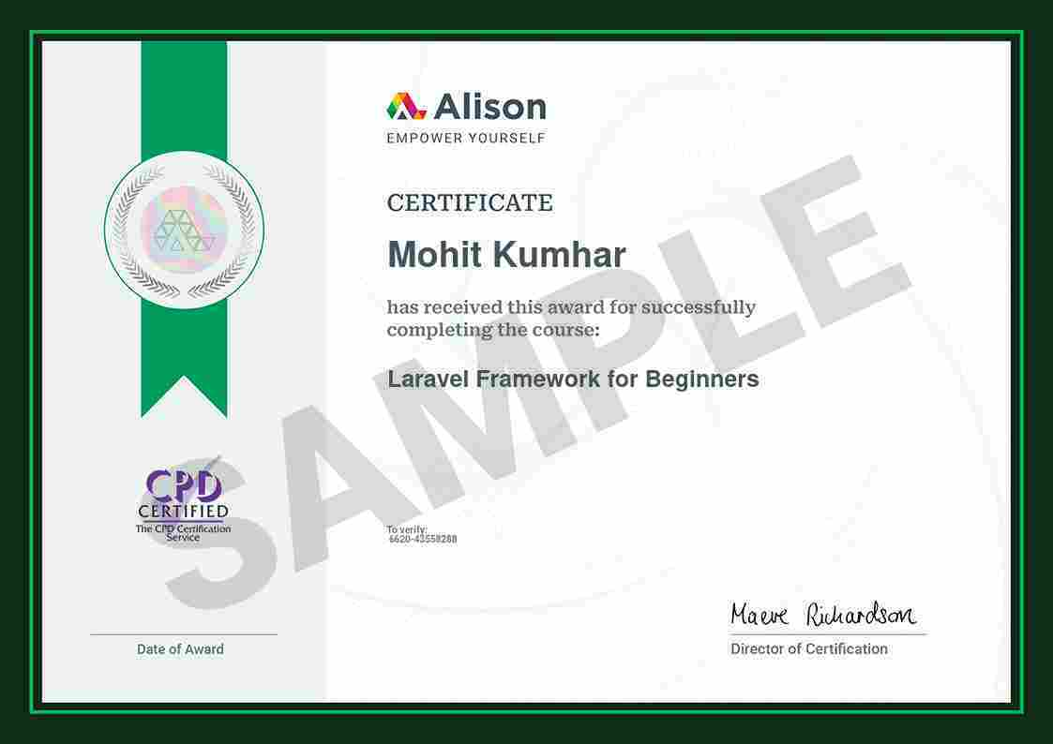


Slide 3
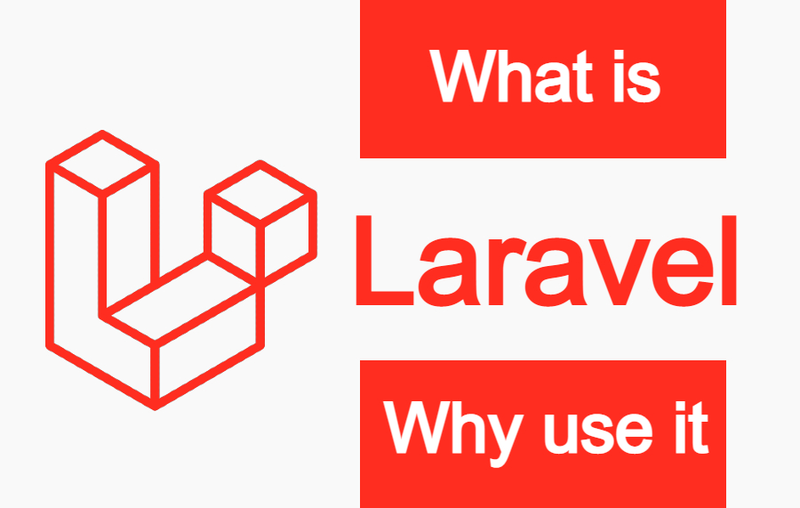
What is Laravel
Laravel is a toolkit for building websites. It's like a pre-built house for your website. It comes with ready-made parts (like a database system, user login system, and tools for creating web pages) that you can use to build your website quickly and easily.
Key benefits of using Laravel:
Faster development: You don't have to start from scratch.
Better organized code: Laravel helps keep your code clean and easy to understand.
Strong community: There are lots of people who use and can help with Laravel.

Slide 4

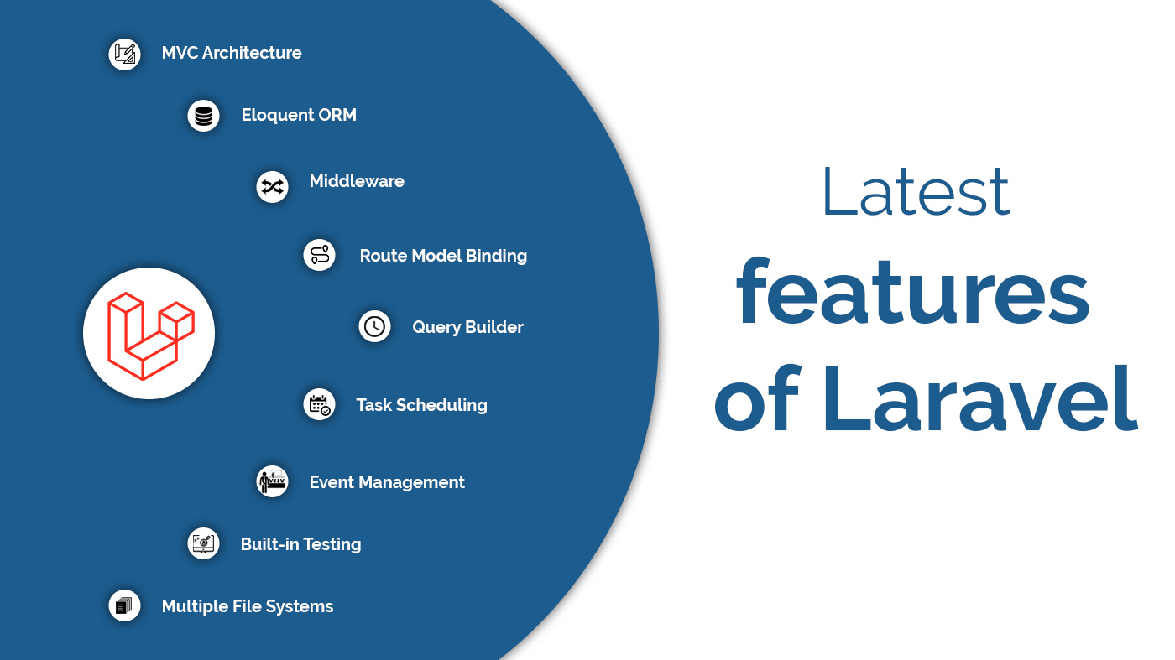
What are the main features of Laravel?

Slide 5
How do I install Laravel?
Installing Laravel: A Step-by-Step Guide
Before we start, make sure you have these installed on your computer:
* PHP: A programming language that powers many websites.
* Composer: A tool for managing PHP packages and dependencies.
Installation Steps:
* Open Your Terminal or Command Prompt: This is where you'll type commands.
* Create a New Laravel Project:
* Type the following command and press Enter:
composer create-project laravel/laravel my-laravel-app
* Replace my-laravel-app with the desired name for your project.
* Navigate to Your Project Directory:
* Type this command and press Enter:
cd my-laravel-app
Start the Development Server:
* Type this command and press Enter:
php artisan serve
* Access Your Laravel App:
* Open your web browser and go to http://127.0.0.1:8000. You should see the Laravel welcome page.
That's it! You've successfully installed Laravel. Now you can start building amazing web applications.
Additional Tips:
* Laravel Documentation: Refer to the official Laravel documentation for detailed instructions and tutorials: https://laravel.com/docs/
* Laravel Ecosystem: Explore the vast ecosystem of Laravel packages to extend your application's functionality.
* Practice and Experiment: The best way to learn Laravel is by building projects. Start small and gradually increase complexity.

Slide 6
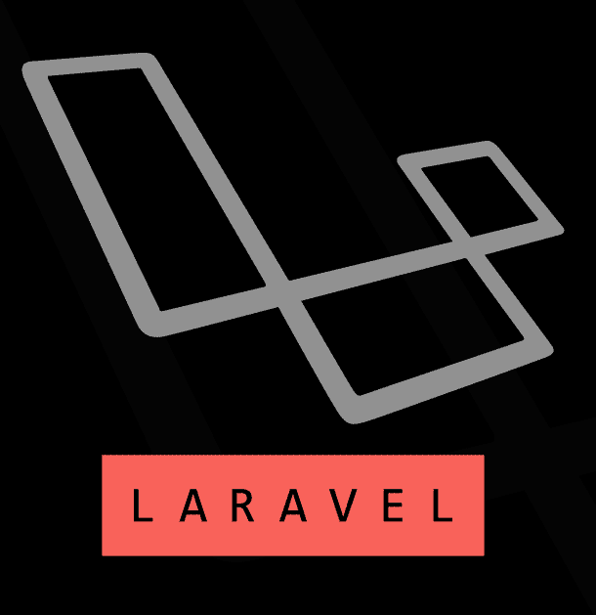
What is Eloquent ORM in Laravel?
Eloquent ORM (Eloquent Object Relational Mapping) is a function for data Manipulation provided by Laravel.
It is a unique function of Laravel for associating database with model and performing flexible data associating database with model and performing flexible data Manipulation

Slide 7
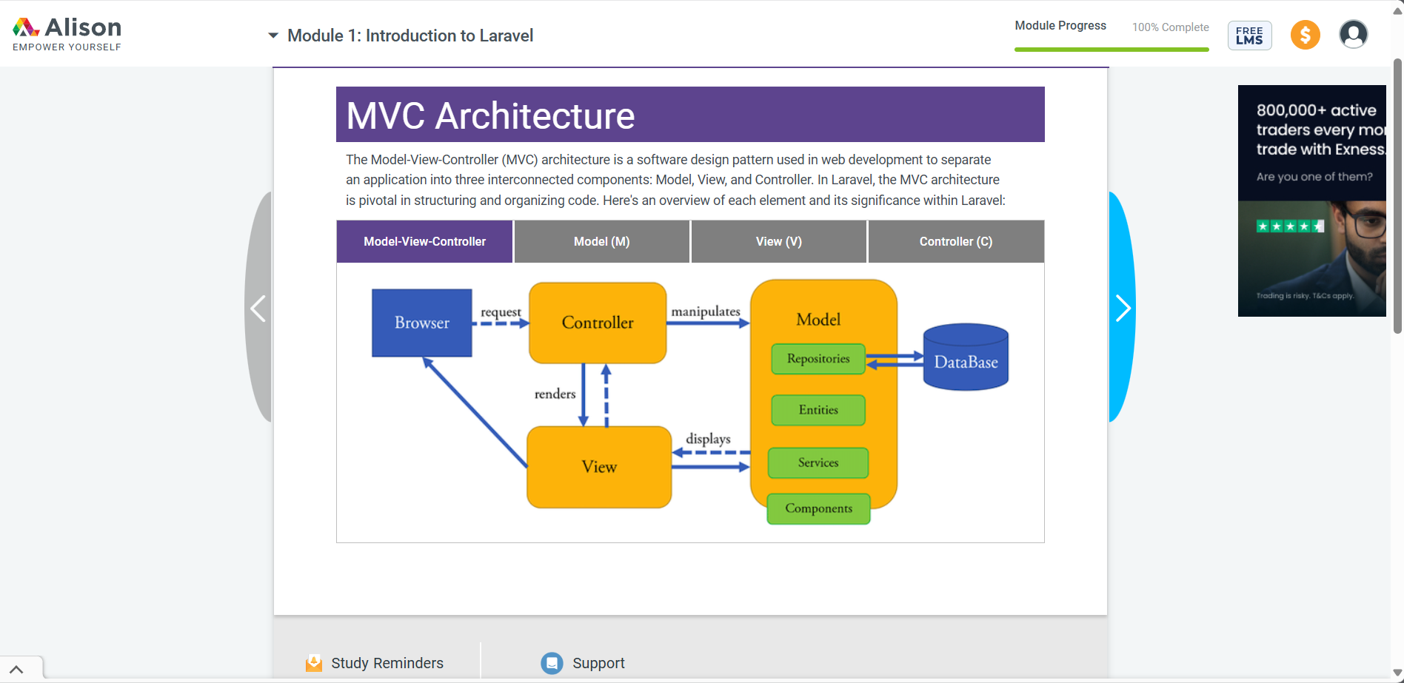

Slide 8
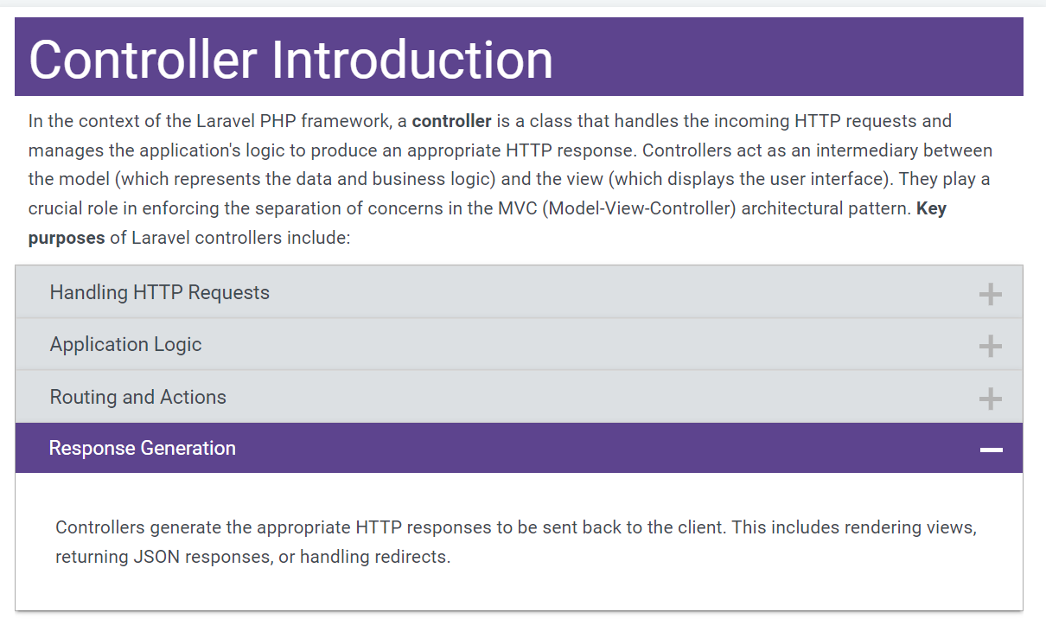

Slide 9

THANK YOU
This Photo by Unknown Author is licensed under CC BY-SA

