Slide 1

Apache Kafka
Mohit
Prasanth

Slide 2
Overview
Apache Kafka is a distributed publish-subscribe messaging system that can handle a high volume of data and enables you to pass messages from one end-point to another.

Slide 3
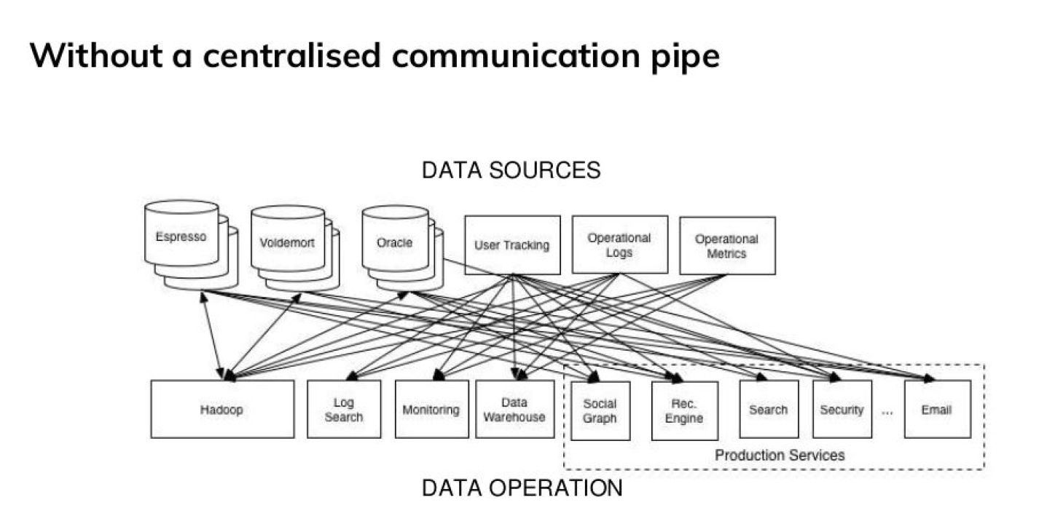
Why Kafka?

Slide 4
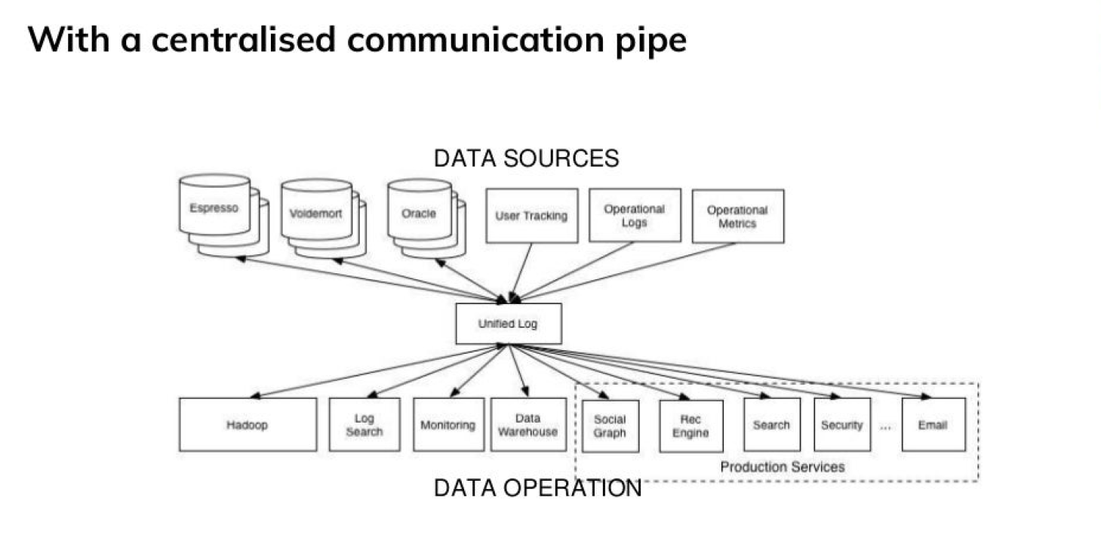
Why Kafka?

Slide 5
Kafka Benefits
Fast
Scalable
Reliable
Durable
Open Source
Available as a Managed Service on Cloud Platforms

Slide 6
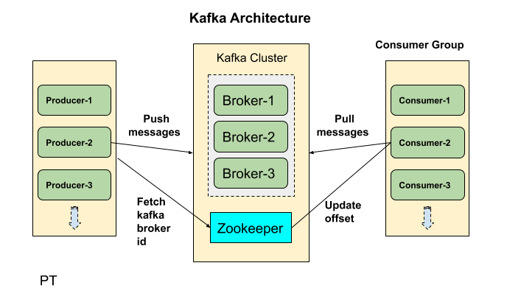
Architecture
Producers write data to brokers.
Consumers read data from brokers.
Data is stored in topics.
Topics are split into partitions, which are replicated.

Slide 7
Kafka Quickstart
Download Kafka, creating a console-based consumer/producer
Requires ZooKeeper to be installed and running
Create a topic as required by the project.
Create a project with the required dependencies.

