Slide 1
About DataSet
There are 377719 rows and 7 columns in our dataset
time datetime64[ns]
Cyclone_Inlet_Gas_Temp object
Cyclone_Material_Temp object
Cyclone_Outlet_Gas_draft object
Cyclone_cone_draft object
Cyclone_Gas_Outlet_Temp object
Cyclone_Inlet_Draft object
As we can we all columns have object type except time column.
First we converted these columns into float(64)
And some columns have strings so we replaced these string by their respective column mean.
We also resampled the data hourwise.
df= df.set_index('time').resample('H').mean().reset_index()

Slide 2
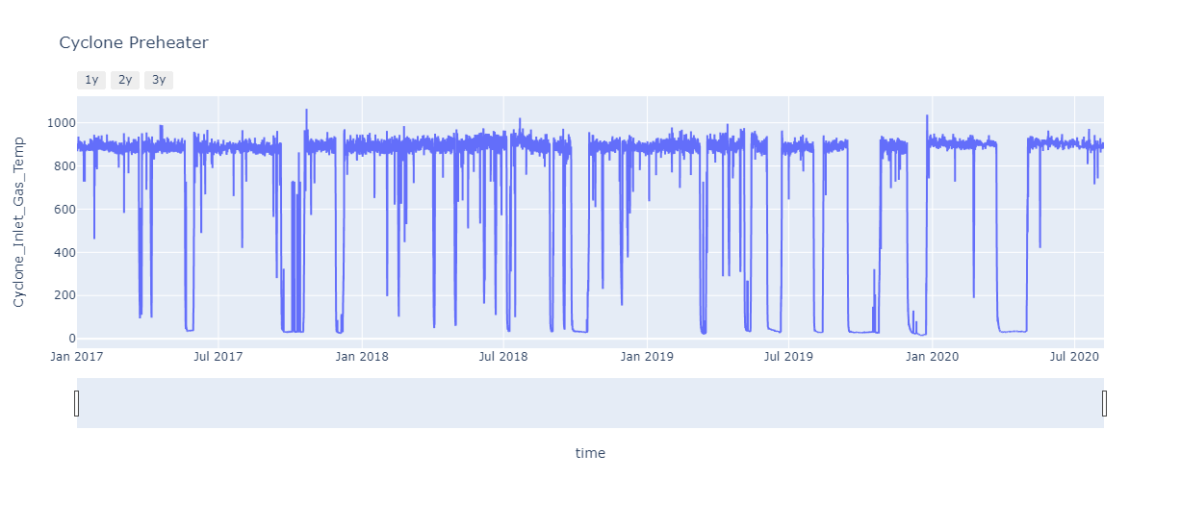
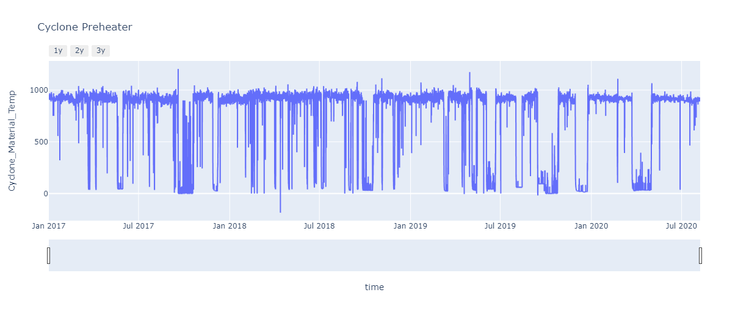
Line Plot Time Vs other Columns

Slide 3
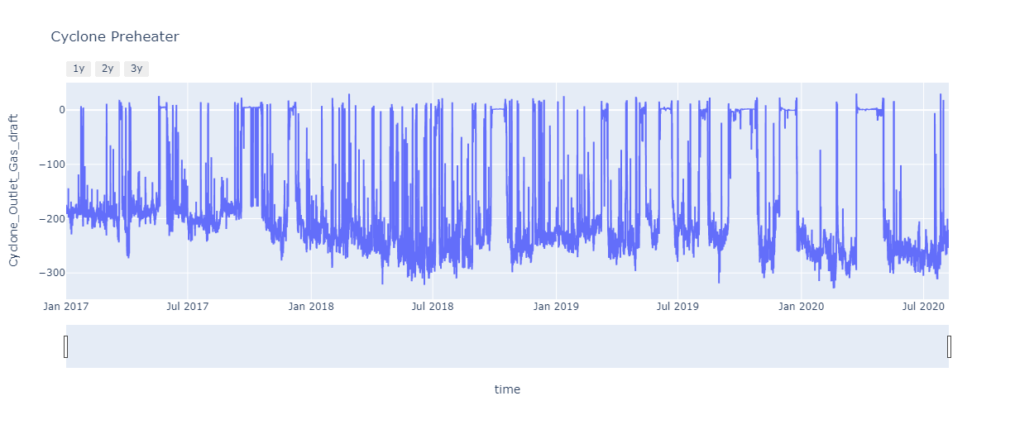

Slide 4
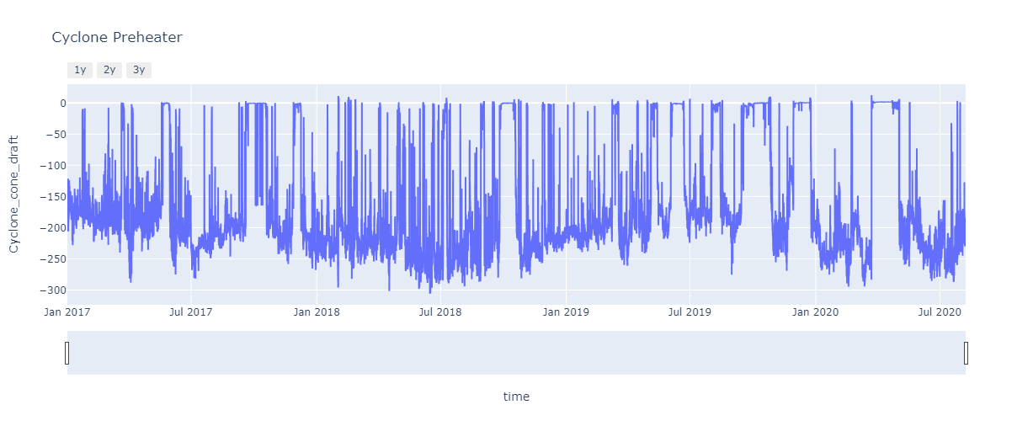
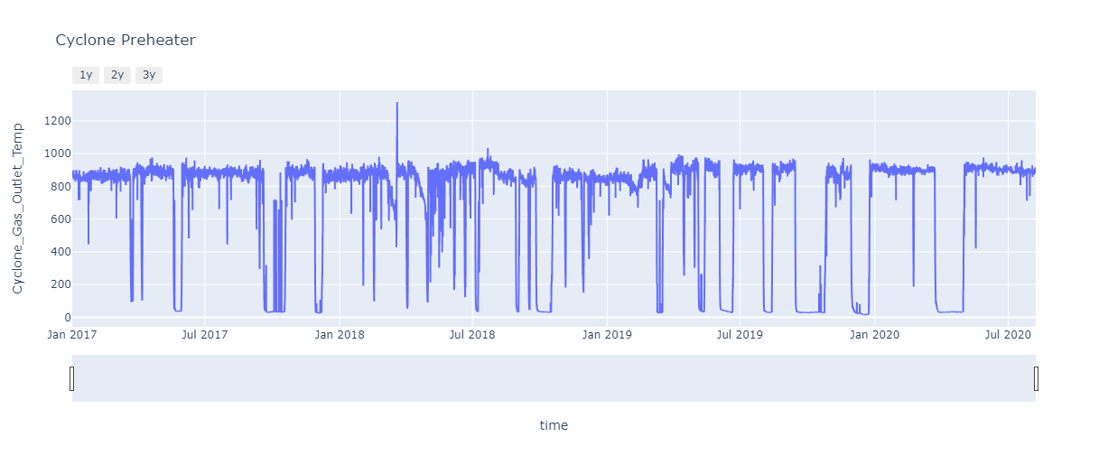

Slide 5
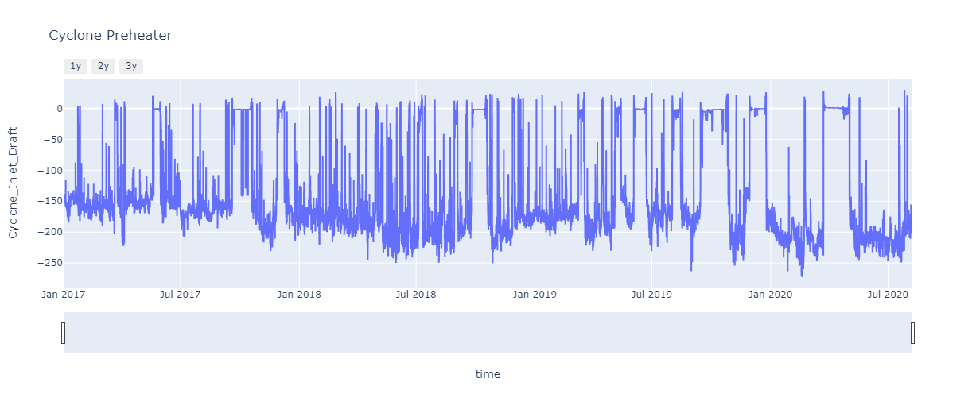

Slide 6
Train Test Split Data
#train test split
train = cyclone_df[(cyclone_df['ds'] >= '2017-01-01') & (cyclone_df['ds'] <= '2020-03-01')]
test = cyclone_df[(cyclone_df['ds'] > '2020-03-01')]
We splitted data form 01-01-2017 to 01-03-2020 for traininging and from from 01-03-2020 fro testing

Slide 7
We uses pycaret Python Libraries for detecting outliers
After that we created two model using this libraries and get 3d image in which outliers were clearly visible.
1.iforest
2.knn

Slide 8
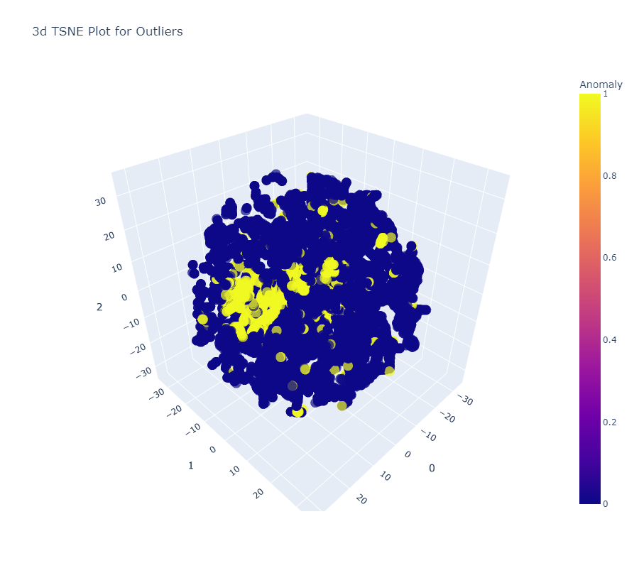
Using iforest

Slide 9
Using KNN

Slide 10
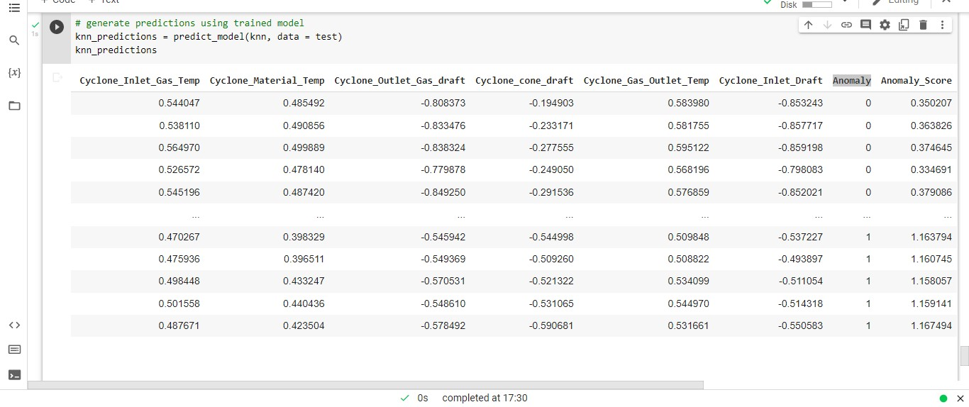
Final Result
After that we did prediction and got column Anomaly which has only 0 and 1

